Slide 1
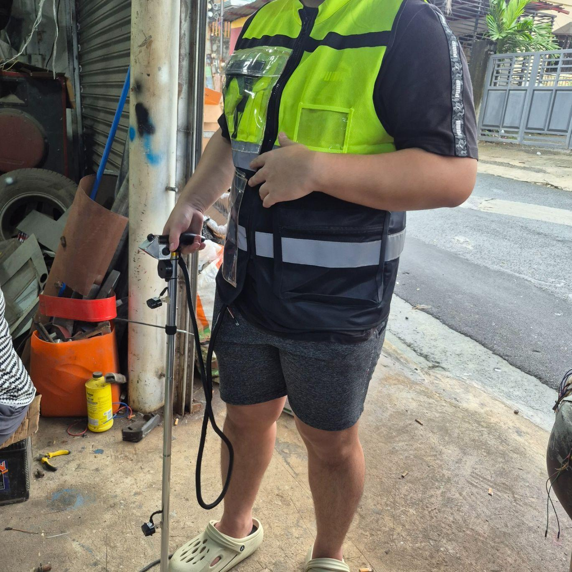
FINAL PROJECT DEFENSE · CpE PRACTICE AND DESIGN 1
IndepenSense: Design and Implementation of an IoT-Based Smart Cane with Computer Vision and Remote Guardian Monitoring
De La Salle Lipa · College of Information Technology and Engineering (CITE)
Computer Engineering Department
CpE Practice and Design 1 · Group 5
Lubay, Cian Eythan Jeremy
Odi, Mearck Francis Voughn
Rivera, Katelyn Denise
October 2026
Notes:
Good morning, distinguished panel members. We are Group 5 of the Computer Engineering Department, and we present IndepenSense: the design and implementation of an IoT-based smart cane with computer vision and remote guardian monitoring. Our work addresses a concrete engineering problem: a conventional white cane tells its user only what it touches, and tells the user's family nothing at all. Over the next minutes we will show how we closed both gaps with a Raspberry Pi 5 edge platform, dual ultrasonic sensing, inertial fall detection and LTE telemetry. We will report our bench and field results as measured, including the tests that failed, because the failures define the boundary of what this prototype can claim.
AUTHOR NOTE: ⚠ match to the approved manuscript title, item 1

Slide 2
INTRODUCTION
Visual Impairment: A Persistent Mobility Burden
Vision is the primary sense for spatial awareness and navigation
Billions worldwide live with some form of visual impairment (WHO, 2026)
Philippines: 1.98% prevalence of visual impairment and blindness (2018 Philippine National Blindness Survey)
Leading causes: cataract, uncorrected refractive error, glaucoma, and many cases still undiagnosed (Garcia et al., 2022)
Mobility barriers, hiring discrimination and limited resources (Oberes et al., 2023)
Medical care delayed or avoided because of transport and the need for an escort (Butalid et al., 2024)
Higher accident and injury risk in crowded, unfamiliar spaces (Hoogsteen & Szpiro, 2023)
The impact goes beyond injury to confidence, independence and psychological well-being
IndepenSense · 2
Notes:
Vision carries most of the information a person uses to move through space. The World Health Organization reports that billions of people live with some form of visual impairment, and in the Philippines the 2018 National Blindness Survey places the prevalence at 1.98 percent, driven by cataract, refractive error and glaucoma. The literature is consistent that the cost goes beyond the medical. Visually impaired Filipinos face mobility barriers that affect employment, delay health care because travel requires an escort, and raise their exposure to accidents in unfamiliar, crowded environments. Every one of these outcomes traces back to a single deficit: limited awareness of the immediate surroundings. That deficit is the engineering target of this project.

Slide 3
INTRODUCTION
The Mobility Crisis in Lipa City
Challenge 1: Identifying obstacles
The cane detects only on physical contact and cannot say what the obstacle is
Challenge 2: Navigating unfamiliar spaces independently
Confidence is high on familiar routes and drops sharply in new places, and many users rely on another person
Challenge 3: Frequent falls
Users reported falls on raised road surfaces and humps and on unexpected changes underfoot
Source: in-person unstructured interviews, with participants chosen by purposive sampling
Participants: visually impaired adults aged 31+ living in Lipa City, Batangas
Range of vision: from residual light and shadow perception to little or no vision
Current aid: mostly a traditional cane or stick
Their requests: different vibration or audio patterns per obstacle
IndepenSense · 3
Notes:
To ground the design in local need rather than assumption, we interviewed visually impaired adults living in Lipa City, selected through purposive sampling. Three challenges came up repeatedly. First, identifying obstacles: a cane reports an obstacle only on contact, and never what it is. Second, unfamiliar spaces: participants were confident on routes they knew, but travel to new places usually meant depending on another person. Third, falls: participants described falls on raised road surfaces and humps, which are common on local pedestrian paths. These three findings map directly to three subsystems of IndepenSense: proximity sensing and vision, voice-guided navigation, and inertial fall detection with guardian alerting.

Slide 4
INTRODUCTION
Research Gap in Existing Smart Canes
Local: ultrasonic + GPS tracking + basic alerts on microcontrollers (Aycardo et al., 2020)
National: microcontroller canes with GSM SMS location and sound feedback (Merencilla et al., 2021; Delgado et al., 2024)
International: YOLOv8n, RGB-D, LiDAR, ToF, IoT tracking (Mai et al., 2024; Mungdee et al., 2025; Shah et al., 2026)
Local gap: no embedded intelligence, no object identity
National gap: threshold-only sensing, reactive emergency models, no continuous guardian view
International gap: high power draw, latency, cost, complexity, plus cognitive overload from unprioritised feedback
Common gap: studies improve one subsystem at a time, with little attention to ergonomic weight distribution
IndepenSense · 4
Notes:
Our review traces three tiers of prior work. Local studies prove the feasibility of ultrasonic sensing with GPS tracking but stop at distance thresholds. National work adds GSM-based SMS alerts, but the emergency model is reactive and offers guardians no continuous view. International systems add object detection, LiDAR and depth cameras, and pay for it in power, latency, cost and, critically, cognitive overload when every detection is announced. The gap we target is therefore integration. Most systems optimise one subsystem in isolation and place every component on the cane itself. IndepenSense combines sensing, vision, voice and guardian monitoring in one architecture and redistributes the weight to the body.

Slide 5
SIGNIFICANCE OF THE PROJECT
Traditional White Cane versus IndepenSense
Traditional white cane
Detection by physical contact only
Range is roughly cane length (~1 m), at ground level only
No object identity: a pole, a person and a sign all feel the same
No head-level protection (branches, awnings, signage)
No fall awareness, and no way to call for help
Guardian has zero visibility of location or status
IndepenSense
Contactless detection: 2× DYP-A22 ultrasonic, upper and ground level
Proximity warnings start at 200 cm and all 3 motors fire inside 50 cm
Object recognition and sign reading on demand: Camera Module 3 + YOLOv8 + Tesseract OCR
MPU-6050 fall detection at 100 Hz triggers an automatic alarm
SOS button sends a GPS-tagged alert over LTE (HTTPS) + SMS
Live guardian tracking on the web + Android platform
IndepenSense · 5
Notes:
This contrast frames the contribution. The white cane is affordable, reliable and trusted, and we do not claim to replace the skill of using it. We extend what the cane can sense. The white cane's range is its length, at ground level, by contact. IndepenSense adds two ultrasonic sensors, one aimed at ground obstacles and one at upper-body and head-level hazards that a cane sweep physically cannot reach. On request, a camera identifies what is ahead and reads text aloud. An inertial measurement unit watches for falls continuously. Finally, the guardian moves from zero visibility to live location and immediate alerts.
AUTHOR NOTE: this slide uses current-build facts (⚑ in the draft) not yet in the manuscript. Update Chapters 2–3 before citing them.

Slide 6
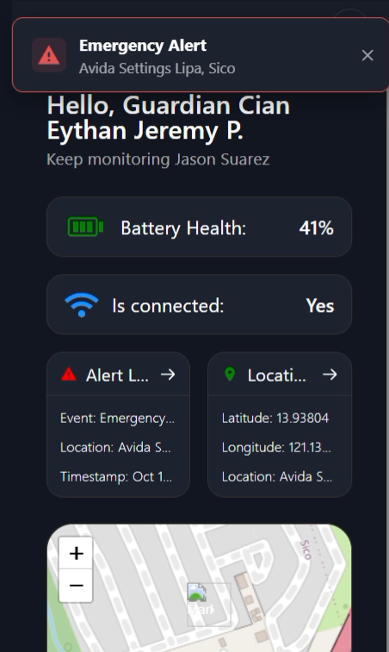
SIGNIFICANCE OF THE PROJECT
Dual-Beneficiary Design: User and Guardian
Environmental awareness for the user
Haptic channel: urgent proximity cues, pulse rate encodes distance (parking-sensor model)
Audio channel: descriptive information such as object names, signs, turn instructions and battery status
Push-to-Talk voice commands, so no screen and no visual menu are needed
Bilingual speech: English + Tagalog
Grounded in Multimodal Interaction and Cognitive Load Theory: urgent cues go to touch, descriptive information to hearing
Real-time safety for the guardian
Live GPS location on the web dashboard + Android app
Automatic alerts for SOS, fall detection and low battery
Device heartbeat every 30 s carrying battery and cellular status
SMS fallback that needs signal but no data connection
SDG 9: Industry, Innovation & Infrastructure · SDG 10: Reduced Inequalities
Guardian app: emergency alert view
IndepenSense · 6
Notes:
IndepenSense serves two people at once. For the user, feedback is split by urgency, following Multimodal Interaction and Cognitive Load theory. Proximity is delivered through touch, where the vibration rate rises as an obstacle approaches, much like a car's parking sensor. Descriptive information such as object names, signs and directions is delivered through speech, so the two channels never compete. For the guardian, the device reports a heartbeat every thirty seconds and pushes an alert the moment an SOS, a fall or a low battery occurs. Because mobile data is not always available, every alert also travels by SMS. The project supports SDG 9 on innovation and SDG 10 on reduced inequalities.
AUTHOR NOTE: this slide uses current-build facts (⚑ in the draft) not yet in the manuscript. Update Chapters 2–3 before citing them.

Slide 7
PROJECT OBJECTIVES
General Objective of the Project
To design and develop IndepenSense, an AI-powered, IoT-based smart cane with computer vision, sensor integration and remote guardian monitoring
Purpose: to improve the navigation, safety and situational awareness of visually impaired individuals
NAVIGATION
SAFETY
SITUATIONAL AWARENESS
IndepenSense · 7
Notes:
Our general objective was to design and develop IndepenSense, an AI-powered, IoT-based smart cane integrating computer vision, multi-sensor input and remote guardian monitoring, in order to improve three outcomes for visually impaired users: navigation, safety and situational awareness. These three words are the measures of success that the rest of this presentation reports against. Every subsystem we describe, and every test we report, traces back to at least one of them. Where a test failed, we will say which of the three outcomes it limits.

Slide 8
PROJECT OBJECTIVES
Specific Objectives Mapped to Engineering Goals
Goal A: Develop the hardware architecture
SO1: smart cane with ultrasonic, GPS, IMU, camera and feedback components
SO2: haptic + audio feedback for guidance and hazard alerts
SO3: AI object recognition as supplementary awareness
Goal B: Integrate IoT cellular notification
SO4: GPS/GNSS outdoor navigation support within test environments
SO5: emergency response with notifications and location monitoring
SO6: guardian web platform for location, alerts and notifications
Goal C: Validate through testing
Bench: component tests on 15 modules, 100+ test cases
Calibration: magnetometer heading and IMU fall trials
On-site: 18 field test cases at Robinsons Lipa with an adult visually impaired participant
Traceability: each SO maps to at least one results table (Tables 5–20)
IndepenSense · 8
Notes:
The six specific objectives in the manuscript resolve into three engineering goals. Goal A is the hardware architecture: the sensor suite, the dual-channel feedback system, and object recognition as a supplementary aid, which we deliberately frame as supplementary because vision is the least reliable sensor under real lighting. Goal B is the IoT layer: GPS-based outdoor navigation, the emergency pipeline, and the guardian platform. Goal C is validation, carried out in three stages: component bench tests, calibration procedures, and an on-site trial with a visually impaired participant. Every objective traces to at least one results table, so the panel can check each claim against its evidence.

Slide 9
SCOPE AND DELIMITATION
Project Scope: Integrated Subsystems
Sensing: ultrasonic tracking. 2× DYP-A22, UART, upper and ground level, continuous polling
Vision: Raspberry Pi Camera Module 3. 12 MP sensor, captured at 1280×720, 15 fps, with YOLOv8 detection and OCR, triggered on voice demand
Safety: MPU-6050 fall detection. 3-axis accelerometer + gyroscope, I²C, sampled at 100 Hz on the chest/vest
Connectivity: SIM7600G-H. 4G LTE data, SMS, and the integrated GNSS receiver
Guardian monitoring: web dashboard + Android app for live location, SOS and fall notifications
Also in scope: QMC5883P compass heading, voice assistant (PTT), on-device routing (GraphHopper + Photon)
Environment: outdoor pedestrian use with GNSS and cellular coverage
IndepenSense · 9
Notes:
Our scope is a functional prototype integrating five subsystems. Ultrasonic tracking uses two DYP-A22 sensors on UART. Computer vision uses the Raspberry Pi Camera Module 3, run on demand when the user asks, rather than continuously, which keeps it from draining the battery. Fall detection uses the MPU-6050, sampled at one hundred hertz and mounted on the vest, where the motion reflects the body rather than the swinging cane. The SIM7600G-H provides LTE data, SMS, and the GNSS receiver used for location. The guardian platform, web and Android, completes the loop. The intended environment is outdoor pedestrian travel where satellite and cellular coverage exist.
AUTHOR NOTE: this slide uses current-build facts (⚑ in the draft) not yet in the manuscript. Update Chapters 2–3 before citing them.
AUTHOR NOTE: ⚠ item 2

Slide 10
SCOPE AND DELIMITATION
Delimitations and Operating Boundaries
Physical / sensing
Forward-facing detection profile only, with an effective 35°–45° cone validated on the bench
No lateral (left/right) sensing. Obstacles beside the user are outside the cone
The 3 vibration motors share one handle, so they signal intensity, not direction
Vision recognises general object classes only, with no fine-grained scene reasoning
Fixed cane length in the tested build
Environmental / network
Absolute cellular dependency for guardian telemetry, SMS and cloud speech features
GNSS degrades indoors and under structural obstruction
CV accuracy degrades in low light, harsh light, rain
Higher power draw when vision is active, which shortens runtime
Indoor navigation is out of scope
What survives offline: obstacle warnings, fall detection, the local alarm, on-device routing and English speech
IndepenSense · 10
Notes:
We bound our claims explicitly. Physically, detection is forward-facing. Our bench tests validated a cone of roughly thirty-five to forty-five degrees, and an obstacle beside the user is outside it. The three vibration motors sit in one handle, and their vibration couples through the shell, so the user feels intensity, not direction. We therefore never use them to signal left or right. Environmentally, the guardian features depend completely on cellular coverage, GNSS accuracy falls indoors, and vision is sensitive to lighting. Our design response is that the safety-critical functions, obstacle warnings and fall detection with its local alarm, run entirely on the device and survive any network outage.
AUTHOR NOTE: this slide uses current-build facts (⚑ in the draft) not yet in the manuscript. Update Chapters 2–3 before citing them.

Slide 11
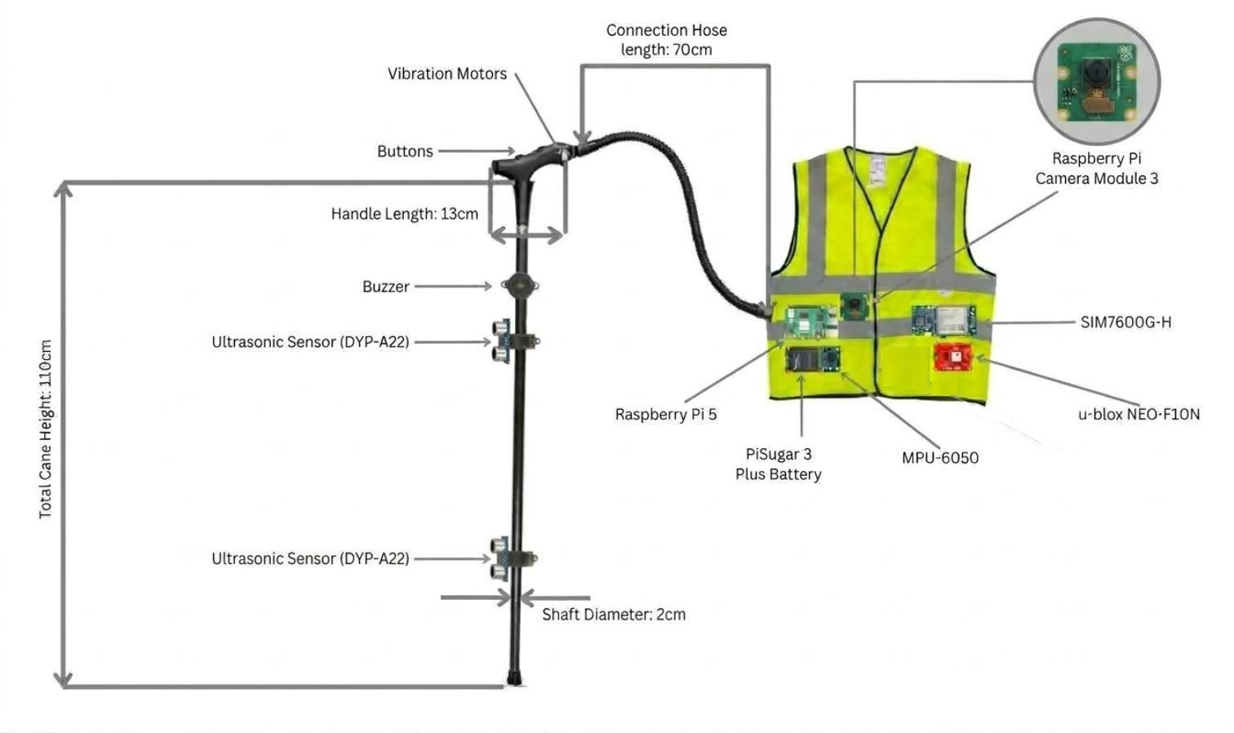
PROJECT DESCRIPTION & HARDWARE ARCHITECTURE
System Overview: Hybrid Edge–Cloud Architecture
Edge (Raspberry Pi 5), always on: obstacle sensing, fall detection, haptics, buzzer, YOLOv8 + OCR, GraphHopper routing and Photon geocoding, both on device
Cloud (optional, with dotted links): Mistral intent classification and open questions, Tagalog speech-to-text and text-to-speech server, backend API → guardian dashboard
Cellular, without data: emergency SMS straight to the guardian's phone
Design rule: every cloud stage has a local fallback, so the device degrades rather than failing
Wearer → device: voice, 3 buttons, motion, surroundings
Device → wearer: speech, vibration, buzzer
Device → guardian: HTTPS heartbeat + alerts over 4G, SMS for alerts
Model representation of the prototype
IndepenSense · 11
Notes:
IndepenSense follows the Edge/Hybrid Computing paradigm from our framework. Everything safety-critical runs on the Raspberry Pi 5: obstacle sensing, fall detection, haptic and buzzer output, object detection and text reading. Pedestrian routing and geocoding also run locally, so navigation does not need cloud maps. The cloud is optional. It improves intent classification accuracy and Tagalog speech quality, and it carries telemetry to the guardian. Each cloud stage has a local fallback. The design principle is graceful degradation: with no network, the device still detects obstacles, detects falls, sounds its alarm and speaks; it loses only the guardian's live view.
AUTHOR NOTE: this slide uses current-build facts (⚑ in the draft) not yet in the manuscript. Update Chapters 2–3 before citing them.
AUTHOR NOTE: The manuscript describes cloud scene description. In the build, vision is fully local (item 5)

Slide 12
PROJECT DESCRIPTION & HARDWARE ARCHITECTURE
Compute and Power Core
Compute
Raspberry Pi 5: quad-core ARM, Raspberry Pi OS Trixie, Python 3.13
~12 W peak board draw (bare board, worst case)
Raspberry Pi Active Cooler (fan + heatsink) for sustained YOLO and speech inference
Micro SD for OS, models and logs
Every device sits behind a hardware-abstraction protocol, so the full runtime runs on a laptop with mocks
Power
Waveshare UPS HAT (E) with 4× 21700 Li-ion cells (3.7 V nominal each)
Single unified supply for the Pi and all peripherals, replacing an earlier dual-source design
Estimated typical load ≈ 11.7 W (sum of Table 2) · SIM7600 transmit peaks up to 2 A
Corrected battery percentage: the HAT's gauge reads ~57–59 % on a flat pack, so the raw value is rescaled
Battery is spoken at boot and shown on the guardian platform
IndepenSense · 12
Notes:
The Raspberry Pi 5 was chosen because it is the lowest-power board able to run object detection and speech recognition locally, with roughly twelve watts at worst case and a large ecosystem of compatible peripherals. An active cooler holds clock speed during sustained inference. Power comes from a single Waveshare UPS HAT E with four 21700 cells, which replaced our earlier dual-supply design and simplified the wiring. Summing our component table gives about 11.7 watts typical, with the LTE modem transmitting in bursts of up to two amps. One finding deserves mention. The HAT's own gauge read about fifty-eight percent on an empty pack, so we rescale it; otherwise the low-battery warning could never have fired.
AUTHOR NOTE: this slide uses current-build facts (⚑ in the draft) not yet in the manuscript. Update Chapters 2–3 before citing them.
AUTHOR NOTE: No measured runtime in the manuscript (item 15)

Slide 13
PROJECT DESCRIPTION & HARDWARE ARCHITECTURE
Perception Layer: Sensors and Interfaces
Component | Bus / Port | Mount | Role
DYP-A22 Ultrasonic · TOP | UART ttyAMA0 | Cane | Upper-body / head-level hazards
DYP-A22 Ultrasonic · BOTTOM | UART ttyAMA4 | Cane | Ground-level obstacles (curbs, walls, planters)
MPU-6050 IMU | I²C | Vest | Fall detection, walking/still state
QMC5883P Magnetometer | I²C 0x2C | Vest | Compass heading for navigation
Pi Camera Module 3 | CSI ribbon | Cane | Object detection + OCR
DYP-A22: waterproof ultrasonic, UART output, distance in cm, about 15 mA each
MPU-6050: accelerometer + gyroscope, ~4 mA, chest-mounted so it measures body motion rather than cane swing
QMC5883P: sold as a "QMC5883L" but answers at 0x2C. It is 3.3 V only
Camera Module 3: 12 MP, run at 1280×720 @ 15 fps, YOLO confidence 0.3
Drivers own the protocol: frame parsing, checksums and register maps live in the driver, not the application
IndepenSense · 13
Notes:
The perception layer has five sensors on three buses. Two DYP-A22 ultrasonic sensors sit on separate UARTs. The bottom sensor watches for ground obstacles such as curbs, walls and planters. The top sensor watches for hazards at upper-body and head height, which the cane tip physically cannot reach. The MPU-6050 and the QMC5883P magnetometer share the I²C bus and are mounted on the vest. That placement is deliberate: an IMU on the cane would read every sweep as violent motion, while one on the chest reads the body. The Camera Module 3 connects over CSI. One integration lesson: the magnetometer sold to us as a QMC5883L was in fact a QMC5883P at a different address.
AUTHOR NOTE: this slide uses current-build facts (⚑ in the draft) not yet in the manuscript. Update Chapters 2–3 before citing them.

Slide 14
PROJECT DESCRIPTION & HARDWARE ARCHITECTURE
Communication Layer: SIM7600G-H Telemetry Module
Box 1: 4G LTE data (HTTPS)
Heartbeat every 30 s: location, battery, signal
Alert events pushed immediately
Buffered retry when the link is down
Box 2: SMS
Sent for Emergency, Fall and Low Battery
Needs signal only, no data bearer
Retried for up to 5 min
Box 3: GNSS
Integrated receiver streaming NMEA ($GN RMC/GGA)
Multi-constellation: GPS, GLONASS, BeiDou, Galileo
Interface: USB to the Pi 5, with multiple serial endpoints (AT, NMEA)
Power: 5 V, ~0.3 A typical, ~2 A transmit peaks
Cost: ₱5,384.92, the second-largest BOM item
Why one module: one antenna system and one USB link carry data, SMS and location
Offline hardening: network route pre-check, per-host circuit breaker, and a 2 s DNS bound, which removed a 20 s per-lookup stall on a dead link
IndepenSense · 14
Notes:
The SIM7600G-H is the device's only link to the outside world, and it carries three independent channels. LTE data carries the thirty-second heartbeat and immediate alert events to the backend over HTTPS, with buffering and retry when the link drops. SMS carries the same emergency, fall and low-battery alerts directly to the guardian's phone, because SMS needs only signal, not a working data connection. Finally, its integrated GNSS receiver streams position. We also found that on a failing link, a single name lookup could hang for twenty seconds, three times per voice command. Bounding DNS and adding a circuit breaker turned that into one slow command followed by local operation.
AUTHOR NOTE: this slide uses current-build facts (⚑ in the draft) not yet in the manuscript. Update Chapters 2–3 before citing them.
AUTHOR NOTE: The manuscript names a separate u-blox NEO-F10N for GPS (item 2)

Slide 15
PROJECT DESCRIPTION & HARDWARE ARCHITECTURE
Feedback and User Interface Layer
Haptic: 3× flat vibration motors
on GPIO 17 / 27 / 22, each switched by a 2N2222 NPN with a 1N4007 flyback diode
Front motor alone = warning, all three = danger (< 50 cm)
Buzzer: piezo tone buzzer
on GPIO 18
Reserved for emergencies only, the one output a bystander can perceive
Buttons: 3× 12 mm PBS-33B waterproof momentary
body-relative
Right = Push-to-Talk (also the "yes" confirm)
Front = Emergency SOS (GPIO 25)
Left = Repeat / Stop (also "no")
Audio: USB open-ear headset
with mic and speaker
Pi 5 has no 3.5 mm jack
Open-ear keeps the user's ambient hearing for traffic
IndepenSense · 15
Notes:
The output design follows one rule: each channel has a single meaning. Three vibration motors, each driven through a 2N2222 transistor with a flyback diode, signal obstacle proximity. One motor warns, and all three signal danger inside fifty centimetres. The buzzer is reserved for emergencies, because it is the only output a bystander can hear. If it also sounded for an awning, it would mean nothing in a real emergency. The three waterproof buttons are placed by touch: right for push-to-talk, front for SOS, left for repeat or stop. Audio is delivered through an open-ear USB headset, so the user never loses the sound of traffic.
AUTHOR NOTE: this slide uses current-build facts (⚑ in the draft) not yet in the manuscript. Update Chapters 2–3 before citing them.

Slide 16
PROJECT DESCRIPTION & HARDWARE ARCHITECTURE
Ergonomic Split: Cane and Wearable Vest
Cane assembly (kept light)
2× DYP-A22 ultrasonic sensors, which must face the path
Pi Camera Module 3, which the user can aim by angling the cane
3 vibration motors, buzzer and 3 buttons in a 3D-printed handle casing
Adjustable, foldable aluminium cane (₱165)
Vest enclosure (carries the weight)
Raspberry Pi 5 + Active Cooler in a 3D-printed case
Waveshare UPS HAT (E) + 4× 21700 cells, the heaviest single item
SIM7600G-H, MPU-6050, QMC5883P, headset interface
High-visibility reflective vest for night safety (₱358)
Tube-like harness hides the cane-to-vest wiring and doubles as an anti-loss tether
Cane–vest split with tube harness
IndepenSense · 16
Notes:
The most important mechanical decision was to split the system across two bodies. Anything that must sense the path, or be touched, stays on the cane: the ultrasonic sensors, the camera, the motors, the buzzer and the buttons. Everything heavy moves to a reflective vest: the processor, the battery pack, the modem and the inertial sensors. There are two reasons. A cane loaded with four 21700 cells and a Raspberry Pi would fatigue the wrist within minutes. And the IMU must be on the torso to measure the body's fall rather than the cane's swing. The wiring tube that joins them also tethers the cane, so it cannot be dropped and lost, which was confirmed comfortable during field testing.

Slide 17
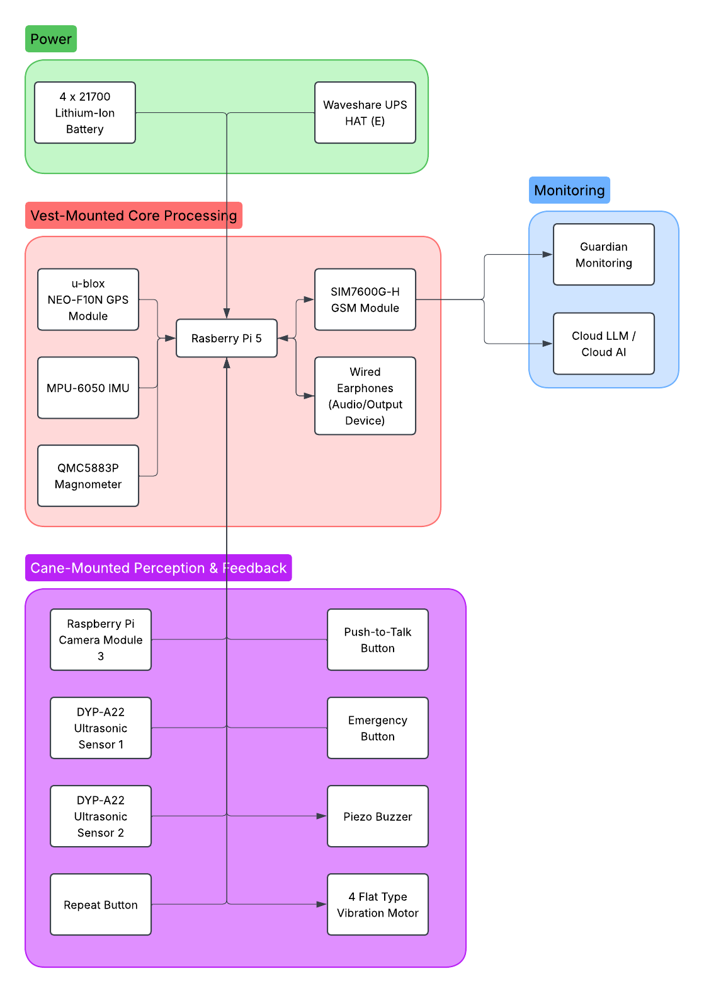
PROJECT DESCRIPTION & HARDWARE ARCHITECTURE
Hardware Block Diagram: Four Subsystems
① Cane perception & feedback: ultrasonics, camera, buttons → motors, buzzer
② Vest core processing: Raspberry Pi 5, IMU, magnetometer, headset
③ Power management: UPS HAT (E), 4× 21700, unified 5 V rail
④ External communication: SIM7600G-H to the backend and guardian app, plus SMS
Buses: UART (ultrasonics) · I²C (IMU, compass, UPS gauge) · CSI (camera) · USB (modem, headset) · GPIO (buttons, motors, buzzer)
Arrow legend: solid = data or control · thick = power · dotted = optional cloud path
Distributed but interconnected: sensing, processing, power and communication are each separable for testing
Prototype block diagram
IndepenSense · 17
Notes:
This block diagram consolidates the architecture into four subsystems. Reading left to right: the cane subsystem gathers proximity, image and button input and returns vibration and buzzer output. The vest subsystem processes everything through the Raspberry Pi 5, with the IMU and magnetometer on I²C. The power subsystem provides one unified rail from the UPS HAT. The communication subsystem, through the SIM7600G-H, links the device to the backend, the guardian application, and SMS. Each subsystem uses a distinct bus, UART, I²C, CSI, USB or GPIO, which let us validate each one independently on the bench before integration, as the methods section will show.

Slide 18
PROJECT DESCRIPTION & HARDWARE ARCHITECTURE
Bill of Materials and Prototype Cost
Item | Qty | Cost (₱)
Raspberry Pi 5 | 1 | 8,000.00
SIM7600G-H GSM/LTE/GNSS | 1 | 5,384.92
Pi Camera Module 3 | 1 | 1,731.18
DYP-A22 Ultrasonic | 2 | 1,718.78
21700 Li-ion cells | 4 | 1,265.00
Active Cooler | 1 | 582.00
Micro SD card | 1 | 456.00
Earphone / headset | 1 | 391.00
Reflective vest · cane | 1 · 1 | 358.00 · 165.00
MPU-6050 · Magnetometer | 1 · 1 | 183.00 · 125.00
Remaining parts (cables, adapters, buttons, motor, buzzer, u-blox, passives, PCB) | — | 2,095.00
TOTAL: ₱22,454.88
Compute + comms = ₱13,384.92 (≈ 60 %) of the build
Sensors and feedback parts are low-cost (₱45–₱1,719)
IndepenSense · 18
Notes:
The complete prototype cost twenty-two thousand four hundred fifty-four pesos and eighty-eight centavos. Sixty percent of that is the Raspberry Pi 5 and the SIM7600G-H modem: the compute needed to run vision and speech locally, and the cellular link needed for guardian monitoring. The sensors themselves are inexpensive. Two waterproof ultrasonic sensors, an IMU and a magnetometer together cost under two thousand five hundred pesos. This distribution matters for future cost reduction: the price falls with the compute platform and the modem, not with the sensing. A production version could trade the Pi 5 for a smaller module once the vision model is quantized.
AUTHOR NOTE: The BOM lists u-blox GPS (₱219) and 1 vibration motor (₱117). Reconcile with the build (items 2–3)
AUTHOR NOTE: The Waveshare UPS HAT (E) has no BOM line. Add it

Slide 19
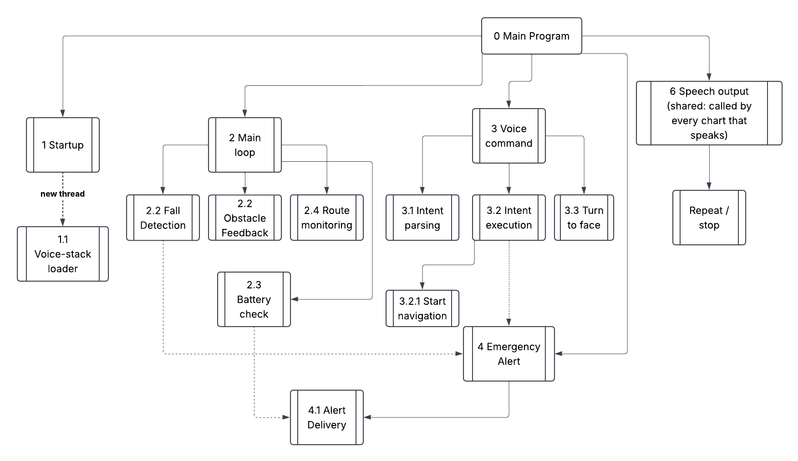
PROCESS FLOW & SOFTWARE LOGIC
Runtime Concurrency Model: Never Block Safety
One synchronous main loop handles only cheap reads:
MPU-6050 at 100 Hz → fall detector
Both DYP-A22 → obstacle warnings
Rule: the main loop never blocks. Speech, network and vibration patterns all run off it
Fixed, named background threads:
Voice thread, one per PTT press
Announcer, which owns all speech from the main loop
Haptic pattern workers, serialised by a mutex
Heartbeat sender · telemetry retry · 1 Hz GPS cache
Button callbacks (gpiozero)
Why it matters: inline speech once froze fall detection for 3–4 s per turn instruction
Call hierarchy
IndepenSense · 19
Notes:
Before the flowcharts, the governing rule: the main loop never blocks. One loop reads the IMU at one hundred hertz and polls both ultrasonic sensors, and does nothing slow. Everything that can take time runs on its own named thread: speech output, voice commands, vibration patterns, the heartbeat, retries and the GPS cache. We learned this the hard way. In an early build, each spoken turn instruction played inline and halted fall detection and obstacle sensing for three to four seconds, every time. Moving speech to a dedicated announcer thread removed that gap entirely. A safety device cannot stop watching while it is talking.
AUTHOR NOTE: this slide uses current-build facts (⚑ in the draft) not yet in the manuscript. Update Chapters 2–3 before citing them.

Slide 20
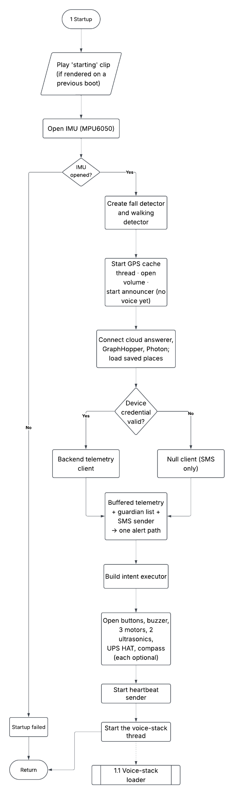
PROCESS FLOW & SOFTWARE LOGIC
Startup Sequence: Safety Features First
T0: Power on
A pre-rendered boot announcement plays before any model loads
T + seconds: Safety live
IMU, ultrasonics, buttons, motors, telemetry and SMS are open, and fall detection, obstacle warnings and SOS are active
In parallel: Voice-stack thread
loads Whisper, TTS, the intent parser and YOLO/OCR
Ready
greeting + battery percentage spoken, and voice commands enabled
Why: model loading took ~200 s from the SD card, and none of the safety features need a model
A PTT press before the stack is ready gets a "busy" cue, not silence
A model that fails to load still fails the process loudly, which avoids a silent half-working device
Startup diagnostics cover battery, connectivity, GPS and sensor readiness
Startup flow
IndepenSense · 20
Notes:
Startup is ordered by safety priority. At power-on, a pre-recorded announcement plays immediately, because silence from an assistive device is indistinguishable from failure. Within seconds, the inertial sensor, both ultrasonic sensors, the buttons, the motors and the alert path are live, so the user is protected while the heavier components load. The voice stack, comprising speech recognition, speech synthesis, the intent parser and the vision models, loads on a separate thread. That took about two hundred seconds from the SD card, and the safety features used to wait behind it. When the stack is ready, the device greets the user and announces the battery level.
AUTHOR NOTE: this slide uses current-build facts (⚑ in the draft) not yet in the manuscript. Update Chapters 2–3 before citing them.

Slide 21
PROCESS FLOW & SOFTWARE LOGIC
Active Multi-Sensor Scanning Loop
Proximity rhythm (parking-sensor model)
Read: IMU sample (100 Hz) and the latest top/bottom ultrasonic distances
Decide:
Is the wearer walking or still? (chest IMU)
Closest obstacle → proximity tier
Hysteresis band of 15 cm so cane sway does not cause false tier changes
Signal: spawn a haptic pattern on a worker thread, never inline
Distance | Pattern
> 200 cm | Silent
~100 cm | ~1 pulse/s, front motor
< 50 cm | 3–5 pulses/s, all 3 motors
< 30 cm | 8 pulses/s (maximum)
80 ms pulses, rate rather than strength, because skin adapts to steady buzzing
Standing still: quiet, with a danger reminder every 15 s
IndepenSense · 21
Notes:
The scanning loop runs read, decide and signal on every pass. It reads the IMU and the latest distances from both ultrasonic sensors. It then decides two things: whether the wearer is walking or standing, and how close the nearest obstacle is. The vibration encodes distance as pulse rate rather than strength, exactly like a car's parking sensor. It is silent beyond two metres, roughly one pulse per second at one metre, and up to eight per second inside thirty centimetres, with all three motors firing inside fifty. We chose rate because people judge rhythm far better than amplitude, and skin adapts to a steady buzz within seconds. A fifteen-centimetre hysteresis band prevents normal cane sway from causing false alerts.
AUTHOR NOTE: this slide uses current-build facts (⚑ in the draft) not yet in the manuscript. Update Chapters 2–3 before citing them.

Slide 22
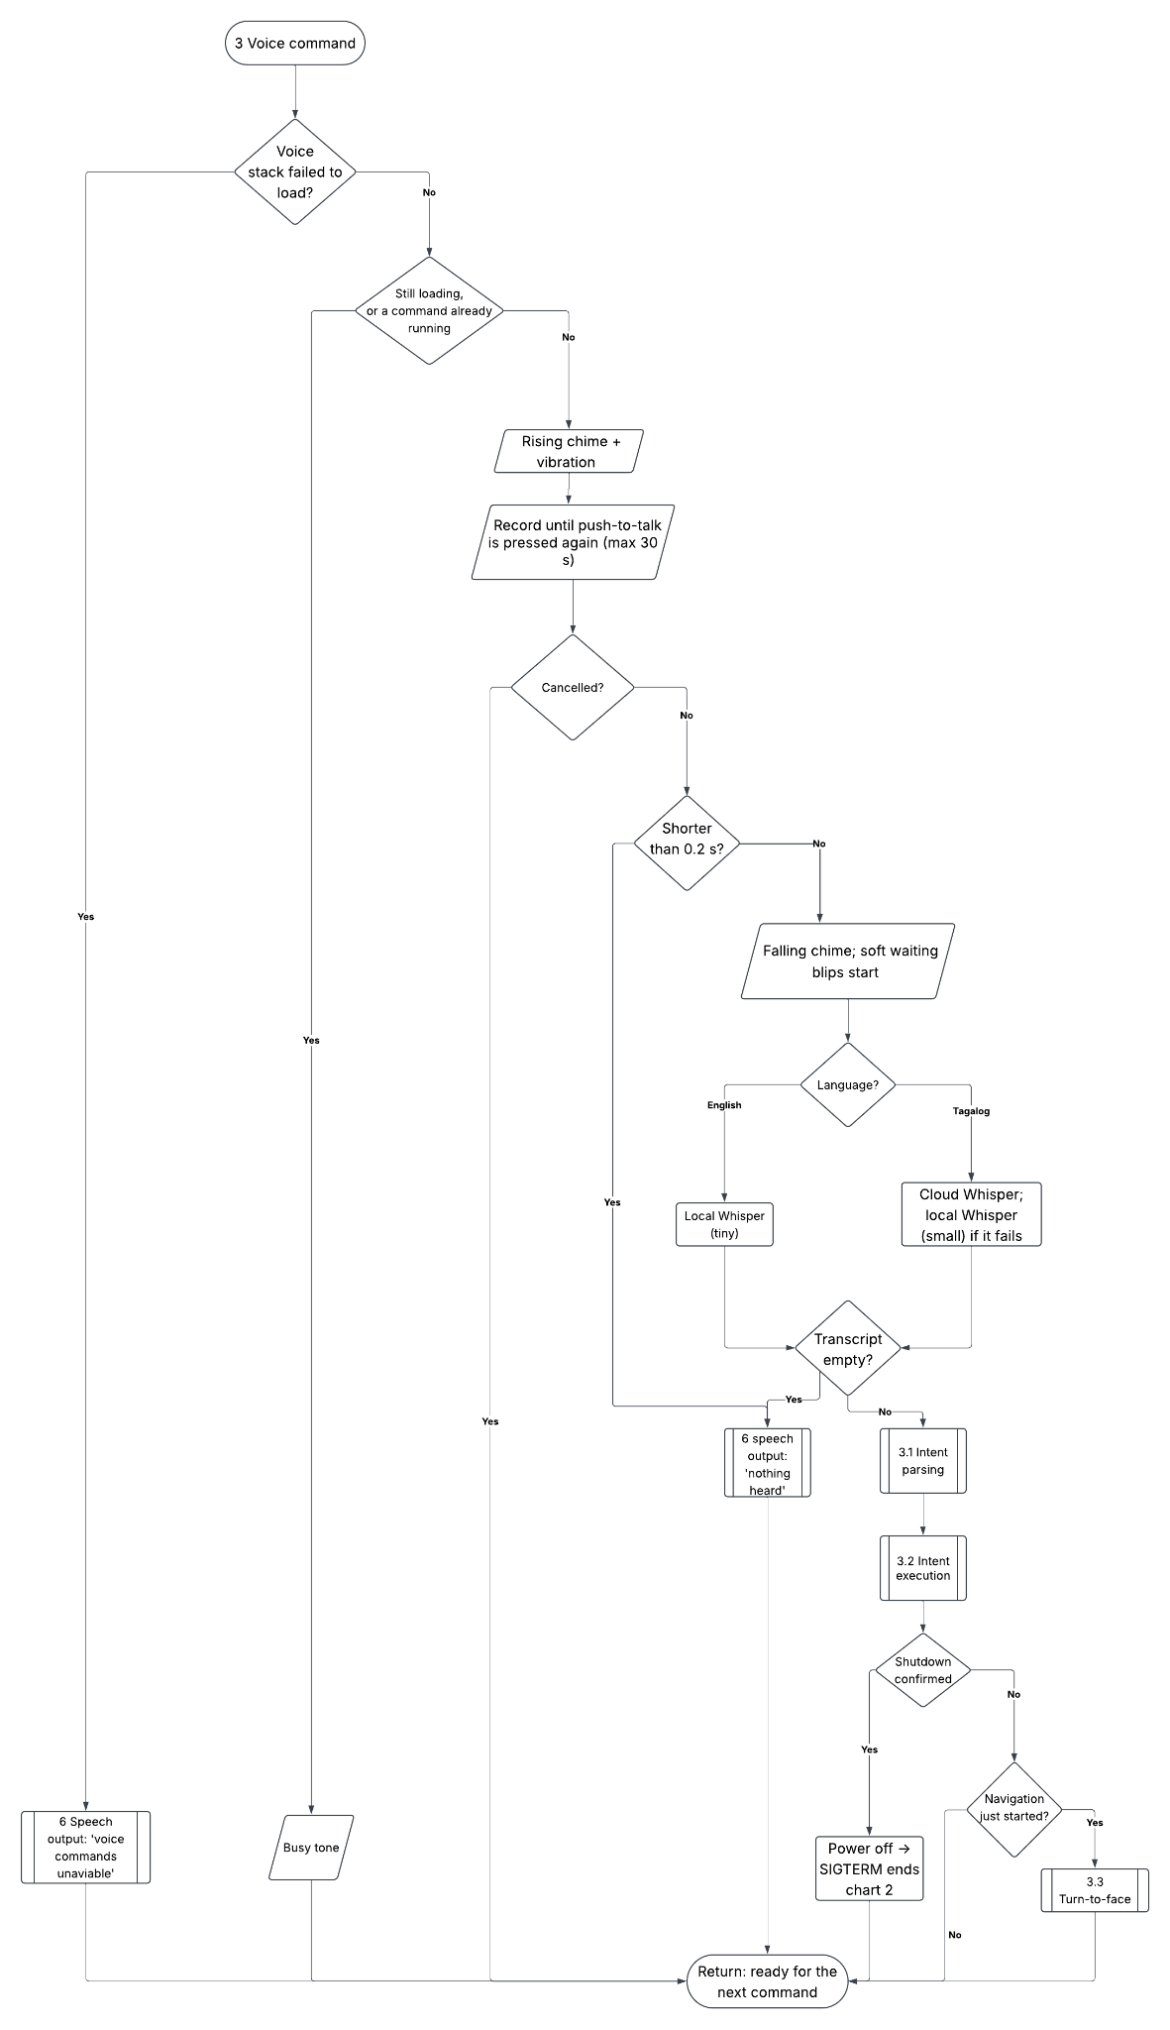
PROCESS FLOW & SOFTWARE LOGIC
Push-to-Talk Voice Command Pipeline
① Press PTT (right): a chime confirms, and recording starts
② Record: the press again (or a timeout) stops it
③ Speech-to-text: English → Whisper tiny on device (1.13 s) · Tagalog → cloud Whisper large-v3-turbo, with local fallback
④ Intent classification:
Embedding fast path (~52% of utterances, ~30 ms)
→ Mistral (cloud) → Qwen 3 1.7B (local) when offline
⑤ Execute + speak: navigation, vision, status, time, language, emergency
Intents served: navigation.​start/​stop/​progress/​location · vision.describe · vision.read · device.status · place.​save/​list/​locate · system.​time/​volume/​language/​help/​shutdown · emergency.trigger · guardian.status_ok
Camera wakes only on a vision intent, never continuously
Working blip if the answer takes > 1.5 s, so silence never reads as a crash
Repeat/Stop cancels a command mid-pipeline
Voice command
IndepenSense · 22
Notes:
A voice command follows five stages. The user presses push-to-talk, hears a chime and speaks. Speech is transcribed on the device for English in about one point one seconds. Tagalog, which local models handled poorly, goes to a cloud transcription server, with the local model kept as a fallback. The transcript is classified in three tiers. A fast on-device embedding matcher answers about half of all commands in thirty milliseconds; the rest go to a cloud language model, and to a local model if the cloud is unreachable. The intent then executes and the answer is spoken. The camera wakes only when the intent needs it, which protects battery life.
AUTHOR NOTE: this slide uses current-build facts (⚑ in the draft) not yet in the manuscript. Update Chapters 2–3 before citing them.

Slide 23
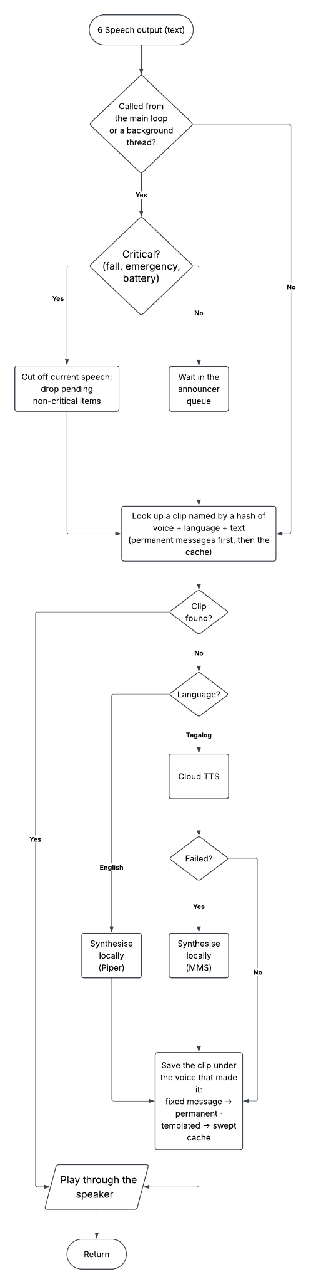
PROCESS FLOW & SOFTWARE LOGIC
Feedback Execution: Haptic and Audio Arbitration
Haptic path
Short-lived pattern worker threads, serialised by a mutex
Encodes intensity only: front motor = warning, all 3 = danger
Navigation never uses the motors, because left and right motors in one handle feel identical
Used for: obstacle proximity, and SOS / fall alarm (all 3 motors + buzzer)
Audio path
Announcer thread queues every main-loop message
Pre-rendered clips: static messages are synthesised once and replayed from disk, and templated messages are cached
English → Piper (0.07–0.30 s) · Tagalog → cloud Filipino voice, with MMS fallback
Critical messages interrupt speech, even mid-synthesis
Repeat replays the last message, and Stop cuts it off mid-sentence
Speech output
IndepenSense · 23
Notes:
Feedback runs on two arbitrated paths. Haptic patterns run on short-lived worker threads under a mutex, so two warnings can never collide. Because all three motors are in the same handle, the hand feels one vibrator with three intensities, not three directions. So the motors carry proximity, and every navigation instruction is spoken. The audio path is owned by a single announcer thread. Static phrases are synthesised once and replayed from storage, which makes the emergency messages instant even with no network. Critical messages such as a fall or a dead battery interrupt whatever is playing. The repeat button replays the last message or, while the device is speaking, stops it.
AUTHOR NOTE: this slide uses current-build facts (⚑ in the draft) not yet in the manuscript. Update Chapters 2–3 before citing them.

Slide 24
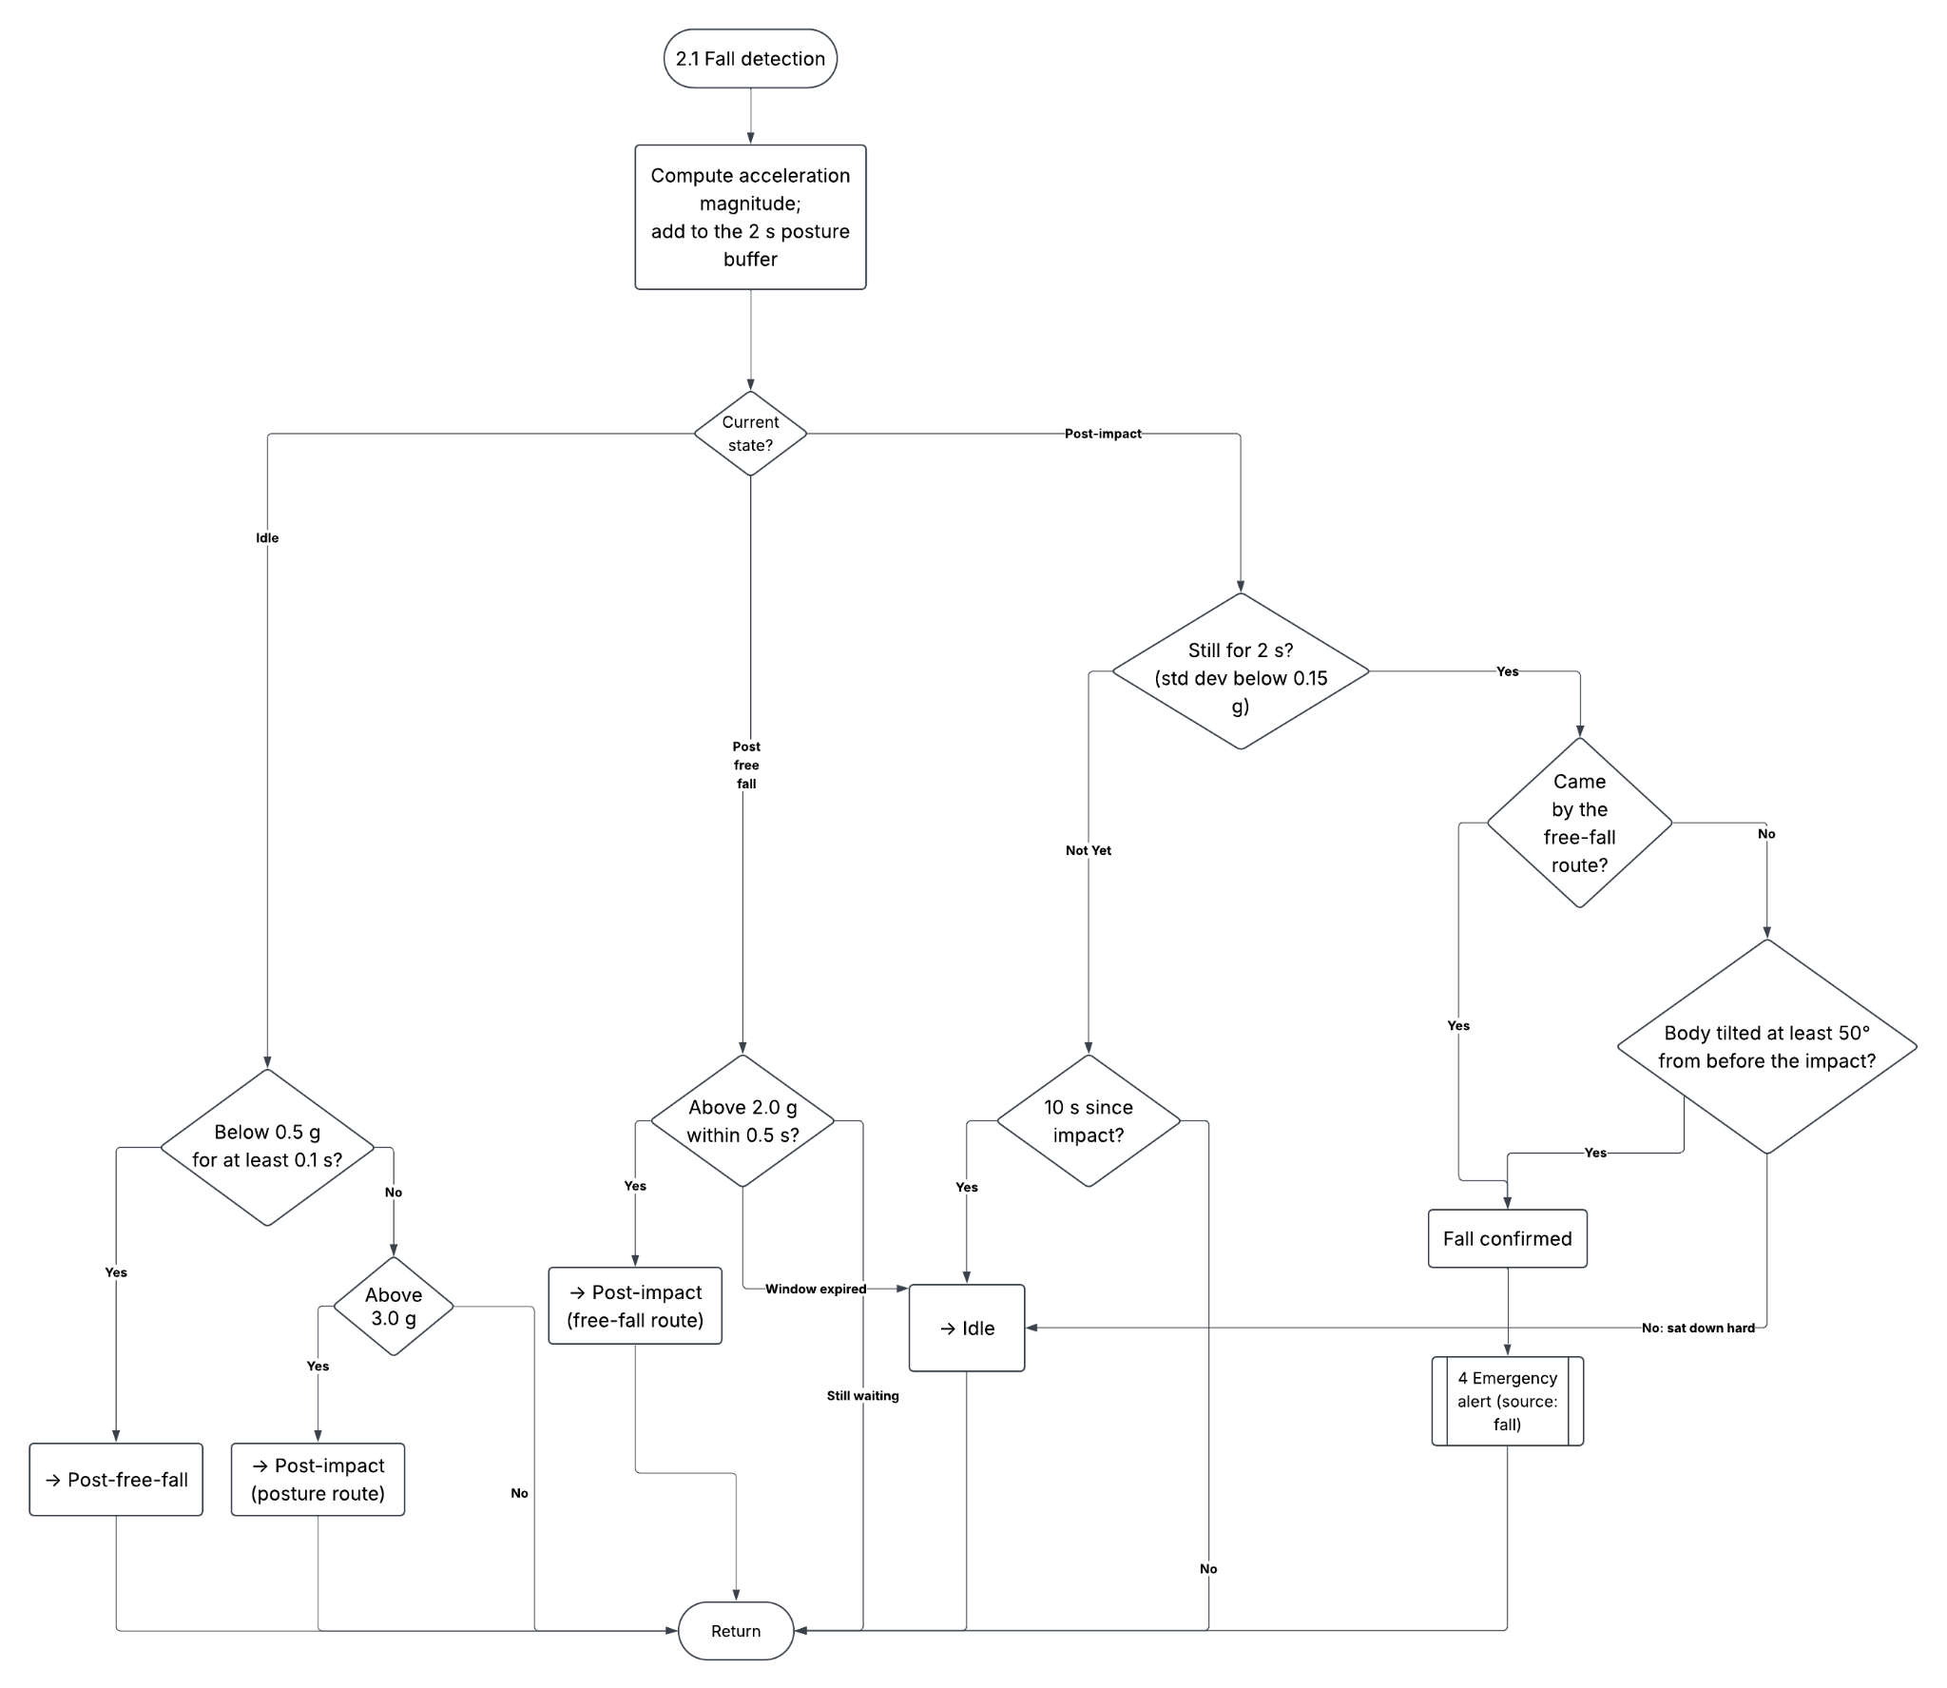
PROCESS FLOW & SOFTWARE LOGIC
High-Priority Interrupts: Emergency and Fall
Trigger A: Emergency button (front)
A gpiozero callback fires on its own thread, preempting nothing on the safety loop
Cancels any voice cycle in progress
10 s re-arm: a repeat press is still felt but does not double-notify the guardian, and the window clears early if delivery failed
Trigger B: Fall detection (MPU-6050, two routes)
Collapse: free fall < 0.5 g for ≥ 0.1 s → impact > 2.0 g within 0.5 s → stillness (σ < 0.15 g) for 2 s
Trip: impact > 3.0 g → torso tilt > 50° → stillness
Shared alert delivery
Local alarm: buzzer + all 3 motors, the same alarm as the SOS button
Spoken to the wearer: "fall detected", so the user knows what was sent
Guardian: HTTPS event with GPS + timestamp → dashboard / app
SMS in parallel, retried for 5 min
Voice "I'm safe now" sends an all-clear to the guardian
Fall detection flow
IndepenSense · 24
Notes:
Two triggers bypass everything else. The emergency button fires on its own callback thread, cancels any voice command in progress, and starts delivery immediately. A second press within ten seconds is acknowledged but not re-sent, unless the first delivery failed. Fall detection runs two routes. A straight collapse appears as free fall, then impact, then stillness. A trip does not: a chest sensor in a trip pivots about the feet and never goes weightless, so the second route looks for impact, then a horizontal torso, then stillness. Both triggers produce the same response: buzzer and motors locally, a spoken confirmation, a GPS-tagged alert to the dashboard, and an SMS in parallel.
AUTHOR NOTE: this slide uses current-build facts (⚑ in the draft) not yet in the manuscript. Update Chapters 2–3 before citing them.

Slide 25
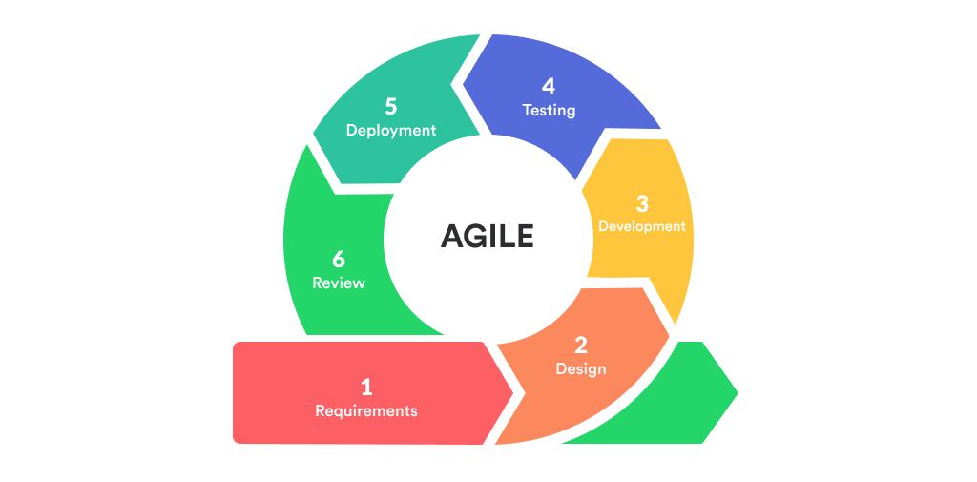
METHODS & TESTING FRAMEWORK
Engineering Planning and Design Methodology
Research design: engineering planning and design approach
① Identify: technical research + unstructured in-person interviews
② Model: feature set, component selection, cane/vest split
③ Develop: Agile, iterative, one feature at a time, then integrated
④ Test: circuit → component → software → system
Sampling: purposive, visually impaired residents of Batangas / Lipa City
Ethics: informed consent, confidentiality, academic use only
Software discipline:
Unit tests run on a Mac with mocked hardware
Manual tests run on the Pi for each wired component
Feature order: object recognition, fall detection and audio/haptic feedback were each built and verified before integration
Agile development model
IndepenSense · 25
Notes:
We followed an engineering planning and design methodology in four stages. We identified the problem through technical research and in-person interviews with visually impaired residents, selected by purposive sampling with informed consent. We modelled a solution, choosing components and deciding the cane-and-vest split. We developed iteratively under Agile, building and verifying each feature on its own before integrating it. Every hardware module has a mock, so the full runtime is unit-tested on a laptop, and every physical component has a manual test script run on the device. Finally, we tested in four layers, from individual circuits up to the complete system in the field.
AUTHOR NOTE: this slide uses current-build facts (⚑ in the draft) not yet in the manuscript. Update Chapters 2–3 before citing them.

Slide 26
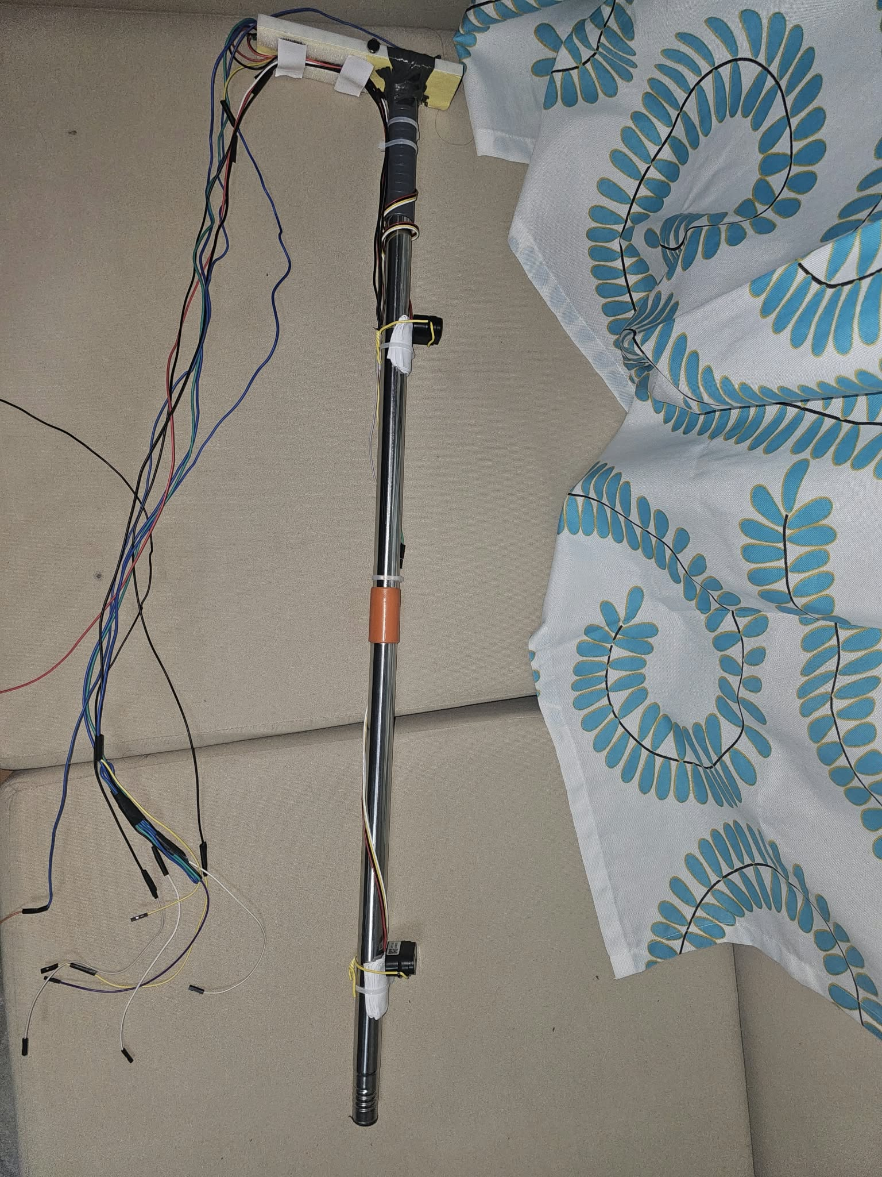
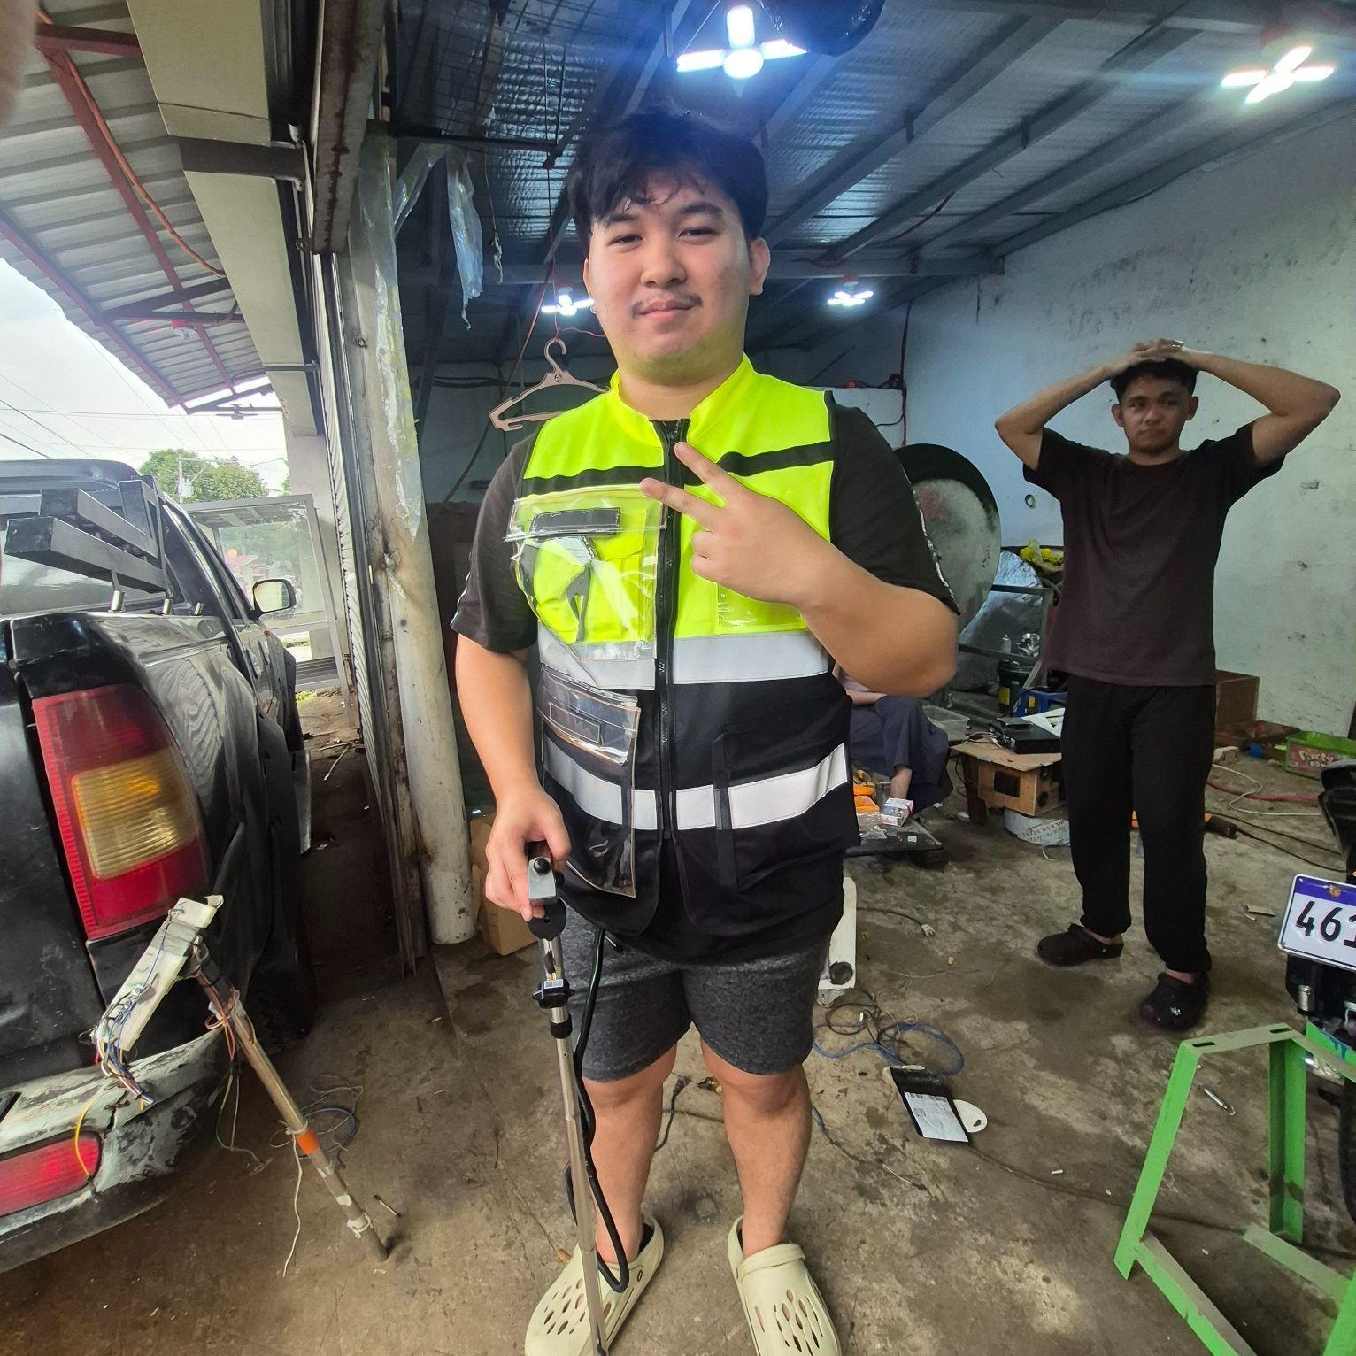
METHODS & TESTING FRAMEWORK
Breadboard Verification to Universal PCB
Stage 1: Breadboard component verification
Each sensor and module verified individually: pin configuration, signal transmission, firmware response
Multimeter checks for voltage levels, continuity and current
Power distribution from the UPS HAT (E) verified under load
Wiring faults (loose, shorted, mis-wired) caught before integration
Stage 2: Migration to a universal PCB
Transferred to a 5 × 7 cm universal PCB with soldered joints
Why: breadboard contacts work loose under cane vibration and swing
Mechanical trace durability and secure connections for field use
Motor drivers on board: 2N2222 NPN ×4, 1N4007 ×4, 1 kΩ / 10 kΩ resistors
Wiring documented in docs/hardware.md, the single source of truth
First prototype
Assembled prototype
IndepenSense · 26
Notes:
Hardware was built in two stages. On a breadboard, we verified each component in isolation: correct pins, clean signals and expected firmware responses, confirmed with a multimeter for voltage, continuity and current. Once every module passed, we migrated the circuit to a universal PCB with soldered joints. The reason is mechanical. A cane is swung and tapped thousands of times per walk, and breadboard contacts loosen under exactly that vibration. The board carries the transistor and diode drivers for the motors. Every connection is recorded in one wiring document that serves as the single source of truth for the build.
AUTHOR NOTE: this slide uses current-build facts (⚑ in the draft) not yet in the manuscript. Update Chapters 2–3 before citing them.

Slide 27
METHODS & TESTING FRAMEWORK
Magnetometer Calibration: Eliminating Magnetic Offsets
Collect
QMC5883P mounted on the vest, calibrated in its operating position, rotated through many orientations
Fit
compute hard-iron offsets (centre shift) and scale correction from the X/Y/Z cloud
Verify
heading compared against a phone compass reference at N, NE, E, SE, S
Recalibrate
when headings deviate, then re-test
Why on the vest: nearby metal, battery cells and the modem distort the field, so calibration must include the mount
What it enables:
Turn-to-face guidance before the first step (stop band ±15°)
Departure heading passed to the router
Missed-turn detection within ~10 m of walking
Status: COMPASS_CALIBRATED = True on the assembled unit
IndepenSense · 27
Notes:
A magnetometer reads every nearby piece of metal and current as well as Earth's field. The vest carries a battery pack, a modem and a processor, so a factory calibration is meaningless here. We therefore calibrated the QMC5883P in its operating position on the vest, rotating it through many orientations and fitting the offsets that shift the measured ellipse back to a centred circle. We then compared headings against a phone compass. The calibrated compass enables turn-to-face guidance, with a fifteen-degree tolerance band, and detects a missed turn within about ten metres of walking. We acknowledge that only five of the eight compass points have been verified so far.
AUTHOR NOTE: this slide uses current-build facts (⚑ in the draft) not yet in the manuscript. Update Chapters 2–3 before citing them.
AUTHOR NOTE: W, SW, NW not yet verified (item 16)

Slide 28
METHODS & TESTING FRAMEWORK
Four-Layer Testing Framework
L1 Circuit testing
multimeter checks of voltage, continuity and current, plus UPS rail stability
L2 Component testing
each module under controlled conditions, covering distance accuracy, image quality, GPS accuracy, IMU motion and feedback response
L3 Software testing
platform features (GPS tracking, SOS, notifications), device logic, and unstable-network behaviour
L4 System testing
Phase 1: controlled environment
Phase 2: real-world on-site (Robinsons Lipa)
Pass criterion: the actual result matches the expected result per test case, reported as pass count / total
Evidence: Tables 5–20 in Chapter 3, 20 tables in total
Metrics: detection accuracy, response, feedback consistency, delivery success
Pre- and post-interviews for qualitative usability
IndepenSense · 28
Notes:
Testing proceeded in four layers, each gating the next. Circuit testing confirmed correct voltage and continuity. Component testing put each module through defined cases under controlled conditions. Software testing exercised the guardian platform and the device logic, including behaviour under an unstable network. System testing ran in two phases: first in a controlled environment, then on site with a visually impaired participant. Every test case defines an expected result in advance and is scored pass or fail against it, and we report the totals per module. The qualitative side, comfort and usability, came from interviews before and after the field trial.

Slide 29
RESULTS: PRE-DEVELOPMENT SURVEY
Interview Findings Driving Design Requirements
Finding (Table 3) | Design implication
Adults 31+, Lipa City | Simple, tactile controls
Mixed vision levels | Audio + vibration together
Mostly traditional cane users | Extend the cane, don't replace it
Low confidence in unfamiliar places | GPS guidance + audio
Daily challenge: identifying obstacles | Ultrasonic + object recognition
History of falls / dangerous incidents | Fall detection + emergency alert
Want distinct patterns per obstacle | Distinguishable feedback
Most requested features: obstacle detection, object recognition, GPS assistance, emergency alerts
All four are implemented in the prototype
Participant suggestion → distance encoded as vibration rate
IndepenSense · 29
Notes:
Our interviews produced requirements, not just context. Participants were adults over thirty-one, so the controls had to be simple and tactile. Their vision ranged from shadow perception to none, so we committed to both audio and vibration rather than either alone. Most already used a cane, so we extended it rather than replacing it. Their stated challenges, identifying obstacles, unfamiliar places and falls, became the three core subsystems. They asked specifically for distinguishable feedback, which became our decision to encode distance in the vibration rate. Each row on this slide is a design decision we can trace back to a participant's words.
AUTHOR NOTE: this slide uses current-build facts (⚑ in the draft) not yet in the manuscript. Update Chapters 2–3 before citing them.

Slide 30
RESULTS: BENCH VALIDATION (PASSED)
Bench Validation: Ultrasonic Sensors 1 and 2
Test case | Expected | Sensor 1 | Sensor 2
30 cm detection | 30 cm | 30 cm · PASSED | 30 cm · PASSED
60 cm detection | 60 cm | 60 cm · PASSED | 60 cm · PASSED
1 m detection | 100 cm | 100 cm · PASSED | 100 cm · PASSED
Angled 35°–45° | Detected in cone | Detected · PASSED | Detected · PASSED
Summary |  | 4/4 · 100% | 4/4 · 100%
DYP-A22 on UART, powered and unobstructed
Exact match at all three distances on both sensors
Off-axis detection confirmed at 35°–45°, which defines the forward cone in our delimitations
Combined: 8/8 · 100%
IndepenSense · 30
Notes:
Both DYP-A22 ultrasonic sensors were tested at thirty centimetres, sixty centimetres and one metre, and against an object placed thirty-five to forty-five degrees off the sensor axis. Both sensors read the exact expected distance in every case and detected the angled object, for eight of eight passes. Two points matter for interpretation. First, these distances span our entire warning range, from the first pulse to maximum alert. Second, the angled test is what defines our forward cone. It tells us where coverage ends, which is exactly why lateral sensors appear among our recommendations.
AUTHOR NOTE: Manuscript typo: "100 meters" should be 100 cm (item 9)

Slide 31
RESULTS: BENCH VALIDATION (PASSED)
Bench Validation: Buttons, Motors and Buzzer
Push Buttons 1, 2, 3: 2/2 each · 6/6 · 100%
Single press → designated action triggered
Idle → no false triggers, no floating input
Vibration Motors: 4/4 · 100%
Activates on trigger · auto-off after 2–3 s
Silent when idle · consistent across repeated cycles, with no dropout or overheating
Combined: 16/16 · 100%
Emergency Buzzer: 6/6 · 100%
BUZ-001 activation on HIGH · BUZ-002 silent on LOW
BUZ-003 immediate on emergency
BUZ-004 repeated alerts
BUZ-005 ignores invalid input
BUZ-006 recovers after power loss
IndepenSense · 31
Notes:
The user-interface hardware passed every bench case. All three push buttons registered single presses reliably and, just as importantly, produced no false triggers when idle, which rules out floating inputs on the GPIO lines. The vibration motors activated on command, stopped on their own after the pattern ended, stayed silent when idle, and ran through repeated alert cycles without dropout or overheating. The buzzer passed six cases, including rejection of invalid signals and correct operation after power loss, which matters because it is the emergency output. In total, sixteen of sixteen. These are the components the user touches and relies on in an emergency.

Slide 32
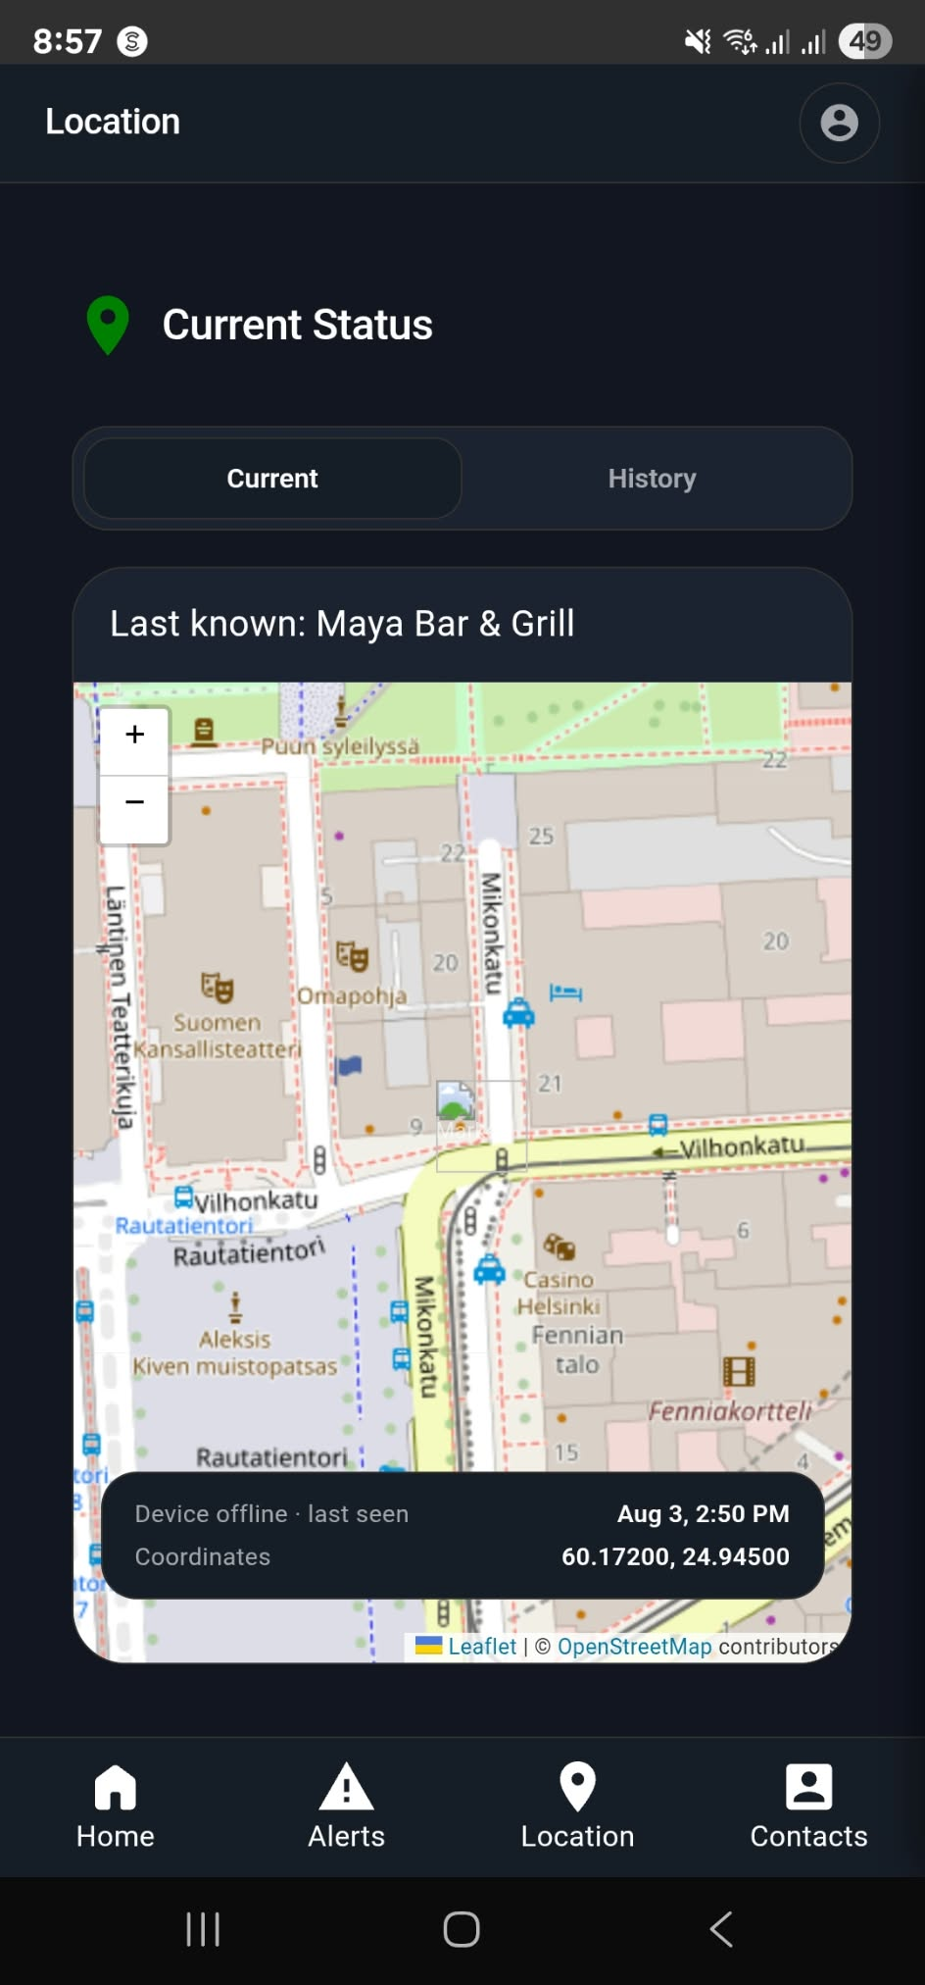
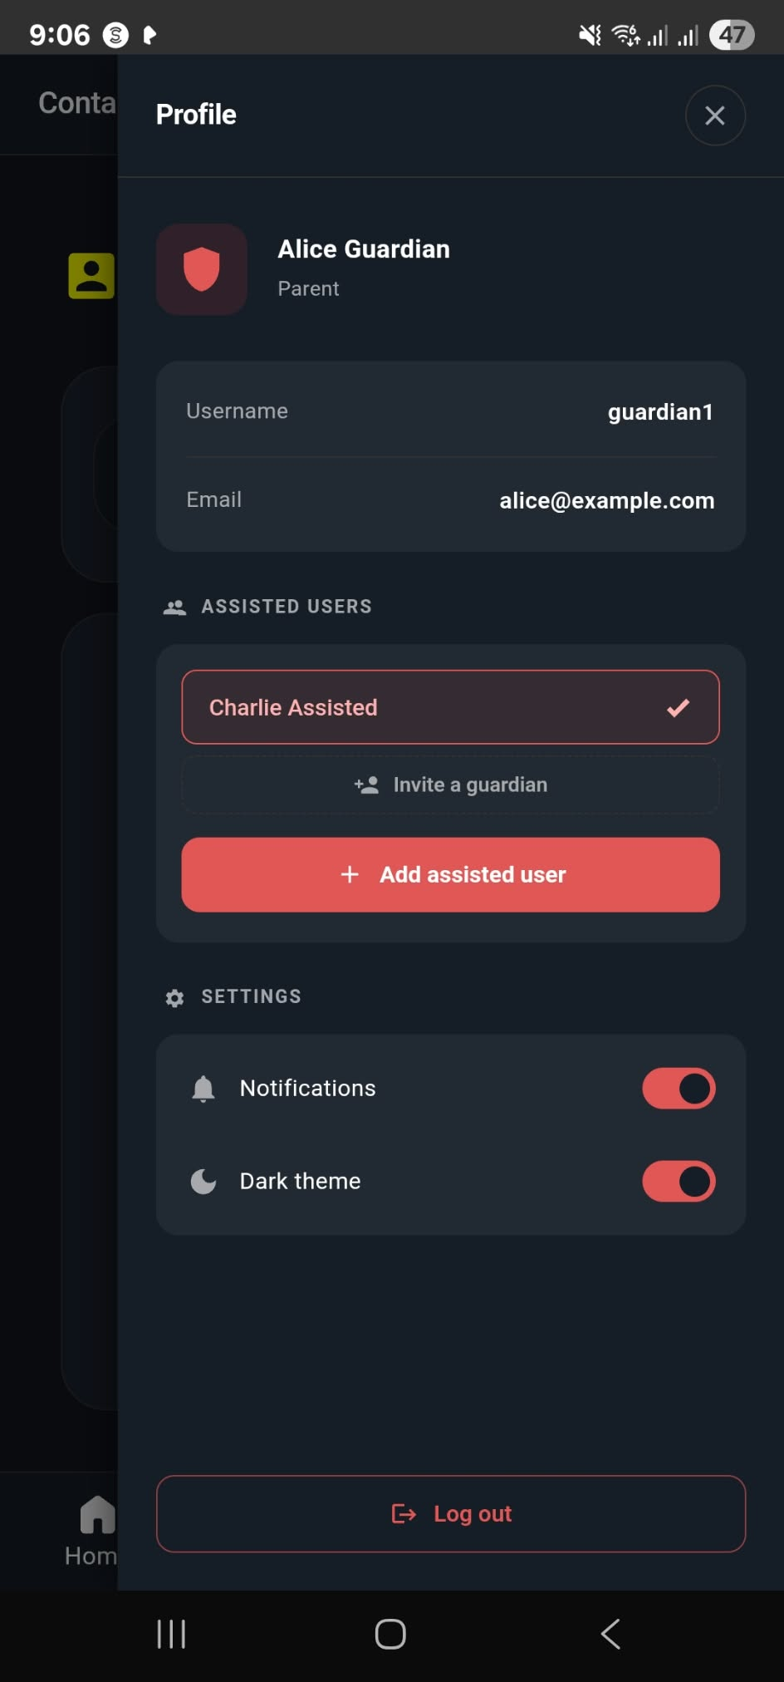
RESULTS: BENCH VALIDATION (PASSED)
Bench Validation: SIM7600G-H and Guardian Platform
SIM7600G-H: 9/9 · 100%
SIM-001 power on · SIM-002 SIM detected
SIM-003 network registration
SIM-004 weak-signal handling
SIM-005 SMS send · SIM-006 SMS receive
SIM-007 LTE data connection
SIM-008 GNSS fix returned
SIM-009 auto-reconnect after interruption
Guardian App: 5/5 · 100% · Audio Feedback: 5/5 · 100%
TC-APP-01 device ↔ app connection
TC-APP-02 SOS notification received
TC-APP-03 live location displayed
TC-APP-04 device status shown
TC-APP-05 alert delivered
TC-AUD-01–05: output device, TTS intelligibility, object descriptions, alert notifications, clarity
Combined: 19/19 · 100%
Live location
Guardian profile
IndepenSense · 32
Notes:
The communication chain passed end to end. The SIM7600G-H powered up, recognised the SIM, registered on the network, sent and received SMS, opened an LTE data connection, and reconnected on its own after we interrupted the signal: nine of nine. On the guardian side, the application connected to the device, received the SOS notification, displayed the user's live location and device status, and received alert notifications: five of five. The spoken output path also passed all five cases for intelligibility and clarity. Together, these results validate the second engineering goal: IoT cellular notification from device to guardian.
AUTHOR NOTE: ⚠ (item 11

Slide 33
RESULTS: BENCH VALIDATION (PASSED)
Calibration Results: Compass Heading Accuracy
Heading | Initial | After recalibration
N | Heading deviation · FAIL | N identified · PASS
NE | Inconsistent · FAIL | NE identified · PASS
E | Wrong direction · FAIL | E identified · PASS
SE | Read as E/S · FAIL | SE identified · PASS
S | Read as N · FAIL | S identified · PASS
Summary | 0/5 | 5/5 · 100%
TC-MAG-01 detected on I²C · TC-MAG-02 valid raw X/Y/Z · TC-MAG-03 calibration applied: all PASS
The S → N inversion is the textbook signature of an uncorrected hard-iron offset
Calibration took heading identification from 0/5 to 5/5
Remaining work: W, SW, NW untested, and degree-level error not yet quantified against true bearings
IndepenSense · 33
Notes:
The compass results show why calibration is not optional. Before recalibration, all five tested headings were wrong, and south was reported as north. That one-hundred-eighty-degree inversion is the classic signature of a hard-iron offset, here from the battery pack and electronics on the vest. After recalibration in the mounted position, all five headings were identified correctly, from zero of five to five of five. We are careful about the limits of this claim. It is direction classification, not a measured error in degrees, and the western headings remain untested. Both gaps are clearly defined and are the next calibration step.

Slide 34
RESULTS: BENCH VALIDATION (FAILED / LIMITATIONS)
Limitation: MPU-6050 Long-Operation Consistency
MPU-6050: 8/9 · 88.89%
PASSED: MPU-001 I²C init · 002 stationary stability · 003 movement · 004 rotation · 005 sudden motion · 006 disconnect detection · 007 vibration noise
MPU-008 Long operation (several hours): FAILED
MPU-009 Long operation (repeat run): PASSED
Verdict: mixed reliability over continuous hours
Fall-motion trials (Gyroscope Testing)
Full standing fall: not detected
Partial fall: not detected
Fall from push-up position: detected
Reading: a single-route (free-fall) detector catches straight collapses, not trips
Design response: a second impact → tilt > 50° → stillness route, giving 3/3 falls, 7/7 daily activities on recorded traces (offline replay, not live use)
IndepenSense · 34
Notes:
The MPU-6050 passed every functional case: initialisation, stability, movement, rotation, sudden motion, disconnection and vibration noise. It produced one failure and one pass on the same multi-hour continuous test, so we report its long-run reliability as mixed, not confirmed. The fall trials were more revealing. Our first detector missed a standing fall and a partial fall, and caught only a fall from a push-up position. The cause is physical: in a trip, a chest sensor rotates about the feet and never goes weightless, so a free-fall detector never fires. We added a second route based on impact and torso tilt, which caught all three recorded falls and rejected seven ordinary activities on replayed traces. Live confirmation is still pending.
AUTHOR NOTE: this slide uses current-build facts (⚑ in the draft) not yet in the manuscript. Update Chapters 2–3 before citing them.

Slide 35
RESULTS: BENCH VALIDATION (FAILED / LIMITATIONS)
Limitation: Audio Input Capture Block
Audio Input/Output: 6/8 · 75%
Case | Result
AUD-001 Microphone detection | PASSED
AUD-002 Low-volume capture | FAILED
AUD-003 High volume, no clipping | PASSED
AUD-004 Background-noise isolation | FAILED
AUD-005 No false triggers in silence | PASSED
AUD-006 Clear playback | PASSED
AUD-007 Minimal response delay | PASSED
AUD-008 Device-disconnect handling | PASSED
Failure 1: a soft voice is not captured reliably
Failure 2: ambient noise is not filtered, so street or mall noise reaches the transcriber
Probable cause: open-ear headset mic sits away from the mouth, by design, to keep the ears free, and has no noise suppression stage
Impact: lower speech-to-text accuracy → misheard commands
Mitigations in place: too-short or empty recordings are answered aloud, never silently dropped
IndepenSense · 35
Notes:
The audio input block failed two of its eight cases, and they are related. It failed to capture low-volume speech, and it failed to isolate background noise. Both trace to the same design trade-off. We chose an open-ear headset so the user keeps hearing traffic, but its microphone sits farther from the mouth and has no noise-suppression stage. In a quiet room this is fine. In a busy public space, the transcriber receives a weaker voice inside more noise. The output side passed all its cases, including clean playback and safe handling of a disconnected device. Our recommendations address input specifically.
AUTHOR NOTE: this slide uses current-build facts (⚑ in the draft) not yet in the manuscript. Update Chapters 2–3 before citing them.

Slide 36
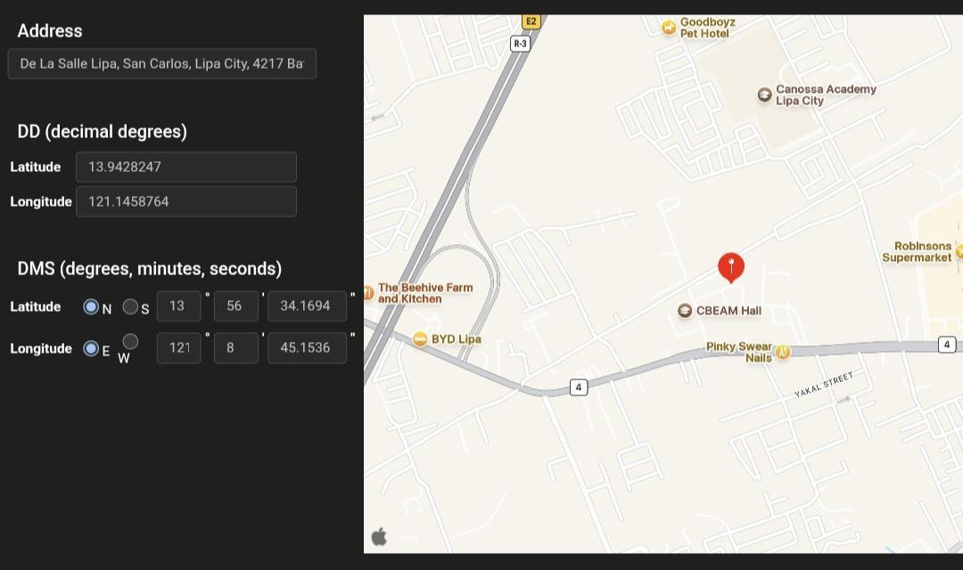
RESULTS: BENCH VALIDATION (FAILED / LIMITATIONS)
Limitation: GPS Location Accuracy Drift
GPS: 5/7 · 71.43%
PASSED: TC-GPS-01 module detected · 02 satellite acquisition · 04 stable while stationary · 05 live updates while moving · 07 auto-recovery after obstruction
TC-GPS-03 Location retrieval: FAILED. Fix at 13.9428247 N, 121.1458764 E deviated beyond the 10 m tolerance
TC-GPS-06 Signal interruption: FAILED
Receiver: SIM7600G-H integrated GNSS
Why > 10 m matters: pedestrian turns and building entrances are often < 10 m apart
Contributing factors: antenna placement on the body (vest), multipath near buildings, cold-start fix quality
Design response: turn-to-face tolerance set to ±15°, because the target bearing inherits several metres of GPS error
Stationary stability passed, so the error is an offset, not jitter
Reported fix vs. reference
IndepenSense · 36
Notes:
GPS passed five of seven cases. Detection, satellite acquisition, stationary stability, live tracking and recovery after obstruction all worked. The critical failure is accuracy: the reported fix deviated beyond our ten-metre tolerance. For a pedestrian that matters, because a turn or an entrance can be closer than ten metres. Since stationary readings were stable, the error is a consistent offset rather than noise, which points to antenna placement on the body and multipath near buildings. We designed around this where we could. The compass tolerance of fifteen degrees exists precisely because the bearing we compute already carries several metres of GPS uncertainty.
AUTHOR NOTE: this slide uses current-build facts (⚑ in the draft) not yet in the manuscript. Update Chapters 2–3 before citing them.
AUTHOR NOTE: ⚠ (the behaviour matched its expectation, item 12
AUTHOR NOTE: ⚠ item 2

Slide 37
RESULTS: BENCH VALIDATION (FAILED / LIMITATIONS)
Limitation: Object Recognition Under Variable Conditions
Camera / Object Recognition: 5/6 · 83.33%
PASSED: TC-CAM-01 camera detected · 02 voice-activated capture · 03 image captured and processed · 04 objects recognised and described · 05 description spoken
TC-CAM-06 Different distances and lighting: FAILED. Performance varied with distance and light
Model: YOLOv8m, Open Images V7 (~600 classes), confidence ≥ 0.3
Input: 1280×720 frames from Camera Module 3
Failure mechanism: small or distant objects shrink below the detector's resolution, and low or harsh light lowers confidence below the threshold
Graceful fallback: when nothing is recognised, the device reports the forward ultrasonic distance instead ("something is about 40 cm away")
Pipeline works end to end. Robustness is the gap
IndepenSense · 37
Notes:
The vision pipeline passed every functional stage. The camera initialised, a voice command activated it, images were captured and processed, objects were recognised and the description was spoken: five of five. It failed the robustness case. Recognition varied with distance and lighting. Distant objects occupy too few pixels for reliable detection, and poor or harsh lighting pushes confidence below our threshold. We designed for this failure. When the camera recognises nothing, the device does not say 'nothing there'. It reports the ultrasonic distance, so the user is never told a path is clear when it is not.
AUTHOR NOTE: this slide uses current-build facts (⚑ in the draft) not yet in the manuscript. Update Chapters 2–3 before citing them.
AUTHOR NOTE: ⚠ item 4: paper says v8n

Slide 38
RESULTS: BENCH VALIDATION (FAILED / LIMITATIONS)
Bench Validation Summary Matrix
Module | Table | Passed / Total | Rate
Ultrasonic Sensor 1 | 5 | 4/4 | 100%
Ultrasonic Sensor 2 | 6 | 4/4 | 100%
Push Buttons 1–3 | 7–9 | 6/6 | 100%
Vibration Motors | 10 | 4/4 | 100%
Buzzer | 11 | 6/6 | 100%
SIM7600G-H | 14 | 9/9 | 100%
Audio Feedback | 18 | 5/5 | 100%
Guardian App | 19 | 5/5 | 100%
MPU-6050 | 13 | 8/9 | 88.89%
Camera / Object Recognition | 16 | 5/6 | 83.33%
Audio Input/Output | 12 | 6/8 | 75.00%
GPS | 17 | 5/7 | 71.43%
Magnetometer headings (post-cal.) | 15 | 5/5 | 100%
Aggregate (excluding magnetometer): 67/74 · 90.5% (computed from Tables 5–19)
Every failure sits in a perception or environment-sensitive block: audio input, GPS, vision, long-run IMU
Every safety-actuation block passed 100%: buttons, motors, buzzer, SMS, app alerts
IndepenSense · 38
Notes:
This matrix consolidates the bench evidence. Across twelve modules, sixty-seven of seventy-four cases passed, about ninety and a half percent. The distribution matters more than the aggregate. Every component in the emergency chain passed completely: the buttons, the motors, the buzzer, the modem's SMS and data links, and the guardian application. Every failure sits in a block that perceives a noisy, variable world: microphone capture, satellite positioning, vision under changing light, and multi-hour IMU stability. That pattern is consistent with our architecture. The actuation path we control is reliable, and the perception path is where future work belongs.

Slide 39
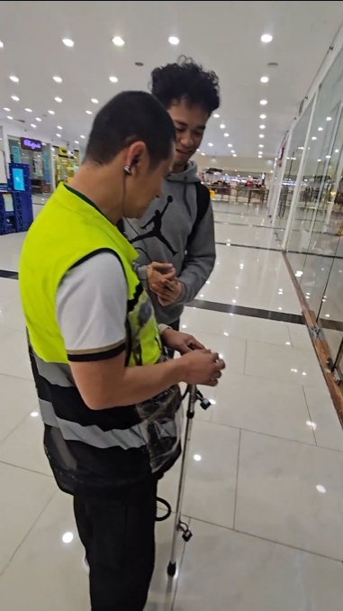
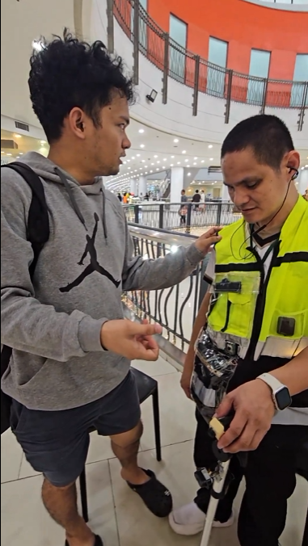
RESULTS: ON-SITE DEPLOYMENT
On-Site Field Test: Robinsons Lipa
Venue: Robinsons Lipa, with walking paths, indoor areas, people and fixtures
Participant: one adult with visual impairment
Protocol: 18 test cases (TC-ONS-01 to 18) covering mobility tasks, obstacle approaches, voice commands, camera requests, GPS transitions, SOS simulation, simulated falls and extended use
Post-test interview guided by the Appendix A instrument
Result: 17/18 · 94.44%
Why this venue: accessible for the participant, and safer than unfamiliar outdoor streets for a first field trial
Realistic obstacles: walls, chairs, displays, crowds
Indoor-outdoor transitions exercised GNSS loss and recovery
Threat to validity: n = 1 participant, a single session
On-site test
On-site test
IndepenSense · 39
Notes:
The field trial was held at Robinsons Lipa with one adult visually impaired participant, across eighteen defined test cases. We chose the venue deliberately. Travelling to an unfamiliar outdoor site poses real transport and safety risks for a visually impaired participant, and a mall offers realistic obstacles such as walls, displays, chairs and crowds, in a controlled and accessible setting. Moving between indoor and outdoor areas also let us observe GNSS loss and recovery. Seventeen of eighteen cases passed. We state the main threat to validity plainly: one participant in one session establishes feasibility, not generalisable performance.

Slide 40
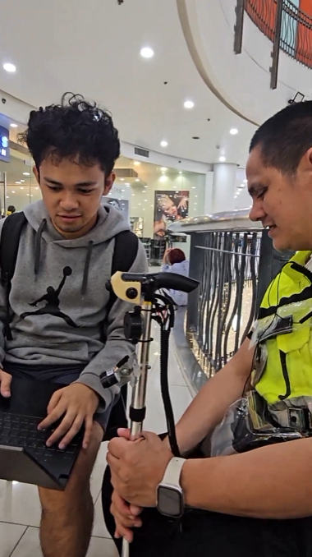
RESULTS: ON-SITE DEPLOYMENT
Usability Wins: Haptic Collision Avoidance
TC-ONS-03 Obstacle detection: PASSED
Vibration alerts came before any collision with walls, chairs and displays
TC-ONS-04 Dynamic distance tracking: PASSED
The participant used the vibration to estimate obstacle distance while walking toward and away from it
TC-ONS-05 Vibration comfort: PASSED
Vibration was comfortable and useful for proximity
TC-ONS-01/02 Independent movement: PASSED
"Easy to use", with added awareness in an unfamiliar place
Interpretation
the rate-encodes-distance design was understood without training
Obstacle approach
IndepenSense · 40
Notes:
The strongest field result is the haptic channel. The participant received vibration alerts before every collision with walls, chairs and displays. More significantly, they used the vibration to judge how far away an obstacle was as they walked toward it and away from it. That is the exact behaviour the parking-sensor rhythm was designed to produce, and it was understood intuitively, without prior training. They described the vibration as comfortable and useful, and said that in an unfamiliar place the device gave them additional awareness. This validates our decision to put proximity on touch and keep speech for description.

Slide 41
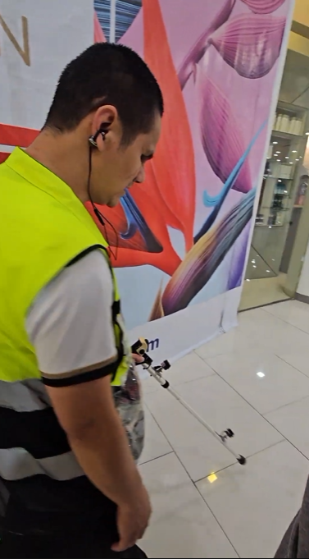
RESULTS: ON-SITE DEPLOYMENT
Usability Wins: Ergonomics, Controls and Connectivity
Wearability: TC-ONS-16 PASSED
The prototype was lightweight and manageable, and the vest made it easier to carry
Controls: TC-ONS-07 / 17 PASSED
Buttons were easily locatable by touch and easy to press, including the power switch
Voice: TC-ONS-07 PASSED
PTT command recognised and the function activated
Safety link: TC-ONS-13 PASSED. Emergency SOS reached the guardian application
Tracking: TC-ONS-12 PASSED. Guardian app received updated location and status
GNSS: TC-ONS-10 / 11 PASSED. Location recorded, with reconnection after indoor/outdoor transitions
Endurance: TC-ONS-15 PASSED. No unexpected shutdowns during the session
Camera: TC-ONS-08 PASSED. Helpful for identifying objects ahead
Wearing the vest
IndepenSense · 41
Notes:
The remaining usability results validate the ergonomic and connectivity decisions. The participant found the system lightweight and manageable, and credited the vest for making it easier to carry, which is direct confirmation of the cane-and-vest split. All buttons, including the power switch, were found by touch without assistance. On the safety side, the SOS alert reached the guardian application, live location and status updates arrived, and GNSS reconnected across indoor-outdoor transitions. The hardware ran for the full session with no unexpected shutdown. The participant also found the camera helpful in principle, which brings us to the failures.
AUTHOR NOTE: ⚠ item 13: fix the note

Slide 42
RESULTS: ON-SITE DEPLOYMENT
Critical Failure: Computer Vision in Public Lighting
TC-ONS-09 Object recognition with common objects: FAILED
Test objects: signs, chairs, tables, displays
Objects not detected with high accuracy
Recognition dropped significantly under public indoor lighting and depth/distance variation
Public signs not read accurately
On one or two occasions a misdetection affected the spoken description
Consistent with bench TC-CAM-06 (FAILED)
Lighting: mall lighting creates glare, reflections and back-lit displays
Depth: objects at varying range fall below detector resolution
Sign reading: OCR needs near-frontal, sharp, well-lit text. Signs are angled, distant and stylised, and a blind user cannot aim the camera precisely
Compute: a larger CPU model on the Pi limits frame rate and retries
Safety boundary held: obstacle avoidance relies on the ultrasonics, not vision
IndepenSense · 42
Notes:
Object recognition in the field is our most significant failure, and we report it as such. With signs, chairs, tables and displays, accuracy fell markedly under public indoor lighting and at varying distances, signs were not read reliably, and on one or two occasions a misdetection changed the spoken description. There are three causes. Mall lighting produces glare and back-lit surfaces. Distant objects fall below the detector's effective resolution. And text reading needs a sharp, frontal view that a user without sight cannot easily aim for. The safety boundary held, however: no collision depended on vision, because obstacle avoidance is carried by the ultrasonic sensors.
AUTHOR NOTE: this slide uses current-build facts (⚑ in the draft) not yet in the manuscript. Update Chapters 2–3 before citing them.

Slide 43
RESULTS: ON-SITE DEPLOYMENT
Edge Cases: Speech Accent and Fall Verification
TC-ONS-06 Audio feedback: PASSED, with a qualification
The participant could hear the feedback, and it was generally understandable
The assistant's voice had a heavy accent, which the participant flagged for improvement
Context: English uses Piper on device · Tagalog uses a cloud Filipino fine-tune, falling back to Meta MMS, which is markedly less natural
Needed: confirm which language and voice was active during the trial
TC-ONS-14 Fall detection: UNCONFIRMED
The system triggered on simulated fall movements
Accuracy was not confirmed during live, active use
The participant reported real falls on raised road surfaces and humps, which is the exact scenario the feature targets
Why it is unconfirmed: a real fall cannot ethically be induced in a visually impaired participant
IndepenSense · 43
Notes:
Two further results need careful framing. The audio assistant was audible and understandable, but the participant noted a heavy accent. Our English voice runs on the device, while Tagalog uses a Filipino-trained cloud voice and falls back to a noticeably less natural local model when the network is weak, so a localised voice is a clear recommendation. On fall detection, the system responded to simulated falls, but we cannot claim accuracy in live use. The reason is ethical: we cannot ask a visually impaired participant to actually fall. Validating this feature properly needs controlled trials with sighted volunteers and padded surfaces, which we propose as future work.
AUTHOR NOTE: this slide uses current-build facts (⚑ in the draft) not yet in the manuscript. Update Chapters 2–3 before citing them.
AUTHOR NOTE: Present as "triggered in simulation, accuracy unconfirmed", not as an unqualified PASS (item 13)

Slide 44
RESULTS: ON-SITE DEPLOYMENT
Post-Test Interview: Design Evaluation Summary
Evaluation item (Table 4) | Participant response
Overall experience | Generally positive
Buttons & controls | Easy to locate and operate by touch
Physical design & weight | Lightweight, manageable, vest helps
Obstacle detection | Appreciated, helped navigation
Audio clarity | Appreciated
Vibration feedback | Appreciated
Object recognition | Liked the feature, accuracy needs work
Emergency / fall | Falls on humps, accuracy unconfirmed
GPS / location | Seen as useful, no performance assessment
Most valued: obstacle detection, vibration, audio output, camera
Requested improvements: object recognition accuracy and directional guidance
Directional guidance aligns with the left/right sensing recommendation, since the motors cannot convey side
IndepenSense · 44
Notes:
The post-test interview confirms the pattern in the quantitative results. The participant's overall response was positive, and the features they valued most were obstacle detection, vibration, audio output and the camera. Physical design and controls drew no complaints. Two improvements were requested: object recognition accuracy, which matches our bench and field failures, and directional guidance, meaning knowing which side an obstacle is on. That second request is significant, because our current hardware cannot provide it. Both sensors face forward and all motors share one handle. It directly motivates one of our recommendations.
AUTHOR NOTE: this slide uses current-build facts (⚑ in the draft) not yet in the manuscript. Update Chapters 2–3 before citing them.

Slide 45
CONCLUSION
Conclusion: Objectives Against Evidence
Objective | Evidence | Status
SO1 Sensor-equipped smart cane | Tables 5–6, 13–17 | Achieved
SO2 Haptic + audio feedback | Tables 10–12, 18; TC-ONS-03–06 | Achieved
SO3 AI object recognition (supplementary) | Table 16; TC-ONS-08/09 | Achieved, accuracy limited
SO4 GPS outdoor navigation | Table 17; TC-ONS-10/11 | Achieved, > 10 m drift
SO5 Emergency response + location | Tables 11, 14, 19; TC-ONS-13 | Achieved
SO6 Guardian web platform | Table 19; TC-ONS-12 | Achieved
All six specific objectives were implemented and demonstrated at the prototype level
Bench: 67/74 (90.5%) · On-site: 17/18 (94.44%)
Safety-actuation chain: 100% on the bench
IndepenSense · 45
Notes:
We conclude that all primary objectives were achieved at the prototype level, and this table shows the evidence for each. The sensor-equipped cane, the dual-channel feedback, the emergency response and the guardian platform are fully supported by passing tests. Object recognition and GPS navigation were implemented and demonstrated, but with measured accuracy limits that we have reported rather than hidden. Across the bench, ninety point five percent of cases passed; in the field, seventeen of eighteen. Most importantly, the components a user depends on in an emergency passed every test we ran.
AUTHOR NOTE: see the manuscript errata table in docs/defense-presentation.md.

Slide 46
CONCLUSION
Conclusion: A Validated Multi-Modal Baseline
Validated 1: Multi-modal integration is feasible
Sensing, vision, voice and cellular alerting run together on one Raspberry Pi 5
Validated 2: The ergonomic split works
A light cane + weighted vest was rated comfortable in the field
Validated 3: Distributed safety works
Local alarm, HTTPS + SMS to the guardian, and offline survival of safety features
Baseline established for user spatial safety: forward obstacle cone, fall alerting, guardian visibility
Defined frontier: vision robustness, GNSS accuracy, audio capture, fall verification
Contribution: an integrated architecture, where the literature mostly offers single-subsystem improvements
IndepenSense · 46
Notes:
Beyond the objectives, the prototype validates three claims. First, multi-modal integration is feasible on a single embedded platform: sensing, vision, voice and cellular alerting coexist without compromising the safety loop. Second, the ergonomic split between a light cane and a weighted vest works, as the participant confirmed. Third, safety can be distributed: a local alarm, two independent channels to the guardian, and safety functions that survive a network outage. Together these establish a baseline for user spatial safety, with a clearly defined frontier. That is our contribution to a literature that has largely improved one subsystem at a time.

Slide 47
RECOMMENDATIONS
Recommendation 1: Quantized Computer Vision
Current
YOLOv8m, FP32 PyTorch on the Pi 5 CPU
1280×720 input · conf 0.3
Field accuracy dropped in indoor light and with depth variation (TC-ONS-09)
Recommended
Model quantization: INT8 export (e.g. NCNN / ONNX Runtime / TFLite) for faster inference on ARM
Speed buys multi-frame voting (several frames per request), which raises effective accuracy without a bigger model
Evaluate YOLOv8n/s vs m on a local dataset (Lipa signage, mall fixtures)
Fine-tune on locally collected images; add exposure / HDR settings for glare
Consider an edge accelerator (e.g. Raspberry Pi AI HAT) if the budget allows
IndepenSense · 47
Notes:
Our first recommendation targets the largest field failure. The current detector runs at full precision on the Pi's CPU, which limits how many frames we can analyse per request. Quantizing the model to eight-bit integers and exporting it to an ARM-optimised runtime would substantially shorten inference. That speed matters less for its own sake than for what it enables: analysing several frames and voting, which smooths over a single bad frame under glare. We also recommend benchmarking smaller model variants against a locally collected dataset of Lipa signage and indoor fixtures, and fine-tuning on it.
AUTHOR NOTE: this slide uses current-build facts (⚑ in the draft) not yet in the manuscript. Update Chapters 2–3 before citing them.

Slide 48
RECOMMENDATIONS
Recommendation 2: Left and Right Sensing
Current: 2 forward-facing ultrasonics (top + bottom) cover only a 35°–45° cone
Gap: obstacles beside the user are undetected
Participant request: directional guidance (Table 4)
Hardware truth: 3 motors in one handle are perceived as one vibrator, so side cannot be encoded today
Add lateral ultrasonics, angled left and right, for near-180° frontal coverage
Relocate haptics off the handle: wrist bands or vest-shoulder motors on separate bodies, so left and right are physically distinguishable
Alternatively, use spatial audio cues (left/right ear) for side
Re-test with an angular coverage protocol (0°, ±30°, ±60°, ±90°)
IndepenSense · 48
Notes:
Our second recommendation answers the participant's request for directional guidance. Today both ultrasonic sensors face forward, covering a cone of about thirty-five to forty-five degrees. We recommend adding angled left and right sensors. Detection alone is not enough, however, and this is a finding we want to emphasise. Our three motors sit in the same handle, and the hand cannot tell which one is vibrating. So directional feedback also requires moving the motors onto separate parts of the body, such as wrist bands or the vest's shoulders, or using left- and right-ear audio cues. A sensor upgrade without a feedback upgrade would detect the side but could not tell the user.
AUTHOR NOTE: this slide uses current-build facts (⚑ in the draft) not yet in the manuscript. Update Chapters 2–3 before citing them.

Slide 49
RECOMMENDATIONS
Recommendation 3: Battery and Power Optimization
Measure first: publish a measured runtime under idle, walking, vision and alert profiles
Compute: quantized vision (Rec. 1) and CPU frequency governor scaling at idle
Peripherals: power-gate the camera between requests and duty-cycle the SIM7600 where latency allows
Storage: replace the SD card with NVMe / high-endurance media. Model loading took ~200 s and the card failed read-back checks
Gauge: a calibrated fuel-gauge curve for the 4× 21700 pack (the raw gauge reads ~58% when empty)
Baseline: ≈ 11.7 W typical (Table 2 sum)
Target: a full day of use on one charge
IndepenSense · 49
Notes:
Our third recommendation is power. The first step is measurement: a published runtime under defined usage profiles, which the current manuscript does not yet report. From the estimated baseline of about twelve watts, the main levers are compute and peripherals. Quantized vision reduces CPU load. The processor can scale down when idle, the camera can be fully powered off between requests, and the modem can be duty-cycled where alert latency allows. We also recommend replacing the SD card. Model loading from it took about two hundred seconds, and our card failed read-back verification, which threatens both boot time and data integrity.
AUTHOR NOTE: this slide uses current-build facts (⚑ in the draft) not yet in the manuscript. Update Chapters 2–3 before citing them.
AUTHOR NOTE: ⚠ item 15

Slide 50
RECOMMENDATIONS
Recommendation 4: Adjustable Physical Cane Length
Finding: the participant identified the overall dimensions of the cane as needing improvement
Why length matters: it sets the sweep arc, wrist angle and, critically, the sensor aim
The ultrasonic heights (ankle level and upper body) shift with cane length and grip
Telescoping shaft with detented length stops, sized to user height
Sensor mounts that hold their angle across lengths, or tilt-adjustable brackets
Software: a per-user height setting in config.py to rescale the obstacle thresholds
Harness: cane-to-vest cable slack sized for the longest setting
Validate with multiple users of different heights
IndepenSense · 50
Notes:
The fourth recommendation is mechanical. The participant identified the cane's overall dimensions as an area for improvement, and length has an electronic consequence as well as an ergonomic one. Cane length sets the angle at which the sensors meet the path, so a cane sized for one user aims its sensors wrongly for another. We recommend a telescoping shaft with fixed length stops, sensor brackets that hold their angle across lengths, and a per-user height setting so the obstacle thresholds scale with the geometry. This must be validated with several users of different heights, which ties into our broader recommendation for more participants.

Slide 51
RECOMMENDATIONS
Recommendation 5: Localized, Natural Audio Models
Speech output (accent)
Field finding: heavy accent (TC-ONS-06)
Train or fine-tune a Filipino-English and Tagalog voice on local speakers
Run it on device, so quality does not depend on the network (the cloud Filipino voice currently falls back to MMS)
User-selectable voice and speaking rate
Listening tests with visually impaired users (MOS scoring)
Speech input (capture)
Bench failures AUD-002 (low volume) and AUD-004 (noise)
Noise suppression / beamforming before transcription
Voice-activity detection to trim silence and noise
A directional or boom microphone that keeps open-ear output
Local Tagalog STT that runs in real time (on-device Tagalog Whisper small runs at an RTF of 2.23×)
IndepenSense · 51
Notes:
Our fifth recommendation covers both directions of speech. On output, the participant noted a heavy accent. We recommend a voice trained on local Filipino and Tagalog speakers and, ideally, running it on the device, so its quality does not drop when the network does. That should be validated with listening tests by visually impaired users, the people who depend on it most. On input, the two bench failures, quiet speech and background noise, call for a noise-suppression and voice-activity stage before transcription, and a more directional microphone that still leaves the ear open. Local Tagalog transcription also needs to get faster than real time.
AUTHOR NOTE: this slide uses current-build facts (⚑ in the draft) not yet in the manuscript. Update Chapters 2–3 before citing them.

Slide 52
RECOMMENDATIONS
Recommendation 6: Validation and Platform Extensions
More participants and environments
move beyond n = 1, covering outdoor streets, night and rain
Fall detection validation
controlled trials with sighted volunteers on crash mats, reporting sensitivity / specificity, plus multi-hour IMU soak tests (MPU-008)
GNSS accuracy
external active antenna at the shoulder, measured CEP against surveyed points, and sensor fusion with IMU/compass dead-reckoning
Guardian app
richer monitoring, notification acknowledgement, a guardian-friendly interface
Navigation test protocol
a turn-by-turn route test to close the evidence gap on SO4
IndepenSense · 52
Notes:
Our final recommendation group strengthens the evidence itself. First, more participants and more environments, including outdoor streets, night and rain, to move from feasibility toward generalisable performance. Second, a proper fall-detection study using sighted volunteers falling onto crash mats, reporting sensitivity and specificity, together with multi-hour soak tests to resolve the IMU's mixed long-run result. Third, GNSS accuracy measured against surveyed reference points, with an external antenna and dead-reckoning from the IMU and compass. Finally, a formal turn-by-turn navigation test, and continued development of the guardian application.
AUTHOR NOTE: ⚠ item 14

Slide 53
THANK YOU
Thank You
IndepenSense: IoT-Based Smart Cane with Computer Vision and Remote Guardian Monitoring
De La Salle Lipa · CITE · Computer Engineering Department
Lubay, Cian Eythan Jeremy · Odi, Mearck Francis Voughn · Rivera, Katelyn Denise
Group 5 · October 2026
Notes:
To summarise: IndepenSense integrates dual ultrasonic sensing, on-demand computer vision, inertial fall detection and cellular guardian monitoring into a single wearable system. Its safety chain passed every bench test, and in the field it gave a visually impaired participant usable, intuitive awareness of their surroundings. We have reported its limits as precisely as its successes: vision robustness, GPS accuracy, audio capture and unconfirmed live fall detection. Those limits define the next stage of this work. Thank you for your attention. The prototype is here for demonstration, and we welcome the panel's questions.

Slide 54
Backup Slides
For the question-and-answer portion

Slide 55
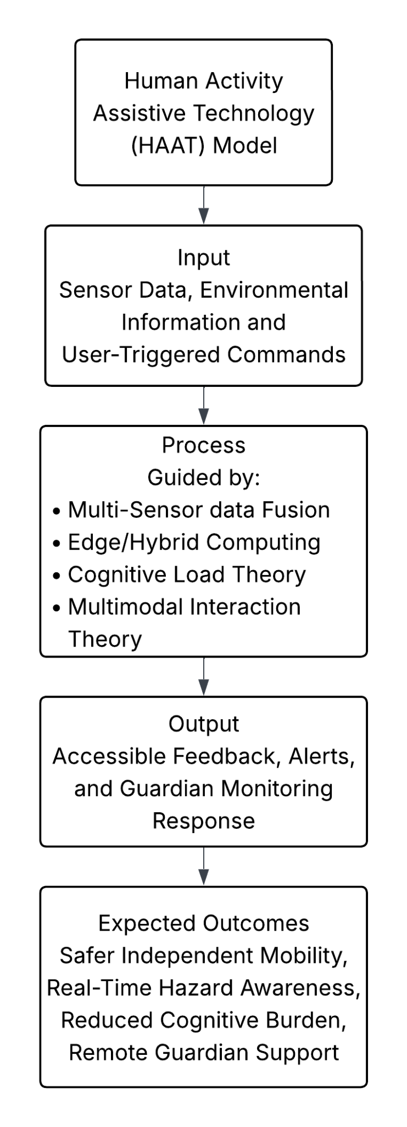
BACKUP
Theoretical Framework of IndepenSense
HAAT Model: Human (visually impaired user) · Activity (independent mobility) · Assistive Technology (smart cane) · Context (physical and social, including guardians)
Multi-Sensor Data Fusion: ultrasonic + camera + GPS + IMU are complementary, each covering another's blind spot
Edge/Hybrid Computing: safety-critical work at the edge, heavy intelligence in the cloud when available
Cognitive Load Theory: filter and prioritise, so only actionable information is delivered
Multimodal Interaction: haptic for urgency, audio for description
Theoretical framework
IndepenSense · B1
Notes:
If the panel asks about our theoretical grounding: the HAAT model frames the device as a system of human, activity, technology and context, which is why guardian monitoring belongs inside the design rather than beside it. Multi-sensor fusion justifies combining sensors whose weaknesses are complementary. The edge-hybrid paradigm determines what must run locally, namely everything safety-critical. Cognitive Load Theory is why the device does not announce every detection. Multimodal Interaction Theory is why urgency goes to touch and description goes to speech, so the two channels never compete for the user's attention.

Slide 56
BACKUP
Voice Intent Classification Performance
Three-stage parser: embedding fast path → Mistral (cloud) → Qwen 3 1.7B (local)
Fast path: answers ~52% of utterances in ~30 ms, on device, for closed intents only
Benchmark: 226 test utterances across English, Tagalog and adversarial groups
Cloud 98.7% vs local 82.3%
Adversarial group: 66.7% → 100%
Cloud timeout 2.5 s, then local fallback
The fallback triggers on a transport failure only, never on a correct "unknown"
Cautious intents: system.shutdown, place.delete, guardian.status_ok, and a missed emergency.trigger
Speech-to-text latency: English Whisper tiny 1.13 s on device · Tagalog Whisper small 5.29 s locally (RTF 2.23×) → cloud
Source: llm_probe / latency_bench, measured on the Pi; not yet in the manuscript
IndepenSense · B2
Notes:
If asked how reliable voice commands are: classification is three-staged. A local embedding matcher answers about half of all commands in thirty milliseconds. The remainder goes to a cloud model, with a small local model as the fallback when offline. On our 226-utterance benchmark across English, Tagalog and adversarial phrasings, the cloud scored 98.7 percent against the local model's 82.3. The adversarial group, where a misclassification would trigger a real action, rose from 66.7 to one hundred percent. These figures come from the current build and should be added to the manuscript before being cited in the defense.
AUTHOR NOTE: this slide uses current-build facts (⚑ in the draft) not yet in the manuscript. Update Chapters 2–3 before citing them.

Slide 57
BACKUP
Offline Behaviour and Graceful Degradation
Function | Online | Offline
Obstacle warnings | ✔ | ✔
Fall detection + local alarm | ✔ | ✔
SOS buzzer + motors | ✔ | ✔
Emergency SMS | ✔ | ✔ (needs cell signal, not data)
Routing + geocoding | ✔ | ✔ (GraphHopper + Photon on Pi)
English speech in/out | ✔ | ✔
Tagalog speech | Cloud | Local fallback (slower, lower quality)
Intent parsing | Cloud 98.7% | Local 82.3%
Guardian dashboard | ✔ | ✘, buffered and retried
Open questions | ✔ | ✘, "needs internet"
DNS stall fix: 20 s per lookup on a dead link → bounded to 2 s
Circuit breaker: a failed host is skipped for 30 s, giving "one slow command, then local"
Route pre-check answers in ~0.2 ms, with no packets sent
IndepenSense · B3
Notes:
If asked what happens without a network: everything that protects the user keeps working. Obstacle warnings, fall detection, the local alarm and the SOS button are fully local, and SMS needs only cellular signal, not data. Routing and geocoding run on the Pi itself. English speech is on the device. What degrades is Tagalog speech quality, intent accuracy and the guardian's live dashboard, which buffers and retries. We also fixed a subtle failure: on a dying link, each name lookup hung for twenty seconds. Bounding it and skipping a failed host for thirty seconds turns that into one slow command, then local operation.
AUTHOR NOTE: this slide uses current-build facts (⚑ in the draft) not yet in the manuscript. Update Chapters 2–3 before citing them.

Slide 58
BACKUP
Anticipated Panel Questions and Answers
Q1. Why test an outdoor-scoped device inside a mall?
Q2. Is n = 1 enough to conclude usability?
Q3. Fall detection marked PASSED but unconfirmed. Which is it?
Q4. How long does the battery last?
Q5. Why not vibrate left/right for navigation?
Q6. Why a Raspberry Pi 5 and not a cheaper microcontroller?
Q7. SIM-008 passed but TC-GPS-03 failed. Contradiction?
A1. Participant safety and accessibility. Obstacle, vision and alert features are location-agnostic, and indoor/outdoor transitions exercised GNSS recovery
A2. No. It establishes feasibility, and we list it as a threat to validity and recommend a larger study
A3. It triggered on simulated movements, but live accuracy is unconfirmed, because a real fall cannot be ethically induced
A4. (Fill in the measured runtime.) Estimated load ≈ 11.7 W
A5. All three motors share one handle, and the hand cannot distinguish them. Navigation is spoken
A6. Local vision and speech recognition need an application processor. A microcontroller would push all of that to the cloud, and offline use would be lost
A7. SIM-008 tested that a fix is returned, while TC-GPS-03 tested accuracy. They are different criteria (fix the wording, item 11)
IndepenSense · B4
Notes:
This slide is for preparation only and is not presented. Each answer is short, factual and concedes the limitation before defending the decision, which is the posture a panel respects. The most likely pressure points are the single participant, the indoor venue for an outdoor-scoped system, the fall-detection status, and the missing runtime figure. Rehearse these four until each answer is under twenty seconds. If a panel member identifies an inconsistency that is listed in the errata table at the top of this document, acknowledge it directly, state the corrected value, and note that the manuscript will be amended.

