Slide 1
Project Name
By GitX

Slide 2
Team Name / Members
Team Name: The CRUD eTeam
Team Members:
Gelissa Leveille
Cameron Kopel
Chad Kaplan
David Lopez

Slide 3

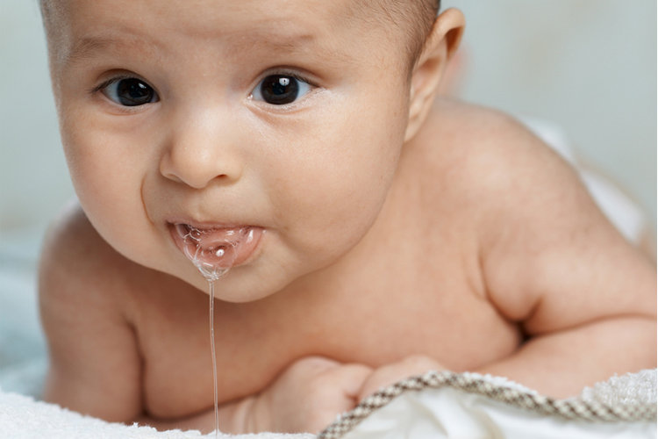



Application
Name that Baby!

Slide 4
Application Concept
To generate a randomized name for babies.
Search by:
Most Popular
Language
Letters
Geographic Origin / Ethnicity

Slide 5
Motivation for App Dev
The motivation is to assist parents with the names of their upcoming baby.
Relieve stress from thinking of baby names.
Develop a name from a specific origin.
Develop a name from ethnicity.
Discover mean of the names.
Combine names found.

Slide 6
User Experience
User Registers
User added to User Table
User Quiery Search
Based on:
Gender/Ethnicity/Letter
Search Results listed
User Flags Favorite Name
User has favorite Table names with
Foreighn key
(primary key of user table)

Slide 7
Design Process
Obtain Data (Multiple datasets)
Develop Database (MySQL)
Establish Tables
Establish Connection btw MySQL and node.
NPM installs
Models Index
Models Table creation
Routes
Public Folder and Files
Authentication
Page Design

Slide 8
Technologies Used
Sequelize
MySQL
Javascript
JQuery
Express
Express-Handlers

Slide 9
Applications Functionality

