Slide 1

Depression Integrative Analysis and Prediction for Students
By Chengxuan Ku

Slide 2
What are we solving?
Depression among university students is a growing public health concern, with significant impacts on academic performance and physical and mental health.Cloud Data Center up-time matters
Our Questions
Is it possible to build a machine learning model to accurately predict and judge whether students have depression?
Which behaviors and characteristics of students are closely related to depression?

Slide 3
Why does it matter?
Rationale and Meaning
Depression analysis is taken for research purposes in psychology, education, and data science, with the goal of enabling reliable insights into the predictors of student depression
Early detection will be crucial for effective intervention and can help schools find and support students who may need help.

Slide 4
Data Overview
A total of 27901 rows of data, each representing a student, bear information for 18 columns.
Numerical Features: id, Gender, Age, Academic Pressure, Work Pressure, CGPA, Study Satisfaction, Job Satisfaction, Work/Study Hours, Financial Stress.
Categorical Features: City, Profession, Sleep Duration, Dietary Habits, Degree, Have you ever had suicidal thoughts ?, Family History of Mental Illness.
Target Variable: Depression: Binary (1:Yes,0:No)- Class label.

Slide 5
What can we do to achieve this?
Our dataset have target variable which is binary and our goal is to predict depression and classify each student,so we should choose the predictive model using supervised learning techniques on our dataset.Then we consider the following models.
Logistic Regression model is simple and interpretable ,and it works well for binary classification.Our target variable is binary,so this model is suitable for our dataset. Logistic Regression model should assume linear relationship between features and log-odds.
Random forest model is the ensemble method that builds multiple decision trees,it performs effectively even with many features (though feature selection can still help).It provide intrinsic estimates of feature relevance, aiding interpretation.Our dataset has various features and our goal is to identify the factors that have the greatest impact on depression,so this model is also suitable for our dataset.
Gradient Boosting is very powerful in dealing with numerical features, class features , and their combination.It works well for classification, so this model is suitable for our goals.
Finally,choose the best machine learning model.

Slide 6
How did we achieve this?
A bit about how these types of problems are generally solved
Our dataset have target variable which is binary and our goal is to predict depression and classify each student,so we should choose the predictive model using supervised learning techniques on our dataset.
Data Processing :
Comprehensive Data Cleaning:Remove noise, inconsistencies, duplicates and missing values.
Created Data visulizations:Intuitively analyze data.
Data Transformation and Feature Engineering:Simplify data and convert the categorical data into numerical labels,Create meaningful features,Scale and balance the data.
Develop Model:
Model Implementation:Created three models:Logistic Regression,Random Forest and Gradient Boosting.Finally choose the best model--Gradient Boosting.
Hyperparameter Tuning:Use the Sequential Grid Search method for parameter optimization.
Model Evaluation:Use confusion matrix,ROC curve and PR curve.

Slide 7
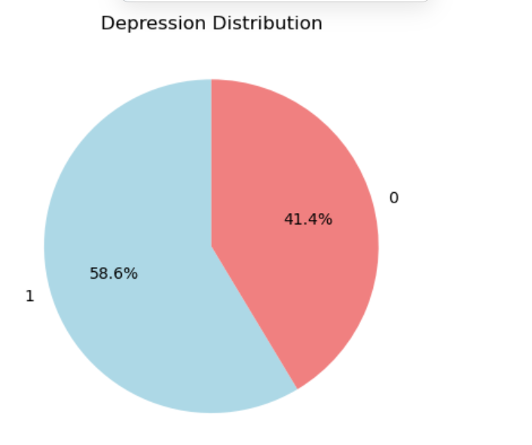
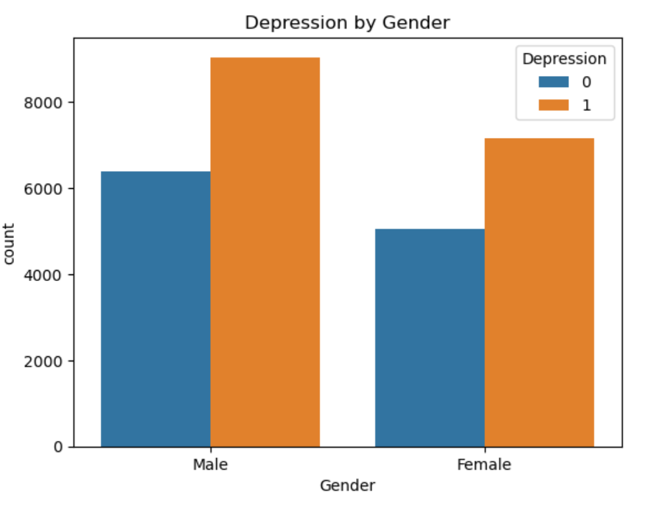
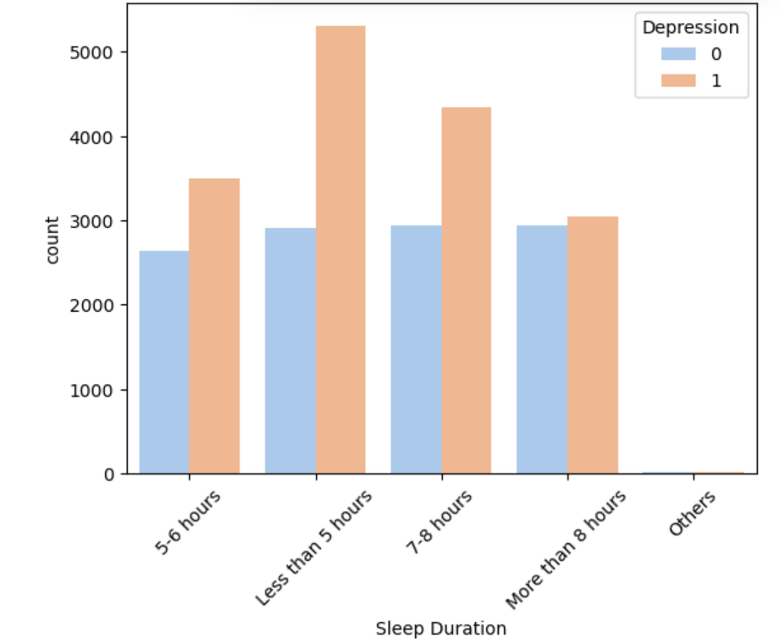
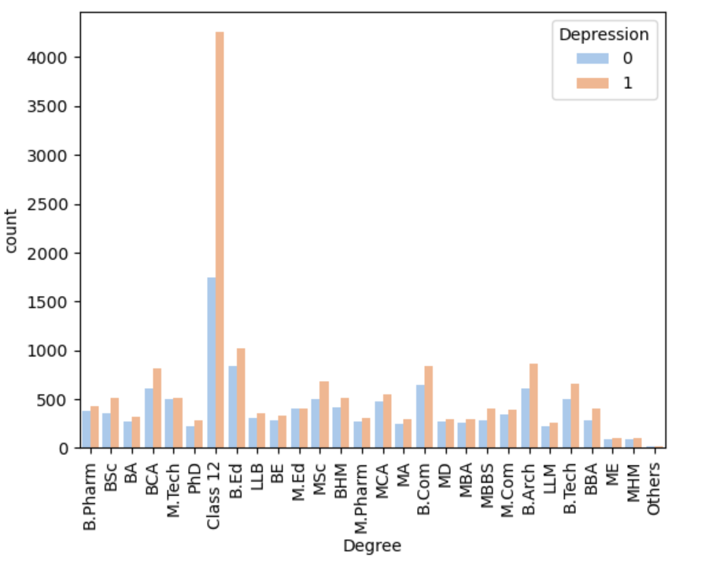
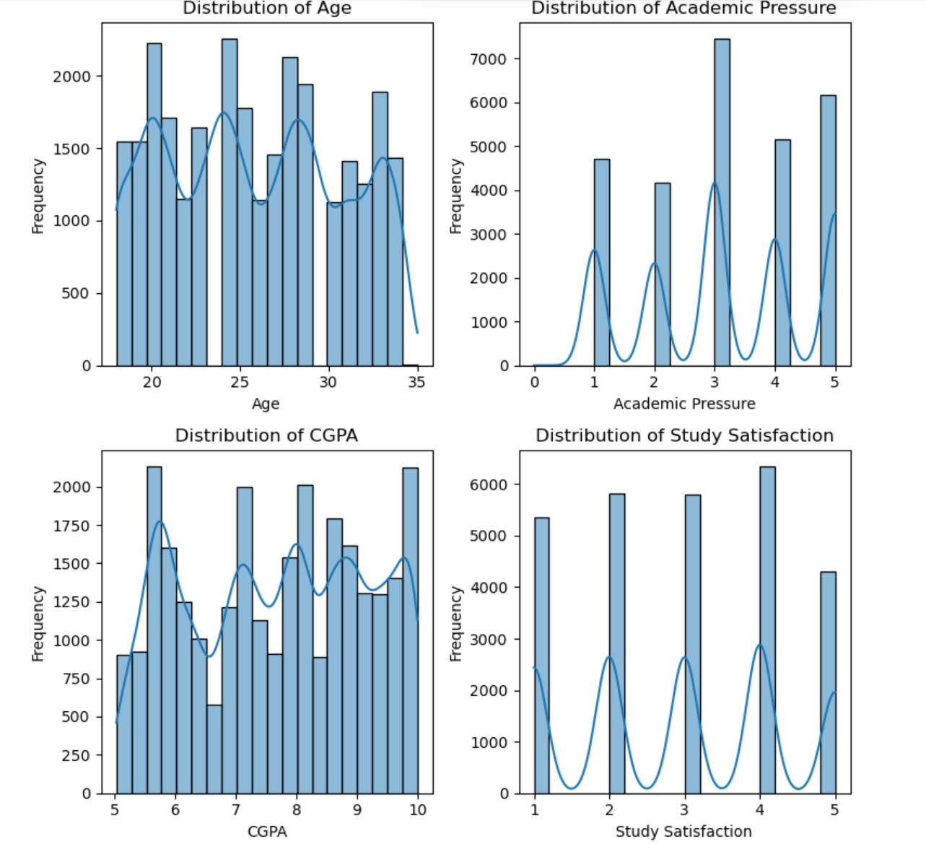
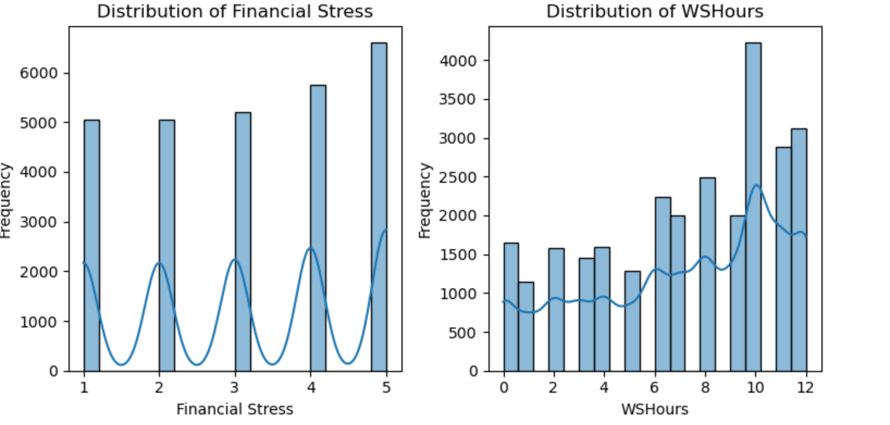
Data Insight

Slide 8
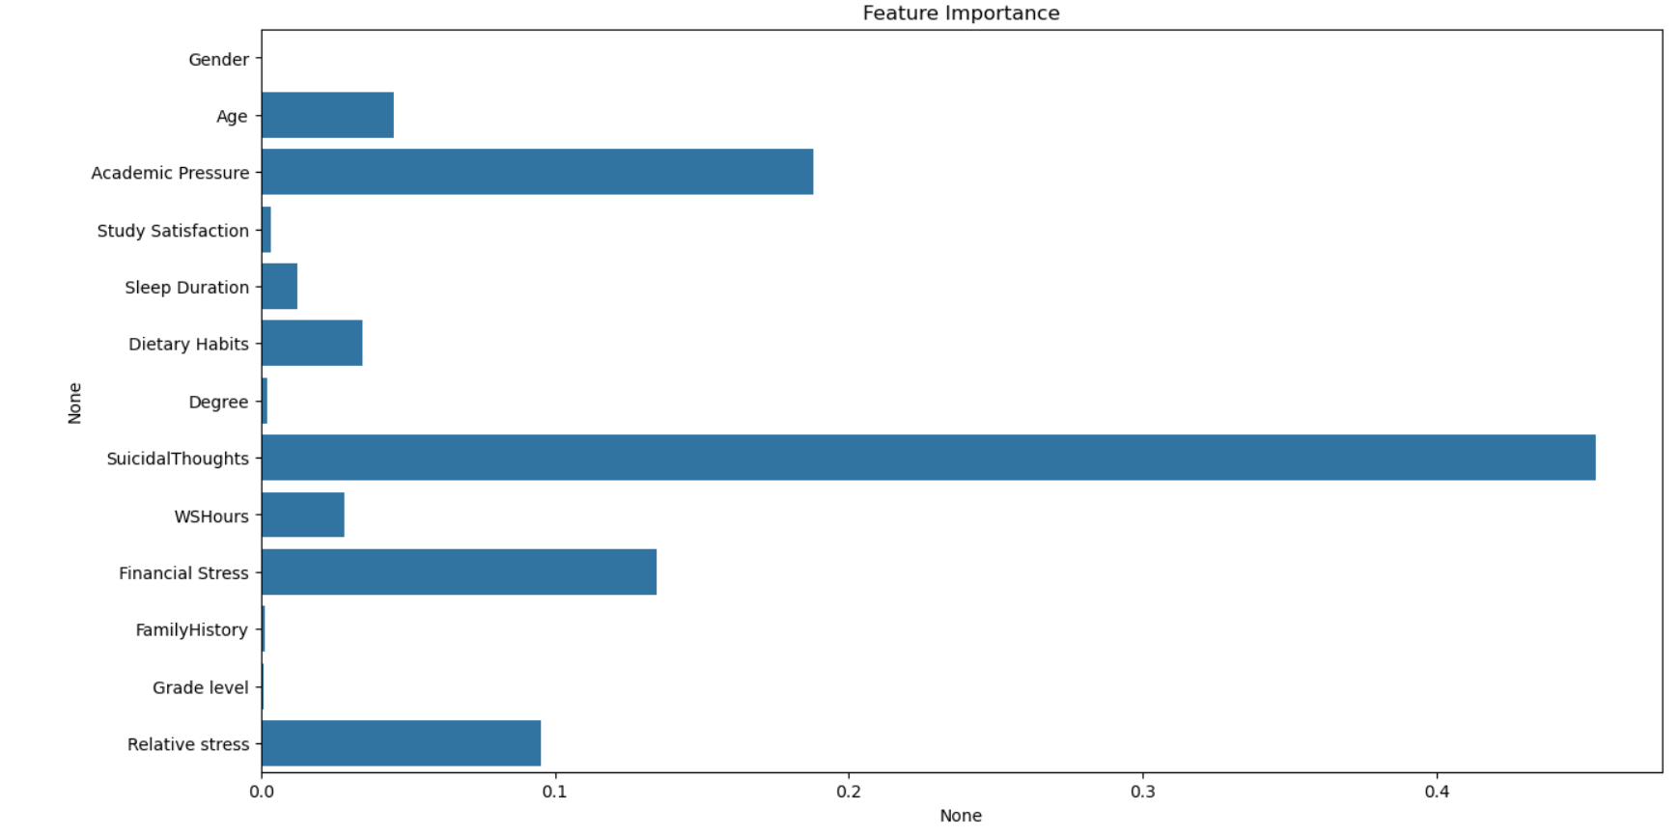
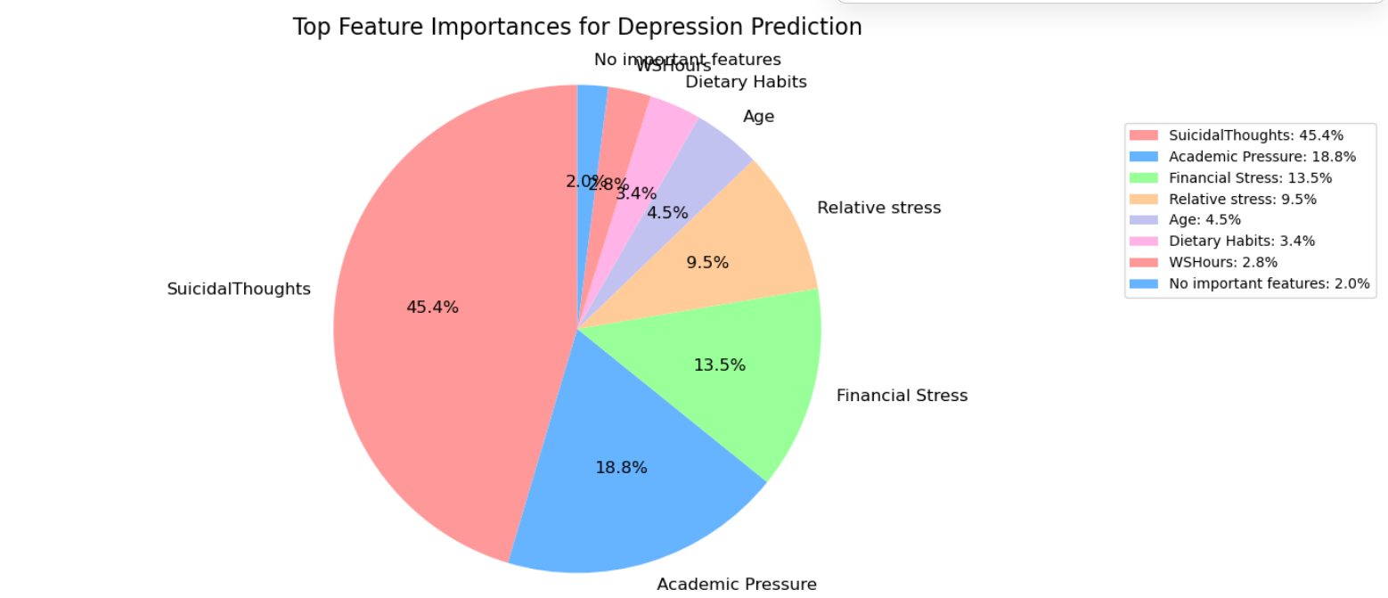
Data Insight(Conclusion)

Slide 9
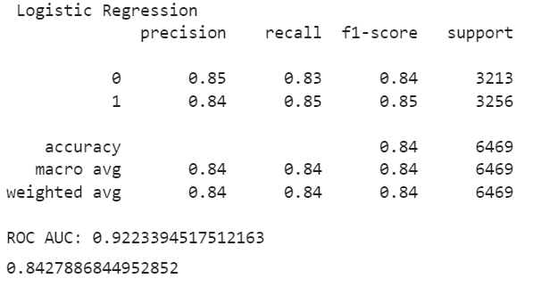
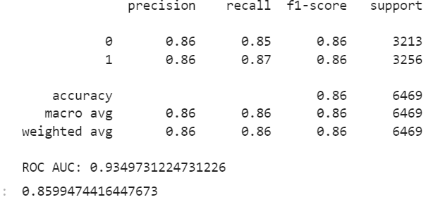
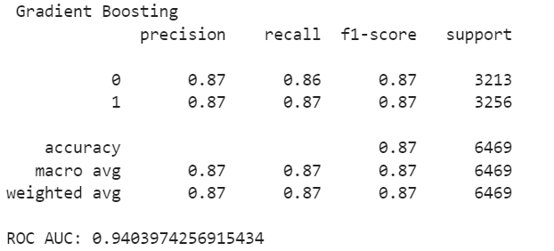
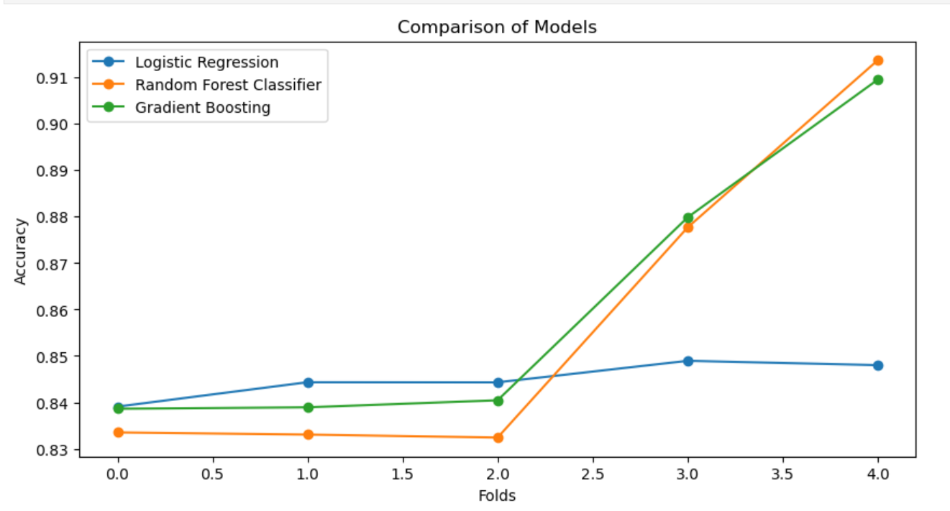

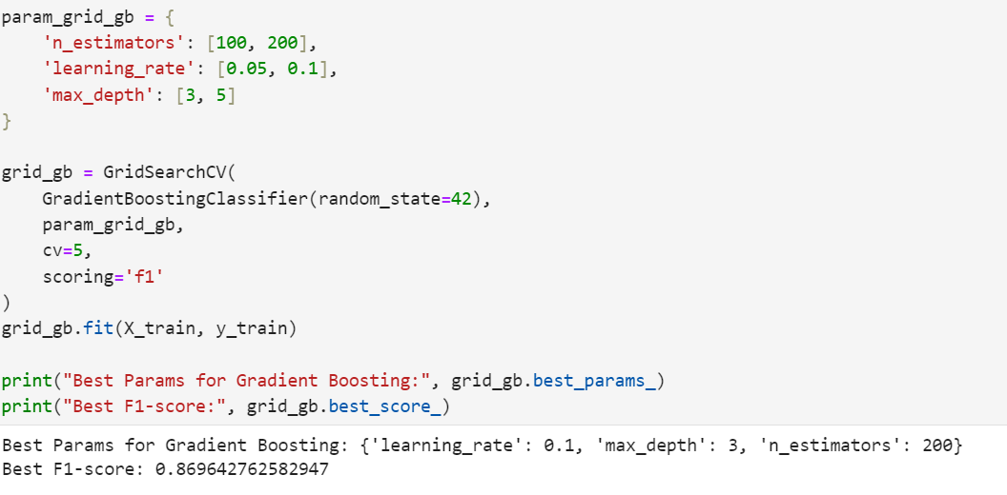
Model Select and Hyperparameter Tuning
Gradient Boosting

Slide 10
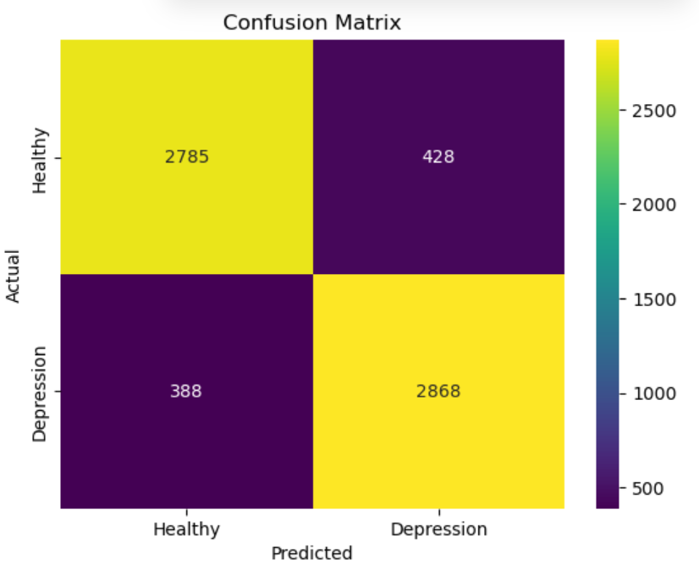
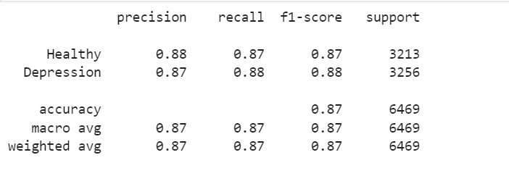
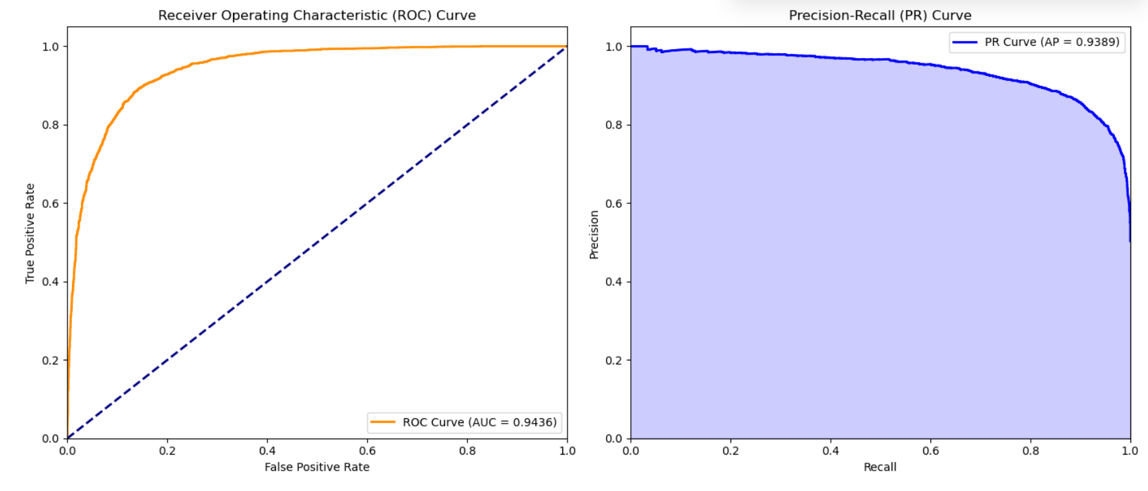
What was our outcome?
The metrics indicate
The model achieves an accuracy of 87%, with strong recall of 88% for class depression.
The ROC curve and PR curve perform well
These indicate effective identification of depression cases.
run into a failure in

Slide 11
Summary
The Gradient Boosting model can accurately identify samples of the target class with minimal misclassification of other classes as the target class.
Overall,the model efficiently and accurately classifies the class of Depression.And the model we created has excellent performance and can provide effective help in predicting students' depression.
Our model has effective identification of depression cases.Therefore, this model has obvious significance for predicting students' depression.

Slide 12

Next steps
Collaborate to refine input features based on clinical relevance and ensure diagnostic labels (ground truth) are accurate and consistent. Discuss the limitations of the labels used.
Define Clinical Utility: Make actively discuss such as How could this model realistically be used? (e.g., screening tool, risk stratification, monitoring symptom change, informing treatment selection). Define clear target use cases.
Aims for a tool (e.g., screening app, clinician decision support), design a small-scale pilot study in a realistic setting. Observe how clinicians or patients interact with it, assess usability, workflow integration, and gather qualitative feedback.

