Slide 1

凡渡_AWD对抗攻防平台

Slide 2
前 言
网络空间已成为国家继陆、海、空、天四个疆域之后的第五疆域，国防的战线也从物理空间延伸到网络空间，没有网络安全就没有国家安全。随着我国网络空间应用的不断普及以及对网络空间依赖程度的不断增加，我国在网络空间内所面临的现实和潜在威胁也不断提升。
网络安全的本质是人与人之间的对抗，普及网络空间基本安全知识，加大培养网络安全对抗人才，加强我国网络空间安全建设刻不容缓。

Slide 3
目录 / Contents
01
AWD比赛介绍
02
项目简介
03
项目架构
04
快速上手

Slide 4
01
AWD比赛介绍

Slide 5


Slide 6
1
《亲爱的，热爱的》视频剪辑

Slide 7

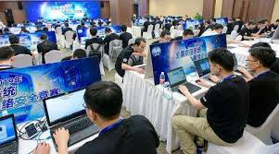
1
AWD比赛简介
AWD -> Attack with Defense
（攻守兼备）
网络安全技术人员在网络空间互相进行攻击和防守
既是hacker，
也是manager
挖掘网络服务漏洞并攻击对手服务来得分，修补自身服务漏洞进行防御来避免丢分。
是一种竞争激烈，具有很强观赏性和高度透明性的网络安全赛制

Slide 8
02
项目简介

Slide 9

2
项目简介
凡渡_AWD攻防对抗平台
凡渡_AWD攻防对抗平台是由 项目组成员 开发的 AWD 比赛平台，前端使用bootstrap框架进行web端界面的可视化，后端基于python-flask框架，持久化存储使用MySQL数据库。
本项目可以作为 CTF 线下比赛平台，亦可用于团队内部 AWD 模拟练习。

Slide 10
2
项目简介
标准化靶场
配合AWD平台编写标准化漏洞靶场docker，方便使用者生成各类漏洞环境
开源
高校,安全团队,安全爱好者免费使用和训练
使用文档
使用vue-press生成和编写项目配套使用文档，方便使用者快速上手和项目推广

Slide 11
2
安装方式
源码安装
Docker安装
1，下载源码
1，下载源码
git clone https://github.com/Cl0udG0d/testAWD
git clone https://github.com/Cl0udG0d/testAWD
2，安装运行依赖
2，docker启动
cd testAWD && pip3 install -r requirements.txt
cd testAWD && docker-compose up -d
3，初始化
3，访问
修改config.py数据库账号密码为本地账号密码，导入init.sql
浏览器输入127.0.0.1:5000进行访问
4，运行访问
运行python3 index.py，浏览器输入127.0.0.1:5000
访问AWD攻防对抗平台

Slide 12
03
项目架构

Slide 13
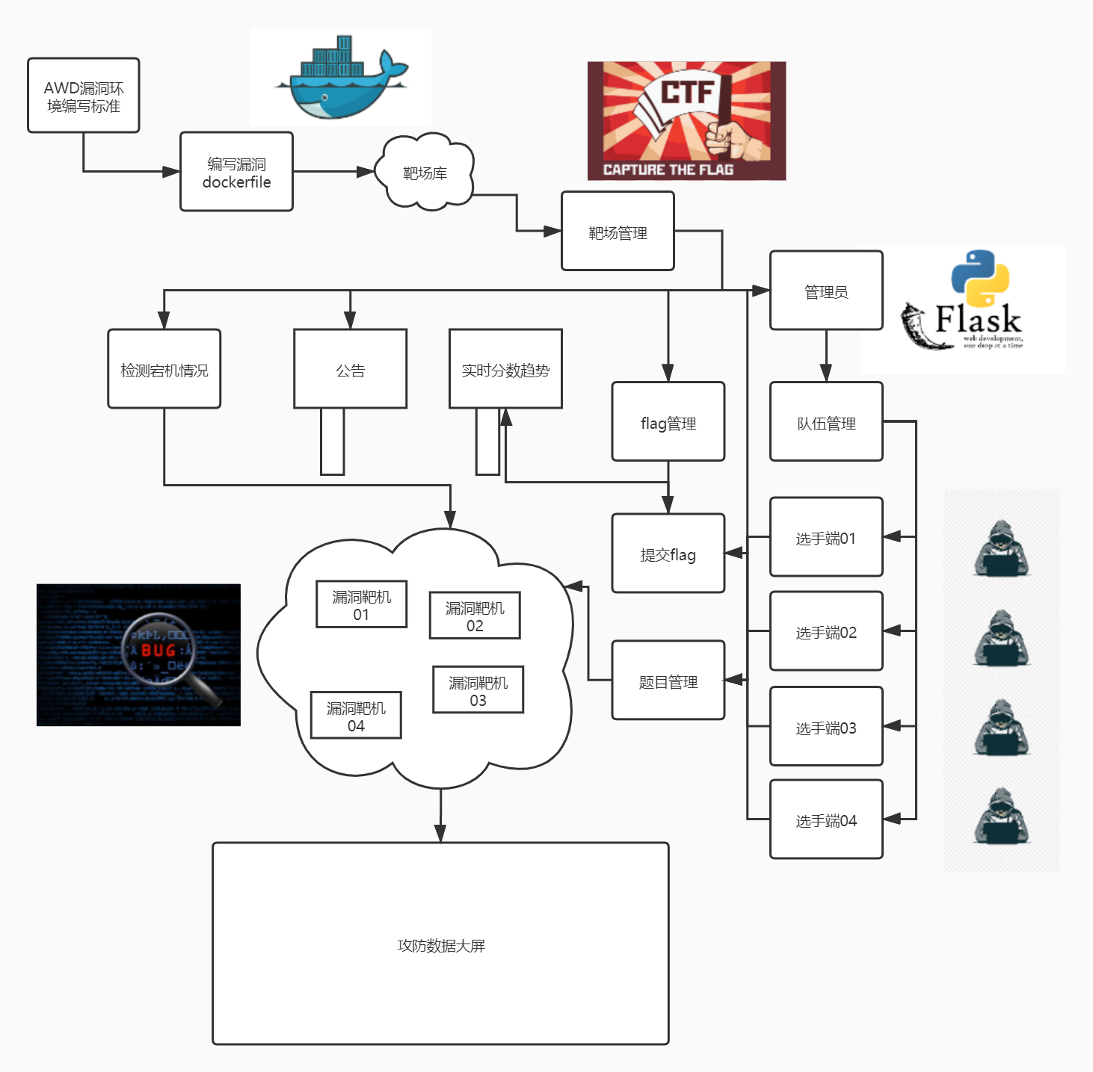
3
项目架构-架构图

Slide 14
04
快速上手

Slide 15
1
单击此处输入标题 / Click here to add your title
单击此处输入标题
单击此处输入标题
I love you more than I've ever loved any woman. And I've waited longer for you than I've waited for any woman.
I love you more than I've ever loved any woman. And I've waited longer for you than I've waited for any woman.
单击此处输入标题
单击此处输入标题
I love you more than I've ever loved any woman. And I've waited longer for you than I've waited for any woman.
I love you more than I've ever loved any woman. And I've waited longer for you than I've waited for any woman.

Slide 16

1
单击此处输入标题 / Click here to add your title
单击此处输入标题
When a cigarette falls in love with a match,it is destined to be hurt.When a cigarette falls in love with a match,it is destined to be hurt.
When a cigarette falls in love with a match,it is destined to be hurt.When a cigarette falls in love with a match,it is destined to be hurt.When a cigarette falls in love with a match,it is destined to be hurt.When a cigarette falls in love with a match,it is destined to be hurt.

Slide 17
1
单击此处输入标题 / Click here to add your title
输入标题
输入标题
输入标题
When a cigarette falls in love with a match,it is destined to be hurt.
When a cigarette falls in love with a match,it is destined to be hurt.
When a cigarette falls in love with a match,it is destined to be hurt.
单击此处输入标题文本
I love you more than I've ever loved any woman. And I've waited longer for you than I've waited for any woman.I love you more than I've ever loved any woman. And I've waited longer for you than I've waited for any woman.

Slide 18
02
单击此处输入标题文本
Remember what should be remembered, and forget what should be forgotten.Remember what should be remembered, and forget what should be forgotten.

Slide 19
1
单击此处输入标题 / Click here to add your title
输入标题
I love you more than I've ever loved any woman. And I've waited longer for you than I've waited for any woman.
I love you more than I've ever loved any woman. And I've waited longer for you than I've waited for any woman.
I love you more than I've ever loved any woman. And I've waited longer for you than I've waited for any woman.
I love you more than I've ever loved any woman. And I've waited longer for you than I've waited for any woman.

Slide 20




1
单击此处输入标题 / Click here to add your title
单击此处输入标题
单击此处输入标题
I love you more than I've ever loved any woman. And I've waited longer for you than I've waited for any woman.
I love you more than I've ever loved any woman. And I've waited longer for you than I've waited for any woman.
单击此处输入标题
单击此处输入标题
I love you more than I've ever loved any woman. And I've waited longer for you than I've waited for any woman.
I love you more than I've ever loved any woman. And I've waited longer for you than I've waited for any woman.

Slide 21
1
单击此处输入标题 / Click here to add your title
85%
73%
78%
90%
单击此处输入标题
I love you more than I've ever loved any woman. And I've waited longer for you than I've waited for any woman.
单击此处输入标题
I love you more than I've ever loved any woman. And I've waited longer for you than I've waited for any woman.
单击此处输入标题
I love you more than I've ever loved any woman. And I've waited longer for you than I've waited for any woman.
单击此处输入标题
I love you more than I've ever loved any woman. And I've waited longer for you than I've waited for any woman.

Slide 22
1
单击此处输入标题 / Click here to add your title
单击此处输入标题
单击此处输入标题
I love you more than I've ever loved any woman. And I've waited longer for you than I've waited for any woman.
I love you more than I've ever loved any woman. And I've waited longer for you than I've waited for any woman.
单击此处输入标题
单击此处输入标题
I love you more than I've ever loved any woman. And I've waited longer for you than I've waited for any woman.
I love you more than I've ever loved any woman. And I've waited longer for you than I've waited for any woman.

Slide 23
1
单击此处输入标题 / Click here to add your title
单击此处输入标题
单击此处输入标题
单击此处输入标题
单击此处输入标题
I love you more than I've ever loved any woman. And I've waited longer for you than I've waited for any woman.I love you more than I've ever loved any woman. And I've waited longer for you than I've waited for any woman.

Slide 24

1
单击此处输入标题 / Click here to add your title
单击此处输入标题
I love you more than I've ever loved any woman. And I've waited longer for you than I've waited for any woman.
单击此处输入标题
I love you more than I've ever loved any woman. And I've waited longer for you than I've waited for any woman.

Slide 25
1
单击此处输入标题 / Click here to add your title
单击此处输入标题
I love you more than I've ever loved any woman. And I've waited longer for you than I've waited for any woman.
单击此处输入标题
I love you more than I've ever loved any woman. And I've waited longer for you than I've waited for any woman.
单击此处输入标题
I love you more than I've ever loved any woman. And I've waited longer for you than I've waited for any woman.
单击此处输入标题
I love you more than I've ever loved any woman. And I've waited longer for you than I've waited for any woman.

Slide 26
04
单击此处输入标题文本
Remember what should be remembered, and forget what should be forgotten.Remember what should be remembered, and forget what should be forgotten.

Slide 27



1
单击此处输入标题 / Click here to add your title
单击此处输入标题
单击此处输入标题
I love you more than I've ever loved any woman. And I've waited longer for you than I've waited for any woman.
单击此处输入标题
I love you more than I've ever loved any woman. And I've waited longer for you than I've waited for any woman.
单击此处输入标题
I love you more than I've ever loved any woman. And I've waited longer for you than I've waited for any woman.

Slide 28
1
单击此处输入标题 / Click here to add your title
单击此处输入标题
I love you more than I've ever loved any woman. And I've waited longer for you than I've waited for any woman.
单击此处输入标题
I love you more than I've ever loved any woman. And I've waited longer for you than I've waited for any woman.
单击此处输入标题
I love you more than I've ever loved any woman. And I've waited longer for you than I've waited for any woman.

Slide 29
1
单击此处输入标题 / Click here to add your title
单击此处输入标题
I love you more than I've ever loved any woman. And I've waited longer for you than I've waited for any woman.
单击此处输入标题
I love you more than I've ever loved any woman. And I've waited longer for you than I've waited for any woman.
单击此处输入标题
I love you more than I've ever loved any woman. And I've waited longer for you than I've waited for any woman.

Slide 30
1
单击此处输入标题 / Click here to add your title
单击此处输入标题
I love you more than I've ever loved any woman. And I've waited longer for you than I've waited for any woman.
单击此处输入标题
I love you more than I've ever loved any woman. And I've waited longer for you than I've waited for any woman.
单击此处输入标题
I love you more than I've ever loved any woman. And I've waited longer for you than I've waited for any woman.

Slide 31
感谢观看

