Slide 1
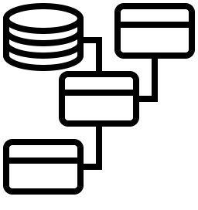


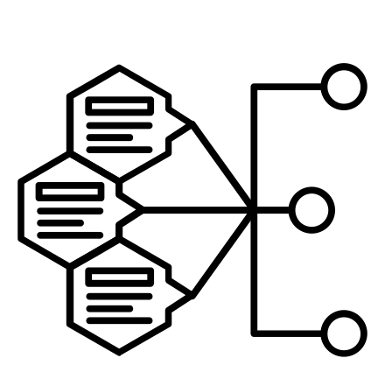




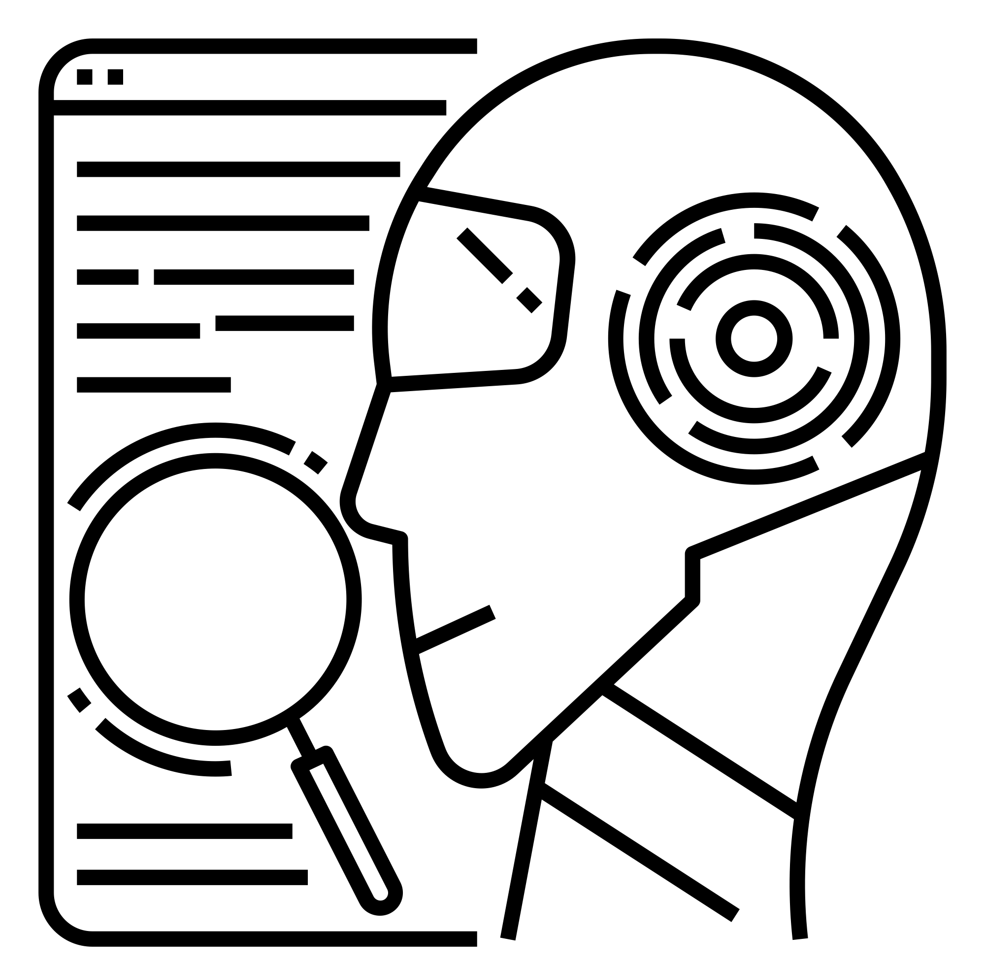



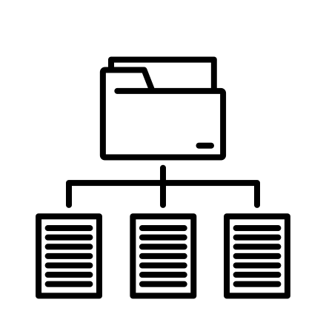
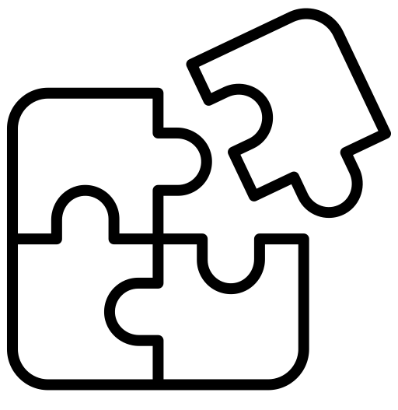
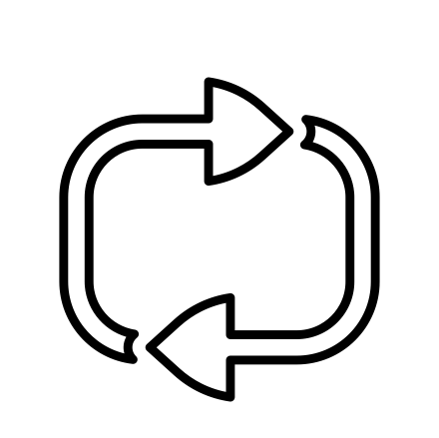
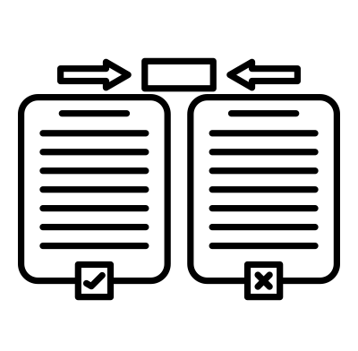
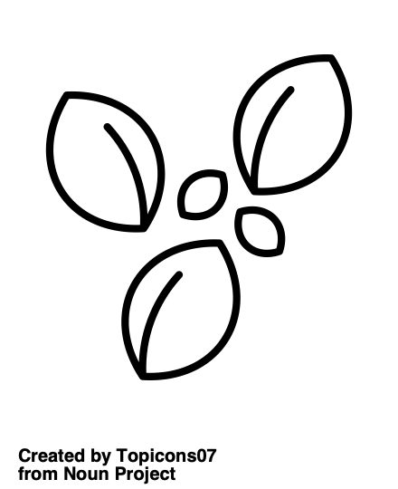

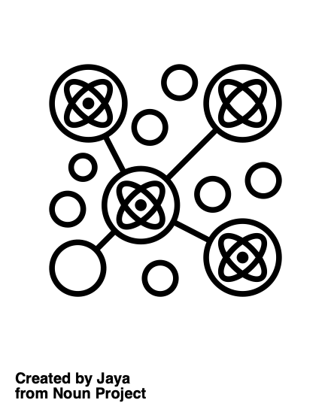


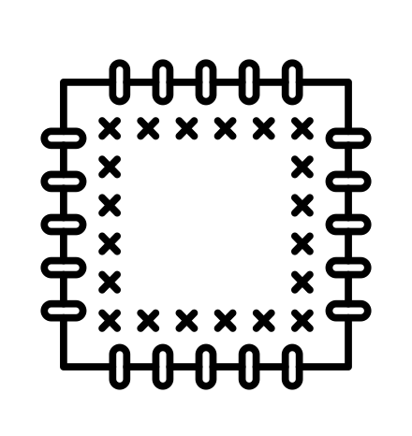

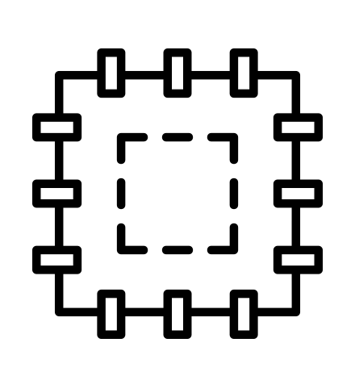

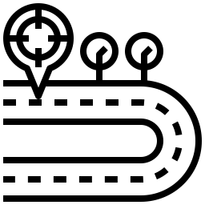
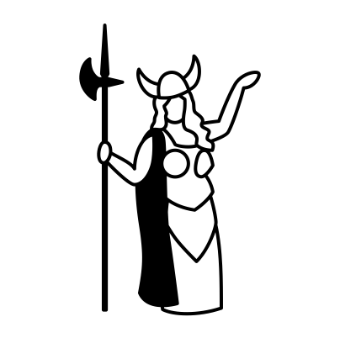

Analyzer
Analysis Graph
Fuzz Target
Analysis Service
source
binary
TOAST/OSS-Fuzz Project
Indexer
IND
DFG
CFG
CPG
Grammar Agent
QuickSeed
AFLoat
Jazzmine
Builder
binary
Crashes
binary
binary
Grammar Composer
binary
Grammar DB
Discovery Guy
Function Heatmap
SeedSync
Diff Guy
POV Guy
Corpus Tracer
Patcher Y
Verified Patch
Patcher G
Patch
Patcher Q
POI Guy
Diva
Verified Bug
Notes:
Note: I am showing a single component for the function indexer and the analysis graph, even though they are implemented separately
Source Code by Asep Jangkar from <a href="https://thenounproject.com/browse/icons/term/source-code/" target="_blank" title="Source Code Icons">Noun Project</a> (CC BY 3.0)
aggregate compile by Eucalyp from <a href="https://thenounproject.com/browse/icons/term/aggregate-compile/" target="_blank" title="aggregate compile Icons">Noun Project</a> (CC BY 3.0)
proof by Hay Lo from <a href="https://thenounproject.com/browse/icons/term/proof/" target="_blank" title="proof Icons">Noun Project</a> (CC BY 3.0)
plaster by sentya irma from <a href="https://thenounproject.com/browse/icons/term/plaster/" target="_blank" title="plaster Icons">Noun Project</a> (CC BY 3.0)
Point of Interest by Template from <a href="https://thenounproject.com/browse/icons/term/point-of-interest/" target="_blank" title="Point of Interest Icons">Noun Project</a> (CC BY 3.0)
plaster by sentya irma from <a href="https://thenounproject.com/browse/icons/term/plaster/" target="_blank" title="plaster Icons">Noun Project</a> (CC BY 3.0)
exe by iconade from <a href="https://thenounproject.com/browse/icons/term/exe/" target="_blank" title="exe Icons">Noun Project</a> (CC BY 3.0)
index by pexel verse from <a href="https://thenounproject.com/browse/icons/term/index/" target="_blank" title="index Icons">Noun Project</a> (CC BY 3.0)
ai grammar checker by WiStudio from <a href="https://thenounproject.com/browse/icons/term/ai-grammar-checker/" target="_blank" title="ai grammar checker Icons">Noun Project</a> (CC BY 3.0)
Puzzle by Alzam from <a href="https://thenounproject.com/browse/icons/term/puzzle/" target="_blank" title="Puzzle Icons">Noun Project</a> (CC BY 3.0)
database by kayaheart from <a href="https://thenounproject.com/browse/icons/term/database/" target="_blank" title="database Icons">Noun Project</a> (CC BY 3.0)
cluster by Jaya from <a href="https://thenounproject.com/browse/icons/term/cluster/" target="_blank" title="cluster Icons">Noun Project</a> (CC BY 3.0)
seed by Lars Meiertoberens from <a href="https://thenounproject.com/browse/icons/term/seed/" target="_blank" title="seed Icons">Noun Project</a> (CC BY 3.0) explosion by Musmellow from <a href="https://thenounproject.com/browse/icons/term/explosion/" target="_blank" title="explosion Icons">Noun Project</a> (CC BY 3.0)
Heatmap by SeeMoo from <a href="https://thenounproject.com/browse/icons/term/heatmap/" target="_blank" title="Heatmap Icons">Noun Project</a> (CC BY 3.0)

