Slide 1
CODE FELLAS HACKATHON
DECODING DNA ENCRYPTION
EMBEDING IN AN IMAGE

Slide 2
WHAT IS DNA CRYPTOGRAPHY
DNA Cryptography can be defined as a technique of hiding data in terms of DNA sequence.
DNA Cryptology users have DNA algorithms like “Public-key system using DNA as a one-way function for key distribution,” “DNASC cryptography system”, DNA Steganography Systems, Triple stage DNA Cryptography, Encryption algorithm inspired by DNA and Chaotic computing.

Slide 3
How Encoding is Done
Data is encoded in a DNA strand which is mainly made, up of 4 nitrogenous bases namely
Adenine (A)
Thymine (T)
Cytosine (C)
Guanine (G)

Slide 4
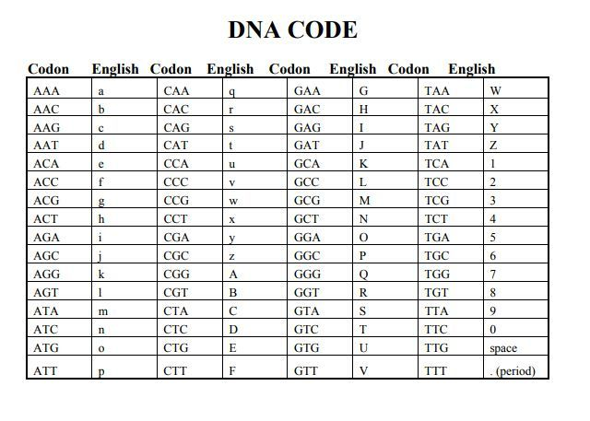
DNA CODE

Slide 5
USES OF DNA ENCRYPTION
DNA cipher can be used in encrypted communication
DNA cipher can be used in steganography
DNA cipher can be used for authentication
DNA cipher can be used in Digital signature

Slide 6
THANK YOU
<Git hub>
https://github.com/ClaMor21/DNA_DECODER.git

