Slide 1




Trying to estimate web behaviors after GDPR regulation
Charles LIETAR - Omar EL HAJJAR - Clara JOUY - Xavier MELLEVILLE - Hojun JUNG

Slide 2
01
02
03
Framing the project
Segmenting our data
Building our test data
TABLE OF CONTENTS
04
05
Modelling and selecting
Recommending final solution
What are Peugeot’s needs?
What solution can we offer?
What is the overall approach?
What different patterns can we find among the web sessions? How to mathematically capture them?
How to construct the closest dataset from the incoming reality and understand how reliable our predictive solution can be?
How to predict web behaviors? What different models can we build and what could be the best one?
How can Peugeot use the global predictive solution to drive business value?

Slide 3

01
Framing the project

Slide 4

Tracking online data is more difficult
Data loss in tracked traffic is growing
Understanding web visitors’ behaviors is harder
Problem Statement
With the GDPR regulations evolving since May 2018, the
usage of cookies to track online data has become more
difficult.
Since more and more users either refuse all or do not give
preferences, the non tracked traffic on the website has
become more important.
Peugeot will lose a large volume of web visitors information, making it harder to understand their online behaviors
Extract historical patterns
Estimate overall user behaviors
Our Goal
By modelling daily captured patterns, the objective is to estimate overall user behaviors on a given day
Using historical user sessions with tracking consent, the goal is to capture session patterns on a daily level

Slide 5
4 target KPIs to quantify user behaviors
Specific metrics have been selected to mathematically quantify daily user behaviors on Peugeot’s website :
Qualified sessions
Sessions with vehicle
% of sessions during which the user did not bounce
% of sessions during which at least one vehicle was seen by the user
Started configurations
Engaged configurations
% of sessions during which the user started a vehicle configuration but did not finish it
% of sessions during which the user started a vehicle configuration and finished it

Slide 6

Our data
User sessions with tracking consent until 08/08/2020, described by more than 40 attributes (number of hits on product pages, number of product added to the cart, which vehicle pages the user consulted…)
Historical sessions are split into training and test sessions
Training sessions: to learn session patterns and thus to model the overall user behaviors
Period: 558 days
from 01/01/2019
until 11/07/2020
Test sessions: to simulate the tracked data loss and evaluate the target KPIs predictions
Period: 28 days
from 12/07/2020
until 08/08/2020

Slide 7
Pipeline
How to group similar sessions?
How to segment days?
How to retrieve similar days ?
Using clustering algorithms
Using clustering algorithms as well
Using distance computation with the days from the same cluster
Clustering
Describing
Segmenting
Simulating
Comparing
Extrapolating
How to describe a day using its sessions ?
How to simulate real data for test?
How to predict the KPIs ?
Using its session-cluster mix
Sampling the sessions for a given test day
Using empirical and statistical extrapolation methods
INPUT
MODEL
OUTPUT
Web Sessions of a given day with data loss
KPIs estimations for that day

Slide 8
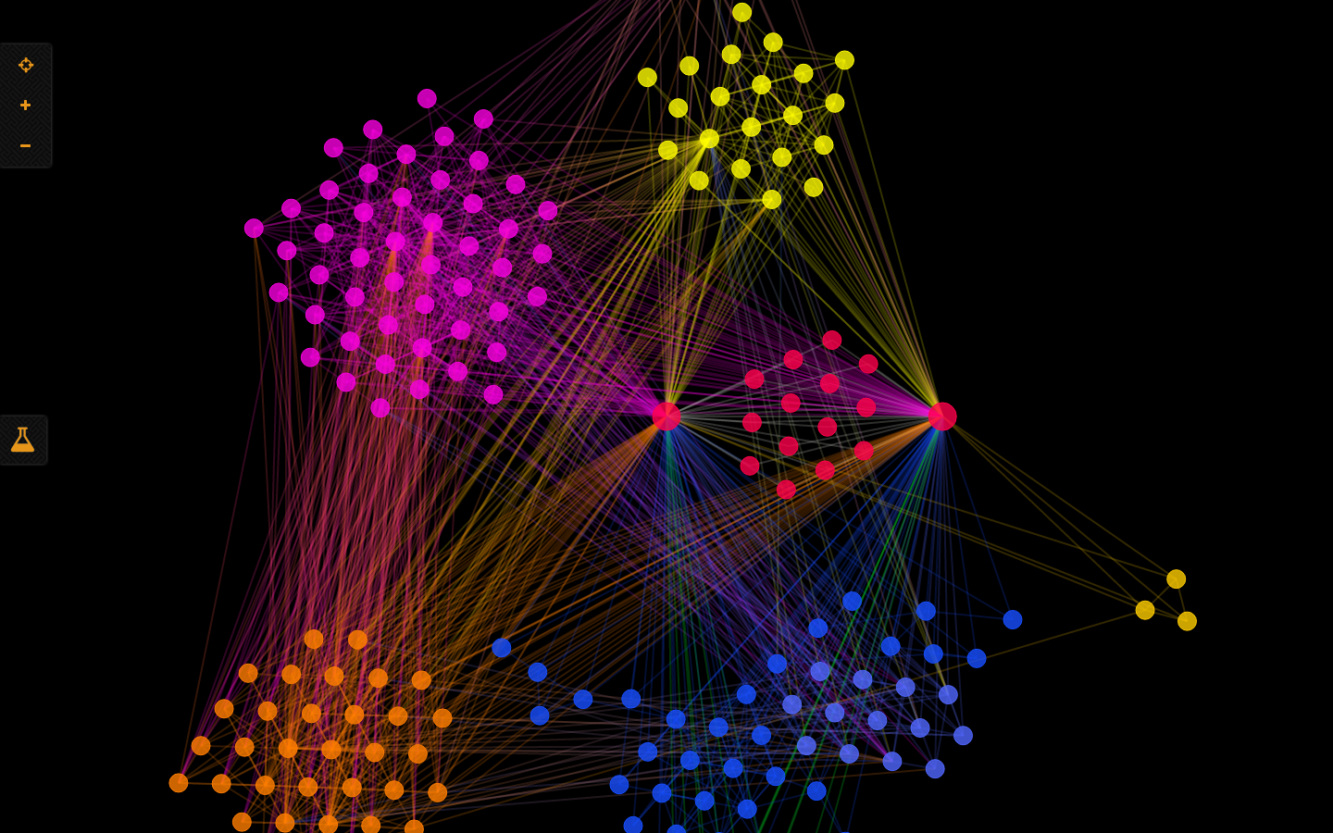
02
Segmenting our data

Slide 9
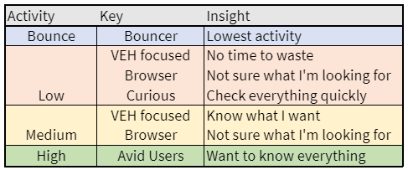
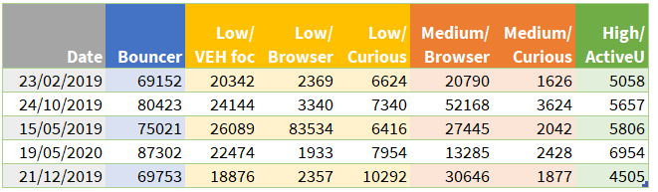
Clustering the sessions
From a session to a daily level
Initial database
About 25 KPI’s describing each sessions (hits, date, medium….)
Data
Preparation
(encrypting...)
KNN & Mini-
batch clustering
(maximization of inter-cluster distance)
7 ‘types’
of sessions
(see right)
Grouping
by
day
Final test and training databases qualify each day by the “types” of sessions that occured at this date
Daily level database

Slide 10
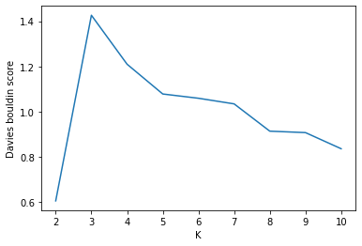
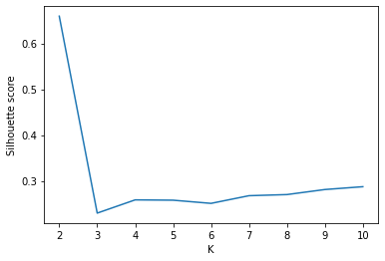
Segmenting the days - Approach
From sessions definitions to days definitions
Model building
Technical testing
Interpretability
Results
4
1
2
3
Model: Agglomerative clustering
# of clusters: 5
Result of a trade-off between performance and interpretability
Test of 3 clustering algorithms’ performances for 2 to 10 clusters:
- K-Nearest Neighbors
-Birch algorithm
-Agglomerative clustering algorithm
Filtering the best algorithms with 2 measures of internal and external dispersion within/between clusters (one based on days, the other based on clusters)
Selecting the final algorithm on 3 interpretability criteria:
-The number of cluster
-The size of each cluster
-The interpretability of each cluster
Agglomerative clustering Davies Boulding score (left) and Silhouette score (right)
←
To Minimize
To Maximize →

Slide 11
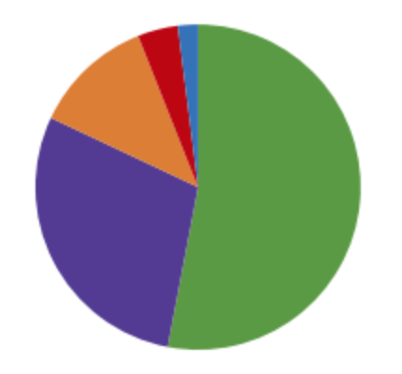
Day-cluster presentation: overview
Our five clusters :
Active days
Pop-in days
Research days
Advanced interactions days
Configurations days
RESEARCH DAYS (4%)
POP-IN DAYS (2%)
ADVANCED INTERACTIONS
DAYS (12%)
ACTIVE DAYS (53%)
CONFIG DAYS (29%)
Key insights on their distribution :
Pop-in Days | The highest variance The highest rate of bouncers The largest number of sessions with at least one vehicule seen during the day: probably due to online advertising campaigns
Active & Research days | The longest time on the website Quite consistent (low variance)
Interactions & Configurations days | The greatest interaction with the website : The largest number of configurations started and engaged The largest number of product details seen

Slide 12
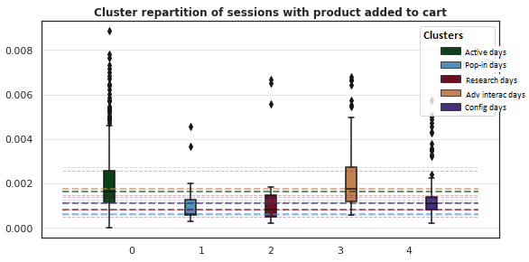
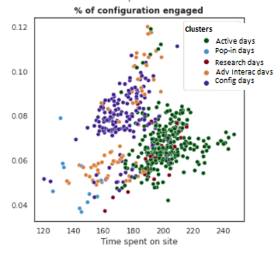
Day-cluster details
Active Days:
Majority of sessions of curious, browsers and avid users :
54.6% of sessions from ‘Curious’
4% of sessions from ‘Avid Users’
Pop-In Days:
Majority of sessions oriented toward vehicules :
39.5% of the sessions from ‘VEH focussed’
Research Days:
27% of sessions from ‘Browsers’
Lots of ‘VEH focussed’
Advanced Interaction Days:
Few time spent on the website
Lots of ‘VEH focussed’ and ‘Curious’ with few but targeted interactions
Configuration Days:
Mainly VEH focussed engaging with the brand
Lowest number ‘Curious’ with low interactions
Figure 1, Scatter plot :
The advanced interactive days and the configuration days have a better ratio of engaged session/ time spent on site than other clusters.
Figure 2, boxplot:
The active days cluster, the advanced interactive days and the configuration days are days during which more products are added to cards.

Slide 13

03
Preparing test data

Slide 14
Preparing test data - Approach
1. SAMPLING TEST DAYS
Shifting from session-level to day level on test data : we simulate the tracked data loss due to new cookie consent banner, by keeping a sample of the test session in a given day
2.DESCRIBING THEM WITH SESSION-CLUSTER MIX
Calculating session-cluster repartition: we describe them by their session-cluster mix as we did for the training days
3. BUILDING DAY-CLUSTER CLASSIFIERS
Constructing day-cluster predictive models using the training days : we evaluate different multi-class classifiers to best predict on which day-cluster a given day can fall in
4. SELECTING BEST MODEL & DEPLOYING IT
Keeping the most accurate day-cluster classifier : we keep the best predictive model and deploy it on the sampled test days to predict their day-cluster

Slide 15
Sampling test days and describing them
 | Days | Cluster Number
1. | Day 1 | 3
2. | Day 1 | 3
3 | Day 1 | 2
... | ... | ...
10. | Day 1 | 1
11. | Day 2 | 2
12. | Day 2 | 4
13. | ...
Days | Session Cluster1 | Session Cluster2 | ... | Session Cluster5
Day 1 | 30% | 15% | ... | 25%
Day 2 | 23% | 40% | ... | 12%
...
Day 28 | 13% | 50% | ... | 10%
Day Cluster
???
???
???
For each test day,
Randomly choose 70%
of sessions
Get Repartition
Goal:
Predict Day Cluster using training days with their day-cluster
1
Dataset:
Test sessions
2
Result:
70% Samples Repartition
3

Slide 16
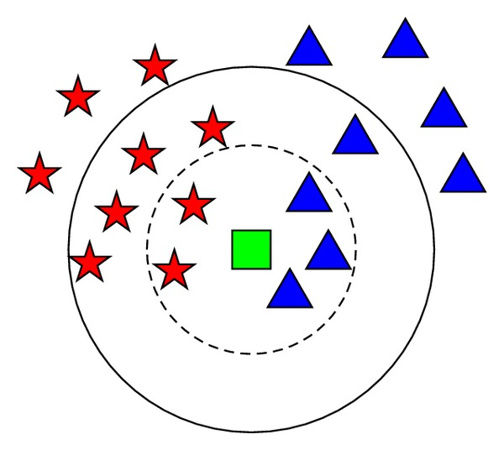
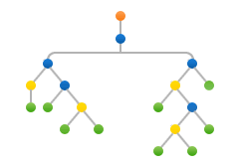
1
Predicting day-cluster on sampled test days
BUILDING
Constructing day-cluster classifiers using 2 methods by learning the classification rule from the training days, described by their session-cluster repartition
2 different methods :
2
SELECTING
Checking accuracy metrics, and selecting the best method with optimal hyperparameters
Instance-based with K-Nearest neighbors
Tree-based with a single decision tree
3
Selected classifier : K-Nearest neighbors with K = 2
DEPLOYING
Deploying selected day-cluster classifier on the sampled test day to predict their cluster

Slide 17

04
Modelling and Selecting

Slide 18
Introduction and extrapolation techniques
We have now:
The sampled test days, where we have tracked only 70% of the sessions, representing the kind of tracking per days we might have after new GDPR implementation.
The cluster these sampled test days belong to and the k most similar days from them we can find in our training set (ie. the days for which we could track all the sessions)
The 4 target KPIs we want to predict for each of these similar days
What we have and what is left to do:
INPUT
Sampled days from the test dataset
4 target KPIs
(for each similar days)
K most similar days
(in train set, with distance function)
25 attributes (sampled) characterizing the traffic on the website
25 attributes characterizing the traffic on the website
OUTPUT
Extrapolation techniques
4 target KPI’s for the sample days
Simple average
Average ponderated by the distance between test and the k similar training days
Linear regression trained on the similar days

Slide 19
Model performance evaluation & selection
Defining how to measure the distance from one given day to its k-nearest days within its cluster
Computing predictions on KPI’s for the three pre-selected extrapolation methods
Comparing the performance of each method for each KPI by computing 2 types of error rates.
1
2
3
4
5
4 distances tested (different mathematical implications):
- Braycurtis
- Euclidean
- Correlation
- Canberra
Defining the k number of nearest days we use for the extrapolation.
Between 5 and 100.
3 preselected models:
-Average
-Ponderated average
-Linear regression
1. Mean Squared Error (MSE): average variance between prediction and true value → More consistent
2. Mean Absolute Percentage Error (MAPE): average percentage of difference from the true value in the sample → More interpretable
Comparing the prediction based on each sampled days VS the true value of the same entire days

Slide 20
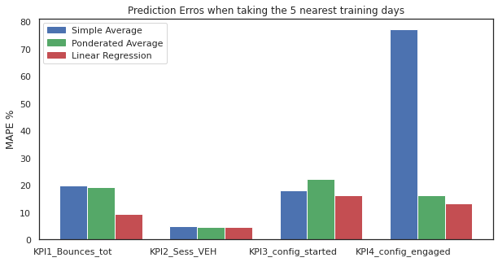
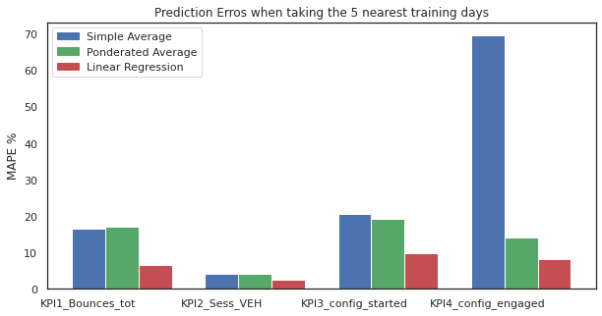
Model comparison : example
Model A | Model B
Distance methodology: Euclidean distance K-Nearest days : 5 days Extrapolation methodology : Test of the 3 methods | Distance methodology: Canberra distance K Nearest days : 5 days Extrapolation methodology : Test of the 3 methods
→ The Canberra distance seems to perform better in average
→ We can see that it improves a lot the performance of the linear regression model

Slide 21
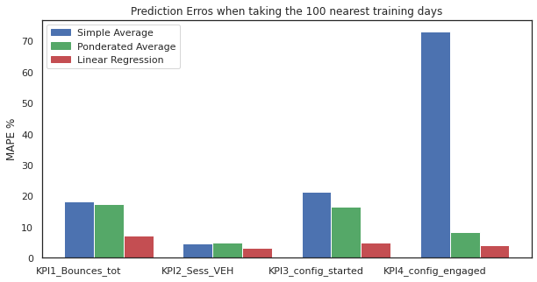
Final step and results
Best hyperparameters:
Distance methodology: Canberra distance
K-Nearest days : 100 days
Extrapolation methodology : linear regression for the 4 KPI’s
Final MAPE error rates for each KPI’s:
Bounce rate: 7.4%
Session with vehicule: 2.9%
Configuration started: 3.7%
Configuration engaged: 3.4%
Impact of increasing K on performance: a consequent error reduction

Slide 22

05
Recommending final solution

Slide 23
Adopting a 6-step approach
4 KPI’s to predict
Predicting some specific insights on the users’ activity of Peugeot’s website after the new version of GDPR implementation in 2021, while we were no longer able to track the activity on the website from users who refused cookies tracking.
The bounce rate for the day
The rate of sessions with at least one vehicle seen for the day
The rate of vehicle configuration started during the day
The rate of vehicle configuration engaged during the day.
1
Cluster the days of the training sessions
2
Sampled days from test sessions
3
Predict their day-cluster
Find their nearest training days using the clustering
Evaluate the predictions with the true value
4
5
Extrapolate their KPI’s with those nearest days
6

Slide 24
Opting for a robust model with linear regression
Model selected :
Distance : Canberra
K-nearest days chosen : 100 nearest days
Extrapolation method : linear regression
Error rate for each KPI’s:
Bounce Rate: 7%
>1 vehicule consulted: 2.9%
Configuration started: 3.7%
Configuration engaged: 3.4%
How can we use it ?
Example with August 08th, 2020
The predictions are quite accurate.
We can see that the error rate on the configuration started is quite higher than expected for the percentage of session with at least one vehicule consulted, but it is normal as long as the percentage error indicated above are averages.
KPI
Bounce Rate
>1 vehicule consulted
Configuration started
Configuration engaged
True Value
35.4%
49.8%
7.9%
5.3%
Predicted Value
37.9%
45.8%
7.5%
5.4%
Error rate
2.5%
3.0%
0.4%
0.1%

Slide 25
A methodology to be tuned
2 hyperparameters in our modelling approach:
K: number of nearest days to select
Distance function: method to compute how far a day is from another
Possible to find optimal K with iterative approach, and try other distance computation methods using probabilities
Tuning hyperparameters
To extrapolate the KPIs, only empirical and simple methods were tried
Other regression techniques with more complexity could be tried (tree-based methods, support vector machines..)
Trying other extrapolation methods
More than 40 variables were used to describe a session.
Some must have more importance across all algorithms used in the methodology, than other features.
Different techniques could be used to extract the modelling power of each feature, and get more transparency.
Getting the features’ importance

Slide 26
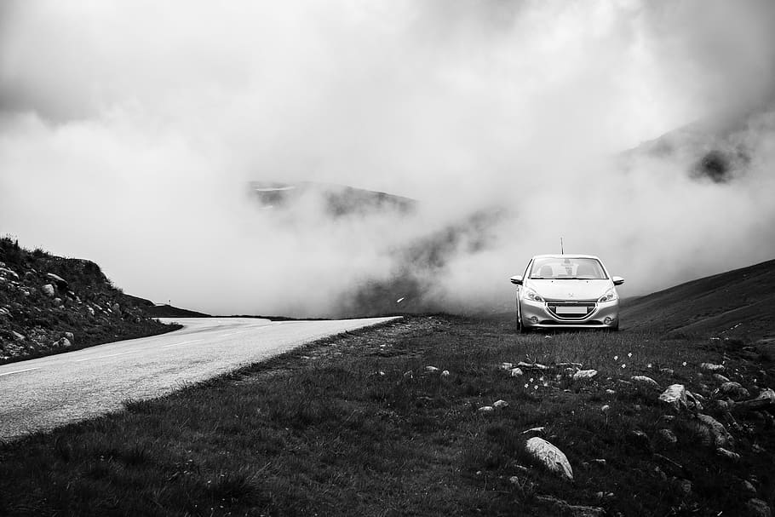

Thank you for listening!

