Slide 1
Data Science Midterm Project
Machine Learning – Model Implementation

Slide 2

Data – Info - EDA
DATA FILES

Slide 3
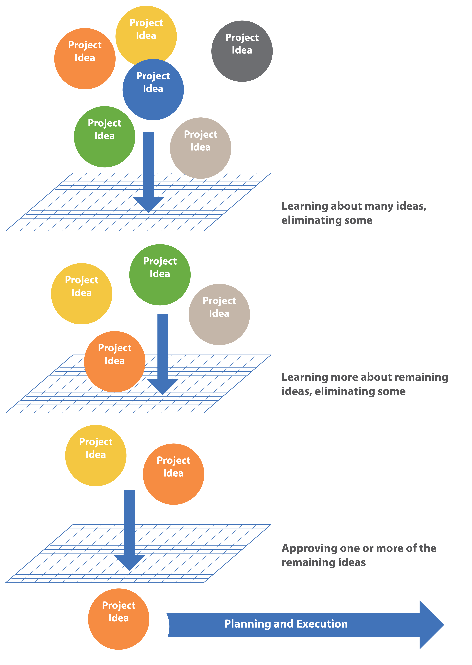
Model Selection
This Photo by Unknown Author is licensed under CC BY

Slide 4
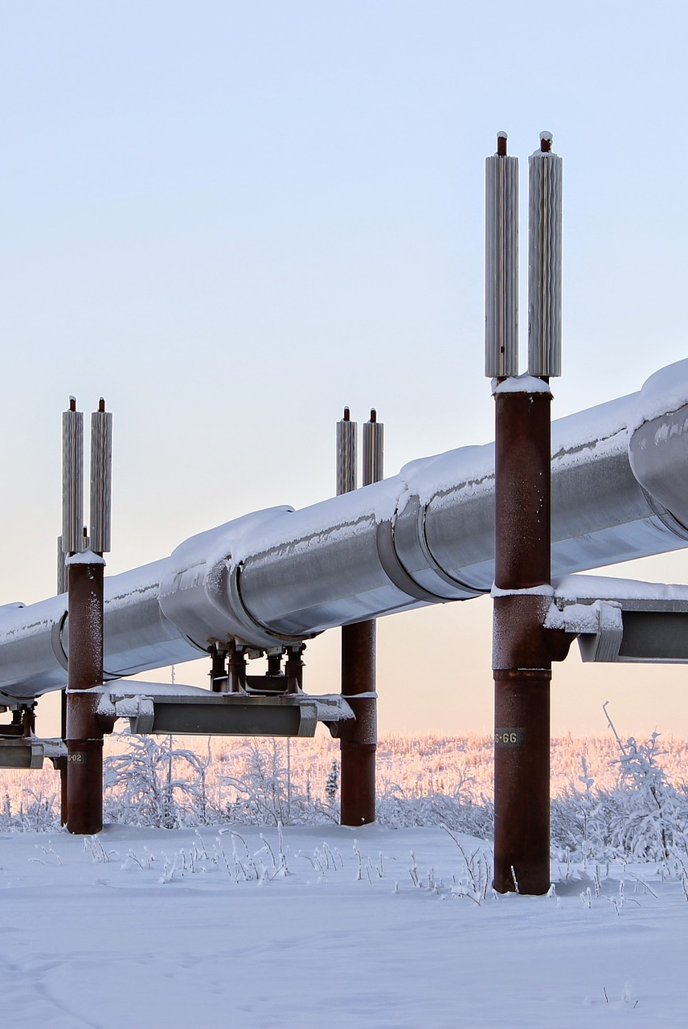
Tuning & Pipelining
M
This Photo by Unknown Author is licensed under CC BY

Slide 5

???
Data

