Slide 1
Endpoint Routing Deep-Dive

Slide 2
About Me
Ryan Nowak
Developer and Architect on ASP.NET Core
Part of .NET Core before .NET Core was .NET Core ☺
@aVerySpicyBoi
https://github.com/rynowak/Presentations/

Slide 3
Agenda
Why would we rewrite routing?
How does it work?
Performance?
How do we make big changes?

Slide 4
Why routing?
Routing is at the heart of everything – we make other decisions based on what routing decides
Routing is the idea that you can give structure to pieces of app functionality

Slide 5
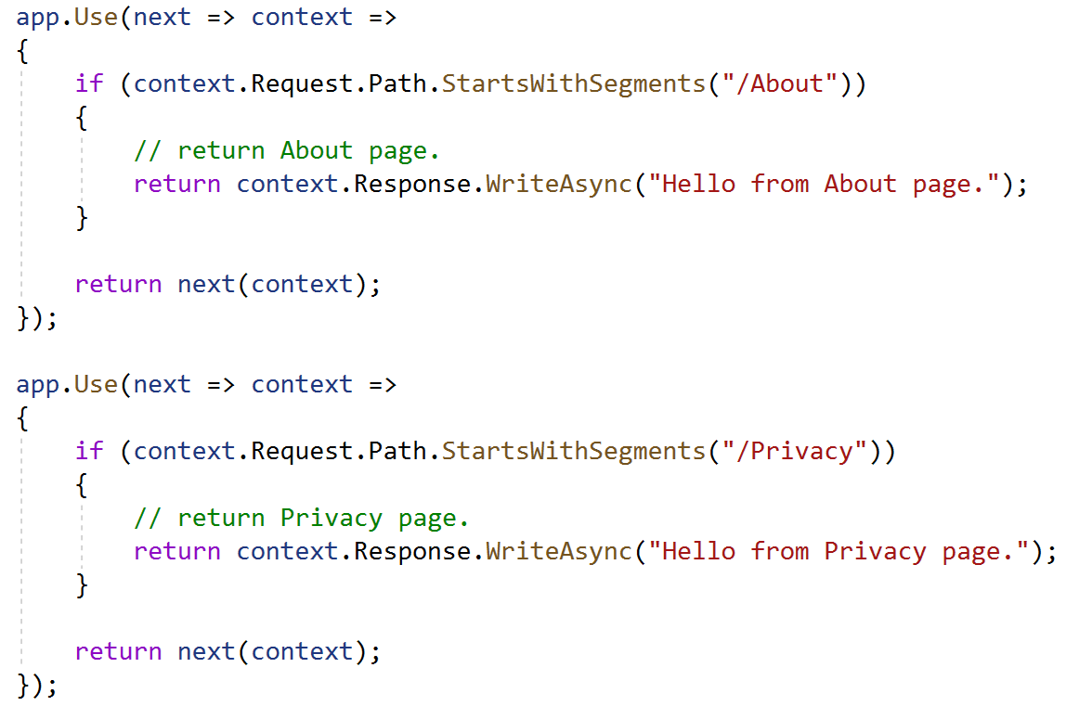
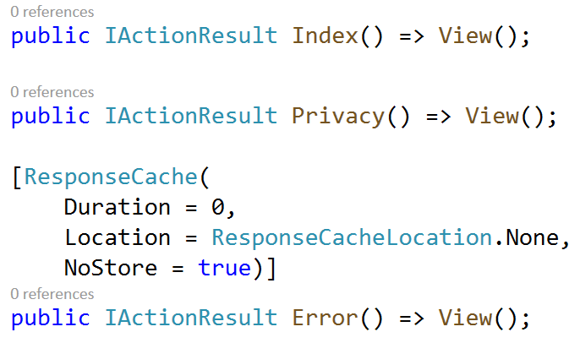
Unstructured VS Structured
Unstructured
Structured

Slide 6
Structured Systems
When would you want a structured system?
Better Scalability
Conceptual
Performance
Metadata

Slide 7
Story Time: Why replace routing?

Slide 8
Why replace routing?
Old version didn’t integrate with middleware
Duplication of functionality between MVC, SignalR, Middleware
All useful extensibility is in MVC
We were planning to add gRPC and Server-Side Blazor
SignalR had already reimplemented routing
Conclusion: old routing wasn’t a good foundation
We (and others!) frequently need to add request-handling functionality
This needs to be configurable by the app developer
Do we use MVC for this? Middleware?

Slide 9
Endpoint routing
Universal representation of “Endpoint” as:
Request Handler
Metadata
Middleware are coupled to their own metadata instead of frameworks
Cross-cutting concerns are cross-cutting again
Any Endpoint is as “first-class” as any other
Separate phases for selection and execution
Allows middleware to run “in-the-middle”
Selection criteria can be arbitrary
Your routing system is as good as ours if result is an endpoint

Slide 10
Routing Implementation
If we’re going to make a new routing implementation, we want it to be as good as possible
Goals:
Close to middleware performance
Make MVC much faster
Better scalability for large number of endpoints
Zero allocation for simple cases

Slide 11
Routing Implementation
Raw Throughput
Simple route tables
Overhead must be minimal
No extensibility required
Complex backend applications
Large route tables
Overhead should be low
Uses existing extensibility like constraints
CMS (complex frontend applications)
Must be able to write custom code
Overhead not a factor
Usually does database lookups (async)

Slide 12

Routing Implementation
I hope you brought your safety goggles

Slide 13
Demo: Let’s see that tree

Slide 14
Routing Implementation
Idea: represent URL space as a tree
Each path segment is an edge
This gives us O(N) decisions based on number of URL segments
Plaintext is a single segment
Big route tables tend to be wide not deep
Seems like O(N) based on depth is a good idea
Idea: prevent backtracking
Previous routing implementation was a tree with backtracking
Backtracking requires allocations
Recursion and async amplifies async overhead
Tree is processed synchronously

Slide 15
Routing Implementation
Nodes are structs instead of reference types
Nodes are packed into an array and use indexes to refer to each other
More cache-friendly than references
More frugal with memory than references
Heavy use of C# 7.2 features like ref-locals

Slide 16
Routing Implementation
To move between nodes we use several kinds of “jump tables”
Optimized cases for jumps that
Don’t look at the text (parameter)
Match a single candidate
Have many candidates (dictionary)
The main jump table implementation
Only handles ASCII text
Uses vectorization (8 bytes at a time)
Uses IL emit to generate a lookup method
Performance is same order of magnitude as a single string comparison

Slide 17
Routing Implementation
How do we efficiently match a set of “known” strings?

Slide 18
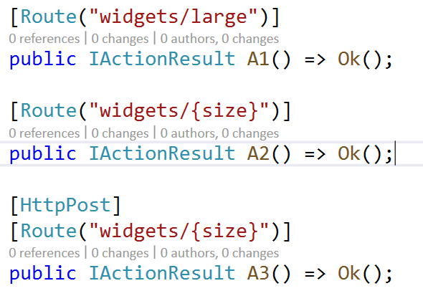
Routing Implementation
Which action should match?
We need a way to represent policies that disambiguate between endpoints
HTTP method
Hostname
Content-Type
Versioning
These policies need to run custom code to:
Control sort order of nodes
Choose which nodes are in/out for the current request

Slide 19
Routing Implementation
Best Solution: Fold these policies into the graph where possible
Policies needs to precompute their possible branches
Con: complicated to write, doesn’t work for all cases
But there aren’t that many of these kinds of policies out there
Why though?
The tree is precomputed so the cost is amortized
The tree walk is the first step of the algorithm so minimal work is done
Stages after tree walk require additional data structures

Slide 20
Demo: Policy nodes

Slide 21
Routing Implementation
We have other extensibility points as well
Policies (non-node-builder)
Can be async
Can look at route values
Can talk to the database
IRouteConstraint
Still works just the same way

Slide 22
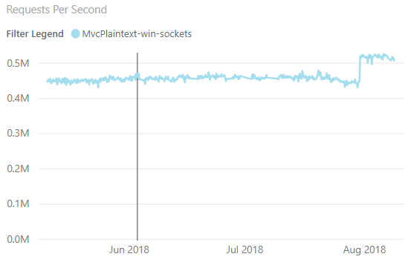
Performance Results
We do regular performance runs for TechEmpower scenarios
https://aka.ms/aspnet/benchmarks
Plaintext is a measurement of framework overhead
In the world of benchmarking it’s a 50m sprint
Approx 20% improvement in MVC

Slide 23
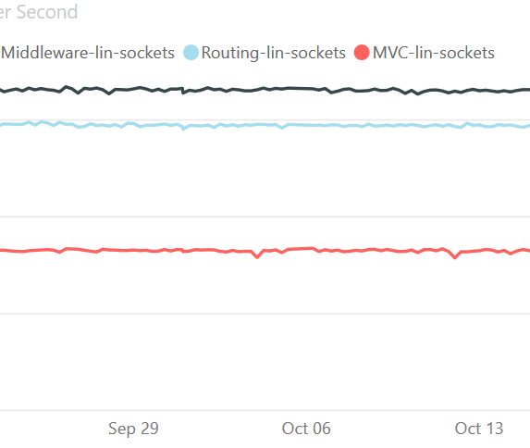
Performance Results
Requests-per-second, more is better
First place (black) => middleware
Second place (blue) => routing
Third place (red) => MVC

Slide 24
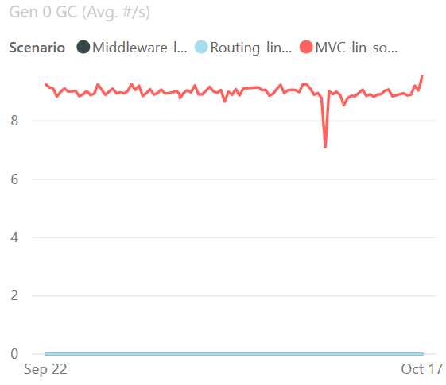
Performance Results
Garbage collections/sec while under 100% CPU load. Lower is better
Third place (red) => MVC
Tie for first => middleware/routing
To reach this level of performance, we avoid allocations completely
It’s not that .NET’s GC is slow, we have left the mortal world behind
No garbage collections occurred – we don’t create any garbage

Slide 25
Performance Results
To test scale we wanted something with a lot of endpoints
But we also wanted a realistic data set
Swagger/OpenAPI to the rescue
We create a tool called the Swaggatherer to codegen endpoints
We grabbed the swagger docs for:
*All of Azure’s APIs* (~1200)
*All of Github’s APIs* (~300)

Slide 26
Thanks!
@aVerySpicyBoi
https://github.com/rynowak/Presentations/

Slide 27
Out with the old
How do you replace something every app is using?
The goal is to break as few people as possible
95% of apps you won’t know something changed
We avoid breaking anything with a cost larger than O(1) per app
You probably have one startup class
Breaking *libraries* is a much bigger deal than breaking apps
Good breaking changes make noise (analyzer)
Good breaking changes are easy to document
Predictable code before -> Predictable code after
Conclusion: This is an easy change to absorb

Slide 28
Out with the old
2.2: We replaced the routing engine but kept the existing architecture. Concepts like endpoints are internal.
There was no code change for apps (other than compat level)
This lets us test the quality of the implementation
MVC has compat switches so its easy to revert behavior
Overall this was a success….. Except
Link generation is complicated ☹
We tried to fix some “design bugs” in link generation
Far too many people were broken by this
Fortunately it was easy to revert

Slide 29
Out with the old
3.0: new startup code with UseEndpoints is the default. Migrated apps get an analyzer warning if they don’t explicitly opt out of endpoint routing.
Security:
We released while working on 3.0 that we need to make the choice of routing system really clear in code.
We’re worried about users being confused and falling into undocumented configurations.
Extra guard-rails with analyzers and runtime errors for misconfiguration
Users are embracing new features
New frameworks like gRPC or Server-Side Blazor only use Endpoint Routing

Slide 30
Out with the old
But what if you used old extensibility like IRouter?
TODO 5 stages of grief graphic
Our goal is to try and take everyone with us. We’ll keep improving the feature set until folks are happy.

Slide 31
Out with the old
What does this say about ASP.NET Core overall?
This is one of the largest changes we asked the community to accept.
These rollouts always span multiple releases for us
Also always requires two-way dialog about what’s needed
We ship on a yearly schedule now
TODO schedule
This means we can announce deprecations and changes with dates attached
If you like change, upgrade every year and get the newest stuff
If you don’t like change, upgrade every 2-3 years and stay on LTS
We plan to innovate in odd-numbered releases and polish in even-numbered ones

Slide 32
Route-to-code new programming model
OK, it’s not super original. This kind of design is prevalent in Go and Node (among others)
With metadata its possible for this kind of framework to be as powerful and customizable as controllers
What else do you need?
Good primitives for reading/writing requests
Good way to interact with DI
We’ll be working to make this great in 5.0

