Slide 1
Navigating Microservices with .NET Core and Tye
Ryan Nowak @aVerySpicyBoi

Slide 2
About me
Worked on ASP.NET Core for many years
MVC/Routing/
Razor
Blazor
.NET Project Tye!

Slide 3
Except…
I’m part of the Azure Incubations team now

Slide 4
Agenda
Accelerate your development productivity
Make development more like production
Easily containerize and deploy .NET Core services

Slide 5
Project Tye
A .NET 5 public experiment
.NET Core cloud development tools
https://github.com/dotnet/tye

Slide 6
Demos: Tye

Slide 7
What we saw
Being productive with multiple services
Tools oriented around “more than one”
Simple patterns for dependency information (service discovery)
Local dependencies using Docker as part of your workflow
Simply containerizing and deploying .NET to Kubernetes

Slide 8
Diagnostics

Slide 9
Observability
Observability and diagnostics are critical for cloud native applications
Your code is running in the cloud and isn’t always easy to log into
What used to be a method call is now a HTTP request
Observability
Logs – consolidated logs for all parts of the application
Metrics – monitor the health and performance of my application
Distributed Tracing – correlate events across different parts of your app

Slide 10
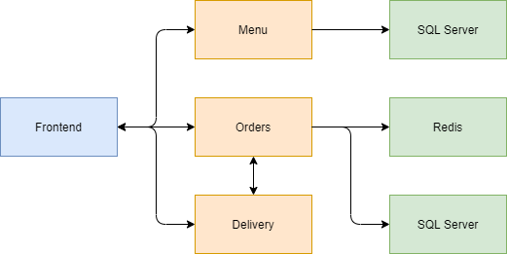
The App: Blazing Backend Cloud Native Blazing Pizzas

Slide 11
Demo: Diagnostics

Slide 12
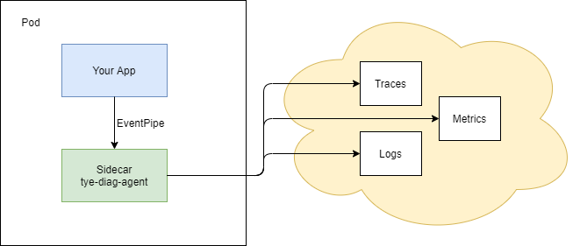
Observability: Sidecars

Slide 13
Q & A

Slide 14
Q: What does it mean that Tye's an experiment?
We’re building something in the open with an undetermined future
We’re trying a two-way collaboration with the community

Slide 15
Q. Who is this for?
Tye is for developers first
We built a menu of options, it’s up to you to choose what to adopt
There’s a spectrum of styles for devops practices
We’re hungry for feedback about what you’d prefer cloud-native deployment

Slide 16
Q. It only does k8s - can it do other things?
It… could
We chose to build on Kubernetes because …
It’s not tied to a cloud vendor
Anyone can run it locally for dev
You might already be using it in production
We wanted to expose more .NET developers to k8s
Kubernetes is powerful enough to customize in meaningful ways

Slide 17
Q. There's lots of tools out there - why this?
ASP.NET Core is fairly complete and users are happy … on the other hand there’s universal *unhappiness* for microservices dev productivity
As framework developers we don’t control how you design/factor your code – but we *can* build tools, and better diagnostics
Most other tools are general and low-level – Tye is .NET-focused and high-level
Very few other tools live with you from the first time you run a project to the point where it’s in a CI/CD system

Slide 18
Fin
Thanks!
Materials: https://github.com/rynowak/presentations
Twitter: @aVerySpicyBoi

