Slide 1
A deeper look at Blazor
Steve Sanderson & Ryan Nowak

Slide 2
Who are we?
Steve Sanderson
Developer and Architect on ASP.NET Core (mostly Blazor)
@StevenSanderson
Ryan Nowak
Developer and Architect on ASP.NET Core
@aVerySpicyBoi
Ryan’s Materials: https:github.com/rynowak/Presentations

Slide 3
Agenda
Blazor Server – how does it work?
Steve’s demos
Q&A

Slide 4
Blazor Server
How does it work?

Slide 5
Agenda
How does it work?
From your code to the browser
Performance
How implementation choices effect performance
How to think about Blazor server performance & scale
Deep dive into details you don’t really need to know
Not a 101
But it’s still fun!

Slide 6
At a high level
You write C#/Razor code
It runs on the server in a .NET Core process
It updates the UI in a browser somewhere on the internet
How can this work?
How can this be done in a performant way?

Slide 7


Blazor Server
https...
ASP.NET Core
SignalR
DOM
Razor Components
.NET
.NET Core 3.0

Slide 8
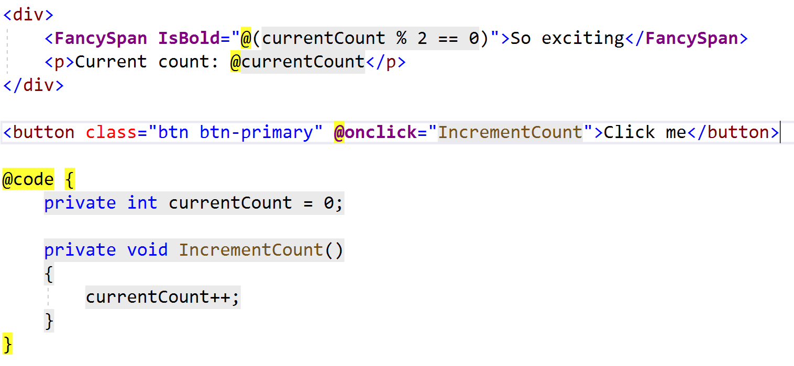
Writing Blazor Code

Slide 9
Primitives of components
Elements
Components
Attributes
Content
High level constructs like events and @bind map to attributes (mostly).

Slide 10
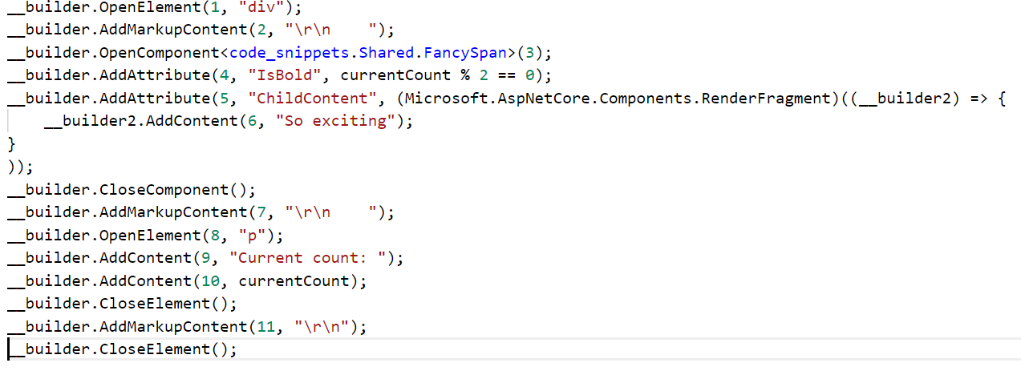
What does the compiler output

Slide 11
What does the compiler output
The compiler understands the code you wrote and how it maps to component primitives
The generated code will reproduce the data for those primitives when executed
We call this process “rendering”

Slide 12
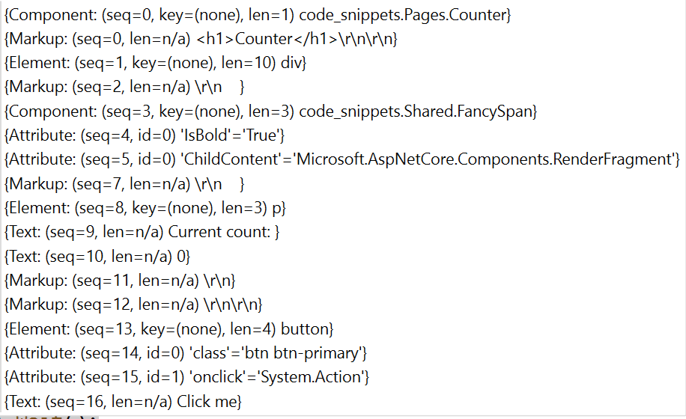
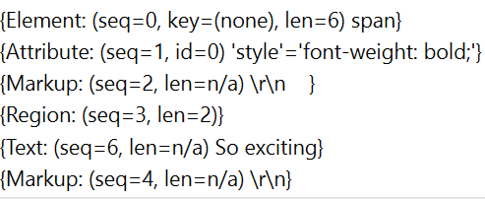
Rendering
Counter
FancySpan

Slide 13
Render Frames
Declarative format for a DOM
Suitable for turning into static HTML
Also great for diffing
If you know the current state – what set of changes get you to the desired state?
DOM operations are expensive, we want to avoid them if possible
We can transmit the minimal amount of information

Slide 14
Render Frames cont.
Frames for each component are stored in memory so we are ready to diff them
Frames use a densely packed representation
Frames have sequence ids to make diffing operations cheap
Each component has its own set of independent frames
Every component is a boundary for rendering and diffing
When does a component render? (When the component says so)
Creation
When parameters change
When an event happens
Background timers (etc)

Slide 15
Who renders?

Slide 16





Who renders?

Slide 17
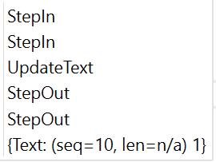

Diffing
Counter component
Update count from 0 -> 1
Counter is inside a div and p tags
FancySpan component
Update ‘style’ attribute to be empty

Slide 18
Diffing
Cheap
Diffing is cheap
Rendering methods are usually cheap
Expensive
Network transmission of updates is batched across groups of components
DOM updates are expensive (relative)
Components only render if they have a reason
This usually “just works”
Otherwise diffing will produce an empty result
Can noop the rest of the work

Slide 19
Just add server
Rendering is the same between server-side and WASM
Adding a server means that DOM updates and events need to travel between client and server
We use SignalR for the network communication
Low overhead per message
Low latency with WebSockets

Slide 20
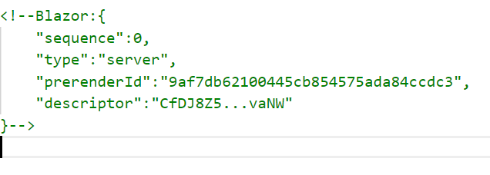
Connection Establishment
Server can have multiple entry points – how do we know what to do?
Server outputs HTML with “markers”
Markers are encrypted payloads with instructions for the server
Client opens connection
Client sends back the markers, and then the connection is ‘live’

Slide 21
Connection management
Client connection is assigned a secret id by the server
Client can use this id to reconnect
Client can use this id to gracefully close connection (browser tab close)
Server holds onto state (components) until
Disconnect + configurable timeout
Graceful close

Slide 22
Demo: Client-server communication

Slide 23
Let’s talk Bandwidth
Thing | Rate | bitrate
Streaming Video | 320p (worst) | 1000kpbs
Streaming Video | 4K HFR (best) | 53000kbps
Spotify (desktop) |  | 160kbps
Blazor Server | 1 Op/s | 0.5kbps

Slide 24
Lets talk performance
DOM updates are usually small
Latency matters most
Latency more than 250ms feels bad
Depends on the kind of interaction
Can design for small DOM updates
Usually a factor when writing complex components like grids
Use @key or other advanced features to avoid big diffs
Since state is in memory on the sever that’s what matters most
How much memory per-client is used by the framework?
How much memory is used by app code?

Slide 25
Experiment: Scalability
How many concurrent users can an app support?
We’re using Ignitor to test
This is a headless test client the team created
Ignitor uses the SignalR client to talk to the server
Knows how to understand render tree diffs
Can simulate a browser without using a browser
Very fast to run many of these on a single machine

Slide 26
Experiment: Scalability
Results
About 250kb of memory used per client
Small VM (D1_V2) handled 5000 concurrent clients with no degradation
Large VM (D3_V2) handled 20000 concurrent clients with no degradation
Main factor is memory consumption and GC

Slide 27
Thanks
@aVerySpicyBoi
Materials: https://github.com/rynowak/Presentations

Slide 28
Some ideas for Q&A
What’s next on the roadmap after May 2020?
How big is the Blazor team and how do we work?
What’s the scope of Blazor – what things will you add?

