Slide 1
The past and future of ASP.NET Core

Slide 2
About me
Ryan Nowak
Developer and Architect working on ASP.NET Core
Twitter: @aVerySpicyBoi
Materials: https://github.com/rynowak/Presentations/

Slide 3


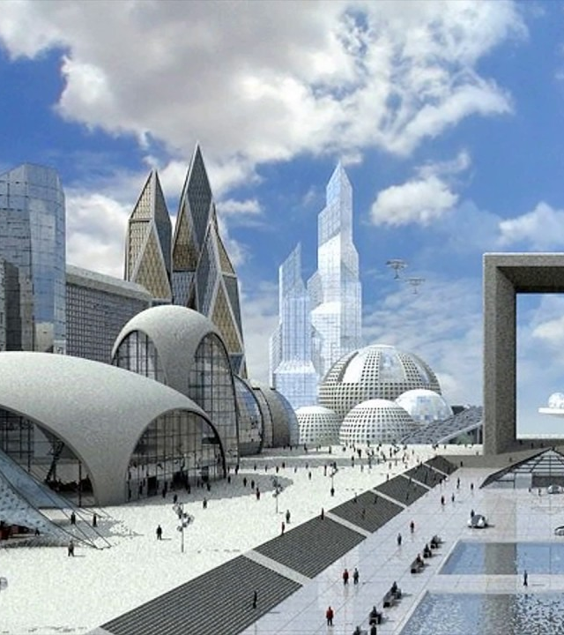
The Deal
We’re talking about things we *might* build in the future
Nothing in this talk is an announcement or a roadmap
Tell us what you like, what you would use it for
Notes:
You didn’t know you were making a deal when you walked in here today. We Americans are great deal-makers, or so I’m told. Look, the deal is that I’m going share with you some information about ideas we have, and in exchange you’re going to be mature about it. Nothing you’re going to see today is a commitment, or a roadmap.

Slide 4
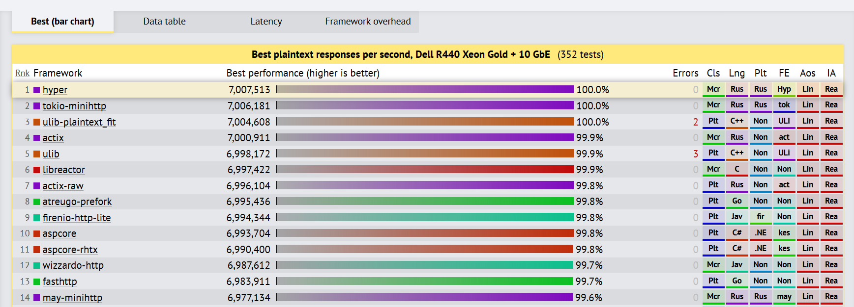
Project Bedrock
Notes:
Before we can talk about what project bedrock is, I want to introduce you to Kestrel. We wrote kestrel in 1.0 because we needed a cross-platform HTTP server for our shiny new cross-platform .NET.
What you’re seeing here is the results from the TechEmpower web framework benchmarks. You can see us hanging out here in about a 17-way timeout for the theoretical maximum throughput.

Slide 5
Introducing KestRel
App
Framework (MVC)
Middleware
Server (Kestrel)
Libuv
.NET Sockets
Early Kestrel used libuv so you know its webscale
Later we added .NET Sockets when we outgrew the performance of libuv
Notes:
This is the laverying of

Slide 6
Modern Kestrel
Protocol (HTTP, HTTP2, SignalR)
Transport (.NET Sockets)
Server
Protocols are layered on top of a replicable transport layer
We have several protocols and transports already
Notes:
E

Slide 7
Project Bedrock
Our effort to standardize contracts for client/server networking
Based on Span System.IO.Pipelines (all the latest high-performance tech)
.NET is a good technology for performant and safe low-level network programming
Bedrock APIs are in .NET Core 3.0
Find the code here

Slide 8

Demo: Multi-transport SignalR

Slide 9
The future
ASP.NET Core Team
HTTP3 and QUIC
MQTT
Others ???
.NET Community
Using connection abstractions in libraries
Keep getting better and faster
Build new things that don’t exist yet

Slide 10
Bedrock Resources
Special thanks to the *incomparable* David Fowler for helping prepare this section
Bedrock APIs: here
Bedrock examples: here
Demo server code: here
Demo client code: here

Slide 11
Project Houdini
Controllers
SignalR
Pages
gRPC
Blazor Server

Slide 12
Project Houndini
Server
Middleware
Routing
Controllers
Pages
SignalR
gRPC
Blazor Server
Endpoint Routing is our first “big bet” in the framework layer
Makes it easy to interop between middleware and high-level frameworks
Uniform way our frameworks are configured

Slide 13
Project Houdini
You thought Endpoint Routing was a single movie but it’s actually part of a cinematic universe
We get the feedback that MVC feels dated, is too heavy
We're working on "pushing down" more complex features from MVC that are reusable to give you more options
Model binding
Formatters
Open API support

Slide 14
Project Houdini

Slide 15
Project Houdini: Route-to-code
How can we make minimal backend services feel good?
Focused on removing concepts - the SFA (single-file application)

Slide 16
Demo: Route-to-code

Slide 17
The future
More MVC features are platform features
Gradual evolution of Controllers and Pages
Smaller amounts of code and ceremony will feel good

Slide 18
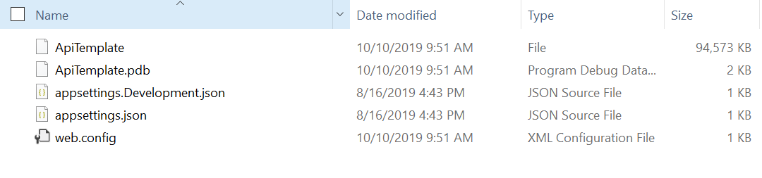
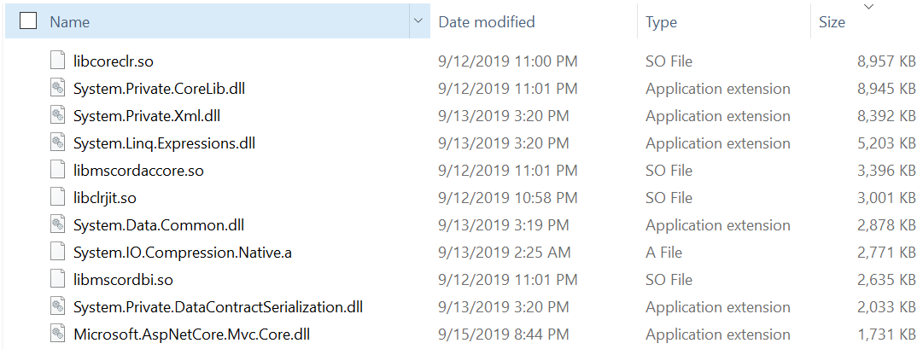
Small Fast .nET Server - no cool codename - sorry ☹

Slide 19
Self-Contained Publish Options
Single File (Today)
5 files
94.5 mb
4 of these files are config
Normal
324 files
92.9 mb
Notes:
This is release, on linux
So we asked ourselves, what would it mean to really lean into this scenario and try to make it great?

Slide 20
Small Fast .NET Server
A few years ago the idea of a self-contained .NET app was revolutionary
What if we leaned into this scenario…
How small can we make a backend server app?
No compromises on performance (make better if possible)
Can require new tech/toolchain
Must work for most apps without extra effort
Use this anywhere you’d use a standalone publish today

Slide 21
Small Fast .NET Server
Changes to Native
“Single file” host
Changes to Managed
“Linkability”
Removal of optional components
Diagnostics changes
Performance optimizations
Removing slow features

Slide 22
Small FAST .NET Server
Single File Host
Puts many assemblies in a single binary
Logic to memory map regions and load assemblies without copying
Faster than reading separate files
This makes a single file – how do we make it small?

Slide 23
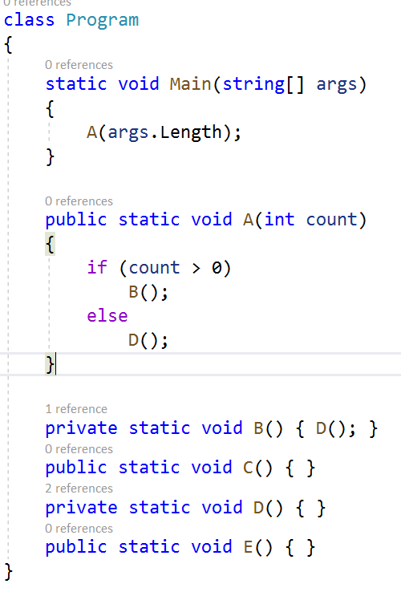
Tree Shaking
You’ve heard about “Tree-Shaking” – what does that really mean?
Tree-Shaking is a family of non-conservative dead-code-elimination algorithms
The linker starts at Program.Main and visits all of the methods/types/fields that are used
If you can’t prove that it’s used, then it’s gone!
E() would be removed here – enough though it’s a public API!

Slide 24
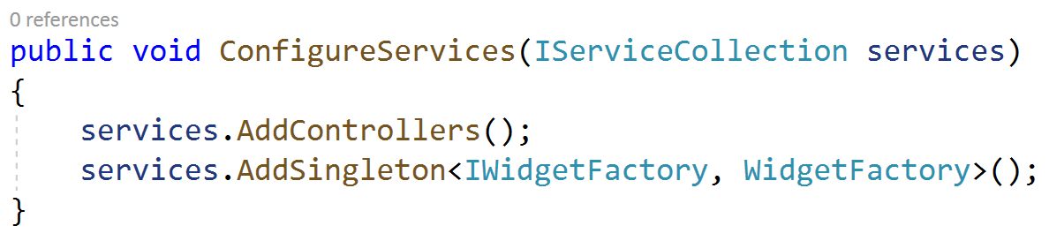
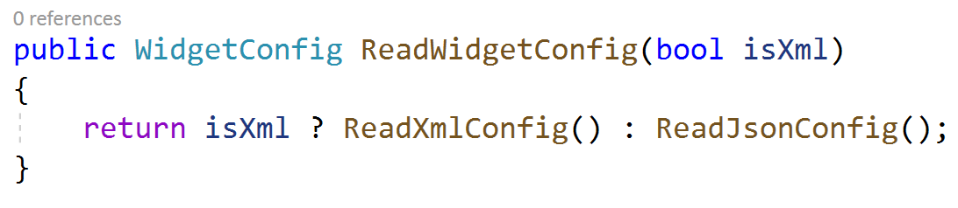
The Linker
Running the linker has lots of challenges:
Unanalyzable patterns
Relying on things that can’t be proven
Choke point APIs
Designs that keep a lot of code “rooted”
Native dependencies of managed code
Solutions will require new tools
Analyzers
Pattern recognition in the linker
Changes to runtime features
This makes it small, how do we make it fast?
Notes:
The XML functionality is about 4mb. This design doesn’t give you a choice about whether its included.

Slide 25
Small FAST .NET Server
Native Runtime
Crossgen (Ready-to-run) trades some size for a lot of speed
Single-file loader is *fast* compared to many files
Some runtime features aren’t for a single-file
Managed Runtime
The main thing that’s slow is prepping code to run – so run less code
Removing/skipping features like don’t fit the scenario
App models that support lower levels of abstraction

Slide 26
Small Fast .NET Server

Slide 27
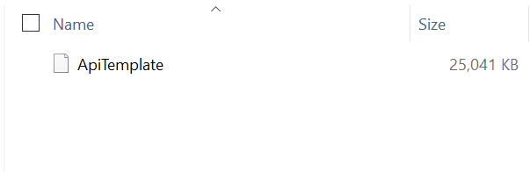
Small Fast .NET Server

Slide 28
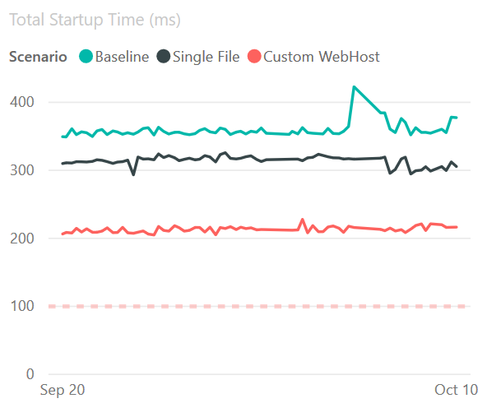
Small Fast .NET Server
This is real data from our perf environment
Startup time = time to run Program.Main + time to serve first request
Legend:
Baseline = normal self-contained publish
Single File = Single File ☺
Custom WebHost = removes optional ASP.NET Core features

Slide 29
Small Fast .NET Server
This is probably the most experimental thing I’m talking about today
Finding the limits of .NET tech – so we can remove those limits
Help Wanted: Tell us what you’d use this for
What kind of apps?
What kind of deployment environments?
What kind of diagnostic tools?

Slide 30




Blazor and B-Lectron
ASP.NET Core
SocketIO
Razor Components
.NET

Slide 31
Blazor and B-Lectron
What is Electron?
Electon is a shell for browser-based applications that can access the operating system
Electron is based on Chromium + Node
Why Electron?
Automatic update
Native menus
Crash reporting
Cross-platform installers

