Slide 1
The past and future of ASP.NET Core
The next 5 years

Slide 2
About me
Ryan Nowak
Developer and Architect working on ASP.NET Core
Part of .NET Core since long before .NET Core
Twitter: @aVerySpicyBoi
Materials: https://github.com/rynowak/Presentations/
Notes:
Hi, I’m Ryan – developer and architect working on ASP.NET Core
You can find me on twitter if you want, and you can find my presentation materials up on github sometime later today.

Slide 3
Agenda
Kestrel and Project Bedrock
Middleware and MVC
Self-Contained Publishing
Blazor and Electron
Notes:
Today I’m going to talk to you about a few big ideas that are going to shape the next 5 years of ASP.NET Core development.
Now something that probably sticks out is that all of these are tied to something that already exists. We think at this point that ASP.NET Core is broad –we’re at 3.0 after all - but there’s still more refinement to do. I want to share with you some of our ideas and convince you there’s some innovation left in the tank.

Slide 4



The Deal
We’re talking about things we *might* build in the future
Nothing in this talk is an announcement or a commitment
Tell us what you like, what you would use it for
Notes:
You didn’t know you were making a deal when you walked in here today.
Look, the deal is that I’m going share with you some information about ideas we have, and in exchange I want you to remember that nothing you’re going to see today is a commitment, or an announcement. We hope that sharing some of our long-term ideas helps us shape our future direction.
Some of these things might be the right solution to the wrong problem, or the wrong solution to the right problem, or just might not come to pass.
So lets get started.
// end 1.5

Slide 5
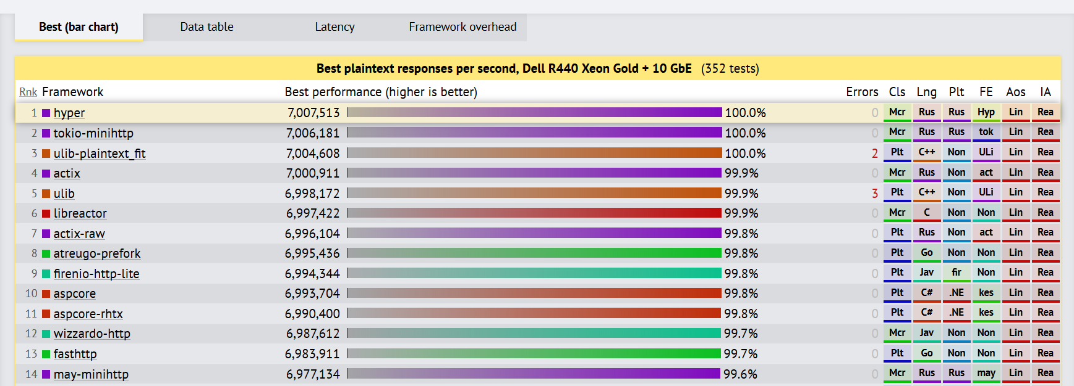
Project Bedrock
Results: here
Notes:
Before we can talk about what project bedrock is, we need some background.
I want to introduce you to Kestrel. We wrote kestrel in 1.0 because we needed a cross-platform HTTP server for our shiny new cross-platform .NET.
What you’re seeing here is the results from the TechEmpower web framework benchmarks. This is the plaintext benchmark which is part of the suite – and this particular one is like a 50 meter sprint. It’s useful to measure the raw throughput of the server, or the raw overhead.
You can see us hanging out here in about a 17-way tie for the theoretical maximum throughput. So we must be doing something right with kestrel.

Slide 6
Introducing KestRel
App
Framework (MVC)
Middleware
Server (Kestrel)
Libuv
.NET Sockets
Early Kestrel used libuv so you know its webscale
Later we added .NET Sockets when we outgrew the performance of libuv
Notes:
The is a layering diagram of ASP.NET Core circa 2.0.
You might not think that much about those bottom two layers, and that’s ok. That’s what I’m here to explain.
Before an HTTP request gets to the middleware pipeline, the server has already done some complicated things. The server has to manage TCP connections, and translate raw bytes going over the internet into structured messages for you to process.
At the bottom of this diagram from v1 is libuv – the library at the heart of nodejs. You heard me right – we took the c library that’s at the core of nodejs and made it the cornerstone of ASP.NET Core in 1.0. Libuv’s purpose in all of this is to provide us with connections and give us the ability to read and write bytes from the network.
Then a funny thing happened, we outgrew libuv’s performance. As we worked on the server, we saw an opportunity to improve .NET’s sockets implementation and put that at the lowest level of the server. So that’s where we are right now, we use the classes in System.Net.Sockets as our primary way of interacting with the network.
We refer to this bottom layer as a “Transport” since it’s the thing that’s dealing with transporting bytes somewhere else.

Slide 7
Modern Kestrel
Protocol (HTTP, HTTP2, SignalR)
Transport (.NET Sockets)
Server
Protocols are layered on top of a replicable transport layer
We have several protocols and transports already
Notes:
Then we started working on HTTP2. So we extracted the top layer – everything that knew about parsing reading and writing messages and turned that into something we call the prototcol layer. We had to do this so that the protocol could be replaced with a new one.
So we’re left with this delicious layer cake.
On the bottom transport layer, we have the capability to understand connections and raw IO.
On the top protocol layer, we have the ability to provide meaning structure, and useful semantics, and bring order to all of those messy bytes.
And in the middle is the delicious layer of peanut butter that mediates between these two.

Slide 8

Transports and Protocols
Tranports
TCP
UDP
Quic
Named Pipes
Domain Sockets
Protocols
HTTP
HTTP2
HTTP3 (see a pattern forming?)
SignalR
AQMP
MQTT
Notes:
So what do we get when transports and protocols are replicable? We get a lot of options.
We’ve figured out the recipe for adding more capabilities without shaking things up.

Slide 9
Project Bedrock
Our effort to standardize contracts for client/server networking
Based on Span System.IO.Pipelines (all the latest high-performance tech)
.NET is a good technology for performant and safe low-level network programming
Bedrock APIs are in .NET Core 3.0
Find the code here
Notes:
So now that everyone’s head is in the clouds, let’s bring it back to project bedrock.
Bedrock is an API we created for client/server networking. This project actually led to the creation of all of the types in System.IO.Pipelines. So all of the newest high performance stuff is part of bedrock. This is in .NET Core 3.0 and if you have a use case you can start experimenting.
And we think that .NET is a good language for safe low-level things like network protocols. With pipelines and now the bedrock APIs, we now have a battle-tested recipe for writing low-level client/server code, and it’s totally memory safe! .NET is getting better every release for writing this kind of code.

Slide 10
Demo: Multi-transport SignalR
Notes:
I’m going to show a demo – I hope you’re somewhat familiar with SignalR – but in case you’re not:
SignalR is a realtime two-way communication protocol that is primarily used in browsers with websockets. What does all that mean? It means you can write a chat app.
// start 7m
// end 10m

Slide 11
The future
ASP.NET Core Team
HTTP3 and QUIC
MQTT
Others ???
.NET Community
Using connection abstractions in libraries
Keep getting better and faster
Build new things that don’t exist yet
Notes:
So what does the future hold?
Well we think that the bedrock APIs are pretty good so they are public and stable in 3.0.
What’s left here is that we need more protocols and transports. QUIC is a new protocol that replaces TCP in HTTP3. We were behind where we wanted to be with our rollout of HTTP2, and we’re already working on HTTP3.
MQTT is really exciting too, this is a message-based pub/sub protocol that’s picking up traction for IoT devices.
Lastly, what makes this pay off is you! There’s a long tail of libraries that do networking. There’s potential here to make existing things better, and make more things plug in with the server.
// 12m

Slide 12
Bedrock Resources
Special thanks to the *incomparable* David Fowler for helping prepare this section
Bedrock APIs: here
Bedrock examples: here
My demos: here

Slide 13
Project Houdini
Controllers
SignalR
Pages
gRPC
Blazor Server
Notes:
Next up, Project Houdini – which relates to all of the frameworks we ship, and how they integrate or don’t integrate with the rest of the platform.

Slide 14
Project Houdini
Platform
Middleware
Static Files
MVC
Authorization
Formatters
Model Binding
OpenAPI
Routing
Filters
Antiforgery
View Engine (Razor)
Error Handling
Error Handling
Notes:
Let me ask you – does this seem balanced?
This is a list of significant features. We have ASP.NET Core the platform on the left – and we have MVC on the left with an embarrassment of riches.

Slide 15
Project Houdini
Platform
Middleware
Static Files
MVC
Authorization
Formatters
Model Binding
OpenAPI
Routing
Filters
Antiforgery
View Engine (Razor)
Error Handling
SignalR
Authorization
Model Binding
Routing
gRPC
Notes:
Let’s add some more frameworks
Anything that’s in the platform can be shared across all of these frameworks. Anything that’s in MVC – well I guess if you want it – it has to be duplicated.
We started peeling the onion to see how many platform level features should be extracted. Routing was the obvious place to start, because so many other decisions are driven by what routing decides.

Slide 16
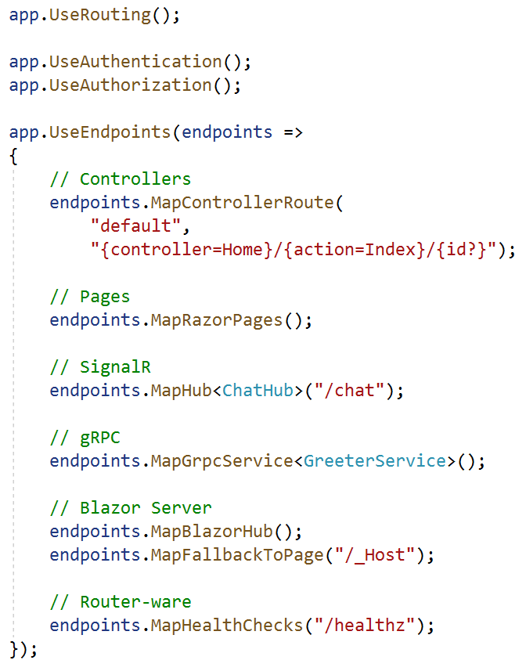
Endpoint routing
“Universal” routing system for ASP.NET Core
Look at all that stuff!
Solves interop with middleware
Problem: Middleware need to make decisions based on what routing will do
Solution: Run routing earlier – let middleware inspect/modify the result
Previous deep-dive talk: here
Project Bedrock is one of David Fowler’s passion projects
This is one of mine xD
Notes:
In 3.0 we made our new routing system – “Endpoint Routing” the default. New stuff like Blazor server and gRPC don’t integrate with the old one, only the new one.
You can see here in this code sample there’s a whole galaxy of stuff that’s all plugging in. Not only are they using the same routing system, they’re also using the same auth system. This wasn’t possible with our old routing architecture.
In the interest of time, I’m not going to do a deep-dive on routing as a topic today – I’ve included a link to my preview talk “Lessons learned building MVC” from NDC London. Watch that if you want a better understanding of the design.

Slide 17
Project Houndini
Server
Middleware
Routing
Controllers
Pages
SignalR
gRPC
Blazor Server
Endpoint Routing is our first “big bet” in the framework layer
Makes it easy to interop between middleware and high-level frameworks
Uniform way our frameworks are configured
Notes:
This is roughly where the architecture lands, now that we have Endpoint Routing in play.
We have the stuff we talked about during bedrock, and we have all of these lovely frameworks built on top of routing. If I can make a diagram that’s this simple, and it tells you the truth – then everything is right with the world.

Slide 18
Project Houdini
You thought Endpoint Routing was a single movie but it’s actually part of a cinematic universe
We get the feedback that MVC feels dated, is too heavy
We’re want to "push down" more complex features from MVC that are reusable to give you more options
Model binding
Formatters
Open API support
Can we make “no framework” viable?
Notes:
Now we’re setup to unpack project Houdini.
What endpoint routing did was take some MVC features, and… (pause) made them disappear. Well they didn’t disappear exactly – they got broken off and turned into a useful feature lower in the platform. In practice this is much less graceful than it sounds like because scientists haven’t yet invented magic.
The reality is that first we provide a better alternative to a feature, then we gradually migrate users, then we eventually remove the old thing. We’re still in the gradually migrating users stage.
But, we think that there’s a lot of value in this for everyone. There’s a lot of useful features that MVC has that could be used standalone.
And before anyone gets upset, we don’t plan to make controllers disappear. We still think controllers are one of the best ways .NET gives you express input and output over HTTP. What we plan to do is give everyone more options.

Slide 19
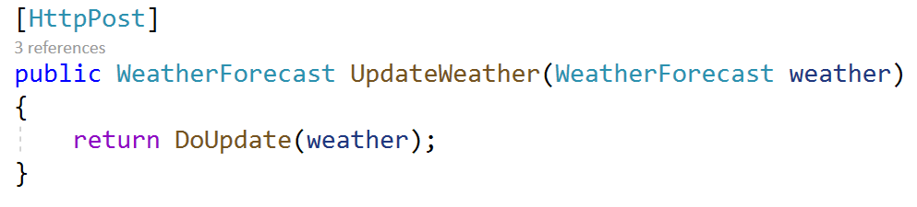
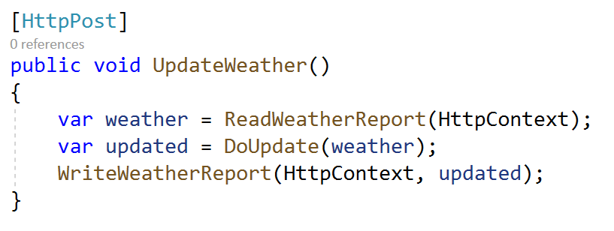
Project Houdini
Declarative Solutions
Expressive when they “fit”
Limiting when they “don’t fit”
Not always pay-for-play
Imperative Solutions
WYSIWYG
More verbose
More control
Notes:
Let me “architect” your brain for a minute.
Controllers provide you with a lot of ways to solve problems declaratively today – by declaring methods, parameters and return types. But what does it feel like when those options aren’t what you want?
We’re missing imperative cohorts for many of these features. If you tried to write a few lines of code to invoke MVC’s model binding or formatters, you’d probably give up, frustrated.
// 16.5

Slide 20
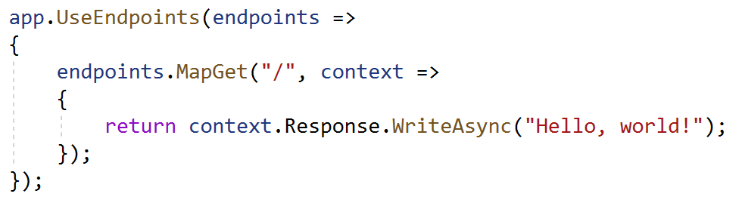
Route-to-Code
What about using no framework at all?
Notes:
What about using no framework at all?
We all call this route to code. This is a style that’s really common in some other tech stacks and it’s caught on a little bit in .NET. You have fewer tools to express yourself declaratively, so you need those imperative features that we’re missing.

Slide 21
Project Houdini
Notes:
So I made a graph. This isn’t scientific so I get to make up the criteria and the results.
I’m graphing how declarative an approach is, VS rich it feels. You can think of richness as “how easily can find a solution that feels right”. Ultimately richness is what you want in a framework and being declarative is a way to get there. If you’re optimizing for performance however you might *not* want to be declarative. Every feature has a cost, and you might not always want the cost of all that declarative magic.
For a controller – it’s very declarative. You express your inputs and outputs by declaring a method, and the framework does the rest. Sometimes you need a few attributes to tweak something – but the key is that you have the tools to solve your problem in a way that feels right most of the time.
For routing – well you get to write delegates. It’s like writing middleware. It’s not very declarative, and you don’t have the same toolset that you get with a controller so it’s not very rich either.
So what if we tried to make some solutions for the problems of routing? We don’t want to add more declarative constructs, because controllers already do that. So what if we add more imperative concepts: more services to interact with, more ways of solving the same problems. I reckon it could be useful for that remaining 20% of controllers as well.
// end 14m

Slide 22
Project Houdini: Route-to-code
How can we make minimal backend services feel good?
1
Focused on removing concepts - the SFA (single-file application)
2
Notes:
Along these lines, we’ve been doing some thinking about how to backend applications with ASP.NET Core small in terms of code.
We haven’t gotten very far with this in terms of building things – we haven’t done anything ambitious like created a standalone model binding system yet. I want show you a quick code sample. The idea of this is that there isn’t anything happening here that you didn’t ask for – no magic.

Slide 23
Demo: Route-to-code
Notes:
// 18m
// 24m

Slide 24
The future
More MVC features are platform features
Gradual evolution of Controllers and Pages
Smaller amounts of code and ceremony will feel good
Notes:
The future of this looks like continuing the work we started with endpoint routing in 2.2 – we want to gradually evolve MVC and move features down in the platform. This makes ASP.NET Core for consistent and capable no matter what feature set you’re using.
In parallel with this, continue to invest in “small code”, and give you direct control when you want it.

Slide 25
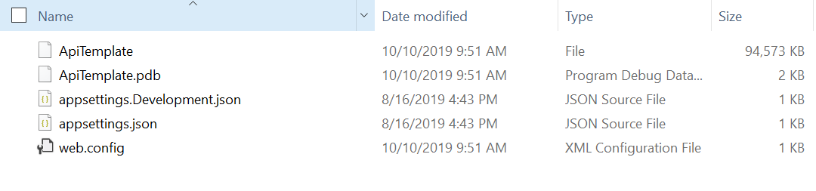
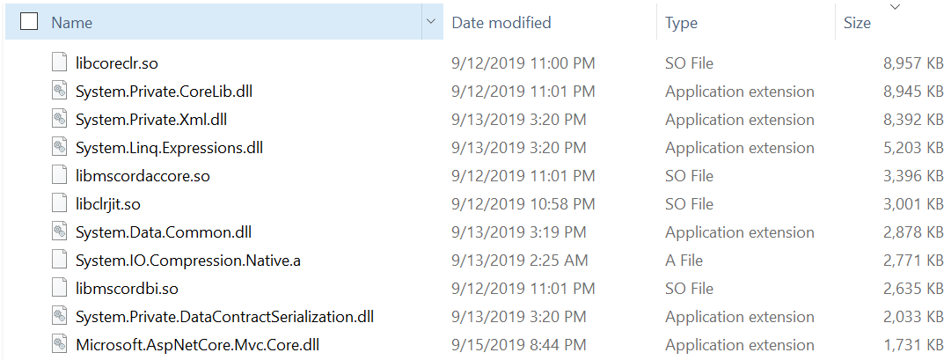
Small Fast .nET Server - no cool codename - sorry ☹
Notes:
Next, I want to talk about publishing. I know, exciting topic.
I’ve got some screenshots on this slide comparing a normal self-contained publish output on the bottom with a “single-file” self-contained publish on the top.
A self-contained publish is the one where you bring the whole .NET runtime with you.
// start 18m

Slide 26
Self-Contained Publish Options
Single File (Today)
5 files
94.5 mb
4 of these files are config
Normal
324 files
92.9 mb
Notes:
Let’s compare these results - this is release, by the way, on linux.
The default self-contained publish is going to give you a massive number of files, because it includes everything that’s in .NET. About 93 mb and 324 files.
You have a “single file” publish option today – that gives you a single executable bundle as well as a few configuration files. The size is slightly bigger than normal.
So we asked ourselves, what would it mean to really lean into this scenario and try to make it great?

Slide 27
Small Fast .NET Server
A few years ago the idea of a self-contained .NET app was revolutionary
What if we leaned into this scenario…
How small can we make a backend server app?
No compromises on performance (make better if possible)
Can require new tech/toolchain
Must work for most apps without extra effort
Use this anywhere you’d use a standalone publish today
Notes:
So we’ve done some investigations into this.
The criteria that we’re working with – we don’t want to lose any performance, we’re willing to increase publish time, and it has to be in reach of mere mortals. Along with getting smaller – we also wanted to make the app start faster.
You might be asking: Why didn’t we use Mono? We know that mono can produce some really small apps, because it’s been designed for that. Since this is about server, and we didn’t want to lose any performance that didn’t seem like the right starting point – we’re using a lot of mono’s toolchain and ideas for this.

Slide 28
Small Fast .NET Server
Changes to Native
“Single file” host
Changes to Managed
“Linkability”
Removal of optional components
Diagnostics changes
Performance optimizations
Removing slow-startup features
Notes:
So we came up with ideas across all of .NET to try and make this better.

Slide 29
Small FAST .NET Server
Single File Host
Puts many assemblies in a single binary
Logic to memory map regions and load assemblies without copying
Faster than reading separate files
This makes a single file – how do we make it small?
Notes:
The runtime team was able to produce a more advanced version of our current single-file host. This once can memory-map all of your assemblies as part of the loading process with zero-copies. It’s about as efficient as the loader can get while still preserving each assembly as a separate unit.
This change was neutral on size, and decreased the startup time significantly.
So that gives us a single file, what else can we do to make startup faster?

Slide 30
Small FAST .NET Server
Native Runtime
Crossgen (Ready-to-run) trades some size for a lot of speed
Single-file loader is *fast* compared to many files
Some runtime features aren’t for a single-file
Managed Runtime
The main thing that’s slow is prepping code to run – so run less code
Removing/skipping features like don’t fit the scenario
App models that support lower levels of abstraction
Notes:
To make this fast, we have a few tools.
The most important native one is crossgen – which is how we trade size for startup speed. If you have a use case where you only care about the size and not about startup speed, then this is a dial you can adjust.
This single-file host goes a long way to improving performance of the native startup path, the prototype host is an improvement over every other option that exists.
---
At the managed layer, we’re still peeling the onion by removing layers and finding out what things cost. We’re looking at features like JSON config and asking hard questions about whether we need them in this scenario. In terms of running code, the main thing that’s slow is actually the volume of code that needs to be loaded and made executable.
The path forward here to improve the startup time further is to run less code. There’s an alignment here between some of the things we just talked about for Houdini.
We have lots of ideas about how we could replace some of this with build-time code generation, but we don’t have enough prototyping experience to see if this will pan out.

Slide 31
The Linker
Can remove “unused” .NET code and assemblies
Has settings to configure what’s eligible to remove
Can remove A LOT with aggressive settings
Running the linker: blog
Repo: here
Notes:
To get smaller, we turned to the linker. Some of you might have already played with the linker – if you’ve done Blazor, or if you’ve done the PublishTrimmed option.
To help understand why “unused” is in quotes, let’s talk about how it works.

Slide 32
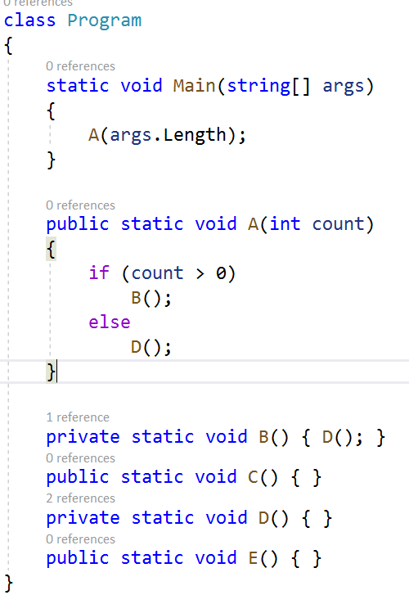
Tree Shaking
You’ve heard about “Tree-Shaking” – what does that really mean?
Tree-Shaking is a family of non-conservative dead-code-elimination algorithms
The linker starts at Program.Main and visits all of the methods/types/fields that are used
If you can’t prove that it’s used, then it’s gone!
C() and E() would be removed here – enough though they are public
Notes:
You might have heard of “tree shaking” before – but what does that really mean?
Tree shaking means that we start at Main, and do static analysis to find every piece method that’s called, every type that’s constructed, and every member that’s used.
If you can’t prove that it’s used, then it’s gone!
// 32

Slide 33
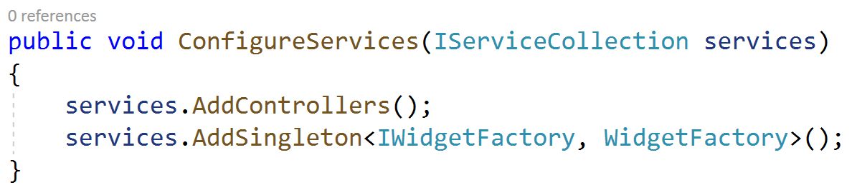
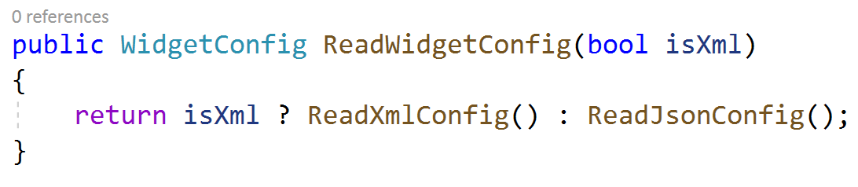
The Linker
Running the linker has lots of challenges:
Unanalyzable patterns
Relying on things that can’t be proven
Choke point APIs
Designs that keep a lot of code “rooted”
Solutions will require new tools
Analyzers
Pattern recognition in the linker
Changes to runtime features
Build-time codegen
All these tools need to work for libraries too!
This makes it small, how do we make it fast?
Notes:
So trying to run the linker with really aggressive settings turns out to be really hard. .NET libraries and frameworks are complex, and I don’t mean that in a nice way. We (myself included) do a lot of things that outsmart the linker.
So what happens if you only call a method through reflection? Well too bad, it’s gone and you get a crash. So what about something like dependency injection? Well most of the constructors are only called through reflection – so they’re done. What about Controllers? They are only called through reflection, so they’re gone. I’ll bet that’s a lot of stuff you use that doesn’t work.
One of the other problems we encounter is when the linker can’t do enough. We call this a choke-point API – where you have more than one code path behind a single API – but you have significantly different dependencies. If you care about the size of your app’s output, this isn’t a great design. The JSON parser is about a megabyte, the XML parser is about 4 including the native bits.
---
These problems require a rethink of a lot of .NET. We know that a real solution we can move forward with is going to involved all of the things on that list. Whatever solutions we put in place have to work for libraries too – we wouldn’t think of this as a success if you have to drop all of your favorite libraries to benefit.
Making .NET more linkable by solving both of these classes of problem would be a really large effort, and it’s one that we want to make sure is worth it.
// 35

Slide 34
Small Fast .NET Server
Notes:
Now some size results. All of these cases use crossgen, which again trades size for speed.
The normal result is our baseline, and it’s 92 mb
Adding the linker with conservative settings and crossgen like we shipped in 3.0 puts us at 74mb – so there’s a drop of 18mb
You can see the impact of the linker’s settings there in that drop from 74 to 42.
To go below that we start removing features of the runtime, and making assumptions about what kinds of dependencies can be removed.
We think the floor based on the tech we have available right now is around 25-28 mb depending on what you want to have included. The effect of application code on the scalability of this number is pretty good, in general the amount of code you write doesn’t raise this number too much, it’s what parts of the BCL you use and what dependencies you add.

Slide 35
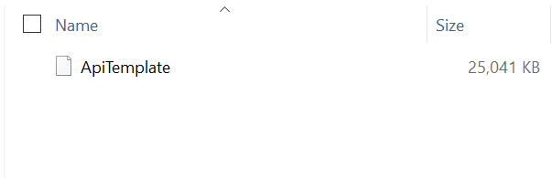
Small Fast .NET Server
Notes:
So, just to prove it: here’s a screenshot of a 25mb linux binary. It’s contains a REST API that’s not too different from what we were looking at with Houdini.
And just to be clear about this, we did a lot of special-casing to get to this point. The numbers are real – but the steps we had to take to get there are extreme.

Slide 36
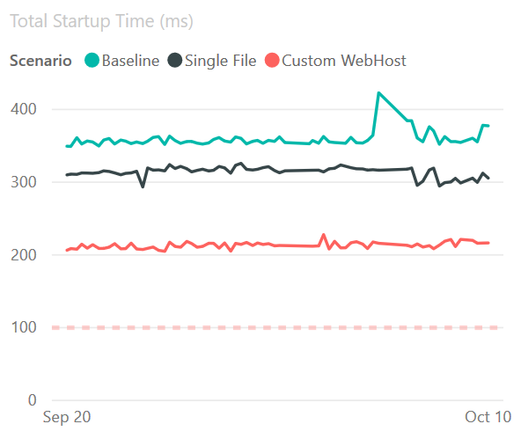
Small Fast .NET Server
This is real data from our perf environment
Startup time = time to run Program.Main + time to serve first request
Legend:
Baseline = normal self-contained publish
Single File = Single File ☺
Custom WebHost = removes optional ASP.NET Core features
Notes:
For startup performance, we always separately measure the time to start the server, and the time to process the first request and add them. We need to include a request, or else it would be easy for us to cheat.
For a simple legend here – the top line is the current state, our baseline. The middle line is the effect of just the single file host. The red line is the effect of removing some of the more startup-expensive ASP.NET Core features.
// end 30

Slide 37
Small Fast .NET Server
This is probably the most experimental thing I’m talking about today
Finding the limits of .NET tech – so we can remove those limits
Help Wanted: Tell us what you’d use this for
What kind of apps?
What kind of deployment environments?
What kind of diagnostic tools?
Notes:
Summing this up a bit. The most clear takeaway from this that I could give you is that we’re still trying to push boundaries all over the place. Many of the ideas we came up here are really complicated to build, and would take multiple years to figure out.
What would help us would be hearing from you about the cases where you use standalone publishing today and how this could help you.
// end 40

Slide 38




Blazor and B-Lectron
ASP.NET Core
SocketIO
Razor Components
.NET
Notes:
Let’s talk about Blazor a little bit.
Blazor is our interactive UI framework using standard web technologies. If you haven’t seen it yet, you’ll get a taste in a minute. I’d also suggest checking out Steve Sanderson’s talk later today.
Now we’ve shipped Blazor Server as part of .NET Core 3.0.
And we’ve officially announced Blazor WebAssembly support coming in May 2020.
What’s behind the horizon for Blazor?
We have a lot of ideas about improving tools
Adding more browser integration
And adding more language features
However, we’re very keen also adding more app models and more ways to run Blazor. Today I want to spend some time talking to you about Blazor and Electron (or B-lectron as it’s often called), and what a marriage between those two technologies might look like. We’ve shown plenty of samples of B-lectron in use, but we haven’t really done a deep dive or a larger public discussion of what that might entail.
If you want to see learn more about Blazor in general, I recommend going to Steve Sanderson’s talk at TODO time later today in this room.

Slide 39
Demo: B-Lectron
Notes:
Just to be different, lets do the demo first this time.
// start 41
// end 48.5

Slide 40
Blazor and B-Lectron
What is Electron?
Electon is a shell for browser-based applications that can access the operating system
Electron is based on Chromium + Node
Why Electron?
Automatic update
Native menus
Crash reporting
Cross-platform installers
Notes:
So why might you care about Electron then? Well do you build applications that need to interact with the user’s computer? Do you need those apps to work on Windows, Linux and Mac?
Blazor + Electron gives you a great way to build UI applications, and you benefit from a lot of the goodies that the Electron ecosystem already provides.

Slide 41
Blazor and B-Lectron
How the prototype works
Runs your app in a .NET process
Electron.NET to control Electron
Custom build of Blazor’s TS boot script running inside Electron’s renderer
Custom Renderer sending updates to Electron process
Electron.NET APIs for more advanced Electron control
Notes:
Let’s talk about how the prototype works, and were we might take this in the future.
The B-lectron prototype is a simplified version of Blazor server. Your .NET Code runs in a normal .NET Core process, and we’re remote controlling the Electron process. In the prototype we’re using a library called Electron.NET – which is worth checking out.
The fact that you’re running in a .NET Core process is beneficial, because you get access to everything .NET Core gives, and the same set of familiar diagnostics tools.

Slide 42
Blazor and B-Lectron
Blazor-Specific Integration
“Blazorey” ways to do Electron
More API surface
Docs and recipes
Toolchain
‘dotnet’ for build and publish
Templates
Electron updates and crash reports
Notes:
So what might the future look like for Blazor and B-lectron?
Well I think it’s easy to visualize – the prototype already seems reasonable right? There’s a lot of work that would be required to “unprototype” everything you’ve seen here.
There’s a whole lot of API surface that’s provided by Electron that’s in addition to Chromium and Node – how much of that do you need exposed in .NET to be happy and successful? Blazor has the ability to interop with JavaScript, but that doesn’t always feel great when its on the critical path.
In additional, doing Electron means we have a whole new toolchain that we need to stitch together.
----
We already know a few of the things that are next for Blazor – a minor update coming soon, and then Blazor WASM coming next spring. After that we think it’s going to be more features and more ways of running Blazor, this is just one we might choose, and we’re not likely to invest in all of the options.

Slide 43
Thanks!
Let us know what excites you!
Twitter: @aVerySpicyBoi
Materials: https://github.com/rynowak/Presentations/
Notes:
// 50

