Slide 2
Blazor Server Scaling with SignalR
Ryan Nowak - @aVerySpicyBoi

Slide 3
About Me
I work on .NET/ASP.NET Core @Microsoft
Engineer #2 on Blazor
Materials: https://github.com/rynowak/Presentations

Slide 4
What is Blazor Server?

Slide 5


https...
ASP.NET Core
SignalR
DOM
Razor Components
.NET
.NET Core 3.1

Slide 6
Demo: Blazor Server
Notes:
2m

Slide 7
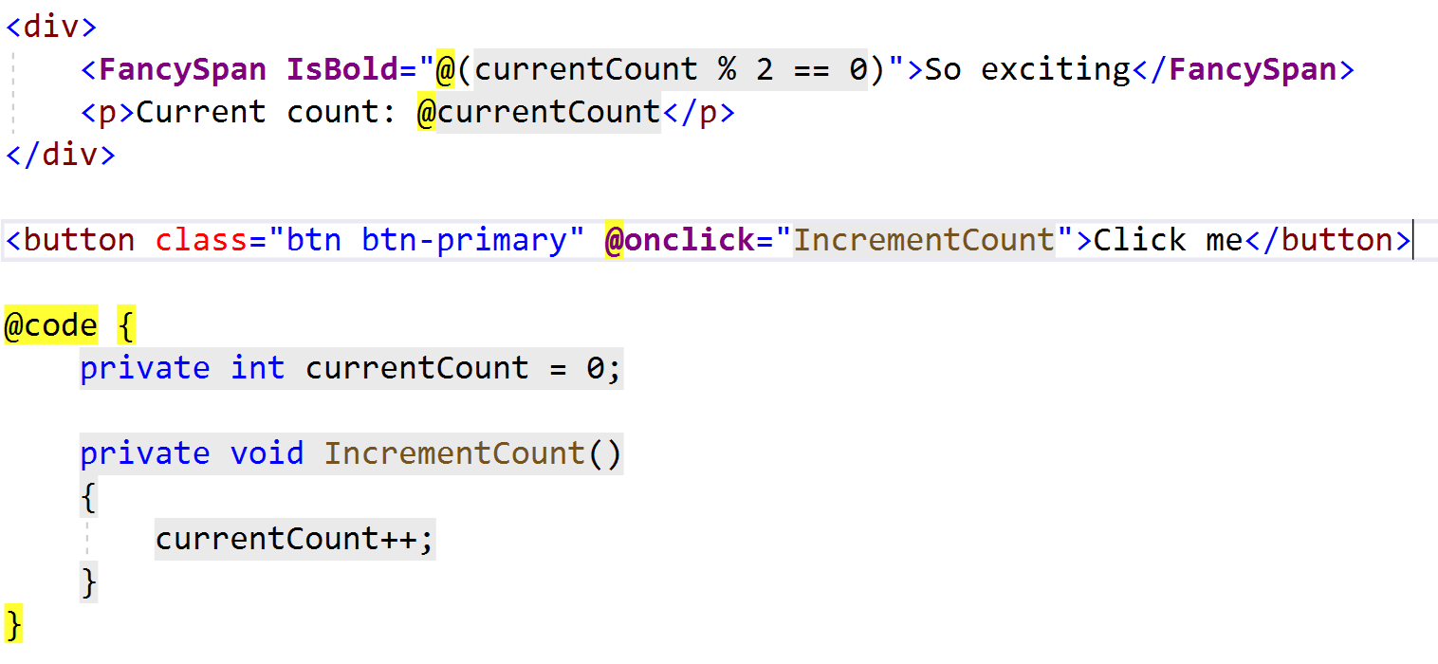
Writing Blazor Code

Slide 8
How does Blazor update UI?
Components respond to events.
Components “render” (update their markup).
This can trigger more updates to other components.

Slide 9

What needs to update?

Slide 10
How Blazor Server Works
Components produce “frames” respresenting elements, attributes, other components.
The runtime produces an efficient diff.
The runtime sends a the diff back to the browser.

Slide 11
What is SignalR?
Notes:
9m

Slide 12
Long polling
Client
Server
Request
Response
Event
Request

Slide 13
Server-sent events
Client
Server
new EventSource(…)
Message
Event
Message
Event
Message
Event

Slide 14
WebSockets
Client
Server
upgrade: websocket
HTTP/1.1 101 Switching Protocols
👍
🙂
messages
🙂

Slide 15
Scale out with Azure SignalR Service

Slide 16
Azure SignalR Service
Offload ASP.NET Core SignalR scale-out to a managed service
Free tier – Up to 20 connections
Pay for “units” of 1,000 connections, up to 100,000 connections
Add NuGet package and 0 lines of code

Slide 17
ASP.NET
Core app
Blazor Server
Pages
SignalR traffic
Client
Web traffic

Slide 18

Azure SignalR Service
ASP.NET
Core app
Blazor Server
Server Endpoint
Pages
Client Endpoint
Client
Web traffic
SignalR traffic

Slide 19
Scaled App
Azure SignalR Service
Scaled App
Server Endpoint
Scaled App
Client Endpoint
Client
Web traffic
SignalR traffic

Slide 20
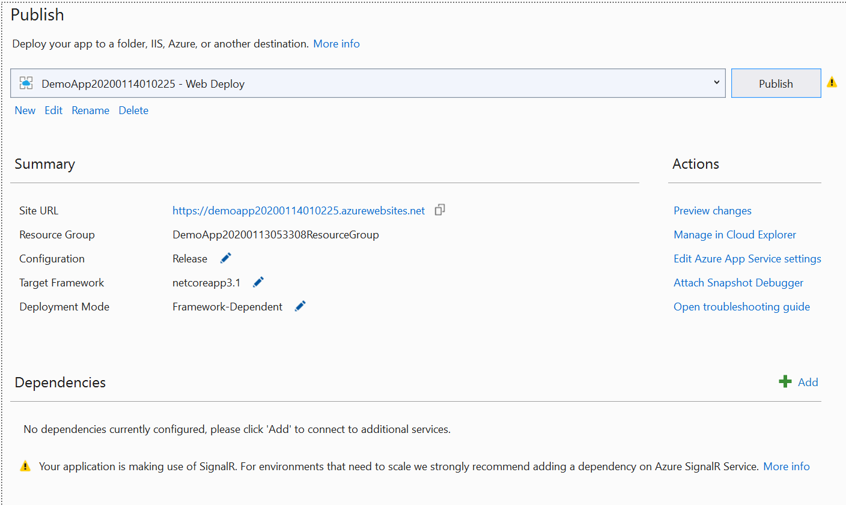

Slide 21
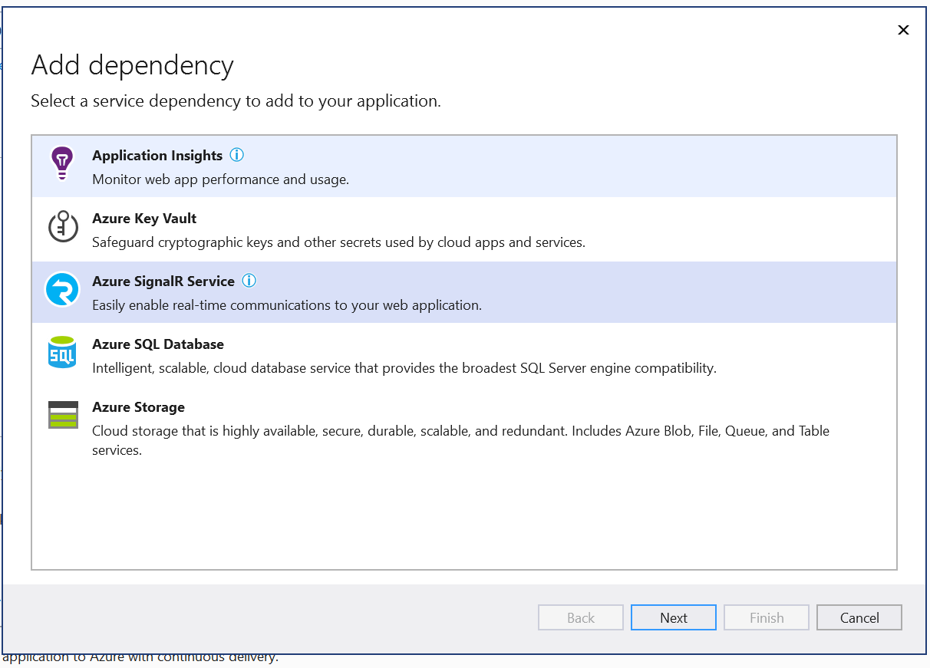

Slide 22
Blazor Server Considerations
Blazor Server needs “stickiness”.
Azure SignalR Service provides this.
Blazor Server needs a WebSocket connection per user.
Azure SignalR Service can help scale.
WebSocket capacity is limited in some environments, can also be subject to per-VM limitations.
Details: https://docs.microsoft.com/en-us/azure/azure-resource-manager/management/azure-subscription-service-limits#app-service-limits

Slide 23
Planning Blazor Server Capacity
Experiment conducted with a very simple app.
Each client uses ~86kb of server memory.
Your usage will vary depending on the needs of the application.
Notes:
15m

Slide 24
Demo: Visualizing Connections

Slide 25










Your platform for building anything
DESKTOP
WEB
CLOUD
MOBILE
GAMING
IoT
AI
.NET
Notes:
You can build anything with .NET. We’ve made significant investments in .NET over the years as well as unifying the ecosystem to support building literally anything. From desktop to gaming to the cloud, .NET is a general purpose programming platform that enables all kinds of scenarios. Once you learn one, you can easily pick up another.

