Slide 1
Endpoint Routing
Ryan Nowak - @averyspicyboi

Slide 2
Why replace routing?
Old version didn’t integrate with middleware
Duplication of functionality between MVC, SignalR, Middleware
All useful extensibility is in MVC
We were planning to add gRPC and Server-Side Blazor
SignalR had already reimplemented routing
Conclusion: old routing wasn’t a good foundation
We (and others!) frequently need to add request-handling functionality
This needs to be configurable by the app developer
Do we use MVC for this? Middleware?

Slide 3
Endpoint routing
Universal representation of “Endpoint” as:
Request Handler
Metadata
Middleware are coupled to their own metadata instead of frameworks
Cross-cutting concerns are cross-cutting again
Any Endpoint is as “first-class” as any other
Separate phases for selection and execution
Allows middleware to run “in-the-middle”
Selection criteria can be arbitrary
Your routing system is as good as ours if result is an endpoint

Slide 4
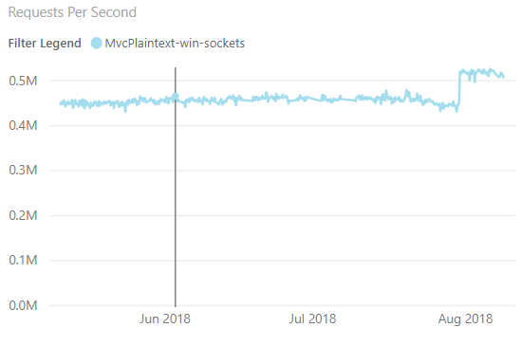
Performance Results
We do regular performance runs for TechEmpower scenarios
https://aka.ms/aspnet/benchmarks
Plaintext is a measurement of framework overhead
In the world of benchmarking it’s a 50m sprint
Approx 20% improvement in MVC

Slide 5
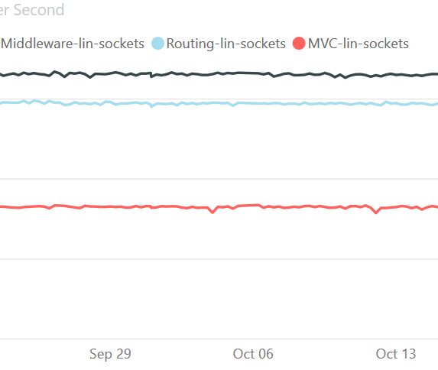
Performance Results
Requests-per-second, more is better
First place (black) => middleware
Second place (blue) => routing
Third place (red) => MVC

Slide 6
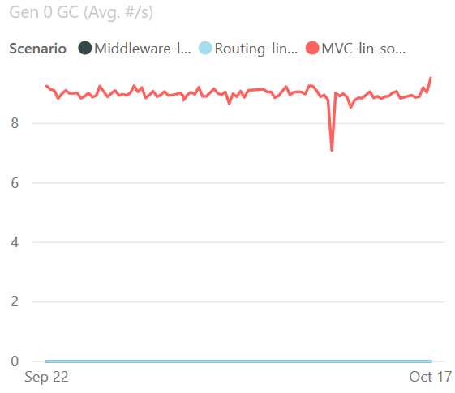
Performance Results
Garbage collections/sec while under 100% CPU load. Lower is better
Third place (red) => MVC
Tie for first => middleware/routing
To reach this level of performance, we avoid allocations completely
It’s not that .NET’s GC is slow, we have left the mortal world behind
No garbage collections occurred – we don’t create any garbage

Slide 7
Thanks!
@aVerySpicyBoi
https://github.com/rynowak/Presentations/

