Slide 1

Intro to Kubernetes
Ryan nowak @aVerySpicyBoi

Slide 2
About ME
ASP.NET Core Architect working on:
MVC
Blazor
Routing
Cloud/Microservices
??? Whatever’s next! ???

Slide 3
Agenda
This is an intro! It’s for people who don’t know!
Wherefore Kubernetes: a ruminant thought experiment
Actual non-pretentious introduction to Kubernetes
Concepts illustrated
What concepts do I need as a developer?
How do I create one of these?
Some demos
Kubernetes as a platform for platforms (what is that about?)

Slide 4
Let’s do a thought experiment
What if Kubernetes didn’t Exist yet???

Slide 5
What if *you* HAD to design a system for Microservices?
Needs to scale
Needs to tolerate machine failures
Needs to support any language/workload
Needs to provide the things that applications need
Needs to integrate with a variety of tools
Needs to be self-healing

Slide 6
Scaling & Machine Failures
How would you do this?
Run an an agent on each VM (so we can communicate)
Agents send pings back and forth with a scheduler process (need to know if it’s still alive)
High-availability data store (runs on multiple nodes)
The system needs to decide which applications run where (migrating apps to another machine on failure)

Slide 7
supporting any language/workload / Needs to provide the things that applications need
How would you do this?
Using virtualization technology like containers (removes need to install things)
Using low level primitives that every workload supports
How do you get configuration? (environment variables and files on disk)
How do you do logging? (console output)
How do you communicate with other services? (DNS and networking are programmable)

Slide 8
Needs to integrate with a variety of tools
How would you control the cluster?
A REST API! (when you have a hammer, everything looks like a nail)
How do you manage applications?
A REST API! (CRUD operations work well)
How would you extend the feature set?
Run more services in the cluster that talk to the REST API (can extend without being baked in)

Slide 9
Needs to be self-healing
We need to be able to react to failures. If an application crashes we can restart it.
How to do it:
We don’t use *imperative commands* to describe deployment
The schedule makes decisions based on desired state
Store the desired state of every object as well as its actual state – iteratively try to make them match
This concept is called *reconciliation*

Slide 10
Summary: What did we build?
An agent on each nodes (kubelet)
Programmable networking (kube-proxy/core-dns)
A REST API (kube-api-server)
A highly-available data store (etcd)
A decision maker for allocating services to machines (kube-scheduler)
An extensible reconciliation process (controller-manager, controllers)

Slide 11
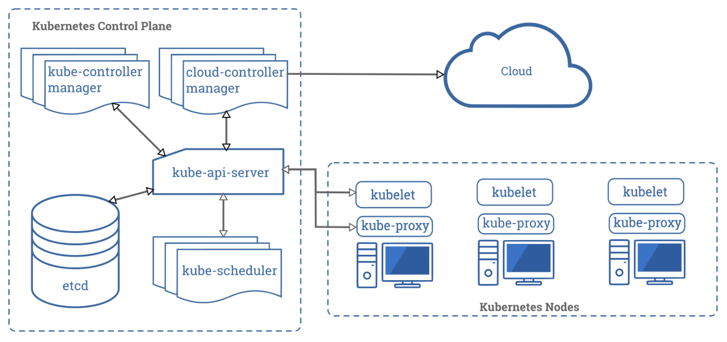
Summary: What did we build?

Slide 12
Let’s See it in action

Slide 13
Summary
What we’ve seen:
Pods
Deployments
Services
ConfigMaps
There’s a whole lot more resource types!

