Slide 1

Microsoft Technology Landscape

Slide 2
Brief History of Microsoft
1975 – 1985:
April 4, 1975 – Founded by Bill Gates and Paul Allen
BASIC programming language
Released first operating system (Xenix) in 1980
Released with first version of Word
DOS
1985 – 1991:
Windows 1.0
Microsoft Works
SQL Server
Windows 3.0
Visual Basic 1.0
Notes:
Xenix was based on Unix
Word – called Multi-Tool Word, first WYSIWYG editor
DOS – Disk Operating System
Windows 1.0 – graphical extension to DOS
Works – document, spreadsheet, database
SQL Server – built on Sybase technology

Slide 3
Brief History of Microsoft
1992 – 1995:
1993 – most used GUI operating system in the world
Windows for Workgroups 3.1 and Windows NT 3.1
Windows 95 released
Internet Explorer
Visual Basic 2.0 and 3.0
1995 – 1999
Microsoft Network (MSN) and MSNBC
Windows CE
Active X and COM
Windows 98
Visual Basic 4.0, 5.0 and 6.0
Notes:
NT 3.1 – server based OS with different kernel than consumer products
Windows 95 – released without a browser
IE – licensed from Spyglass
MSN – direct competitor to AOL
CE 1.0 – first PDA OS from MS

Slide 4
Brief History of Microsoft
2000 – 2005:
Windows 2000 and ME
Windows XP
Windows Messenger
.NET and Visual Studio
C# introduced
2005 – Present:
Vista
Windows 10
Notes:
Win 2K – based on NT kernel

Slide 5
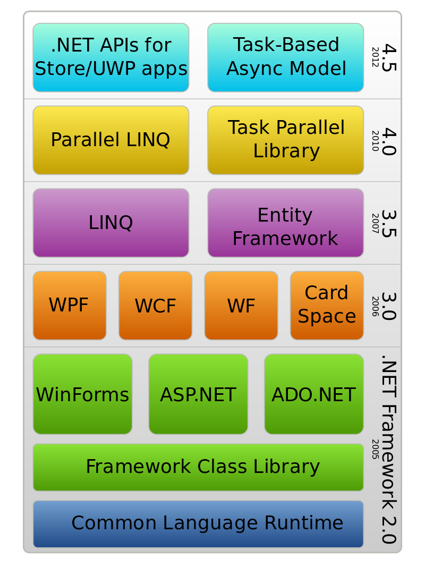
History of .NET Framework

Slide 6
Other Microsoft Technologies
Azure
Web API
Notes:
Win 2K – based on NT kernel

Slide 7
Lab – Install Visual Studio and SQL Server
Notes:
Win 2K – based on NT kernel

Slide 8
On Your Own
Get familiar with Visual Studio
https://msdn.microsoft.com/en-us/library/jj153219(v=vs.110).aspx

