Slide 1
Smart Horn
Imagine the world

Slide 2
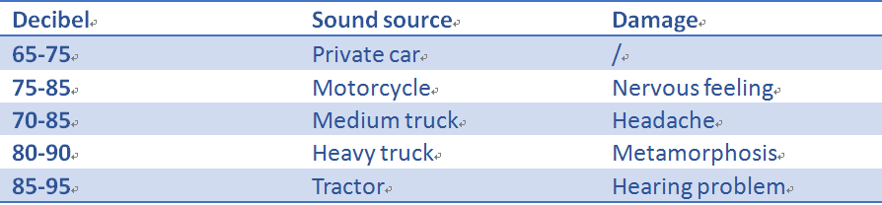
Sound pollution
Sound pollution cause many health problems！
How can we allow this to reduce the life quality of human life?!
The sound pollution of vehicle’s horn now become one of the serious problems of the modern city.
More emphasis should be the focus on car sound pollution.

Slide 3
The horn and the sound pollution
85 %
of the urban sound pollution
is caused by the vehicle’s horn.

Slide 4
Key words
Big data
Environ-mentally friendly
a
Environ-mentally friendly
have
Smart Horn
Embedded system
try
Blue
tooth

Slide 5

Why use the horn?? To warn the others to keep safety.
Q&A
Why use the horn??
To warn the others to keep safety.
Why use the smart horn?
To adaptively
control the volume of the vehicle’s trumpet

Slide 6
Smart phone control
Smart phone reduces the vehicle sound pollution by changing the car horn’s volume and tonality
Q:How to locate??
A:To connect with the cloud client to locate the position of each car and operate the road congestion
By taking the advantage of MCU, Bluetooth, timing relay and visual studio for developing software, the device is designed to enhance the quietness of the communitymass media is considered to be built in the smartphone application for users to remark other users so that a driver’s driving manners can be showed.

Slide 7
Smart phone control
Smartphone platform to monitor the horn has many advantages. First, smart phone is very popular in the society and daily life; everyone will be very convenient to use those programs. Second, smart phones platform have many functions; the programs will be better in light of those superior features. Third, smartphones platform have superb Protocols Communication and is very easy to communicate with those horns.
Because of the nature of blue tooth 4.0, information can be exchanged stably and conveniently. Also, using blue tooth will not interfere your smart phone’s Wi-Fi. So there will be no problem to control the smartphone and the art horn with blue tooth 4.0 for completing the function that is control the bright horn by smartphone.

Slide 8
Cloud data control
Because of large amount of complicated data which needed process and calculate，this project need cloud data to calculate and process the data on the background of the Smartphone and can give data to the government or non-government organization in order to let the government control the traffics better and make better urban road construction.

Slide 9
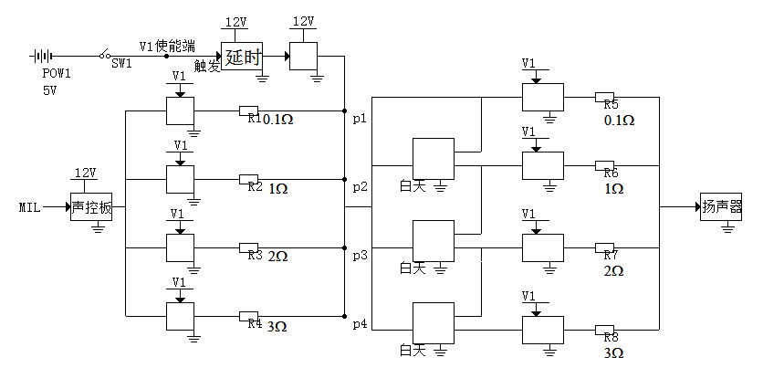
电路图

Slide 10
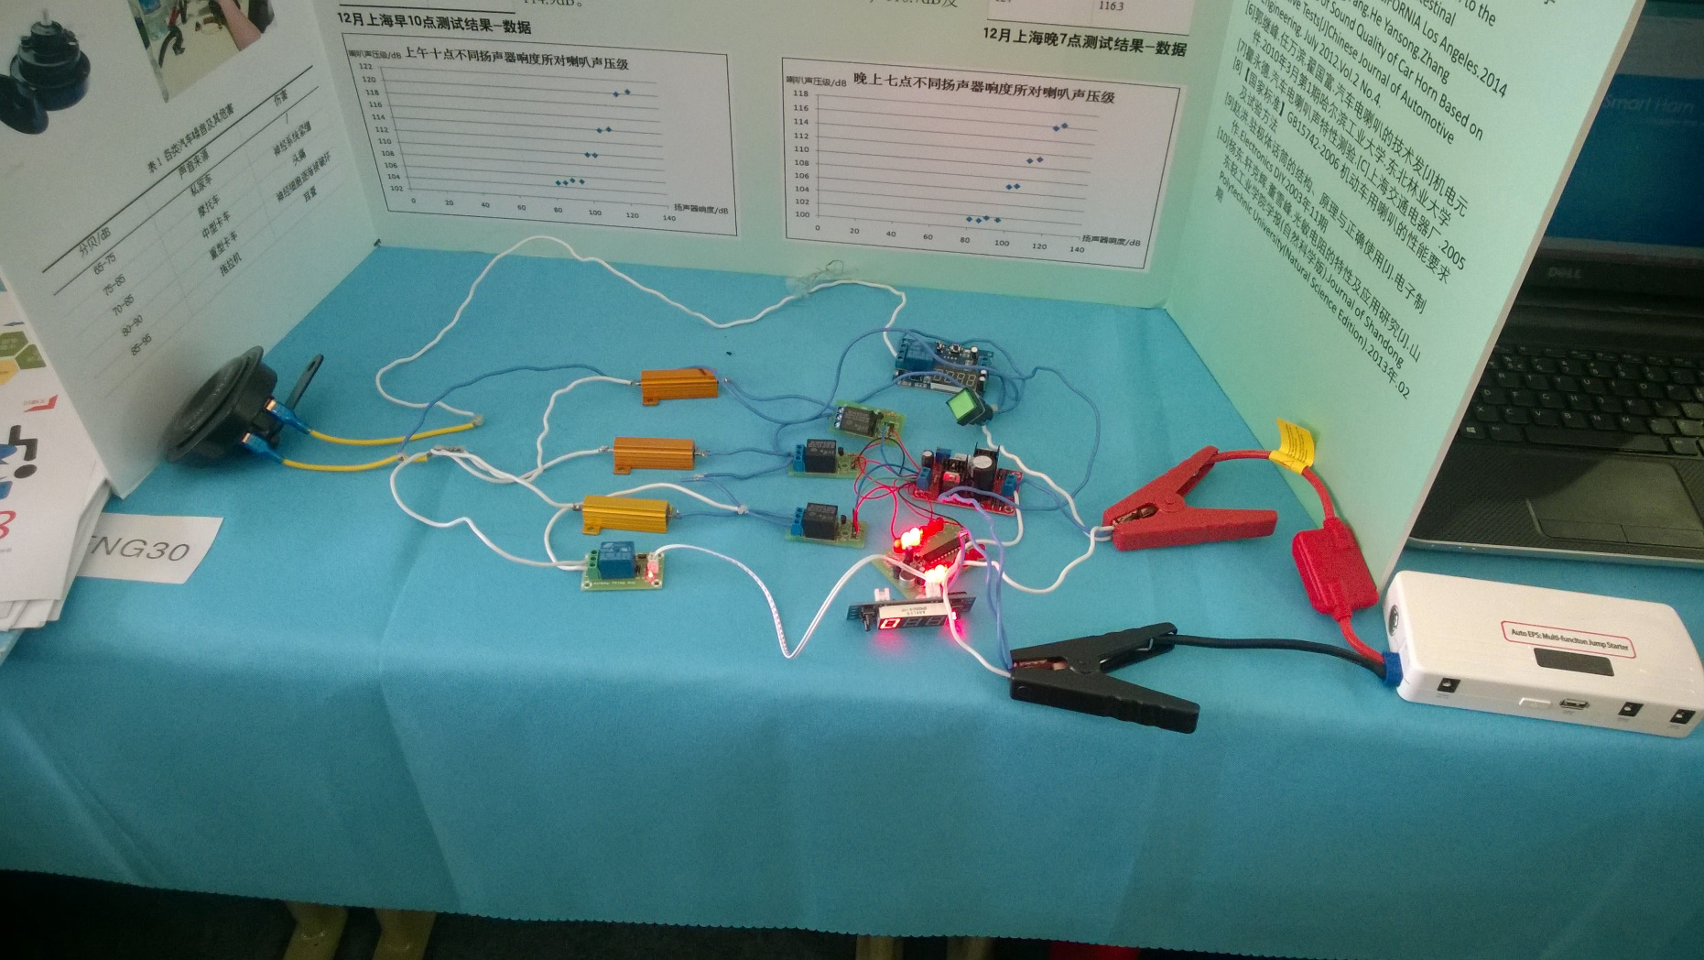
实物图

Slide 11
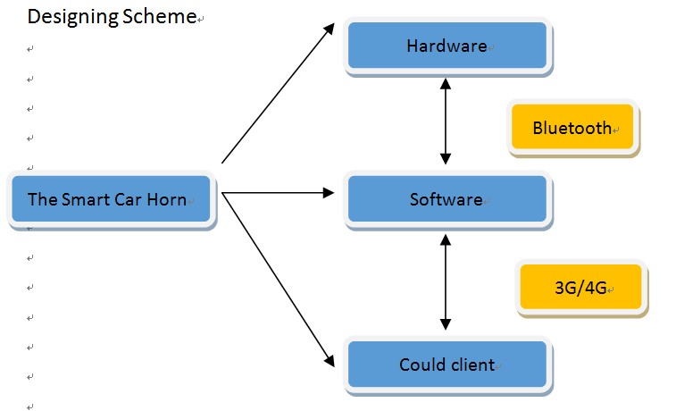
Designing Scheme

Slide 12
Software Design
Near the car antenna, there will be a microphone equipped to sample the outside ambient noise data and upload the signal to the phone via Bluetooth operations inside the cell phone. The smart phone will frequency shift to the signal and transmits the new signal back to the sound source of the car horn via Bluetooth, changing the vibration frequency of it to make it obviously different from environment ambient noise.

Slide 13
Data Transmission
Voice recognition system is installed in the phone, and users can inform the phone of some road congestions and the volume of traffic. This information will be uploaded to the 3 G / 4 G network to the cloud.
According to the uploaded number and contents, the system will draw a map in which the congestion degree can be divided into four ranks that identified with four different colors: red, orange, yellow and green. It is convenient for the driver to find the most suitable route in the shortest possible time. Feedback the map to the phone and the user can choose the best travel route by looking up this map. Travel can be more convenient, and travel time can be shortened appropriately.

Slide 14
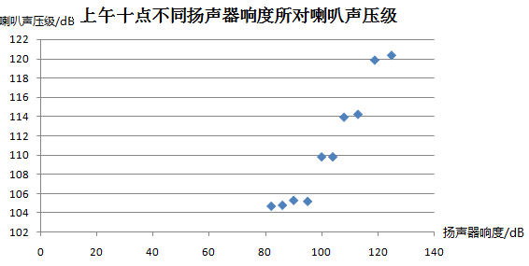
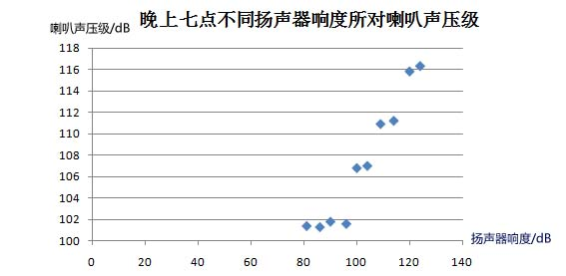
Cloud data control
12月上海早10点测试结果-散点图
12月上海晚7点测试结果-散点图

Slide 15
Q&A
Do you want to live in a quiet place, drinking some coffee, listening to the aria and enjoying your own time in your own world?
OF COURSE!
So why not use the Smart Phone & app name?
SURE~

Slide 16
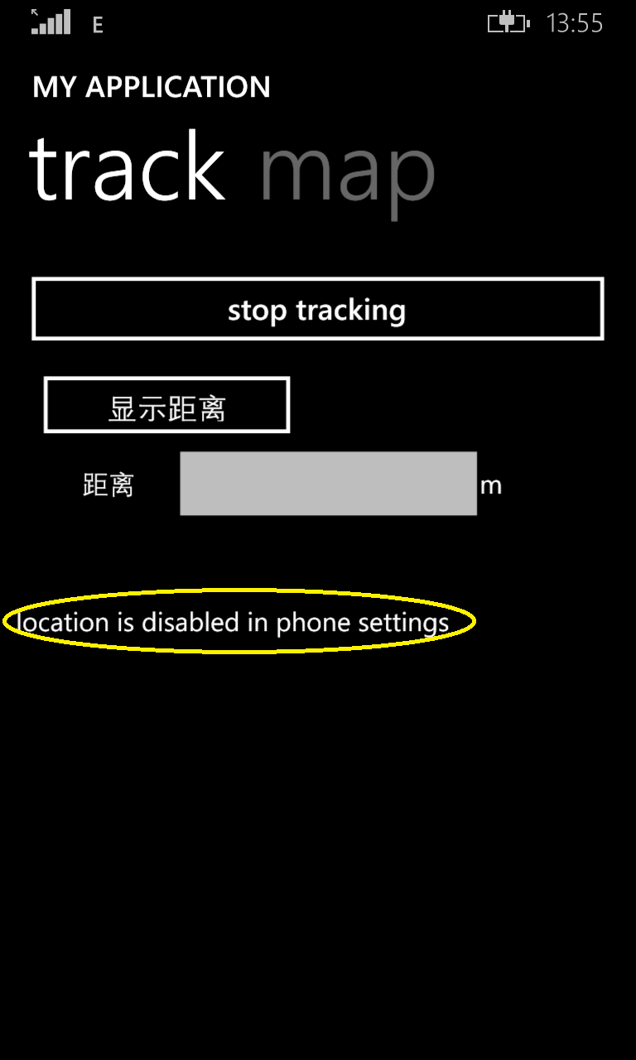
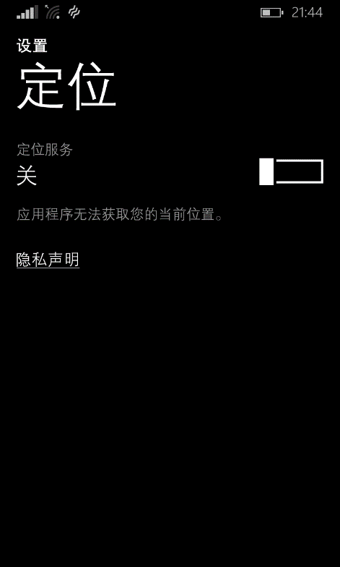
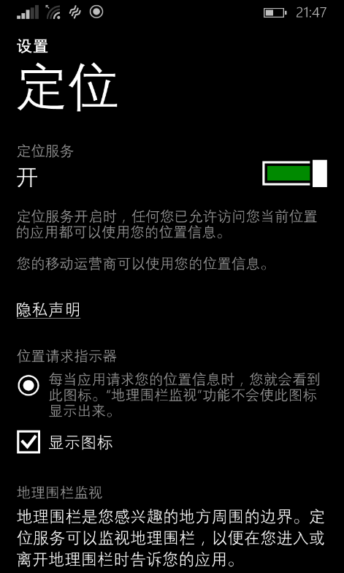
Please turn on the Location before using Smart horn. If you forgot it, Smart Horn will remind you with a message. (Wi-Fi or 4G network is not needed for the application.)
Smart Horn software control

Slide 17
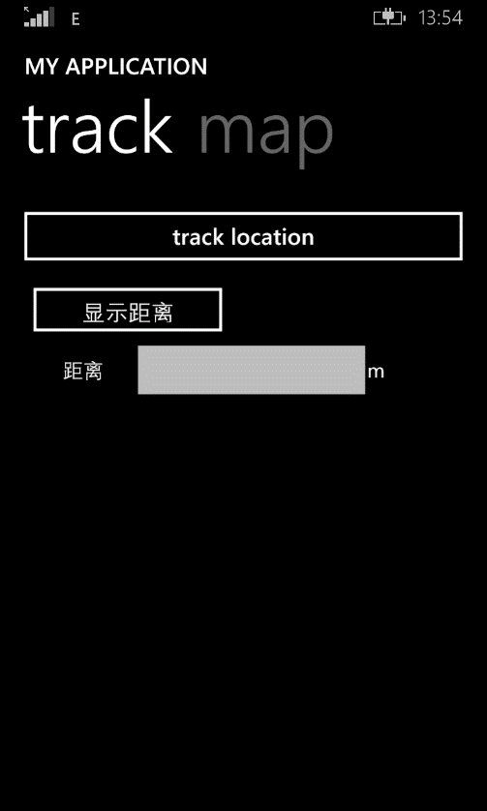
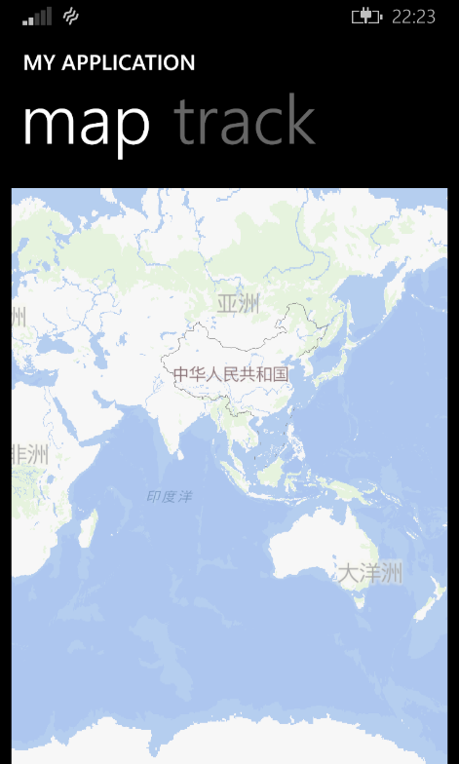
Below are the two main pages. Track and Map
Smart Horn software control

Slide 18
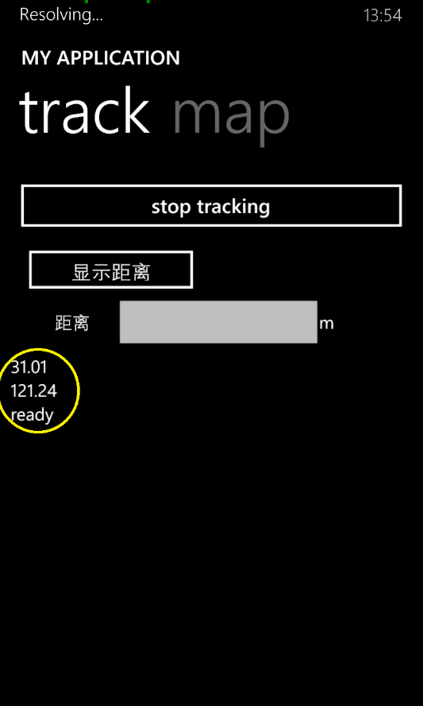
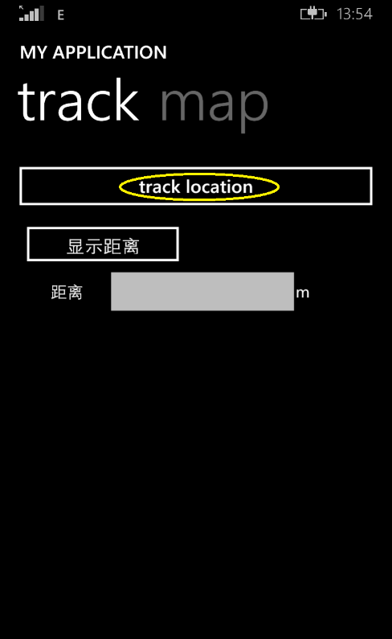
1. Press the button <<track location>>, if you see initializing and latitude and longitude of your location and ready, You have successfully initialized Smart Horn
Smart Horn software control

Slide 19
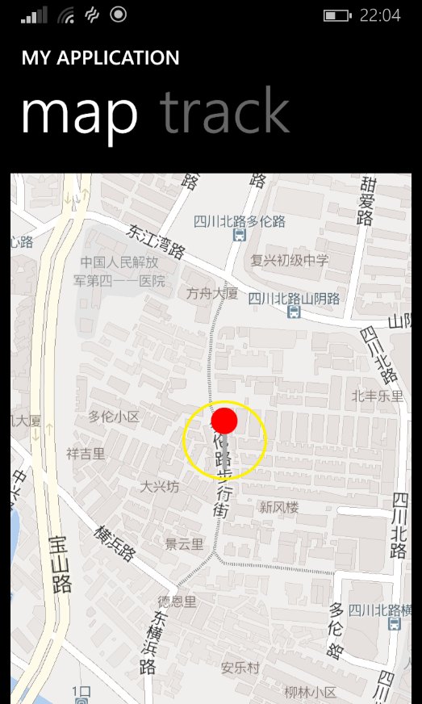
2. Then you will find a mark on the map page, it is your current location
Smart Horn software control

Slide 20
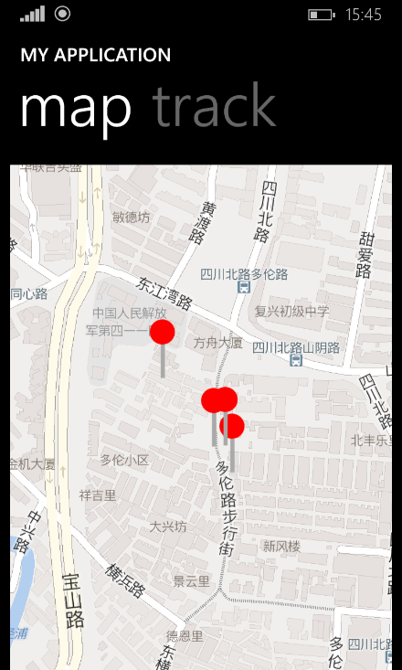
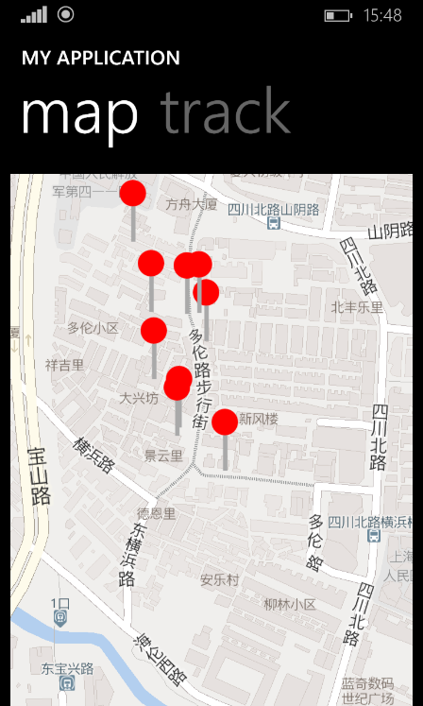
3.With the change of your position, the application will use a lot of mark to record your track of location
Smart Horn software control

Slide 21
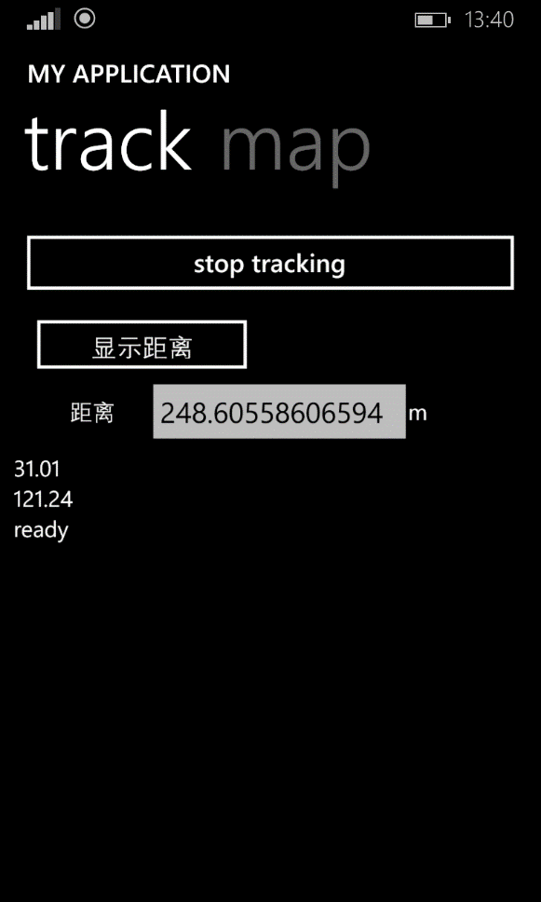
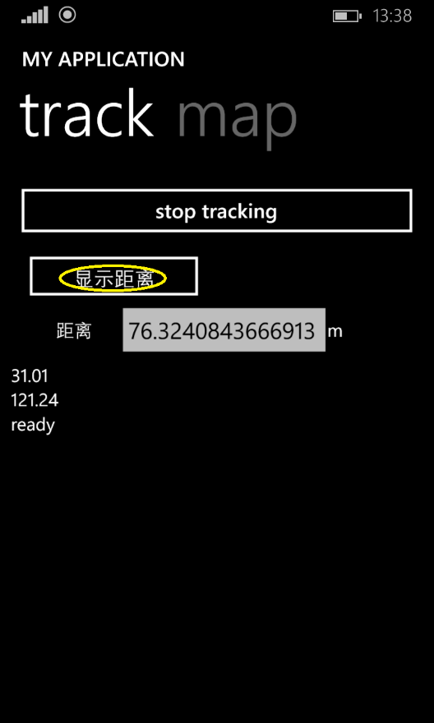
4.Press the <<显示距离>>button, the textbox will display your distance from the first initial button. With the movement the distance will automatically increased
Smart Horn software control

Slide 22
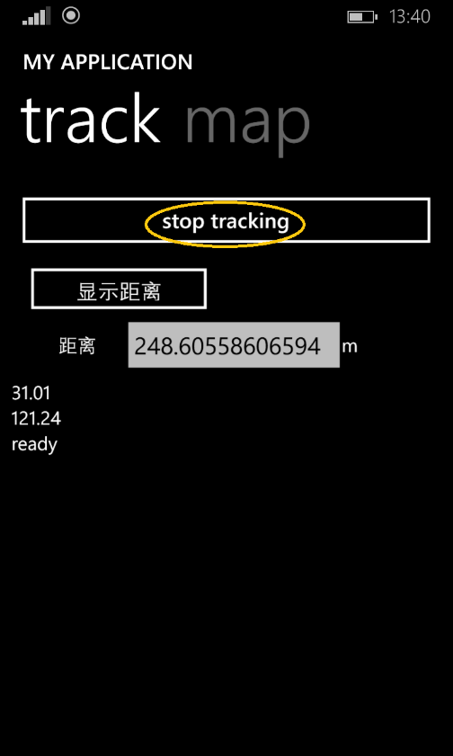
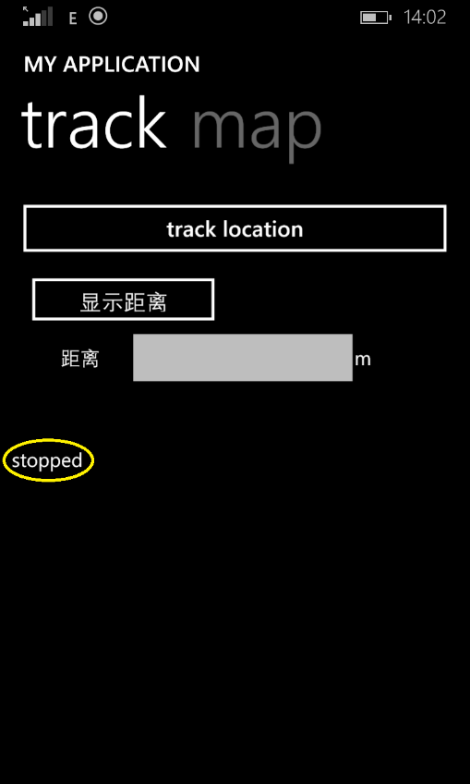
5. Press the <<stop tracking>> button, All the data will be cleared and you can restart it whenever you want.
Smart Horn software control

