Slide 1
LIGHTWEIGHT
Open GL Based 3D Game Engine
Team 11
William DeCook
Wesley Krafft
Claira Safi

Slide 2
Project description
Our project is an extensible game engine designed in Java. The project aimed to provide a sensible and feature-rich environment in which developers can create 3D games or programs. By abstracting away the majority of the rendering and 3D through an API such as our engine, game design is made much simpler and enables developers to focus on the game itself rather than worry about low level implementation.
Our engine aimed to provide the following major features:
Creation and positioning of 3D objects
Rendering of 3D objects
Object behaviors
Creation and positioning of GUI Elements
Rendering of GUI elements
GUI Behaviors
Console Environment
Universal Event System
Spatial Audio Playback
We have also created a space-themed demonstration game that showcases these features.

Slide 3
OpenGL & LWJGL
Our project is designed around LWJGL (Lightweight Java Game Library) which is an open-source Java library that exposes OpenGL commands to the Java environment.
OpenGL is an API built around computer graphics hardware and provides a way for software programmers to talk directly to the GPU. It is essentially a state machine. The basic concept of the drawing process is as follows:
Buffer Data : Store model data into sections of GPU memory
Compile Shaders : Compile special programs that tells OpenGL how to draw things
Set Drawing State : Setup any special states of the GPU (Depth testing, blending…)
Bind Shaders : Tell OpenGL to use one of the Shader Programs you compiled
Bind Buffers : Tell OpenGL to draw from one (or many) of the Buffers you stored
Draw the current combination!
OpenGL “Objects” are pointers to areas in GPU memory, and most of the interaction involves adding data to these pointers or telling the GPU to use the data at those pointers

Slide 4
OpenAL
OpenAL is an API used for rendering audio. It’s style and implementation is based heavily on OpenGL conventions.
There are three main objects that are used in OpenAL:
Buffers : Sound data stored on audio hardware memory
Sources : Spatial position of a sound emitter
A Listener : Spatial position of the listener
OpenAL handles audio samples in way similar to how OpenGL handles texture objects. A buffer stores a sound sample and can be bound to a source. A source can be positioned at different locations in 3D space. How the user experiences this sound is defined by the location and attributes of a listener object (ex. the sound can be louder if the listener is closer to the source).

Slide 5
Scene Graph (Nodes)
To be a useful 3D engine, the developer must be able to do a number of basic things:
Place objects in 3D space
Manipulate these objects (translate, rotate, or scale them)
Attach behaviors to these objects
Create objects from conglomerations of other objects
A very popular way of doing this is known as a Scene Graph, and it is what we used. The scene graph is a tree-like structure where objects are heirarchal.
Each Node (or object) that make up the tree can have one parent Node and many child Nodes.
Additionally, each Node keeps track of a Transform, which contains the Nodes position, rotation, and scale. Child nodes inherit the position, rotation and scale of the parent, so attaching, say, wheels to a car is trivial.

Slide 6
Scene Graph (Components)
The real heart of the engine lies in the Component objects. Components are objects that can be attached to Nodes, and provide an easy way to add properties to the Node. Nodes can have unlimited numbers of components.
Some examples of what can be done with Components:
Rendering : Components can describe 3D models, or any kind of graphics
Physics : Position and rotation of Node can be changed over time
Game AI : Intelligent behavior
User Input : Components can be made to listen for different events
Sounds : Components can control playback of sounds in 3D space
Putting these concepts all together, we have a system where we can place things anywhere in 3D, relate them to each other, and describe them in any way we want.

Slide 7
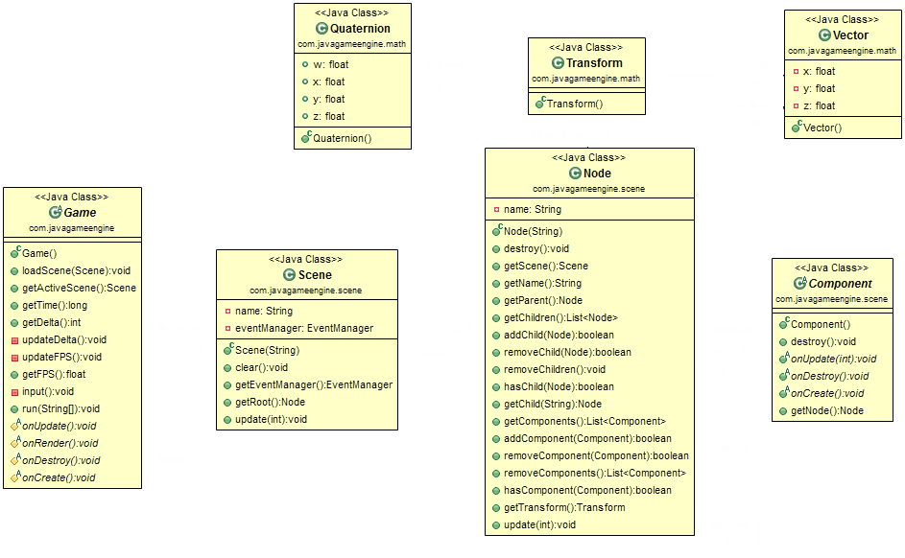
Scene Graph Implementation

Slide 8
GUI
GUI components are drawn using awesomeness

