Slide 1
LIGHTWEIGHT
Open GL Based 3D Game Engine
Team 11
William DeCook
Wesley Krafft
Claira Safi

Slide 2
Project description
Our project is an extensible game engine designed in Java. The project aimed to provide a sensible and feature-rich environment in which developers can create 3D games or programs. By abstracting away the majority of the rendering and 3D through an API such as our engine, game design is made much simpler and enables developers to focus on the game itself rather than worry about low level implementation.
Our engine aimed to provide the following major features:
Creation and positioning of 3D objects
Rendering of 3D objects
Object behaviors
Creation and positioning of GUI Elements
Rendering of GUI elements
GUI Behaviors
Console Environment
Universal Event System
Spatial Audio Playback
We have also created a space-themed demonstration game that showcases these features.

Slide 3


OpenGL & LWJGL
Our project is designed around LWJGL (Lightweight Java Game Library) which is an open-source Java library that simply exposes OpenGL commands to the Java environment and provides very simple APIs for user input devices and communicating with the display. (Hence “lightweight”). It does not provide any of the software framework a game requires.
OpenGL is an API built around computer graphics hardware and it provides a way for software programmers to talk directly to the GPU in the language understood by the GPU. It is essentially a state machine. The basic concept of the drawing process is as follows:
Buffer Data : Store 2D/3D geometry data into sections of GPU memory
Compile Shaders : Compile specially made programs that tells OpenGL how to draw things
Set Drawing State : Enable any special states of the GPU (Depth testing, blending…)
Bind Shaders : Tell OpenGL to use one of the Shader Programs you compiled
Bind Buffers : Tell OpenGL to draw from one (or many) of the Buffers you stored
Draw the current combination!
OpenGL “Objects” are pointers to areas in GPU memory, and most of the interaction involves adding data to these pointers or telling the GPU to use the data at those pointers. We use a number of wrapper classes that extend an abstract NativeObject class to keep track of these on the software side.

Slide 4

OpenAL
OpenAL is an open-source API used for playing spatial audio using hardware. Its style and implementation is based heavily on OpenGL conventions.
There are three main objects that are used in OpenAL:
Buffers : Sound data stored on audio hardware memory
Sources : Spatial position of a sound emitter
A Listener : Spatial position of the listener
OpenAL handles audio samples in way similar to how OpenGL handles buffer objects. A buffer stores a sound sample and can be bound to a source. A source can be positioned at different locations in 3D space. How the user experiences this sound is defined by the location and attributes of a listener object (ex. the sound can be louder if the listener is closer to the source). Since it is so similar to OpenGL, we reuse the NativeObject class to keep track of audio buffers on the hardware side.

Slide 5
Scene Graph (Nodes)
To be a useful 3D engine, the developer must be able to do a number of basic things:
Place objects in 3D space
Manipulate these objects (translate, rotate, or scale them)
Attach behaviors to these objects
Create objects from conglomerations of other objects
A very popular way of doing this is known as a Scene Graph, and such a model is what we decided to implement. The scene graph is a tree-like structure where 3D objects are related in a hierarchy.
Each Node (or object) that make up the tree can have one parent Node and many child Nodes. Additionally, each Node keeps track of a Transform object, which contains the Nodes position, rotation, and scale. Child nodes inherit the position, rotation and scale of the parent, so attaching, say, wheels to a car is a trivial matter. Moving the car will naturally move all child wheels automatically.

Slide 6
Scene Graph (Components)
The real heart of the engine lies in the Component objects. Components are objects that can be attached to Nodes, and provide an easy way to add properties to the Node other than simple spatial information. Nodes can have unlimited numbers of components. Component is an abstract class, and the developer is meant to extend it to create unique types of components.
Some examples of what can be done with Components:
Rendering : Components can describe 3D models, or any kind of graphics
Physics : Position/rotation of the component’s Node can be changed over time
Game AI : Intelligent behavior
User Input : Components can be made to listen for different events
Sounds : Components can control playback of sounds in 3D space
Putting these concepts all together, we have a system where we can place things anywhere in 3D, relate them to each other, and describe how they look and behave in any way we want.

Slide 7
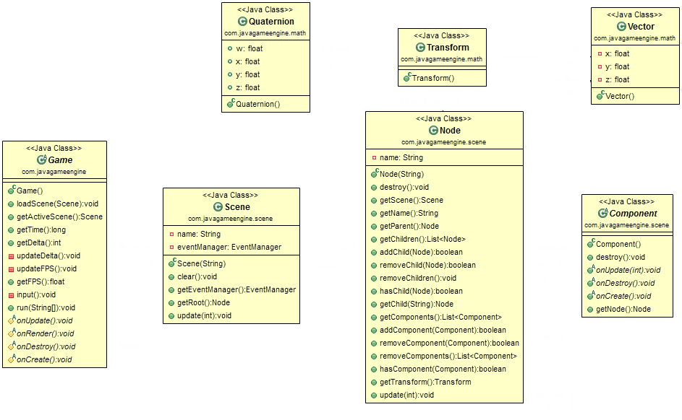
Scene Graph (Implementation)

Slide 8
GUI
GUIs (Graphical User Interfaces) within the engine are primarily made up of GUIcomponents, which have a similar type of hierarchy as the Scene Graph Nodes. There is also a GUI class which is a container for a particular GUI state, and which contains GUIcomponents.
The GUIcomponent class is extended to create special components. For example, we extend it in the Button and TextBox classes, which enable user input and the display of text respectively.
Various methods within these classes can be overridden to allow for separate instances of the same class to have different functionality.
If the component has a shape, it is drawn using OpenGL at the end of the rendering session, on top of the 3D scene.

Slide 9
Game Loop
Finally, to put it all together, we need a game loop. This is a continuously running loop that updates the game over time. Each run of the game loop is called a frame.
There are a number of things that need to be done in the loop:
User Input : We get Mouse/Keyboard IO events from LWJGL
Logic Update : We update the logical behavior of all objects. This is where time-dependent behaviors are updated, Events are fired, and event Listeners are called
Render : We set up the Renderer class with all of our objects we need to draw and the states associated with each, then draw them

