Slide 1








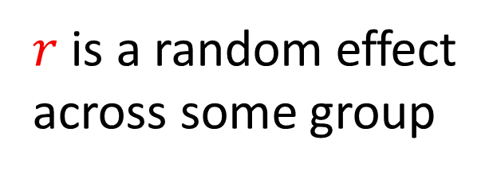
Data-filtering-based or model-based: methods comparison for a data-limited-stock abundance indicator. Case study on a striped red mullet stock. Kermorvant Claire¹, Bru Noëlle¹, Deniau Clémentin², Lissardy Muriel², Caill-Milly Nathalie² ¹ CNRS/Univ Pau & Pays Adour, Laboratoire de Mathématiques et de leurs Applications de Pau - Fédération MIRA, UMR 5142, 64600 Anglet, France ² Ifremer, LITTORAL, 64600 Anglet, France
SACROIS data
Fishing sequences of all otter bottom trawl (OTB) which have ever fish red-mullet in ICES subarea 8
Development of abundance indicators is important for the sustainable monitoring of exploited resource stocks. International Council for the Exploitation of the Sea (ICES) classifies the western stock of north Atlantic striped red mullet (Mullus surmuletus) as a Data Limited Stock. Only Landings Per Unit Effort (LPUE) data are currently available.
One of the most used method to study LPUE data are Generalized Additive Mixte Model (GAMM). We decided to use LPUE as abundance indicator of red mullet stock through GAMM, within ICES subarea 8 (including Bay of Biscay) and during the 2000-2023 period.
Data cleaning: focus on the meaningful information
At least 1 sequence of red mullet by vessel × year
How much performance of GAMM modeling and abundance indicator prevision vary according to the data preprocessing ?
Reminder: GAMM models
Intercept
Residuals:
non-explained LPUE variability
$${E\left(LPUE\right)}_{i} =β_{0r}+{f\left(Var\right)}_{ir}+ ε_{ir}$$
Second method:
medium data processing
Third method:
complex data processing
First method:
without data processing
Mean LPUE
Function of explicative variable
$r$ is a random effect
across some group
Spatio-temporal aggregation (year ×15 days duration period × ICES rectangle × vessel): selection of the useful statistical unit
Fishing time is maximum 1 hour*
Vessel must be present more than 4 years*
At least 24 fishing sequences by year*
Fishing time is maximum 1 hour*
Not considered
filter
Vessel must land more than 500 kg by year*
Mesh size between 20 and 320 mm*
Mesh size between 20 and 320 mm*
Best GAMM model selection (based on AIC) for both methods
Analysis of goodness-of-fit and GAMMs residuals
Activity
filter
LPUE is more than 0,4 kg* (1 fish)
Research and discussions with professionals to keep or remove suspicious data
Not considered
Fishing
filter
Anormal data
More than 2 sequences in a new groups
Cut into two periods following a change in LPUE declarations
Creation of vessels typologies by machine learning analysis :
Principal Component Analysis coupled with Hierarchical Ascendant classification
Other filters
Not considered
Best pre-processing method to create a red-mullet abundance indicator
Data pre-analysis
* Discussed and approved by professional fishermen during working groups
This is an ongoing work, please feel free to ask us for more information or to share ideas of improvement!
XVIIIth International Symposium on Oceanography of the bay of Biscay (ISOBAY 18) – 5th to 7th June 2024
Notes:
Discussion groupe de travail !

