Slide 1
Predicting muscle loss after radiotherapy in oral cavity cancer
Ning-Hsiang Weng
Date : 2025.08.25

Slide 2
Model Features: (黃色亮底, 請加入model)
下列是臨床因子(左側)及副作用因子(右側)
Age
Sex
ECOG
Tumor_site
Stage
Chemotherapy
Smoking
pre-BMI
BMI change
pre-SMI
Dermatitis
Mucositis
Xerostomia
Dysphagia
Pain
Anorexia
Nausea
Fatigue
2

Slide 3
CCH cohort
(0: 428/ 1: 144)
30%
Internal Test Data
(0: 129/ 1: 43)
MMH cohort
(External Test Data )
(0: 250/ 1: 81)
70% Training data
(0: 299/ 1: 101)
Bootstrap 500 times
Training Set (bootstrap samples)
Validation Set
(OOB: out-of-bootstrap samples)
Apply SMOTE to balance training set (Positive: Negative = 1:1)
Model training (RF, XGB, CatBoost)
Each round trains with different hyperparameters and evaluates performance using validation set(OOB)
Select hyperparameter combination with best average performance
Retrain on entire 70% training set + SMOTE + best hyperparameters

Slide 4
CCH cohort (n=)
MMH cohort (n=)
Exclusion:
History of prior malignancy (n=)
Insufficient clinical data (n=)
Insufficient toxicity data (n=)
No post-RT CT scans (n=)
Insufficient follow-up data (n=)
Exclusion:
History of prior malignancy (n=)
Insufficient clinical data (n=)
Insufficient toxicity data (n=)
No post-RT CT scans (n=)
Insufficient follow-up data (n=)
Derivation set (n=572)
External validation set (n=331)
Clinical and toxicity features
Internal validation (30%)
Training (70%)
Explanation with SHAP
Bootstrap sample on training set
SMOTE to deal with data imbalance
Positive : Negative = 1:1
Repeat 500 times
RF
XGBoost
CatBoost
Selection of best performing model:
RF
XGBoost
CatBoost
Evaluate performance of models
Notes:
This
4

Slide 5
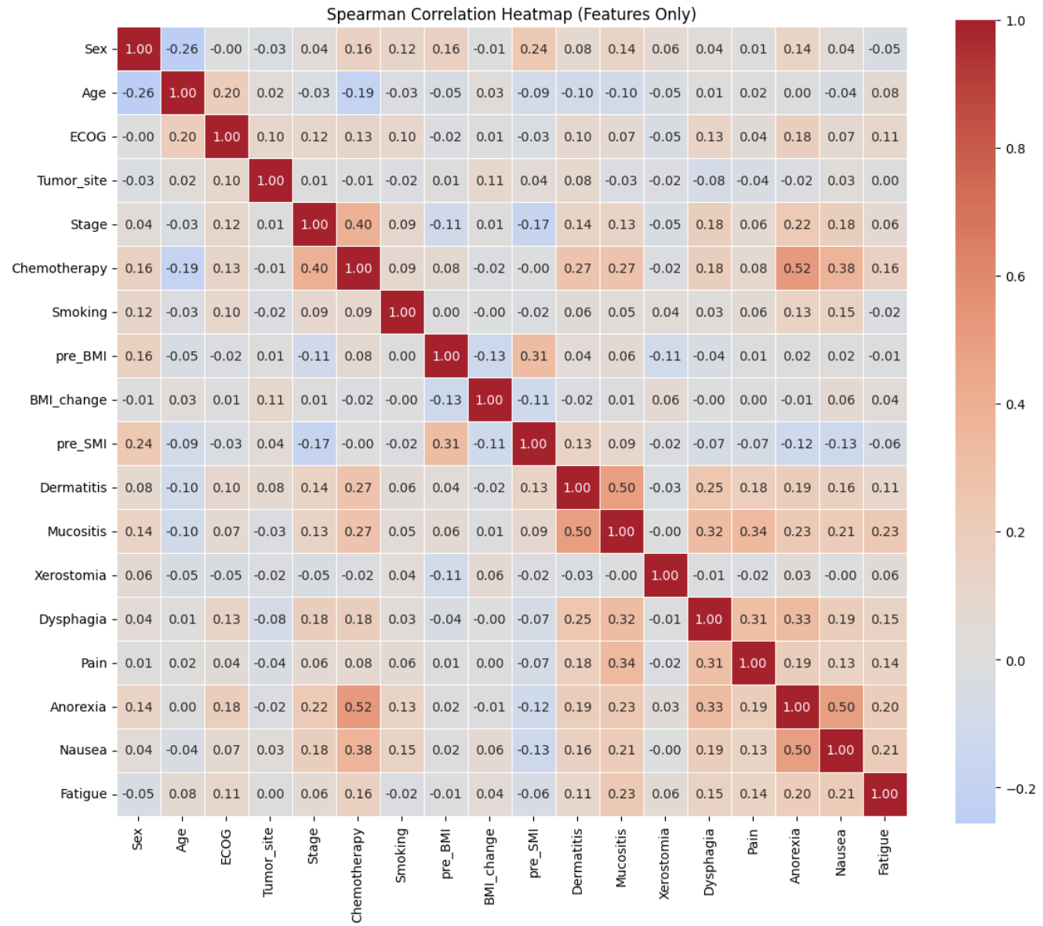
Notes:
Chemotherapy 化學治療 和Anorexia 食慾不振: 0.581199
Anorexia食慾不振 Nausea噁心: 0.549797
Dermatitis皮膚炎 Mucositis黏膜炎 : 0.529775

Slide 6
Training set (70% CCH)
Table Model performance in the Training set.
Model | F1 score | AUC | Sensitivity | Specificity | Precision | Accuracy
RF | 0.795 (0.716, 0.860) | 0.943 (0.915, 0.971) | 0.759 (0.626, 0.887) | 0.951 (0.914, 0.980) | 0.840 (0.748, 0.931) | 0.902 (0.868, 0.932)
XGBoost | 0.798 (0.722, 0.863) | 0.939 (0.910, 0.968) | 0.795 (0.667, 0.909) | 0.935 (0.890, 0.972) | 0.807 (0.697, 0.903) | 0.900 (0.867, 0.930)
CatBoost | 0.799 (0.722, 0.862) | 0.942 (0.910, 0.970) | 0.790 (0.654, 0.906) | 0.938 (0.897, 0.972) | 0.813 (0.711, 0.901) | 0.900 (0.868, 0.932)
Notes:
SMOTE 1:1

Slide 7
Hyperparameter of final models
model | Hyperparameter
Random forest | max_depth: 3 max_features: 'sqrt’ min_samples_leaf: 3 min_samples_split: 8 n_estimators: 169
XGBoost | colsample_bytree: 0.7132174938466316 gamma: 0.8934987308365134 learning_rate: 0.012373297085065264 max_depth: 4 min_child_weight: 10 n_estimators: 127 reg_alpha: 1.9806001782849103 reg_lambda: 4.902898908128205 subsample: 0.7922278712012697
CatBoost | 'auto_class_weights': 'Balanced', 'bagging_temperature': 0.20006561136230805, 'border_count': 132, 'depth': 4, 'iterations': 167, 'l2_leaf_reg': 1.2211010200894439, 'learning_rate': 0.01356569347892665, 'random_strength': 0.1359188776651899, 'rsm': 0.8136667289564085

Slide 8
Internal validation set (30% CCH)
Table Model performance in the internal validation set.
Model | F1 score | AUC | Sensitivity | Specificity | Precision | Accuracy
RF | 0.831 | 0.964 | 0.744 | 0.985 | 0.941 | 0.924
XGBoost | 0.825 | 0.958 | 0.767 | 0.969 | 0.892 | 0.919
CatBoost | 0.821 | 0.966 | 0.744 | 0.977 | 0.914 | 0.919

Slide 9
External validation set (MMH)
Table Model performance in the external validation set.
Model | F1 score | AUC | Sensitivity | Specificity | Precision | Accuracy
RF | 0.910 | 0.993 | 0.877 | 0.984 | 0.947 | 0.958
XGBoost | 0.899 | 0.991 | 0.938 | 0.952 | 0.864 | 0.949
CatBoost | 0.921 | 0.994 | 0.938 | 0.968 | 0.905 | 0.961

Slide 10
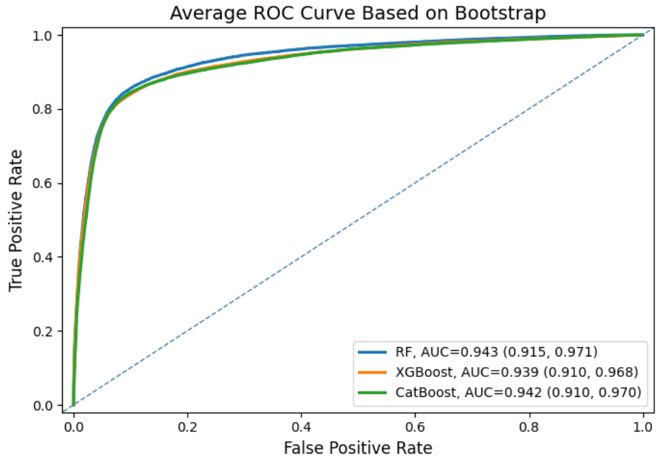
ROC plot Training set 平均 ROC
10
Notes:
10

Slide 11
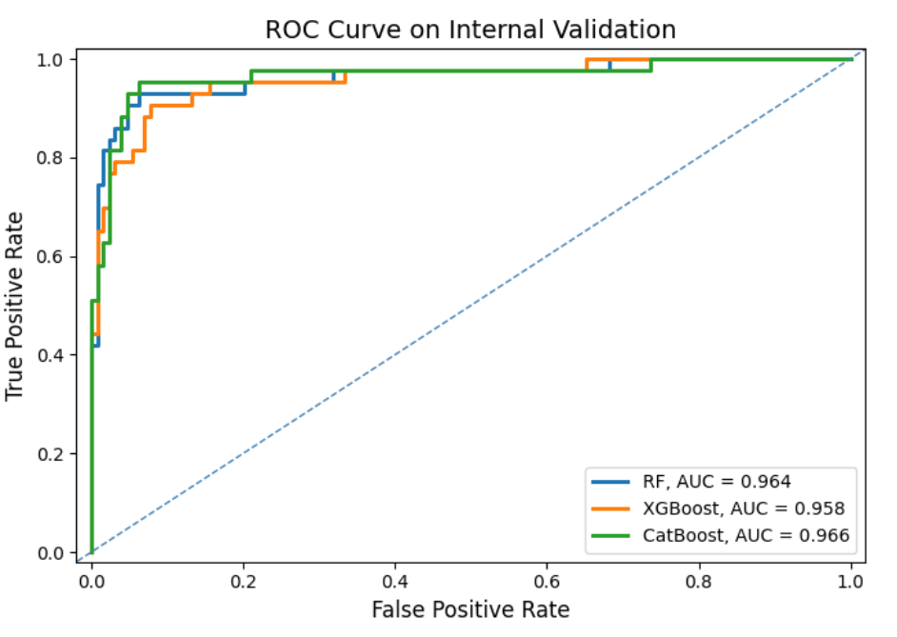
Internal validation ROC curves.
11
Notes:
11

Slide 12
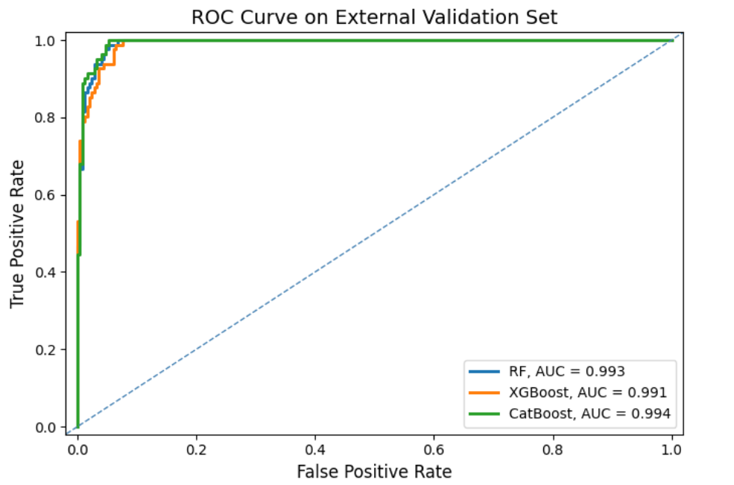
External validation ROC curves.
12
Notes:
12

Slide 13
SHAP method requirement
請以 CatBoost model 進行 SHAP
需要的SHAP plots (training, internal validation, external validation三組均需要)
SHAP importance plot.
SHAP summary plot
SHAP dependence plot
SHAP force plot .

Slide 14
SHAP plots 內feature名稱呈現
製作SHAP plots請注意圖內各feature名稱需依照下列相對應的名稱呈現 (左邊是excel資料的名稱, 右邊是圖片呈現的名稱)
Age: Age
Sex: Sex
ECOG: ECOG
Tumor_site: Tumor site
Stage: Stage
Chemotherapy: Chemotherapy
Smoking: Smoking
pre_BMI: Pre-BMI
BMI change:
pre_SMI_1: Pre-SMI
Dermatitis: Dermatitis
Mucositis: Mucositis
Xerostomia: Xerostomia
Dysphagia: Dysphagia
Pain: Pain
Anorexia: Anorexia
Nausea: Nausea
Fatigue: Fatigue

Slide 15
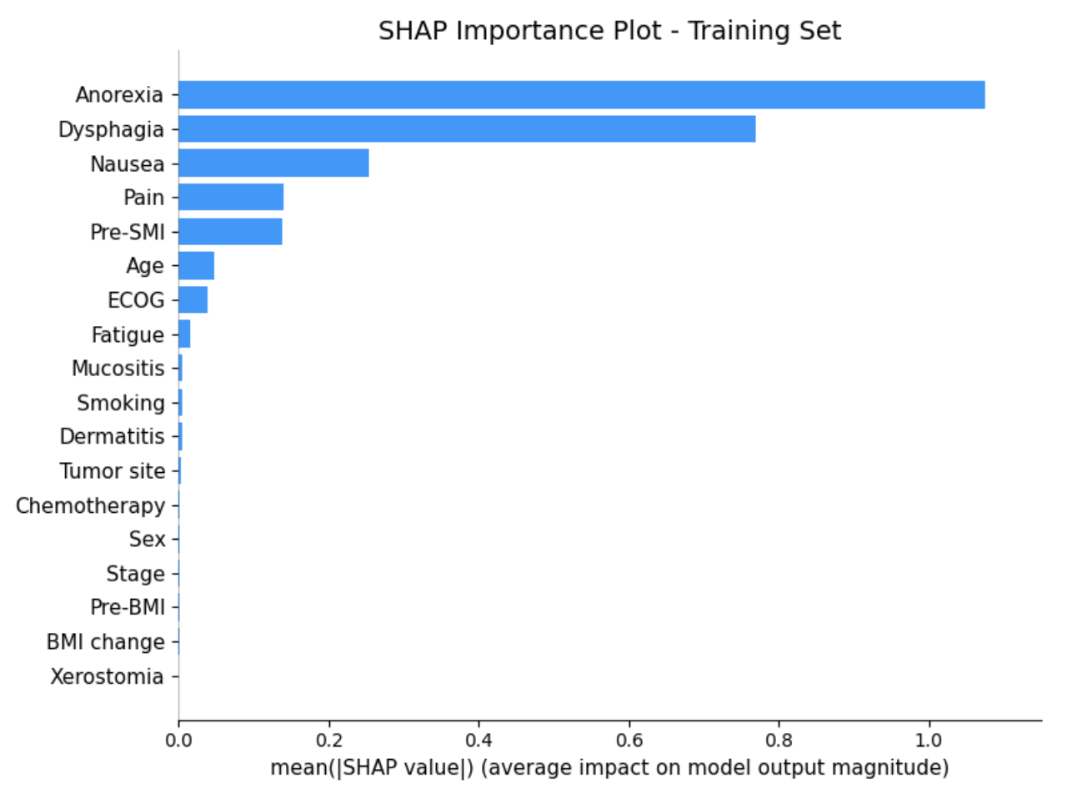
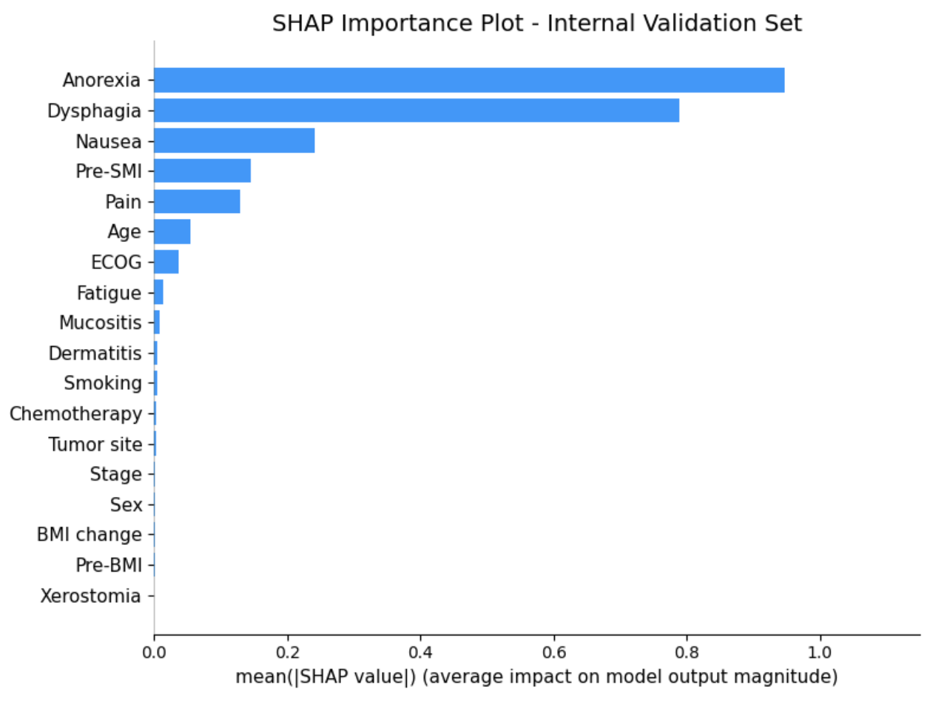
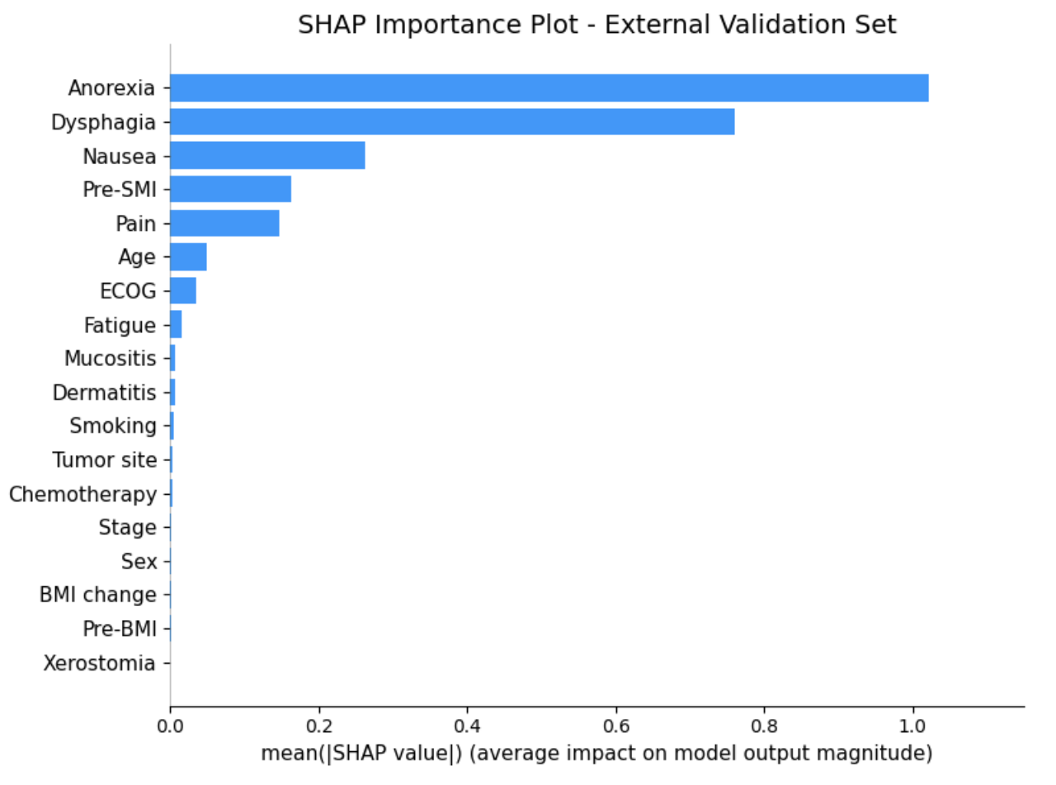
SHAP importance plot (CatBoost model for muscle loss)
Training data
Internal validation data
External validation data

Slide 16
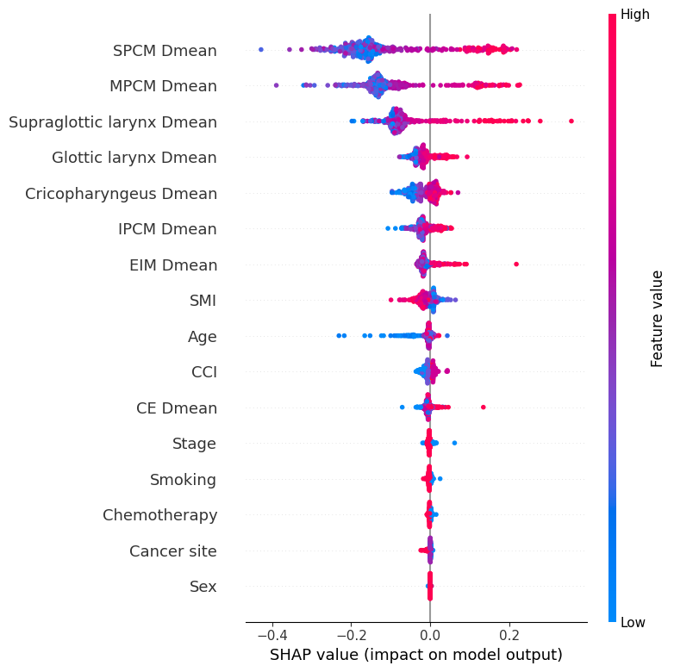
SHAP feature summary plot
製作SHAP plots的請注意圖內各feature名稱需依照下列相對應的名稱呈現 (左邊是excel資料的名稱, 右邊是圖片呈現的名稱), 右圖是之前製作的RF範例.
Age: Age
Sex: Sex
ECOG: ECOG
Tumor_site: Tumor site
Stage: Stage
Chemotherapy: Chemotherapy
Smoking: Smoking
pre_BMI: Pre-BMI
BMI change:
pre_SMI_1: Pre-SMI
Dermatitis: Dermatitis
Mucositis: Mucositis
Xerostomia: Xerostomia
Dysphagia: Dysphagia
Pain: Pain
Anorexia: Anorexia
Nausea: Nausea
Fatigue: Fatigue

Slide 17
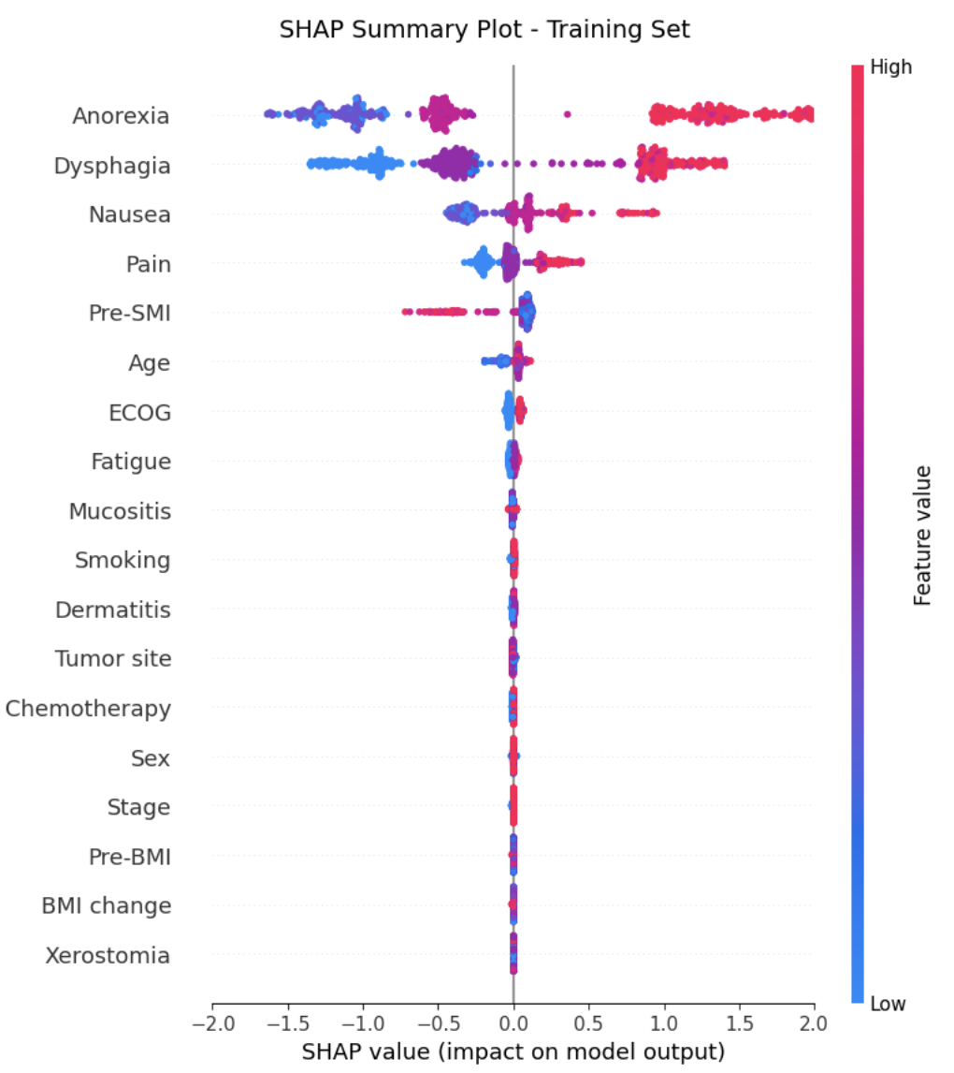
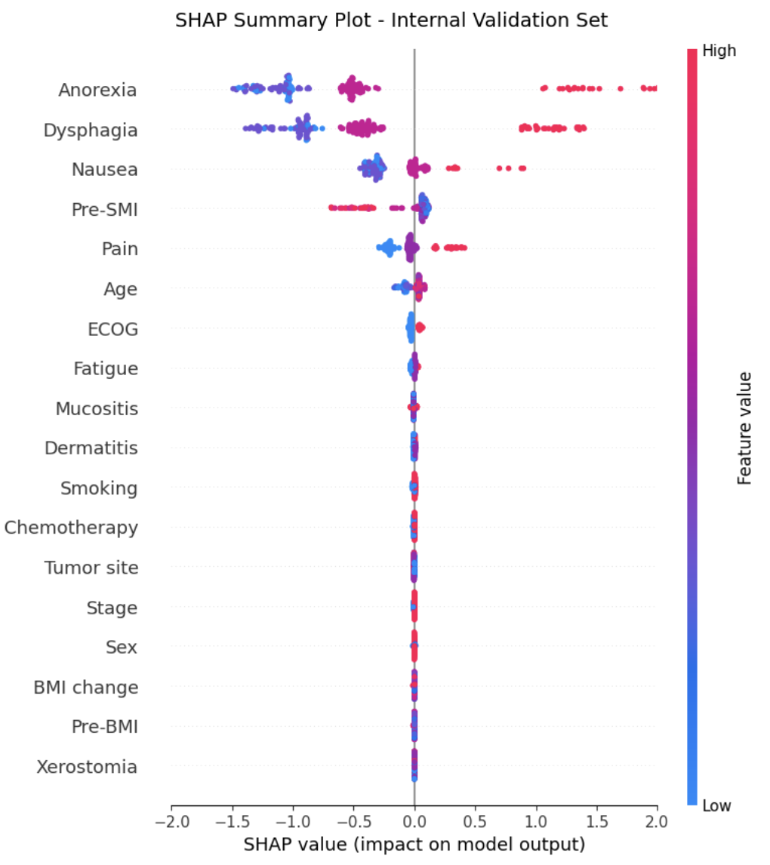
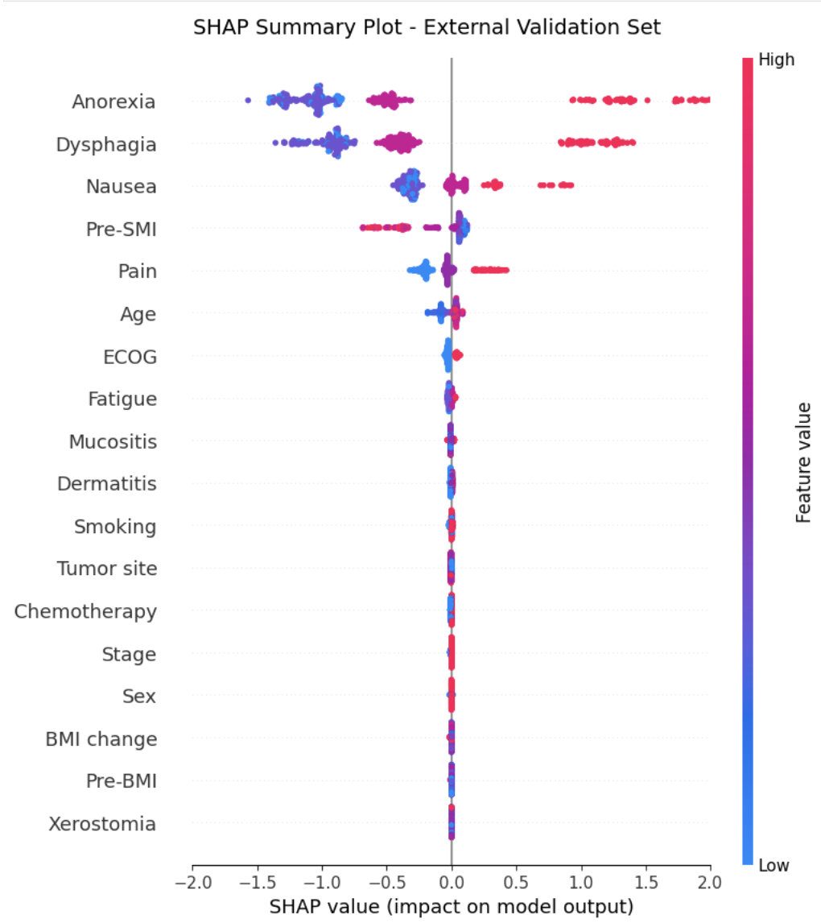
SHAP feature summary plot (CatBoost for muscle loss)
Training data
Internal validation data
External validation data

Slide 18
SHAP dependence plot (RF model)
接下來要製作SHAP dependence plots,各slide左下角有標示需要的內容.
Training, internal validate, and external validate 均需要
圖片請注意x,y 軸的名稱, 各個點需要藍->紅呈現feature value高低, 底面請留白底勿格紋 (可比照slide圖片的呈現方式); 各圖的尺寸大小需一致
這些 Dependence plot可以幫助了解各features與SHAP value的關聯, 進一步解讀feature與肌肉流失的關聯.

Slide 19
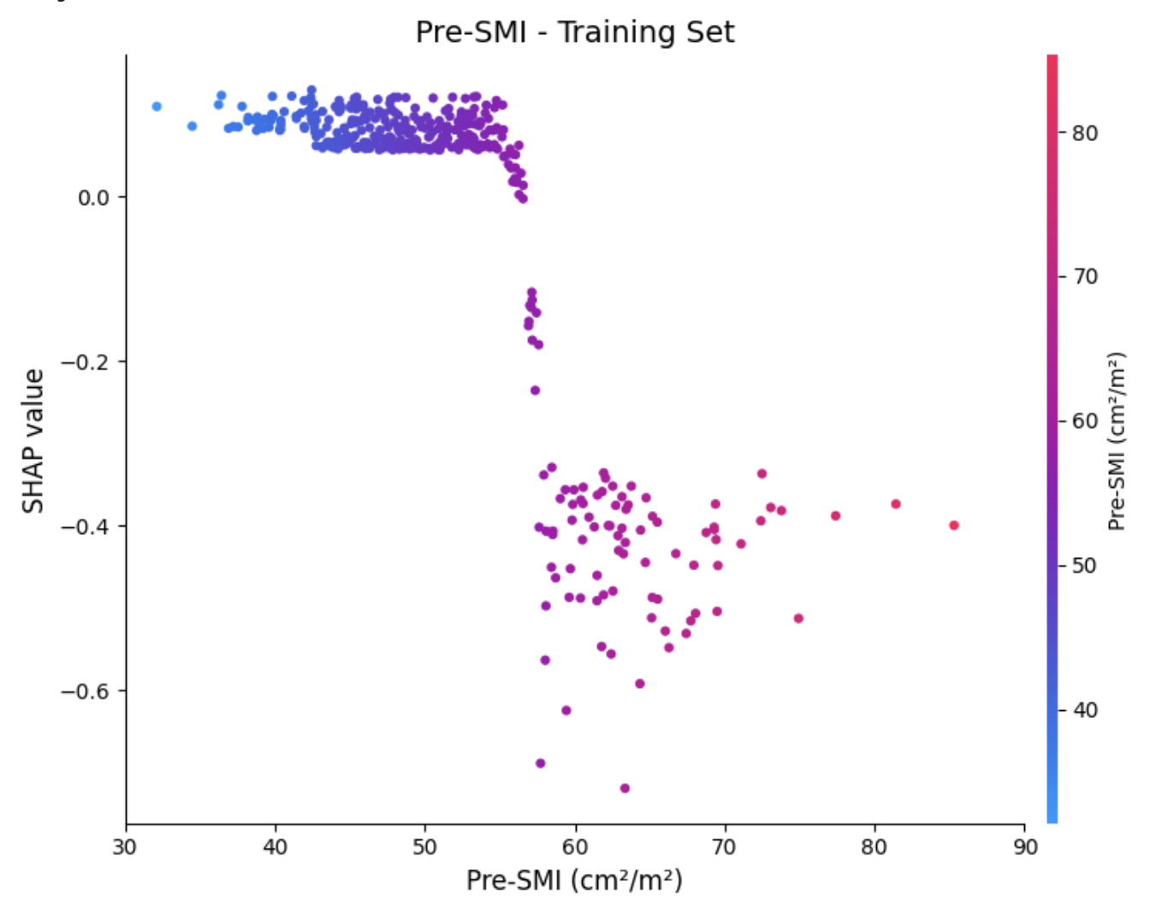
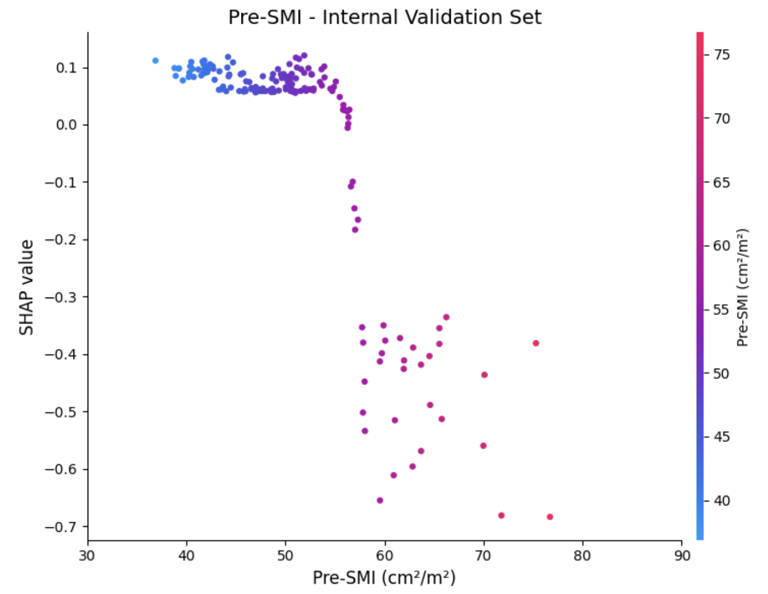
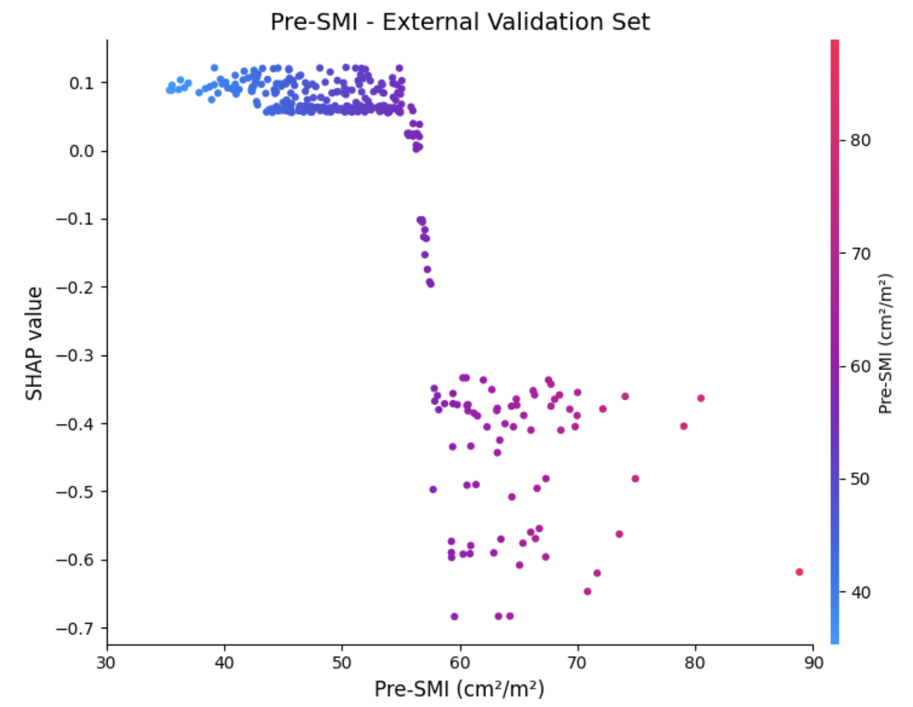
若有重跑, 也請更新
請提供”CatBoost” Pre-SMI 的SHAP dependence plots
左邊training data, 中間internal validate data, 右邊是External data
SHAP Dependence plot
CatBoost
Pre-SMI
圖片X軸: Pre-SMI (cm²/m²)
圖片Y軸: SHAP value
XY軸
請注意單位
19

Slide 20
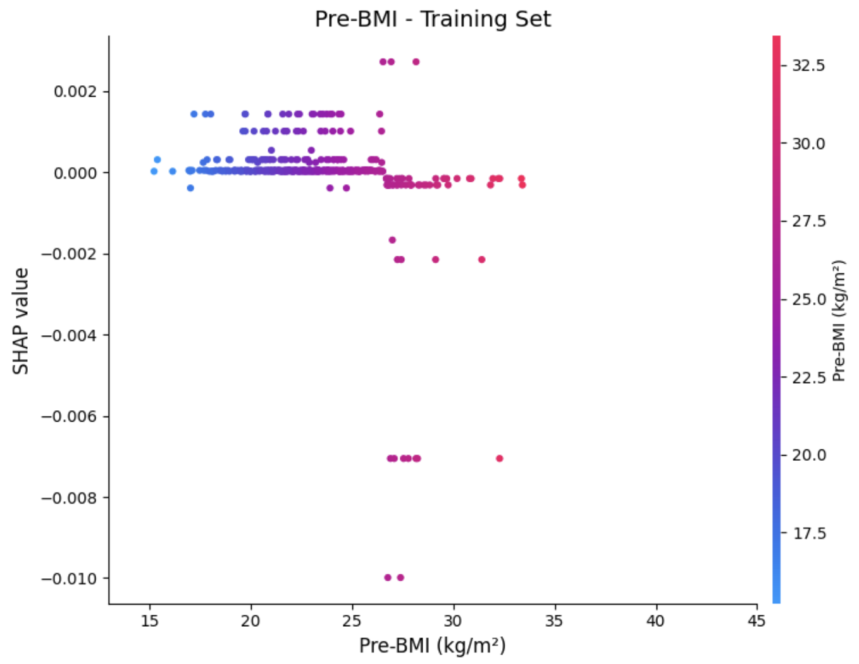
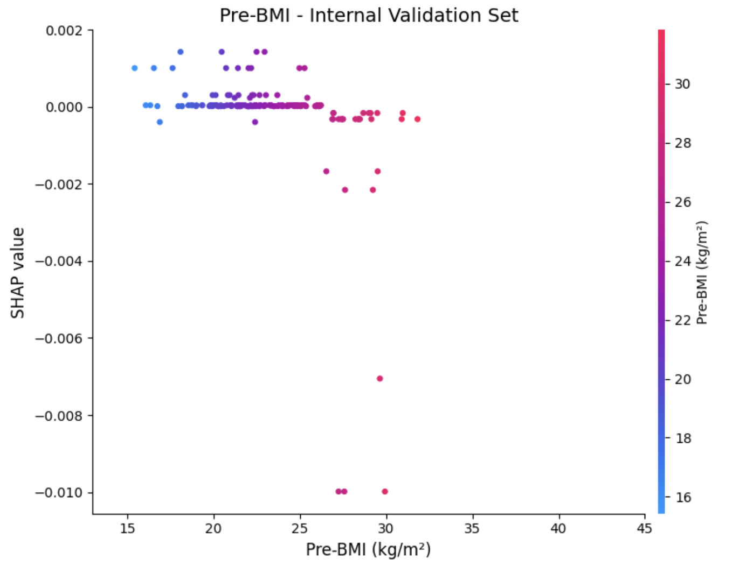
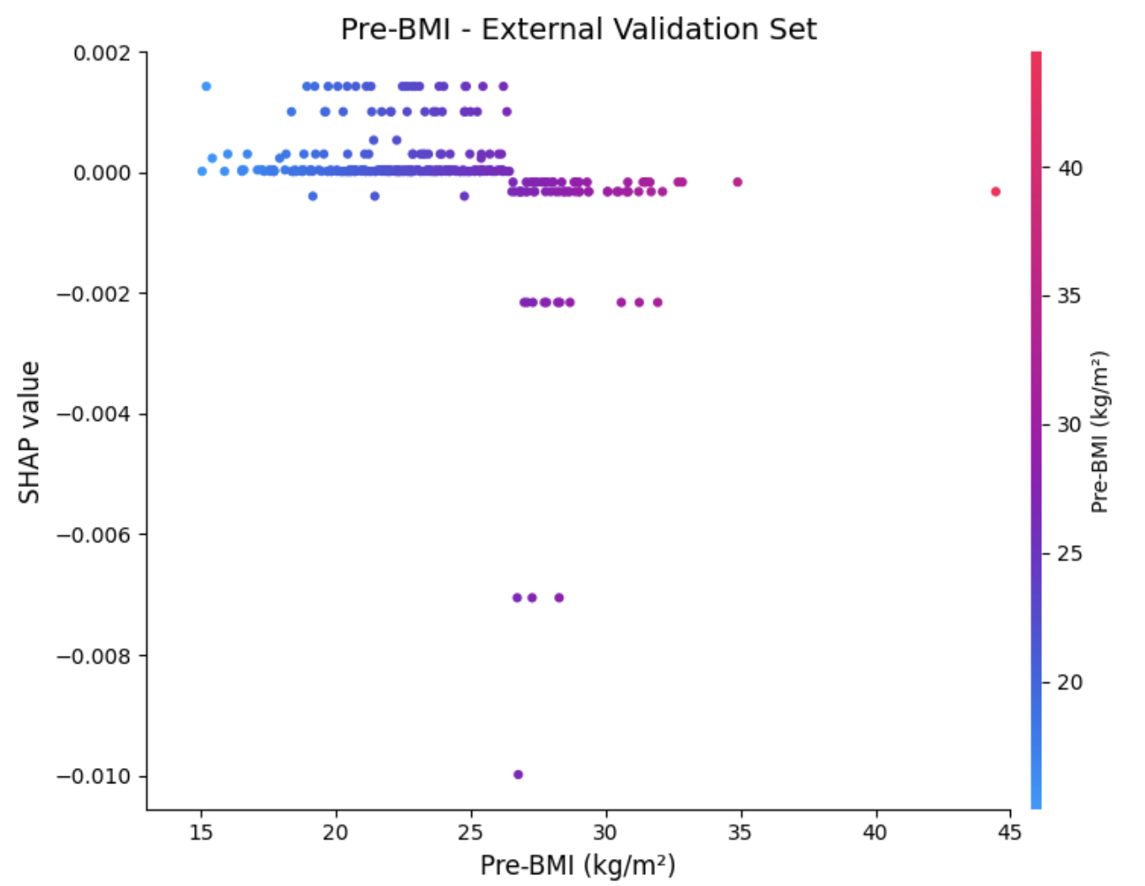
若有重跑, 也請更新
請提供”CatBoost” pre-BMI 的SHAP dependence plots
左邊training data, 中間internal validate data, 右邊是External data
SHAP Dependence plot
CatBoost
Pre-BMI
圖片X軸: Pre-BMI (kg/m²)
圖片Y軸: SHAP value
XY軸
請注意單位
20

Slide 21
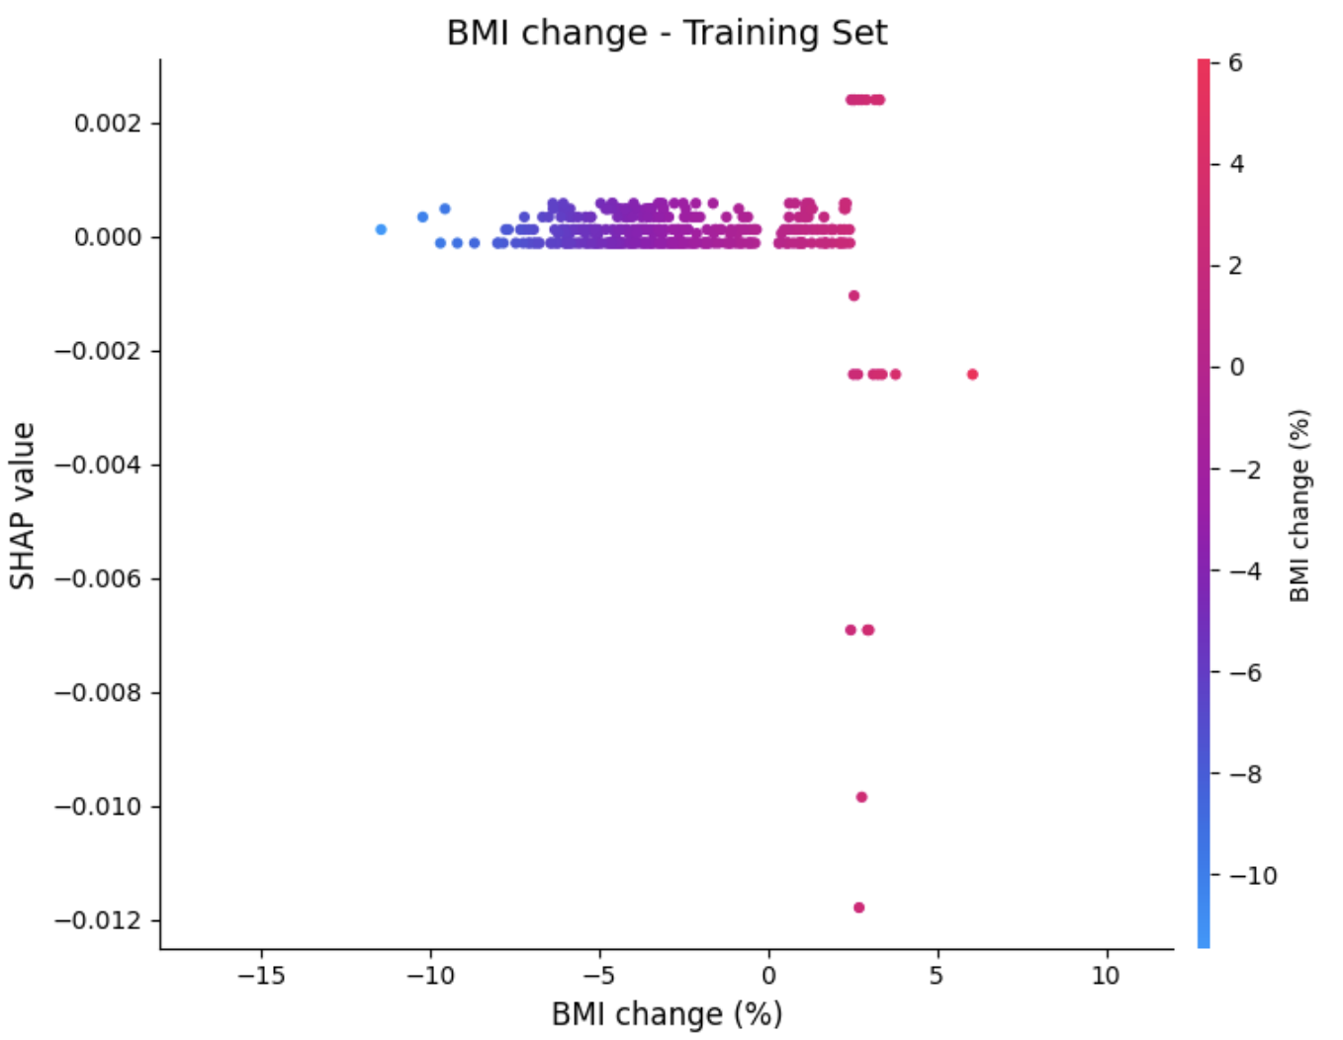
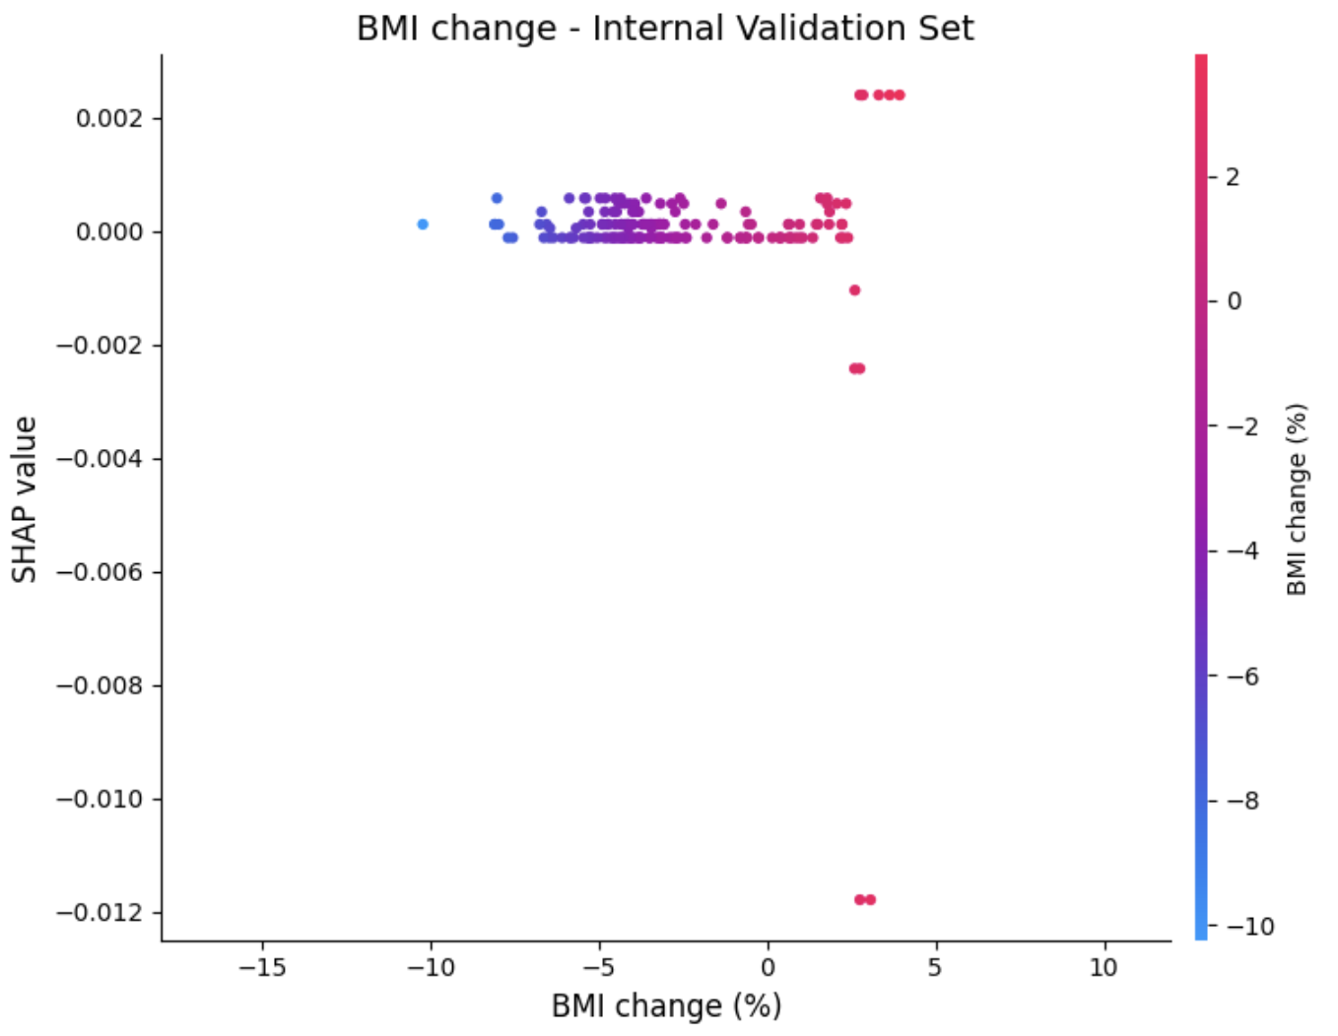
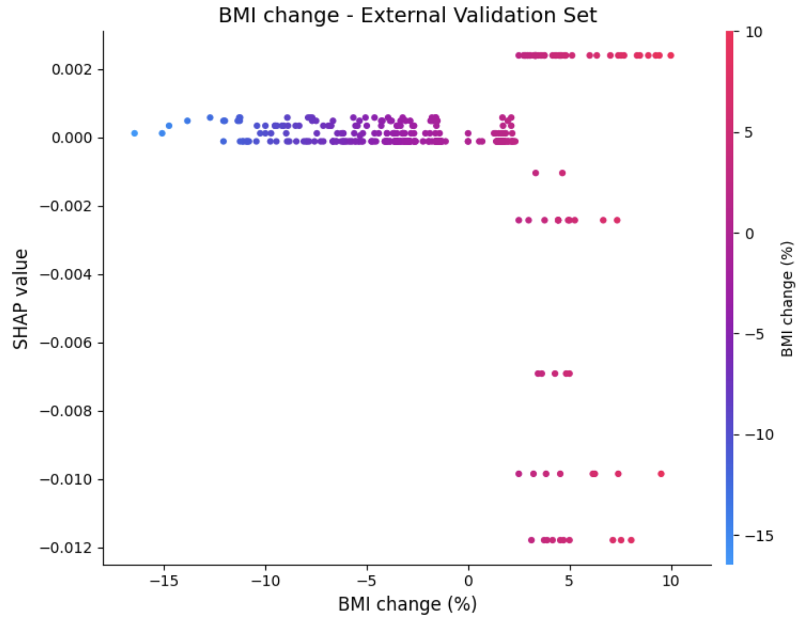
若有重跑, 也請更新
請提供”CatBoost” BMI_change 的SHAP dependence plots
左邊training data, 中間internal validate data, 右邊是External data
SHAP Dependence plot
CatBoost
BMI_change
圖片X軸: BMI change (%)
圖片Y軸: SHAP value
XY軸
請注意單位
21

Slide 22
SHAP force plot
SHAP force plot有助了解各個案的預測, 而且可以了解哪些feature對muscle loss發生的預測有重大的貢獻, 這些資訊可以幫助臨床調整放射治療照護計畫.
若是可行, 請提供每名個案的SHAP force plot
SHAP force plots呈現方式可參考slide 23-24 (需要probability; feature以raw data呈現).

Slide 23
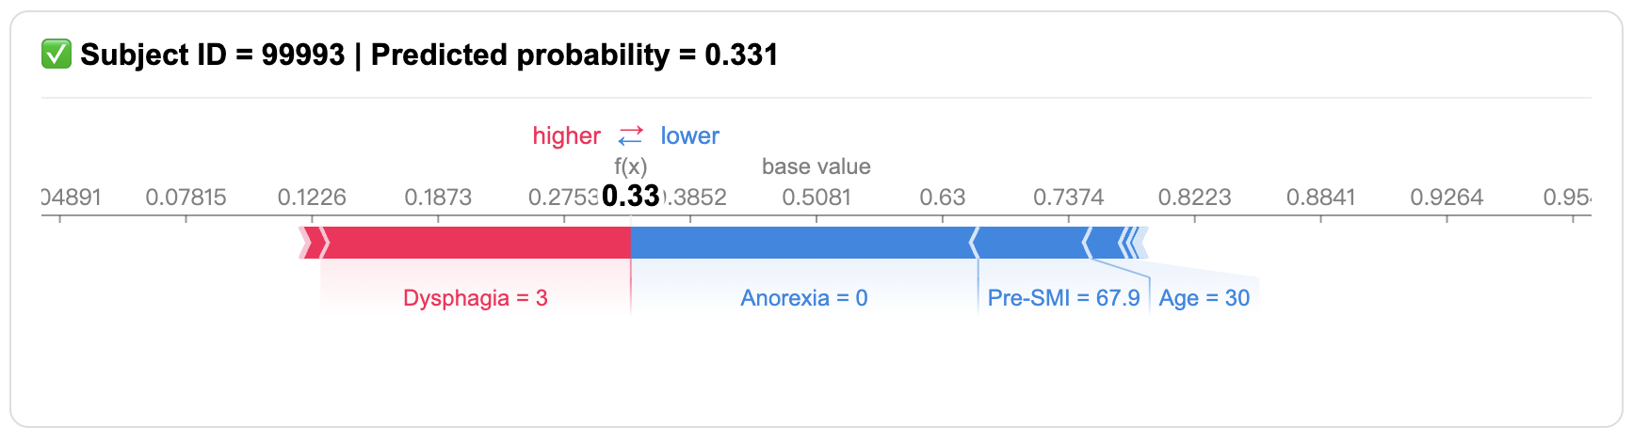
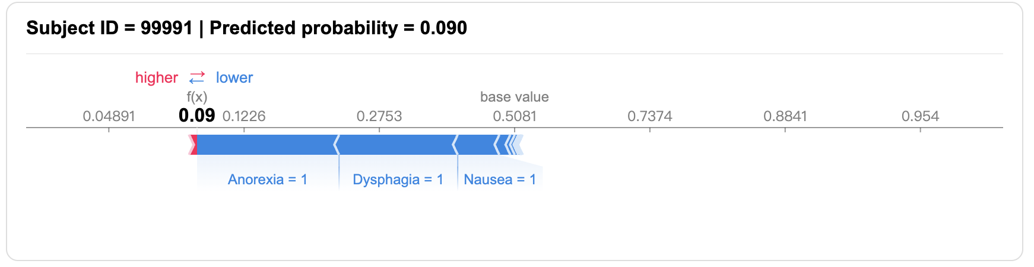
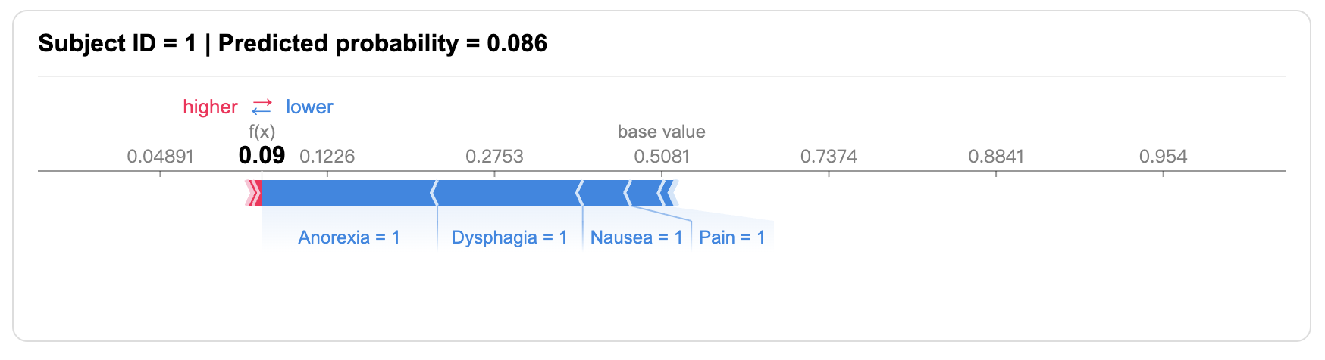
SHAP force plot
Training data
Internal validation
data
External validation
data

