Slide 1
Survival Analysis and Threshold Discovery from Pre-treatment Skeletal Muscle Index and Density in Cancer Patients Using Explainable AI
Student：Ning-Hsiang Weng
Advisor：Kun-Pin Wu, PH.D.
Date : 2025.06.05
Notes:
本研究採用存活分析模型，建構以治療前骨骼肌指標預測癌症病患整體存活風險的模型，並進一步透過可解釋 AI 工具（如 SHAP），發掘具有臨床意義的風險切點（cut-point）。

Slide 2
Contents
2. Study Design and Methodology
2.1 Study Workflow and Data
2.2 Survival Modeling and Evaluation
2.3 SHAP-based Interpretation, Threshold Discovery and Validation
2.4 Preliminary Results
2.5 Conclusion and Future Work
Background and Motivation
1.1 Definition and Prognostic Role of Skeletal Muscle Index (SMI) and Skeletal Muscle Density (SMD)
1.2 Review of Traditional and AI-based Survival Models
1.3 Clinical Need for Reliable Cut-offs and the Role of Explainable AI
1.4 Research Aim
2
Notes:
預後作用/傳統和基於人工智慧的生存模型

Slide 3
1.
Background and Motivation

Slide 4
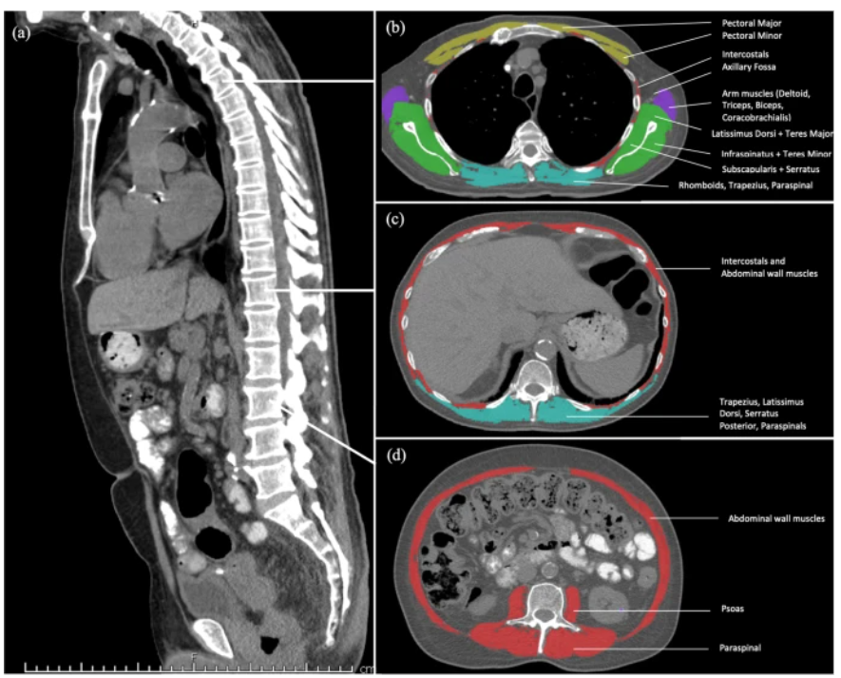
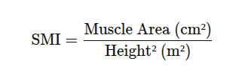
Definition of Skeletal Muscle Index (SMI) and Skeletal Muscle Density (SMD)
1. Skeletal Muscle Index (SMI)
SMI is a standardized metric of skeletal muscle mass.
Derived from L3 CT images using a Hounsfield Unit (HU) range of -29 to +150, and serves as a validated proxy for total body skeletal muscle mass (Mourtzakis et al., 2008; Shen et al., 2004).
Single CT slice at L3 vertebra
Source: Arayne et al. BMC Cancer (2023); 23:56.
1.1 Definition and Prognostic Role of Skeletal Muscle Index (SMI) and Skeletal Muscle Density (SMD)
)
4

Slide 5
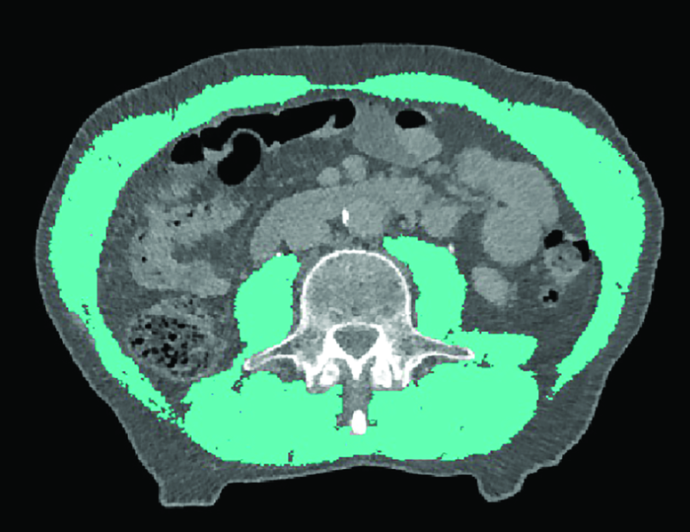
2. Skeletal Muscle Density (SMD)
SMD reflects the quality of skeletal muscle, specifically the degree of fat infiltration (myosteatosis), assessed using CT imaging.
SMD is expressed in Hounsfield Units (HU).
Measured as the mean Hounsfield Unit (HU) value of skeletal muscle area at the L3 vertebra.
Muscle region is defined using HU thresholds: –29 to +150, same as for SMI.
Lower SMD values indicate higher intramuscular fat content and poorer muscle quality.
Source: Tham et al. Cancers (2023); 15(6):1752.
1.1 Definition and Prognostic Role of Skeletal Muscle Index (SMI) and Skeletal Muscle Density (SMD)
)
5

Slide 6
Prognostic Meta-analytic Evidence on Pre-treatment SMI and SMD
Low SMI
Meta-analysis of 7,843 patients with solid tumors from 38 studies (Shachar et al., 2016).
Associated with low Overall survival (HR = 1.44) and Cancer-specific survival (HR = 1.93).
2. Low SMD (Myosteatosis)
Meta-analysis of 21,222 patients (Aleixo et al., 2020).
↑ 75% higher mortality risk (HR = 1.75, 95% CI: 1.60–1.92).
Findings consistent across: Colorectal, hepatic, gastric, pancreatic, renal, gynecologic cancers.
3. Further Evidence
Meta-analyses confirmed in specific cancers:
Ovarian (Tranoulis et al., 2022).
Hepatocellular (Xu et al., 2020).
Gastric (Guo et al., 2025).
1.1 Definition and Prognostic Role of Skeletal Muscle Index (SMI) and Skeletal Muscle Density (SMD)
)
6

Slide 7
Prevalence and Prognostic Significance of Low SMI and SMD in Cancer Patients
McGovern et al. (2021)
Systematic review of 160 studies including 42,000+ cancer patients.
Found that low SMI and SMD are highly prevalent across tumor types and stages.
Prevalence of low SMI/SMD ranged from 35% to 50%, regardless of threshold, cancer type, or disease stage.
Suggests that poor muscle quantity (SMI) and quality (SMD) are endemic at diagnosis in cancer patients.
1.1 Definition and Prognostic Role of Skeletal Muscle Index (SMI) and Skeletal Muscle Density (SMD)
)

Slide 8
Traditional Survival Model
The Cox Proportional Hazards (CPH) model estimates the risk of an event (e.g., death) over time based on patient covariates.
It assumes that the hazard function is a product of a baseline hazard and a log-linear function of covariates.
As a semi-parametric model, it does not require explicit specification of the baseline hazard function.
However, it has the following limitations:
Limitation | Description
Linearity assumption | Assumes a linear relationship between covariates and log hazard (may not hold in practice)
Proportional hazards assumption | Assumes that hazard ratios between groups are constant over time, which is often violated in dynamic clinical risks
Limited in handling high-dimensional and interaction effects | Performance deteriorates in the presence of many variables, nonlinear patterns, or complex feature interactions
1.2 Review of Traditional and AI-based Survival Models
8

Slide 9
Advancing Survival Prediction: From Cox to AI-based Survival Model
Aspect | Traditional Cox Models | AI-Based Survival Models
Assumptions | Linear effects, proportional hazards | No assumption of linearity or proportional hazards
Handling of time | Static risk estimation | Time-dependent, patient-specific survival prediction
High-dimensional data | Limited capacity, requires manual variable selection | Handles high-dimensional data (e.g., radiomics, genomics) automatically
Interactions between variables | Typically ignored or simplified | Can model complex, nonlinear interactions
Model interpretability | Direct interpretation of coefficients | Requires XAI techniques (e.g., SHAP) for interpretability
1.2 Review of Traditional and AI-based Survival Models
9

Slide 10
The Importance of Standardized Skeletal Muscle Cutoffs in Oncology Prognosis
A 2025 subanalysis of the SORAMIC clinical trial evaluated how 14 SMI and 7 SMD cutoff definitions influenced sarcopenia/myosteatosis prevalence and survival prediction in 179 liver cancer patients.
Sarcopenia prevalence ranged from 8.9% to 69.8%
Only 3 SMI and 1 SMD cutoffs showed significant OS prediction (HR ~1.5)
Most definitions failed to predict prognosis
These findings highlight the urgent need to establish cancer-specific, standardized cutoff values to improve clinical applicability of body composition metrics.
1.3 Clinical Need for Reliable Cut-offs and the Role of Explainable AI
10

Slide 11
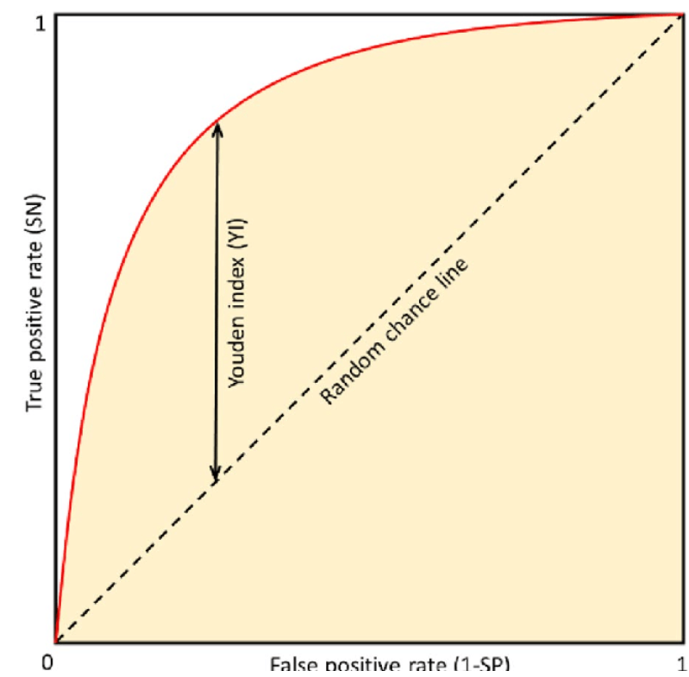
Traditional Statistical Methods for Determining Cut-off Values
Common Methods
ROC Curve Analysis Identifies the point maximizing sensitivity and specificity → using Youden's Index
Optimal Stratification Determines the cut-off that best separates survival curves (e.g., via log-rank test)
Tertile or Quartile Split Uses distribution-based grouping (e.g., lowest 25% vs. others)
Source: Voršilák et al., J Cheminform, 2020. CC BY 4.0.
1.3 Clinical Need for Reliable Cut-offs and the Role of Explainable AI
11

Slide 12
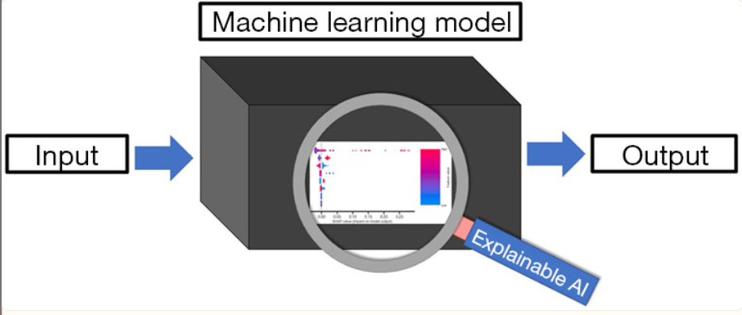
Explainable Artificial Intelligence (XAI)
Definition
XAI aims to provide insight into the inner workings of “black-box” models by generating quantitative and visual explanations of how predictions are made.
Key Functions of XAI
Quantifies how much each feature contributes to a specific prediction.
Visualizes nonlinear relationships and feature interactions(SHAP dependence plots).
Explains predictions at both global (entire population) and individual (per patient) levels.
Source: Ladbury et al., Transl Cancer Res, 2022.
1.3 Clinical Need for Reliable Cut-offs and the Role of Explainable AI
12

Slide 13
Explainable machine learning can outperform Cox regression predictions and provide insights in breast cancer survival
Dataset
Data: Netherlands Cancer Registry (36,658 patients with non-metastatic breast cancer).
Variables: demographics, tumor size, nodal status, and receptor subtype, and surgery type.
Preprocessing
Basic preprocessing was applied, including imputation for missing values, derivation of clinical features (e.g., lymph node ratio, hormone receptor subtypes), and selection of key variables based on clinical relevance and algorithmic ranking.
Model | C-index (Test Set)
Cox Proportional Hazards | 0.63 - 0.64
Random Survival Forest
Survival SVM
Extreme Gradient Boosting | 0.73 （p < 0.0001）
1.3 Clinical Need for Reliable Cut-offs and the Role of Explainable AI
13

Slide 14
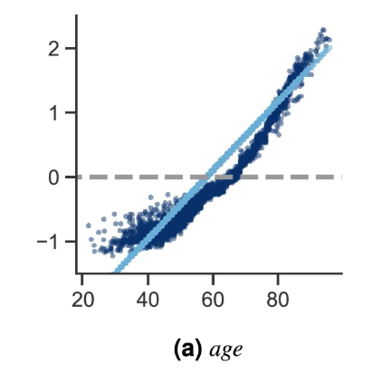
Explainability with SHAP
Feature importance ranking
Dependence plots → Revealed nonlinear patterns and turning points in risk
Interaction effects
Threshold Identification Strategy
SHAP-based turning points identified risk thresholds, e.g.:
Age ~65: SHAP value shifts from negative to positive
Tumor size plateaued risk beyond ~45 mm
Positive lymph nodes showed risk increase only after ≥1
SHAP feature dependence plots can help us identify important turning points for the different features.
1.3 Clinical Need for Reliable Cut-offs and the Role of Explainable AI
14

Slide 15
Interpretable Machine Learning for Choosing Radiation Dose-volume Constraints on Cardiopulmonary Substructures Associated with Overall Survival in NRG Oncology RTOG 0617
Dataset
428 patients with Stage III NSCLC (RTOG 0617 trial)
Clinical data included treatment arm, demographics, tumor stage, RT delivery, chemotherapy status, and toxicity events.
Preprocessing
Censored data imputed with CondiS, then 972 features reduced to 5 key predictors via multistep selection (Sparse PLS → PCA → Boruta).
4 dose-volume metrics and chemotherapy status.
1.3 Clinical Need for Reliable Cut-offs and the Role of Explainable AI
15

Slide 16
Model Performance
Model Interpretation
EBM (Explainable Boosting Machine)
Naturally interpretable via shape functions
Feature importance: mean absolute shape scores
SHAP values used additionally for cutoff (DVC) identification
Other Models (CPH, RSF, XGBSE, DeepSurv)
Interpreted using SHAP-based Partial Dependence Plots (PDPs)
Feature importance: mean absolute SHAP values
Model | C-index (Test Set)
Cox Proportional Hazards | 0.632
Random Survival Forest | 0.642
XGBoost Survival Embedding | 0.646
DeepSurv | 0.638
Explainable Boosting Machine | 0.653
1.3 Clinical Need for Reliable Cut-offs and the Role of Explainable AI
16

Slide 17
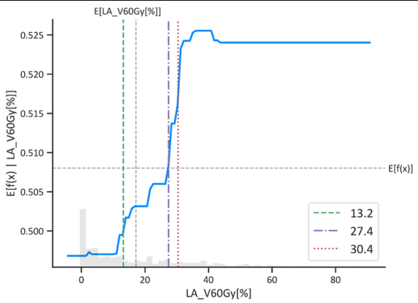
Cut-off (DVC) Derivation
Binary change point detection was applied to each PDP to identify up to 3 turning points.
The final decision value cut-off (DVC) was selected as the point closest to the model’s expected SHAP value, representing the global risk transition.
Cut-off Evaluation
Patients were grouped based on each DVC (high vs. low exposure).
Kaplan–Meier analysis and log-rank tests assessed the prognostic separation.
→ Although risk thresholds identified from individual features by most models resulted in significant survival differences in the training and validation sets, these differences did not persist in the test set
1.3 Clinical Need for Reliable Cut-offs and the Role of Explainable AI
17

Slide 18
Motivation
SMI and SMD are established prognostic clinical indicators in cancer.
However, current cut-off values vary and lack reproducibility.
Traditional methods use linear thresholds, limiting clinical utility.
While XAI enables interpretation of model outputs, its use in deriving data-driven thresholds for SMI/SMD remains unexplored.
➤ There is a need for a data-driven, explainable framework to identify and validate clinically meaningful thresholds.
Aim
Construct survival prediction models using pre-treatment SMI and SMD with clinical covariates.
Apply explainable AI (e.g., SHAP) to derive thresholds from learned feature-risk relationships.
Assess patient stratification performance using AI-derived thresholds through survival curves and hazard ratio analysis.
1.4 Research Aim
18

Slide 19
2.
Study Design and Methodology

Slide 20
Workflow
Clinical Data
Data Preprocessing
Split
The log-rank test will be applied to compare survival outcomes across SHAP-based groups.
Kaplan–Meier survival analysis
Training Set
Testing Set
Apply Threshold
Model Evaluation
SHAP Value
Threshold Identification
Feature Selection
Survival Model Building
SHAP-based cut-points will be determined on the training set.
SurveSHAP
2.1 Study Workflow and Data
20
Notes:
資料 → 前處理 → 生存模型 → XAI → threshold 推導 → 分群驗證

Slide 21
Dataset Overview
Source
The dataset was collected from the Department of Radiation Oncology at MacKay Memorial Hospital, Tamsui Branch.
Study Population
627 patients diagnosed with ovarian cancer
All patients underwent pre-treatment assessment prior to surgery and chemotherapy
Prediction Targets
1. Overall Survival (OS)
Event: 1 = death (n=223), 0 = censored (n=404)
Time: Duration from diagnosis to death or last follow-up (in years)
2. Progression-Free Survival (PFS)
Event: 1 = progression or death (n=299), 0 = censored (n=328)
Time: Duration from treatment to recurrence/progression/death (in years)
2.1 Study Workflow and Data
21
Notes:
從患者確定疾病開始，到其死亡或最後一次追蹤為止的年數。
無惡化存活率: 治療開始到疾病復發、惡化期間

Slide 22
Pre-treatment Features Demographics & Body Composition: Age, Body Mass Index (BMI), Skeletal Muscle Index (SMI), Skeletal Muscle Density (SMD) Inflammatory Markers: Serum albumin (Alb), Neutrophil-to-Lymphocyte Ratio (NLR), Platelet-to-Lymphocyte Ratio (PLR) Clinical Risk Indicators: Malignant ascites (1 = malignant, 0 = non-malignant or none) FIGO （International Federation of Gynecology and Obstetrics) stage grouping (0 = Stage I/II, 1 = Stage III/IV)
2.1 Study Workflow and Data
22
Notes:
基本資料與身體組成:Age、BMI、SMI、SMD
發炎相關指標：白蛋白（作為營養與發炎狀態的指標）嗜中性白血球與淋巴細胞比(全身系統性發炎)、血小板與淋巴細胞比（+免疫反應）。
惡性腹水狀態
第二個是FIGO(婦科腫瘤（如卵巢癌、子宮內膜癌、子宮頸癌）的標準分期系統) 分期分類，根據卵巢癌國際標準，我們將第 I/II 期設為 0，III/IV 期為 1。

Slide 23
Model
Model | Mechanism | Notes
Cox Proportional Hazards | Linear regression model that estimates the log-hazard function with proportional hazards assumption. | Interpretable. Assumes proportional hazards.
Random Survival Forest (RSF) | Ensemble of decision trees built on bootstrapped samples; splits nodes by maximizing survival difference using log-rank test. | Handles nonlinearity and censoring. Outputs survival curves
XGBoost Survival Embedding | Modified XGBoost with Cox loss function; maps features to sparse high-dimensional embeddings for modeling nonlinearity. | Reduces noise and dimensionality. Models nonlinear effects
2.2 Survival Modeling and Evaluation
23

Slide 24
Model | Mechanism | Notes
Survival Support Vector Machine (Survival SVM) | Extends SVM to censored data by optimizing a ranking loss that respects survival ordering | Focuses on risk ranking. Good for small datasets
DeepSurv | Deep feedforward neural network that outputs a nonlinear log-risk function via a single linear node. | Learns nonlinear risk. Outputs relative risk scores
Explainable Boosting Machine (EBM) | Based on Generalized Additive Models (GAMs) and tree-based cyclic gradient boosting. Interpretable additive model using cyclic gradient boosting with one feature per round. | Transparent and interpretable. Shows feature-level impact.
2.2 Survival Modeling and Evaluation
24

Slide 25
Evaluation metrics
Metric | Aspect of Performance | Model Output Type | Description
C-index | Discrimination | Time- independent | Agreement between the predicted vs. the observed order of the events.
Time- dependent AUC | Discrimination | Time- dependen | Reflects the probability that a patient who experiences the event before a given time is assigned a higher risk score than one who survives longer or is censored.
Calibration plot | Calibration | Time- dependent | Plot of the event probability values predicted by a model against the observed event probabilities.
2.2 Survival Modeling and Evaluation
25

Slide 26
Model Interpretability
Comparison | SHapley Additive exPlanations | SurvSHAP(t) (Time-dependent SHAP )
Prediction Target | Event risk (scalar risk score) | Risk function or survival probability at different time points
Interpretation | Global or individual contribution to overall risk | Feature importance dynamics across the time dimension
Threshold Detection | Yes ( identifies static cut-points based on risk score) | Yes (supports identification of dynamic cut-points over time)
Time-awareness | Aggregation may lose temporal signals; cannot model time-varying effects | Preserves temporal structure and captures feature importance over time
2.3 SHAP-based Interpretation, Threshold Discovery and Validation
26

Slide 27
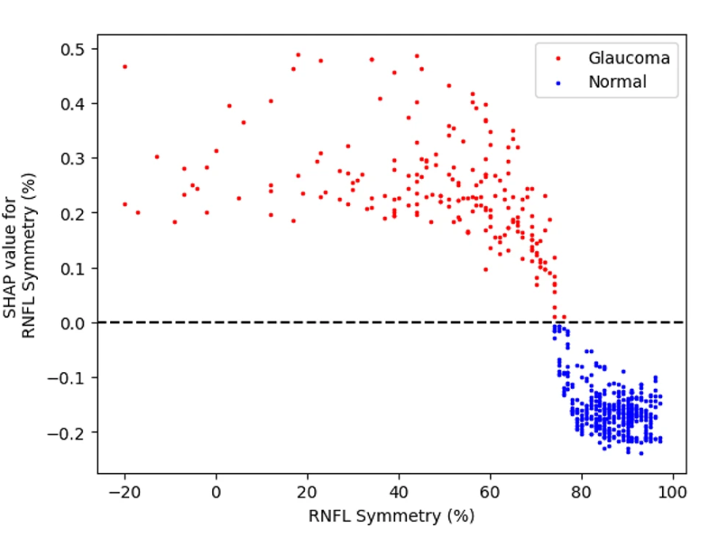
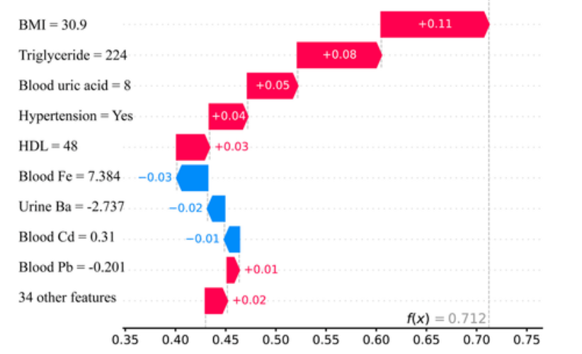
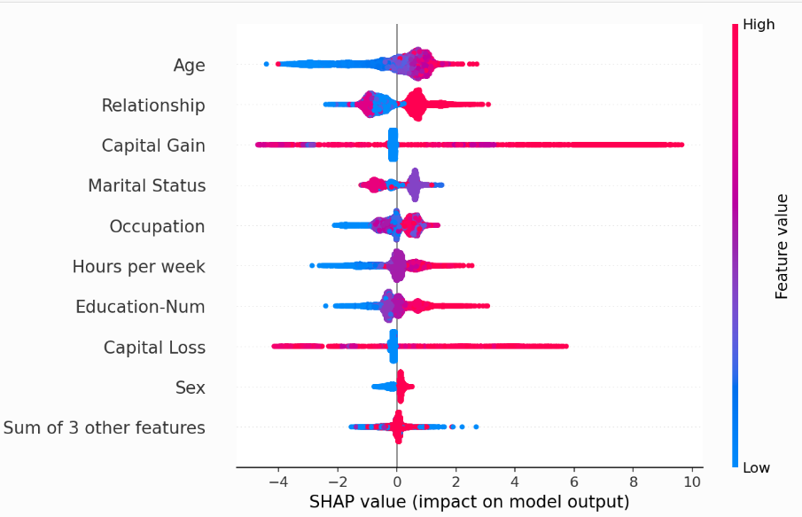
SHAP (SHapley Additive exPlanations)
It quantifies each feature’s contribution to predictions, enhancing transparency in complex models.
It offers both local (per-sample) and global (overall) explanations.
Beeswarm Plot
Dependence Plot
Waterfall Plot
2.3 SHAP-based Interpretation, Threshold Discovery and Validation
27

Slide 28
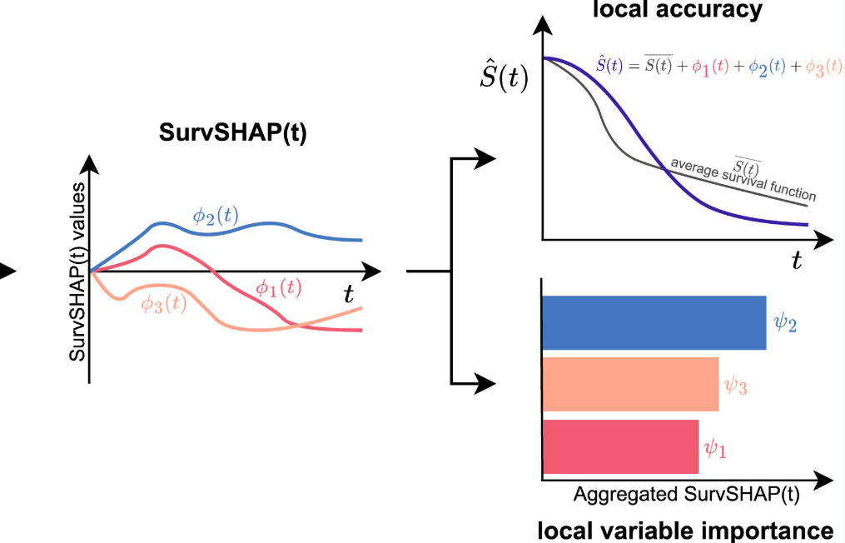
SurvSHAP(t)
SurvSHAP(t) provides time-resolved feature attributions for survival models, showing how each variable increases or decreases the predicted survival probability at different time points.
The predicted survival curve is the sum of baseline and feature effects
Cumulative impact of each feature across time
Time-specific risk contributions from each feature
Source: Krzyiński et al., Knowl-Based Syst, 2023.
2.3 SHAP-based Interpretation, Threshold Discovery and Validation
28

Slide 29
Definition of Threshold
To identify cut-points (decision boundaries) that distinguish high- vs low-risk groups using model-derived explanations.
SHAP Dependent Plot
2.3 SHAP-based Interpretation, Threshold Discovery and Validation
29

Slide 30
2. SHAP-based Partial Dependence Plots (PDP)
Illustrates nonlinear feature-risk relationships
3. Select the optimal cut-point (DVC)
2. Apply Binary Change Point Detection
2.3 SHAP-based Interpretation, Threshold Discovery and Validation
30

Slide 31
Validation of Threshold
To evaluate whether the identified SHAP-derived cut-point can meaningfully distinguish between high- and low-risk patient groups in terms of survival outcomes.
1. Kaplan–Meier Survival Analysis
Stratify patients into high-risk vs low-risk groups using the selected cut-point
Plot survival curves
Use log-rank test to assess statistical significance (p < 0.05)
2. (Optional) Cox Proportional Hazards Model
Cox regression estimates the magnitude of risk difference between groups
Estimate the hazard ratio (HR) for the high-risk group
Adjust for covariates (e.g., age, sex, stage) if needed
Report: HR, 95% CI, and p-value (HR > 1: increased risk; HR < 1: protective)
2.3 SHAP-based Interpretation, Threshold Discovery and Validation
31

Slide 32
Preliminary Results
Data Preprocessing
Two patients with missing Skeletal Muscle Density (SMD) values were excluded from analysis.
Dataset Split
The dataset was randomly divided into:
80% training set (OS: 178/322, PFS: 239/261)
20% testing set (OS: 45/80, PFS: 60/65)
No internal cross-validation or hyperparameter tuning was conducted in this preliminary phase.
Modeling Approaches
Time-to-event survival analysis:
Applied Cox Proportional Hazards (CPH) and Random Survival Forest (RSF) models.
2.4 Preliminary Results
32

Slide 33
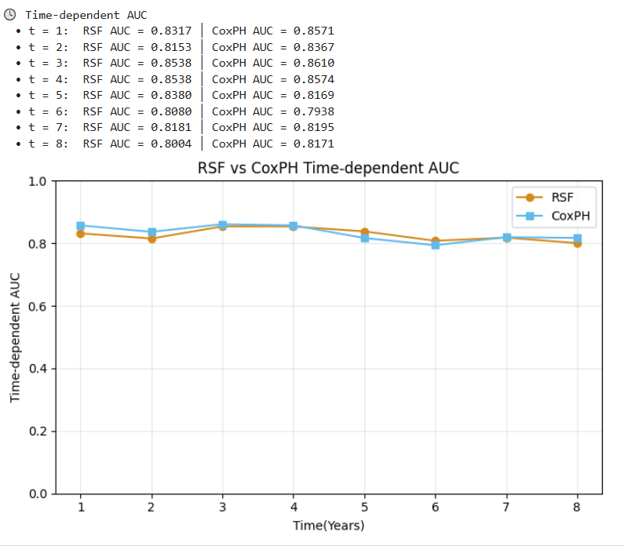
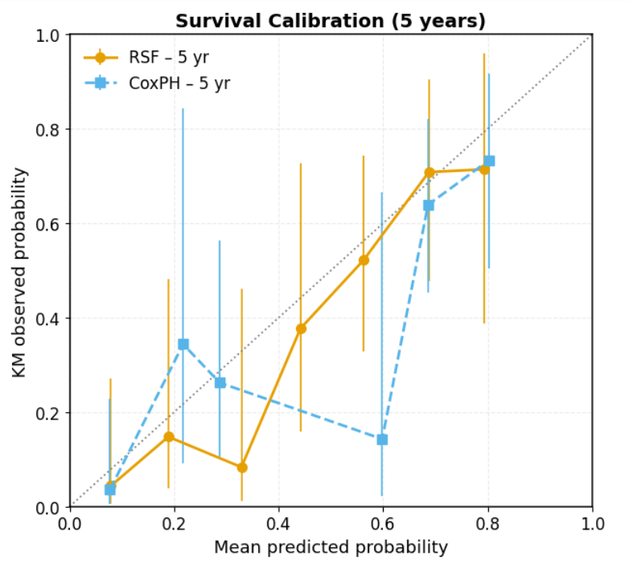
Survival Prediction for Overall Survival (OS)
CPH (OS) C-index: 0.8141
RSF (OS) C-index: 0.8070
2.4 Preliminary Results
33

Slide 34
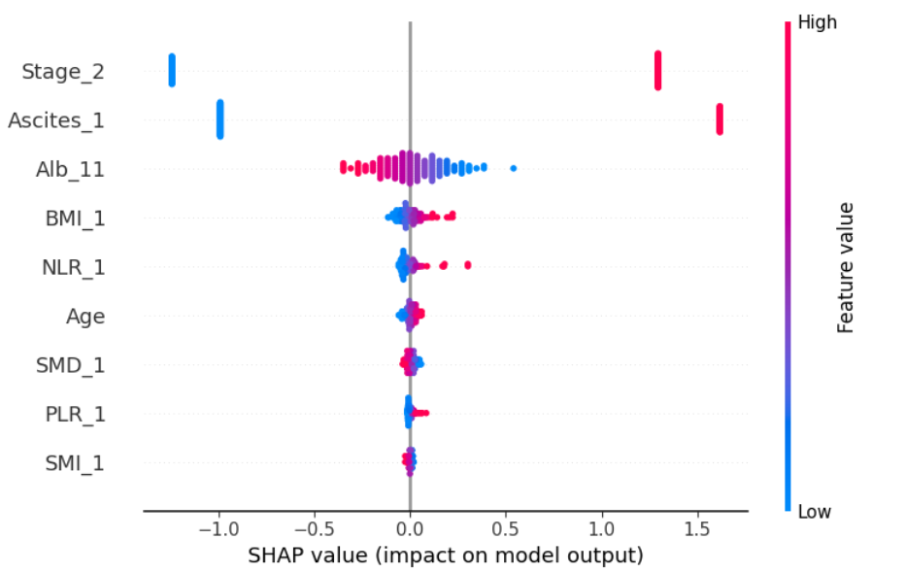
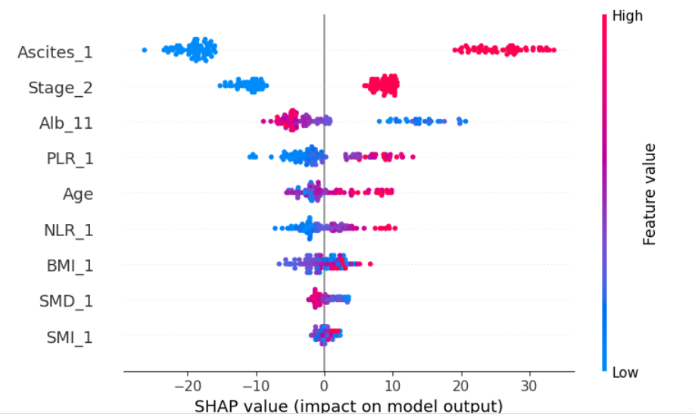
SHAP
CPH RSF
2.4 Preliminary Results
34

Slide 35
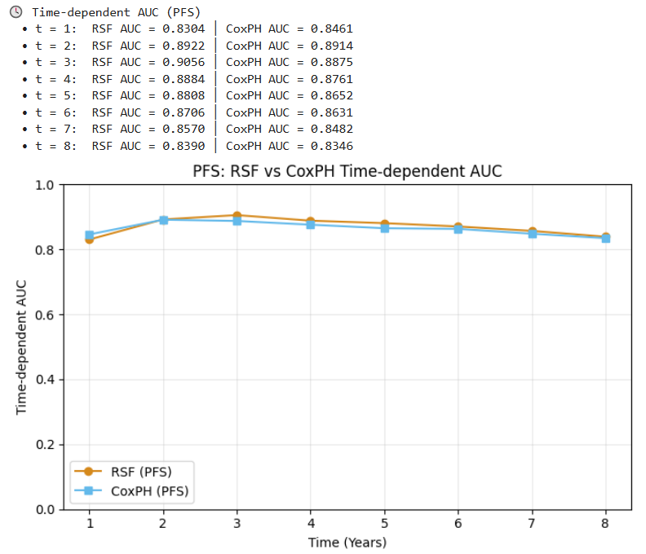
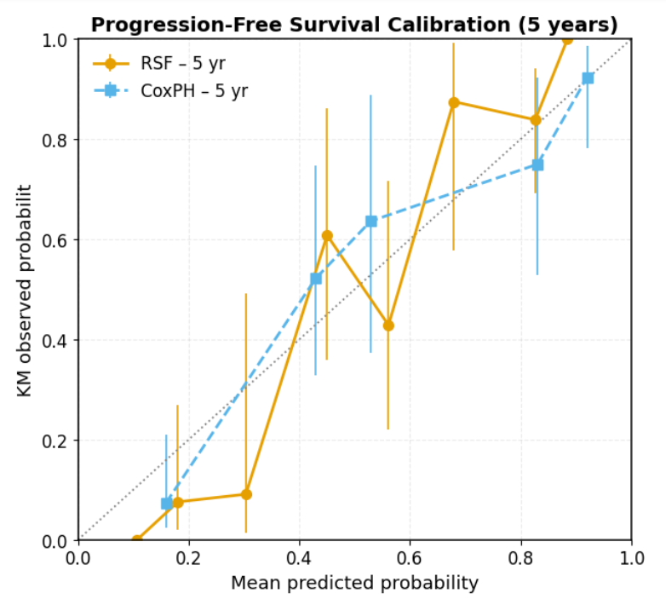
Survival Prediction for Progression-Free Survival (PFS)
CPH (PFS) C-index: 0.8060
RSF (PFS) C-index: 0.8118
2.4 Preliminary Results
35

Slide 36
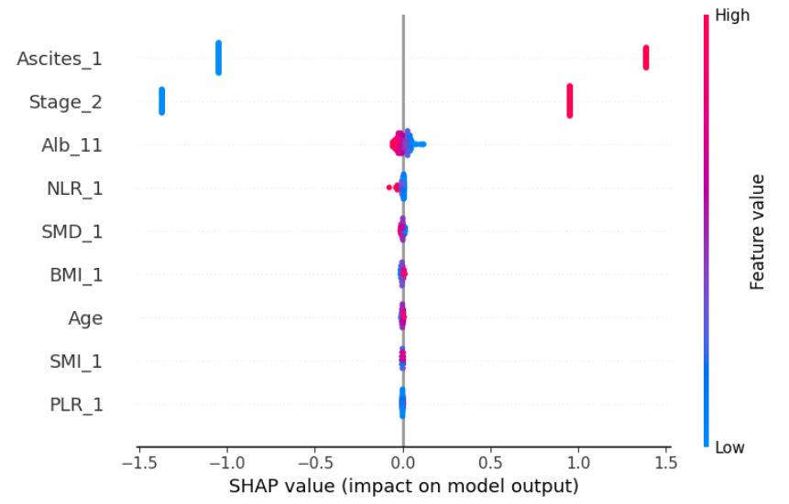
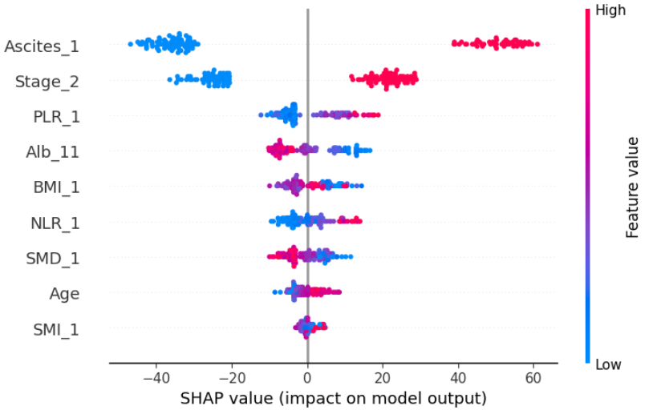
SHAP
CPH RSF
2.4 Preliminary Results
36

Slide 37
Conclusion and Future Work
Development of survival prediction models based on pre-treatment skeletal muscle index (SMI) and skeletal muscle density (SMD), incorporating relevant clinical features.
Implementation of explainable AI (e.g., SHAP) to quantify feature contributions and visualize non-linear risk patterns.
Identification of optimal, data-driven thresholds for SMI and SMD using SHAP dependence plots and change-point detection.
Validation of AI-derived cut-offs via survival analysis (Kaplan–Meier curves, log-rank test, Cox regression).
These findings may support more refined patient stratification and serve as a reference for future clinical decision-making and research.
2.5 Conclusion and Future Work
37

Slide 38
Reference
Mourtzakis M, Prado CMM, Lieffers JR, Reiman T, McCargar LJ, Baracos VE. A practical and precise approach to quantification of body composition in cancer patients using computed tomography images acquired during routine care. Appl Physiol Nutr Metab. 2008;33(5):997–1006. doi:10.1139/H08-075
Shen W, Punyanitya M, Wang Z, Gallagher D, St-Onge MP, Albu J, et al. Total body skeletal muscle and adipose tissue volumes: estimation from a single abdominal cross-sectional image. J Appl Physiol. 2004;97(6):2333–8. doi:10.1152/japplphysiol.00744.2004
Mourtzakis M, Prado CM, Lieffers JR, Reiman T, McCargar LJ, Baracos VE. A practical and precise approach to quantification of body composition in cancer patients using computed tomography images acquired during routine care. Appl Physiol Nutr Metab. 2008;33(5):997–1006.
Shachar SS, Williams GR, Muss HB, Nishijima TF. Prognostic value of sarcopenia in adults with solid tumours: A meta-analysis and systematic review. Eur J Cancer. 2016;57:58–67.
Aleixo GFP, Shachar SS, Nyrop KA, Muss HB, Malpica L, Williams GR. Myosteatosis and prognosis in cancer: Systematic review and meta-analysis. Crit Rev Oncol Hematol. 2020;145:102839.
Di Giorgio A, Rotolo S, Cintoni M, et al. Prognostic value of skeletal muscle index after cytoreduction and HIPEC for peritoneal metastases from colorectal cancer: A systematic review and meta-analysis. Eur J Surg Oncol. 2022;48(3):649–656.
Tranoulis A, Kwong FLA, Lakhiani A, et al. Prevalence of CT-based sarcopenia and prognostic value of skeletal muscle index and attenuation in epithelial ovarian cancer: A systematic review and meta-analysis. Eur J Surg Oncol. 2022;48:1441–1454.
38

Slide 39
Reference
Xu L, Jing Y, Zhao C, et al. Preoperative CT-assessed skeletal muscle index as a prognostic factor in hepatocellular carcinoma after hepatectomy: A meta-analysis. J Gastrointest Oncol. 2020;11(5):1040–1053.
Guo H, Chen S, Zheng T, et al. Association of low skeletal muscle mass and radiodensity with outcomes in robotic radical gastric cancer surgery: A population-based cohort study. BMC Cancer. 2025;25:741.
McGovern J, Dolan RD, Horgan PG, Laird BJ, McMillan DC. CT-defined low skeletal muscle index and density in cancer: A systematic review. J Cachexia Sarcopenia Muscle. 2021;12(6):1408–1417.
Surov A, Thormann M, Wienke A, Ricke J, Seidensticker M. Different cutoff values for skeletal muscle mass and myosteatosis affect survival outcomes in oncology: A subanalysis of a clinical trial. J Cancer Res Clin Oncol. 2025;151:141–151.
Ladbury C, Zarinshenas R, Semwal H, et al. Utilization of model-agnostic explainable AI frameworks in oncology: A narrative review. Transl Cancer Res. 2022;11(10):3853–3868.
Moncada-Torres A, van Maaren MC, Hendriks MP, Siesling S, Geleijnse G. Explainable machine learning outperforms Cox regression in breast cancer survival prediction. Sci Rep. 2021;11:6968.
Lee SH, Geng H, Arnold J, et al. Interpretable machine learning for choosing dose-volume constraints associated with survival in NRG Oncology RTOG 0617. Int J Radiat Oncol Biol Phys. 2023;117(5):1270–1286.
39

Slide 40
Thank you !

