Slide 1
Spatial Temporal Massive Memory Results
March 18th

Slide 2
Old-New Lag distribution
There were more smaller lags than longer lags
Median Lag ~= 21.5, range [1, 282]

Slide 3
Old/new response
From the previous SMM exps
Old/New response slightly better in SMM-TMM

Slide 4
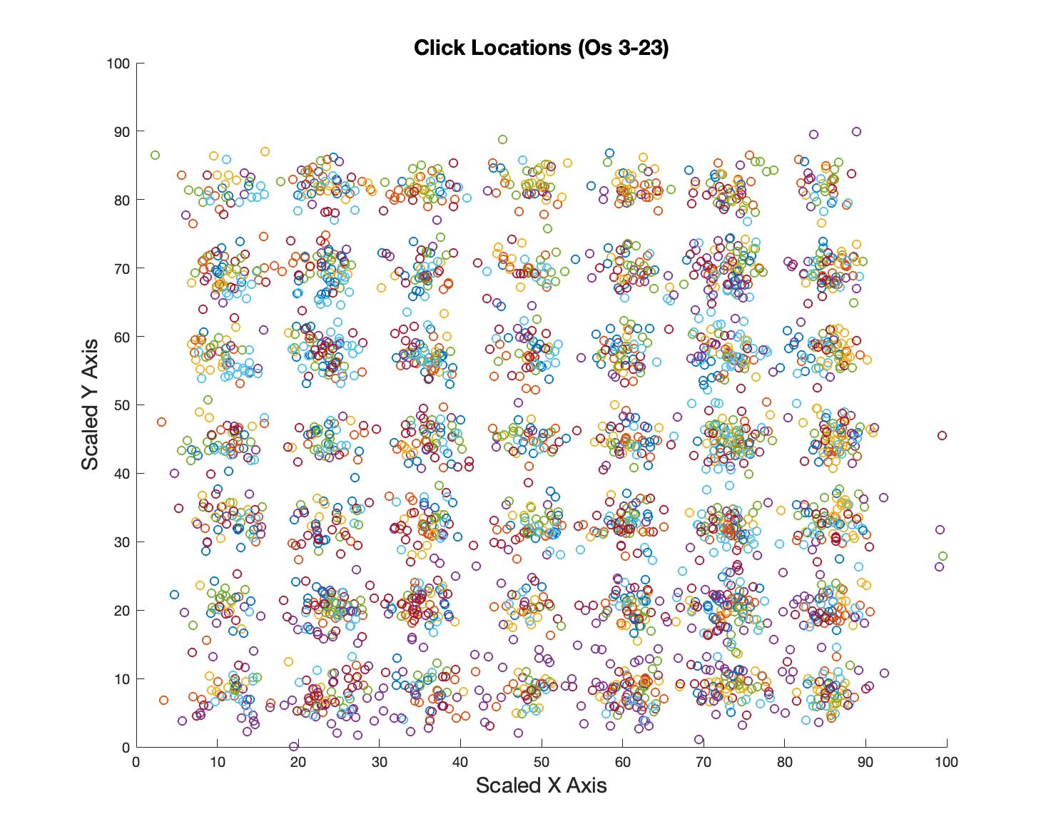
Click response
Avg distance = 12.5

Slide 5
Spatial Error by Log2Lag
13 Os clicked into the green region when old item is tested immediately after the new item
Spatial Error increases with Lag

Slide 6
X
Define ROI
This click is outside ROI 1 and ROI 2
Inside ROI3 and > 3

Slide 7
Percent correct across ROI sizes
When ROI = 3, Remember location for about 30% of old items, ~45 item

Slide 8
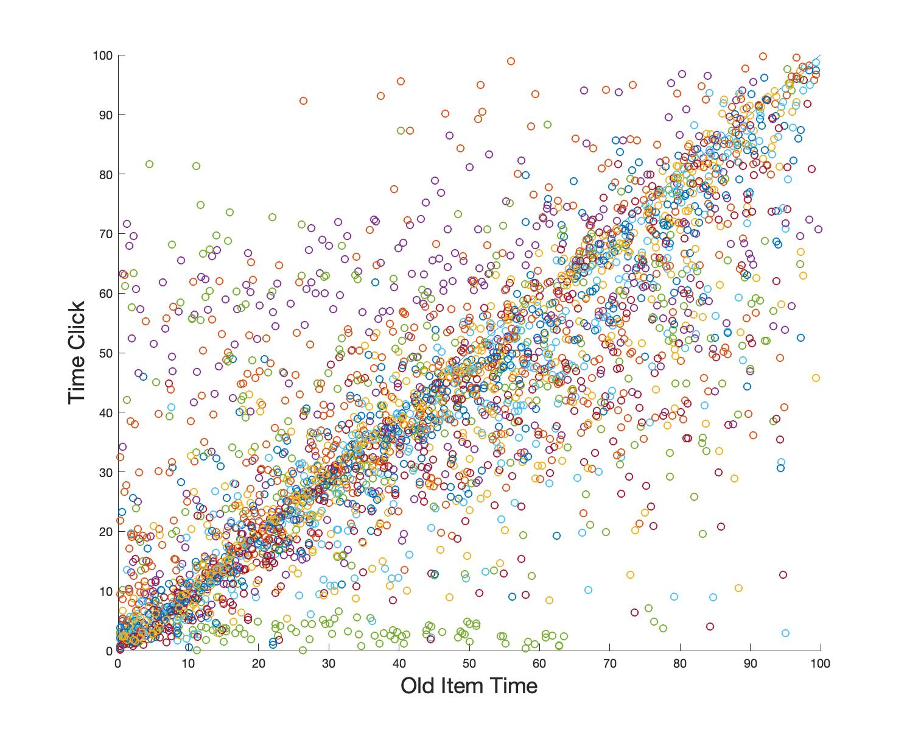
Temporal response
Perfect response will lie on the diagonal

Slide 9
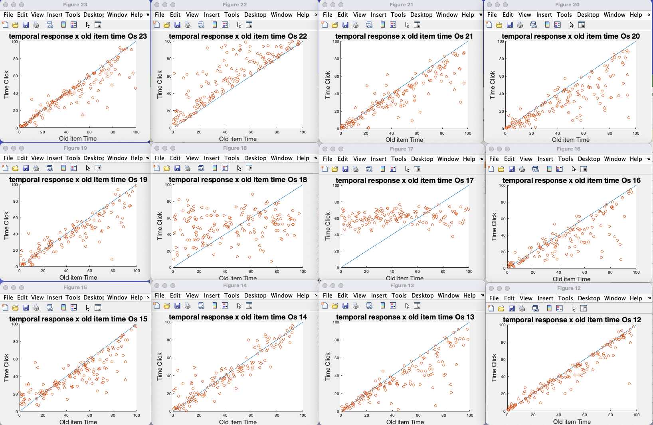
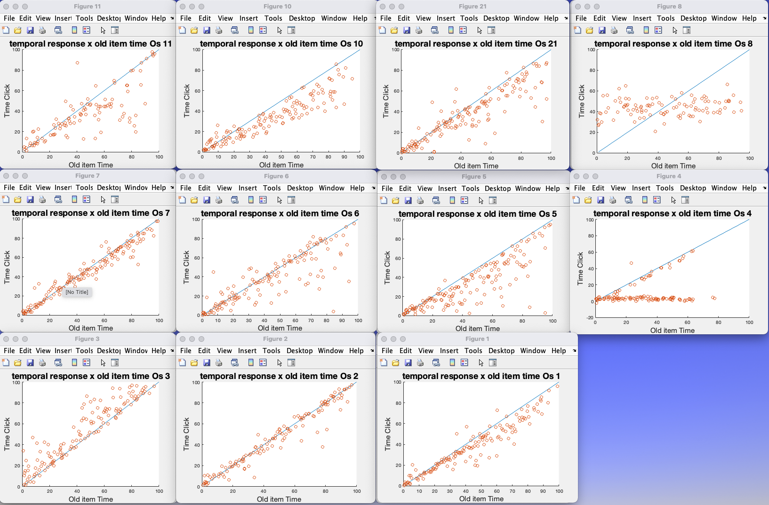
Temporal response (individual Os)
At least four Os appeared to be guessing

Slide 10
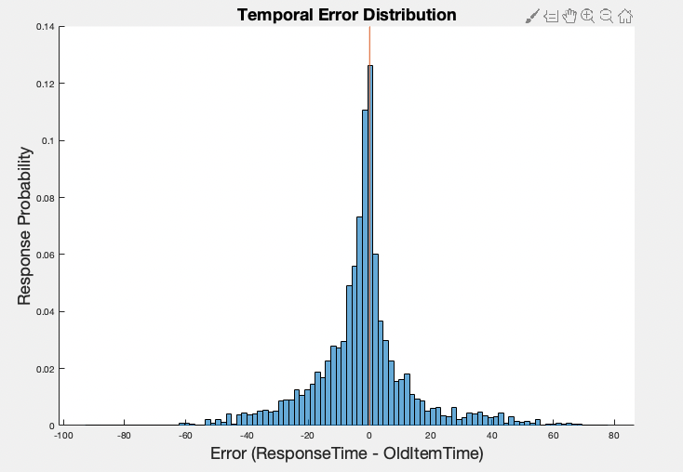
Distribution of temporal error
Respond early
Respond late
Most Os respond too early

Slide 11
Temporal error by lag
Except for the four guessing Os, there is a systematic increase in error with Lag
Os who performed poorly in spatial task did fine in the temporal task.

Slide 12
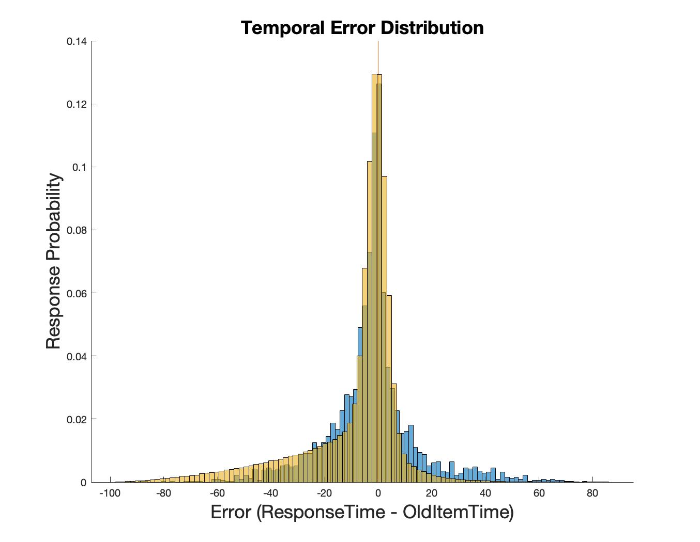
Guess 1
If guess clicks are distributed uniformly along the valid range on the time scale, the error distribution (in yellow) would have a large tail on the left.
We don’t see the tail in the actual data
(valid range = [0, current time point])
Yellow – simulated distribution (if guessing 50% of time)
Blue – Data error distribution

Slide 13
Percent correct across ROI range
Old
New
Uniform guess plotted in Pink
ROI = 10
0
50
55
60
100

Slide 14
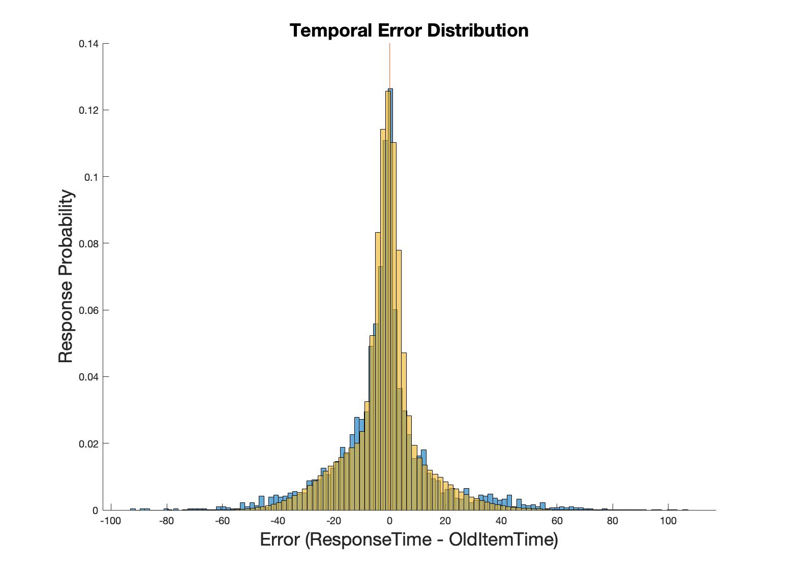
Guess 2
Guess click could bias towards the current time position, since more pairs have smaller lags.
Left figure: if each guess is sampled from a normal distribution with a mean = 0.75 * current time position
Yellow – simulated distribution (if guessing 50% of time)
Blue – Data error distribution

Slide 15
Percent correct across ROI range
Not sure how to think about this capacity?
Uniform guess plotted in Pink
Old
New
Normally distributed guess plotted in Blue
ROI = 10
0
50
55
60
100

Slide 16
Spatial error x temporal error
No obvious correlation between Spatial and Temporal errors

