Slide 1


Work Experience
February 2025

Slide 2
Contents
1 | Introductions
2 | Timetable
3 | Project Introduction
4 | Technical Content

Slide 3

Introductions

Slide 4

Who are we?
Xak Sen
Studied Aerospace Engineering at the University of Bath where I worked at Amazon & Rolls-Royce whilst completing my Masters degree
Self taught through online courses & hobby programming (C++, Python, HTML, MATLAB)
Pivoted to Software Engineering
Started at Softwire in September 2024 – no professional coding experience at the time
I’ve worked on Channel 5 & Elexon projects since joining (React, .NET, Ruby on Rails)
Outside of work, I spend most of my time playing football, pool, travelling abroad, chess, FPS games & board games

Slide 5
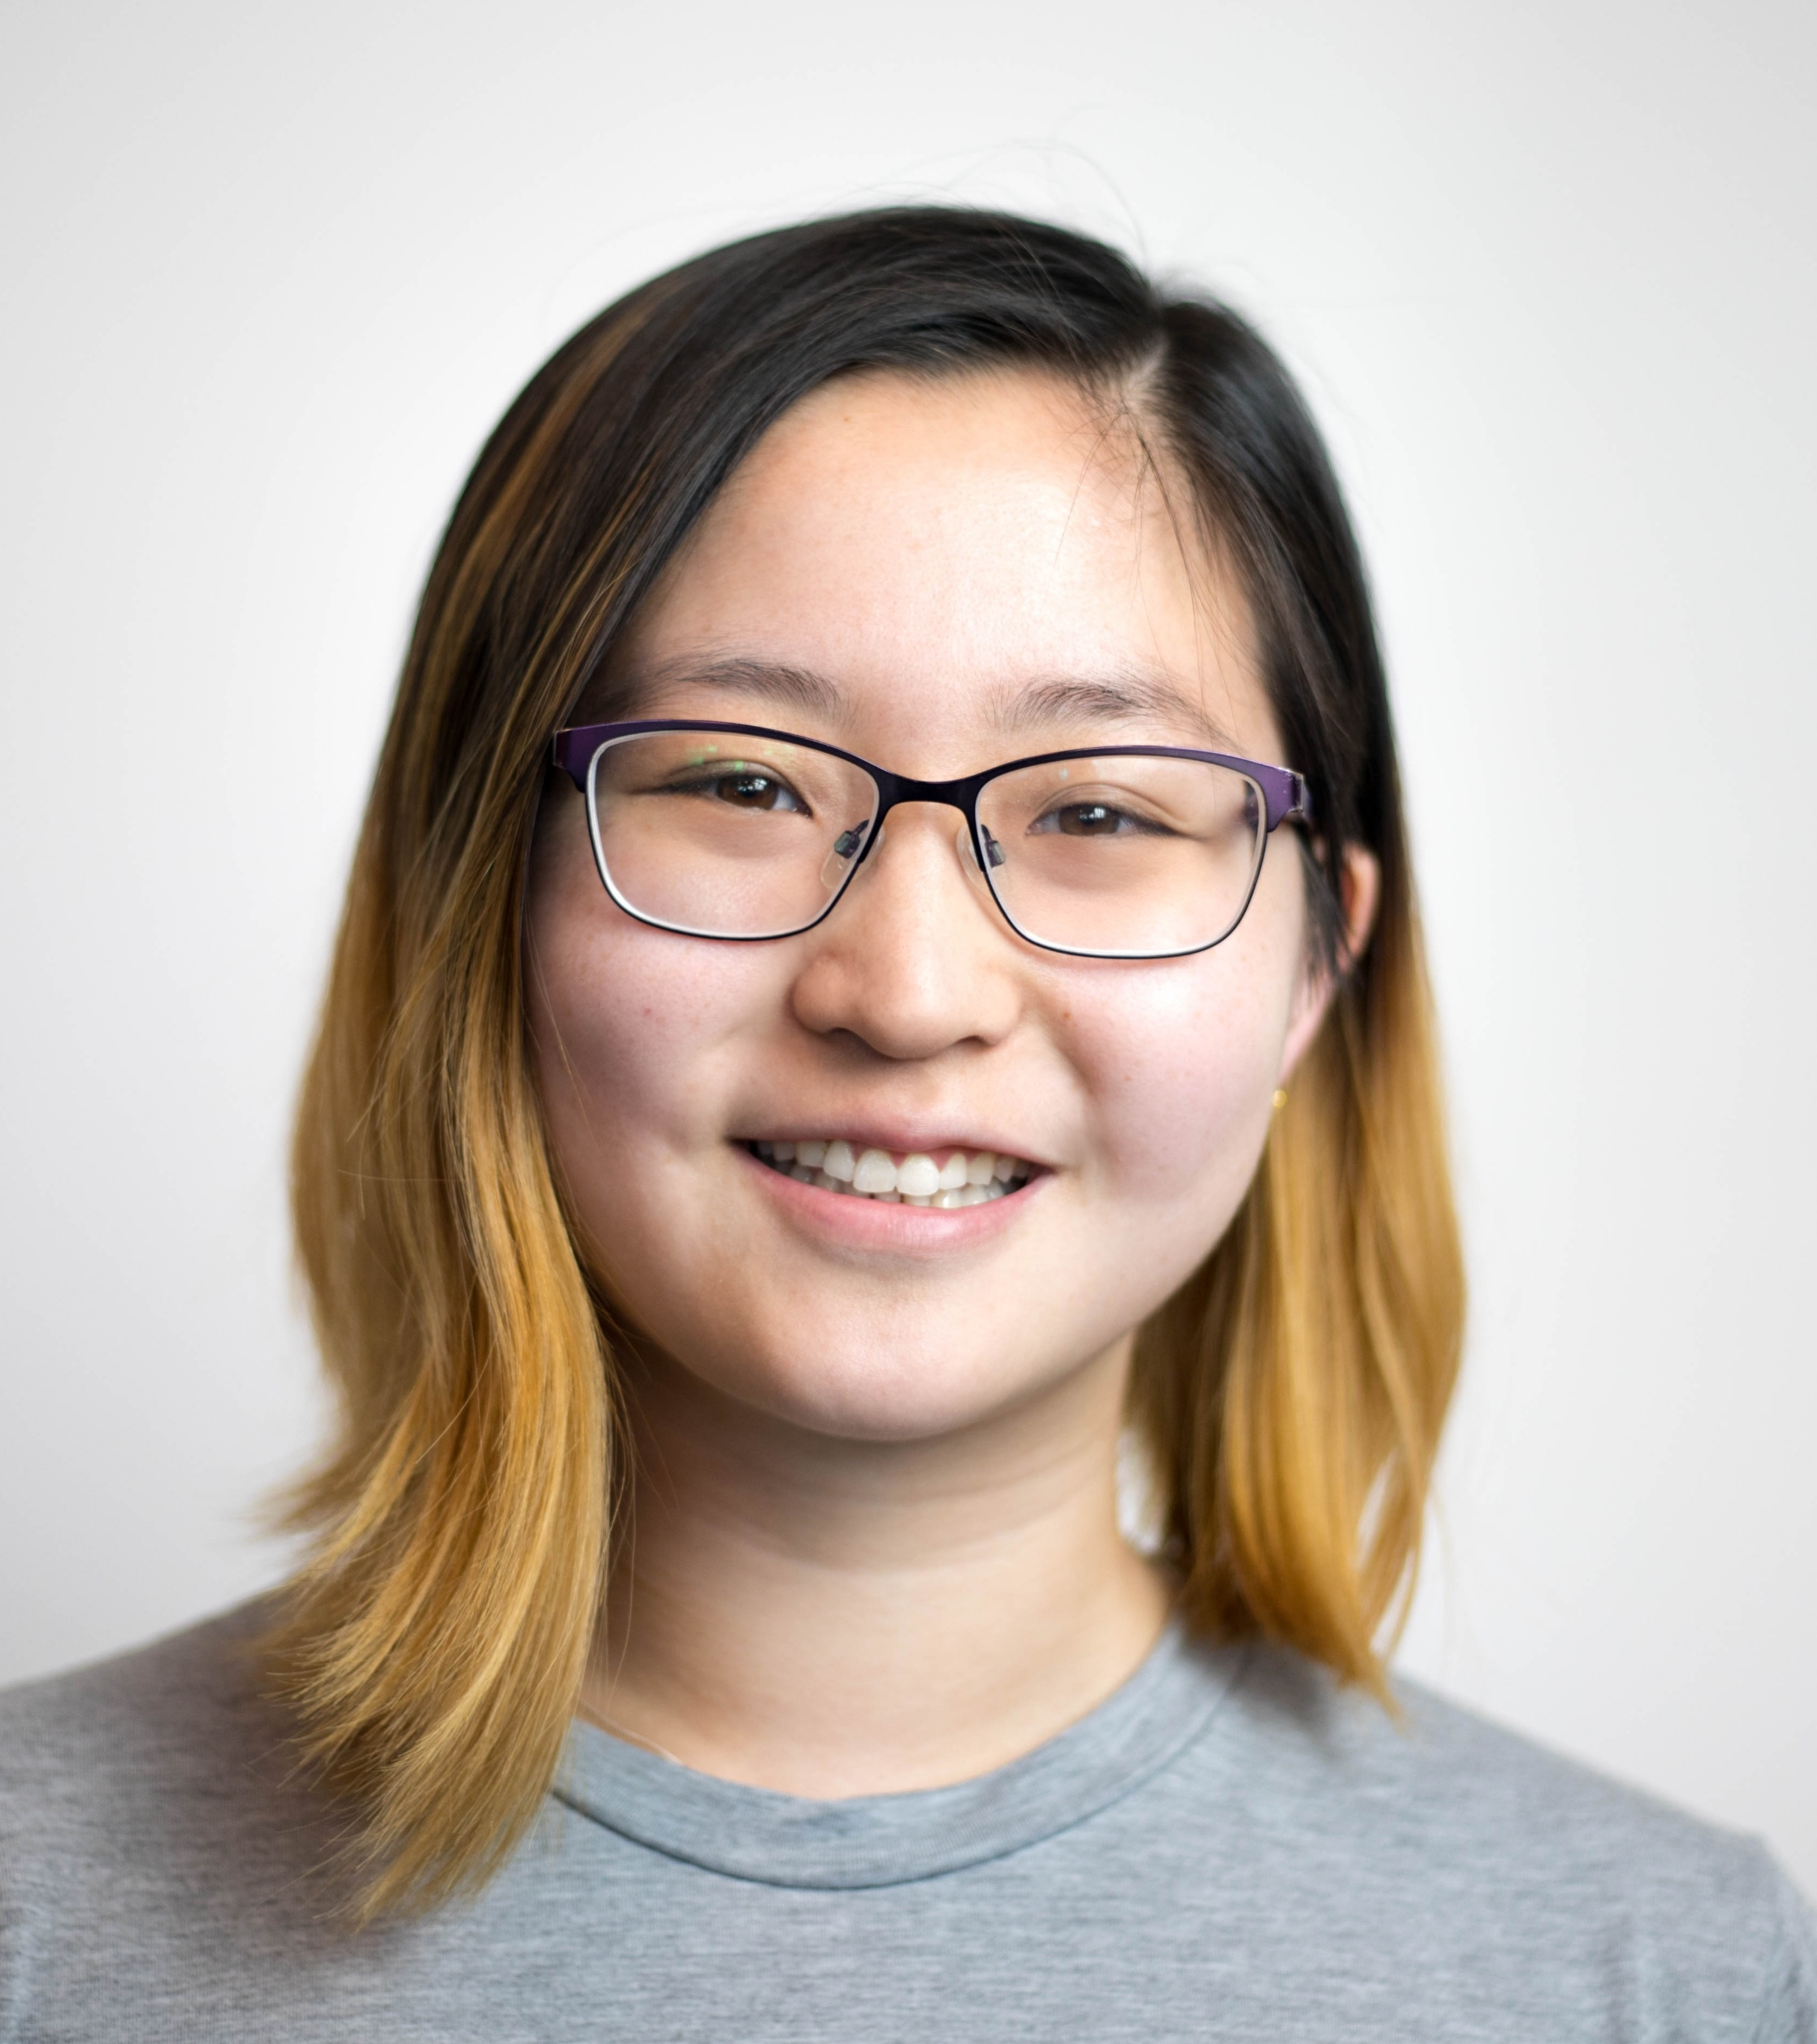
Who are we?
Wendi Fan
Studied Mathematics at the University of Cambridge
Started at Softwire in November 2021
I’ve worked on several projects, including with the British Library, the BBC, Channel 5, LNER and Utilities Warehouse
Outside of work, I enjoy playing badminton, board games and baking. I also love travelling and playing escape rooms.
We’ll be running your work experience program this week, and will be the primary people you interact with!

Slide 6
Who are you?
What is your preferred name?
Do you require any special accommodations to be comfortable this week?
What are your previous experiences with Software Engineering? (It’s completely OK for your answer to be nothing yet!)
Have you done any programming projects as schoolwork or as a hobby? (Again, your answer can be no here)
Is there a topic you’d particularly like to focus on this week?
What are your goals for this work experience?
What do you expect from us, your trainers, this week?
What do you like to do in your free time?

Slide 7
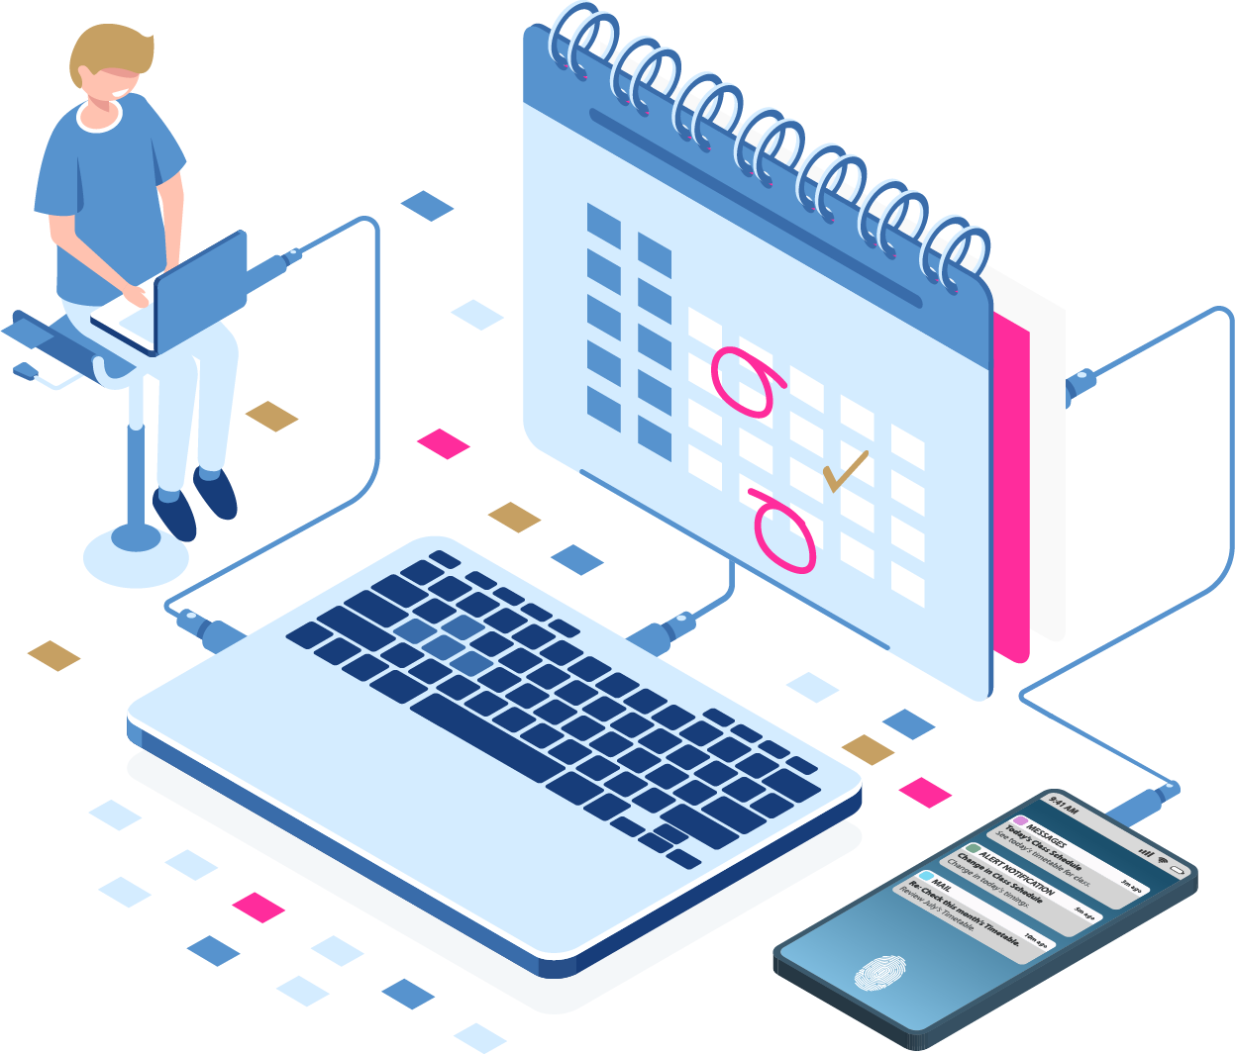
Timetable

Slide 8
General Schedule
9.55 AM – Meet at Softwire Reception & sign in on tablet
10.00 – We’ll meet you at reception and bring you to 410
10.15 – Standup (daily update – I’ll explain this more later)
1.00 PM – Lunch (1 hour)
4.00 PM – We’ll take you back to Reception to sign out
4.05 AM – Head home
NB:
Some days we’ll attend seminars hosted by other Softwire Engineers to expose you to general Software topics
In between meetings, we’ll be working on our main project this week – building a Tetris game!
Friday (after Lunch?) – you will be presenting your project & learnings to the company as well as answering some questions about your time here

Slide 9
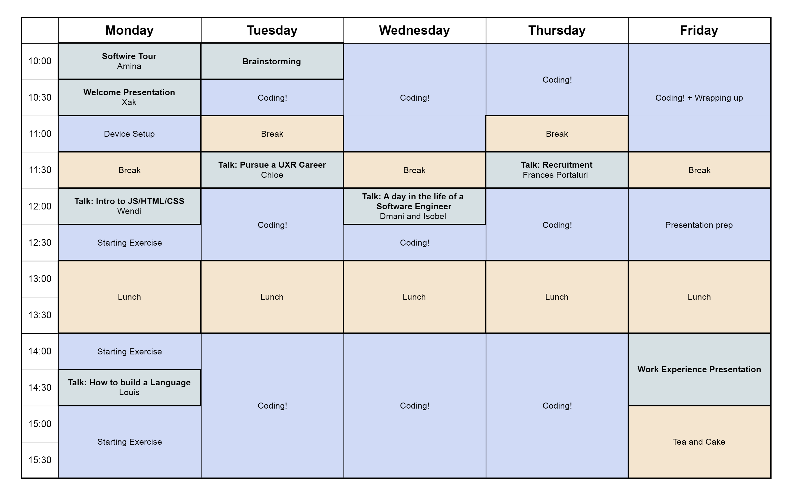
Timetable

Slide 10

Project Introduction

Slide 11
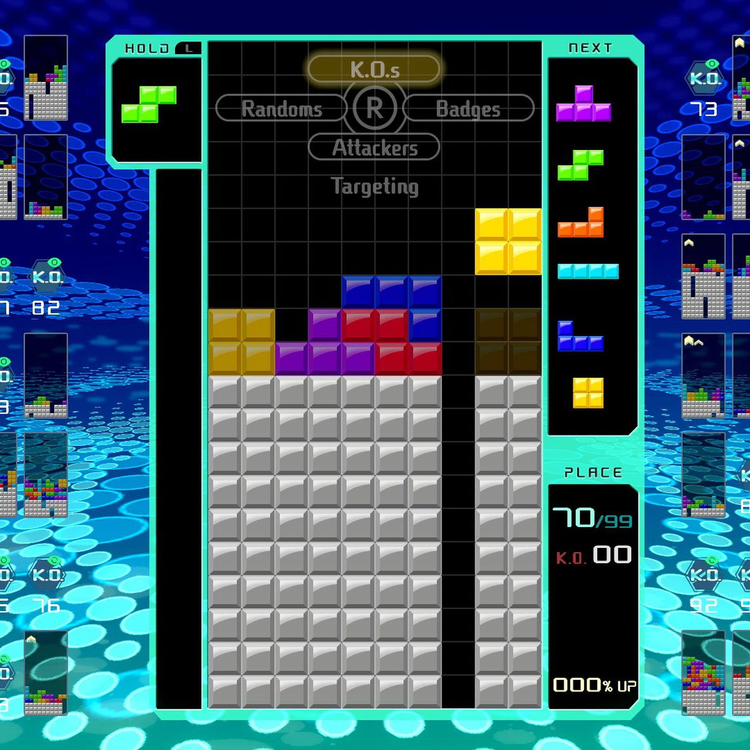
What are we going to build?
We will be building a Tetris game!
The game will:
Have a home screen from which a game of Tetris can be started
Have a playable Tetris game
Handle the game logic properly
Present a leaderboard of the highest scores

Slide 12
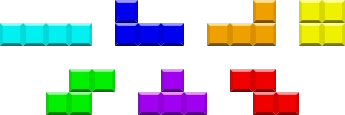
What is Tetris?
You can play Tetris here: https://tetris.com/play-tetris
Tetris is a 10x20 square grid, where different shaped pieces are added randomly to the top of the grid one-at-a-time and descend downwards until they hit another piece or the bottom of the grid.
The player can move the piece in play left or right, or rotate the piece into a different orientation.
In some versions of Tetris, the player can make the pieces drop faster with the down key.
In most version of Tetris, the pieces drop faster as the game progresses.

Slide 13
Let’s play some Tetris!
Let’s take 15 minutes to play some Tetris so that you can introduce yourself to, or remind yourself of, the gameplay.
You can play Tetris here: https://tetris.com/play-tetris

Slide 14

Technical Content

Slide 15
What technology are we going to use?
The project will have two parts:
The frontend code – this is where the static web pages and main gameplay will be. Most of the work will probably be in this area.
The backend code – this will run on a web server and can be used to store or modify data (for example, saving users’ scores).

Slide 16
What technology are we going to use?
Frontend:
The frontend code base will be written in HTML/CSS/JS.
HTML provides the basic structure of each page
CSS is used to control the formatting and layout of the HTML content
JavaScript is used to control the behaviour of different elements on the page
There will be a presentation tomorrow with more details about frontend development and there is more information in the README.
We will not be using any JavaScript framework or library or working with Typescript. These things are excellent, and very common on professional software projects, but by working with “vanilla” JavaScript you’ll be able to focus more closely on writing code and will get a better fundamental understanding of how a website works.

Slide 17
What technology are we going to use?
Backend:
The backend for the website is a Node.js/Express web application. The code for this application will also be written in JavaScript.
Node.js is a JavaScript runtime that allows JavaScript to run outside of a web browser. You don’t need to know too much about it, other than that it’s what we’re using! I am of course happy to discuss in more detail with those who are interested.
Express is a Node.js web application framework. It allows web applications to be built quickly, easily and robustly.
On Wednesday, I’ll be explaining the backend codebase in more detail. I expect we will all start by working on frontend code.

Slide 18
Agile/Scrum/Sprints
“Scrum” is a project management technique that is commonly used on software projects. It is a subset of “Agile”.
There’s lots to it, but in summary:
Work is done in short “Sprints”
At the start of a sprint, the work to be done in the sprint is defined and goals are set
There is a dedicated “scrum master” who is responsible for keeping the team on track
During the sprint, there is a daily “standup” meeting to discuss how things are going and if there are any issues
During the sprint, people work on the various tasks and goals
At the end of the sprint, a retro meeting is held to review how the sprint went and discuss any ideas to be applied in future sprints
This week will be structured a bit like a sprint. We’ll start by defining goals for the week and features that we’d like our website to have. We’ll have a standup meeting at the start of every day and at the end of the week we’ll have a retro to see how things have gone and if we’ve met the goals we set out at the start of the week.

Slide 19
Pairing
Pair programming, or “Pairing”, is an Agile software development technique where two developers work together on a problem
Traditionally, this happens at the same computer screen, but in the era of remote working it also very commonly happens via video call and/or live share
There are two roles:
The “Driver”: writes the code and focuses closely with line-by-line detail
The “Navigator”: reviews each line of code as it is typed in, and tries to keep in mind the overall direction of the work beyond the current line of code
Advantages of this:
Developers bring different experience to the task and may assess it in different ways
Developers are forced to think in different ways by the two different roles
Knowledge sharing happens between the developers
Main disadvantage: it takes longer!

Slide 20
GitHub Repository
We will all be working on the same codebase, using Git and GitHub (I’ll be explaining how these work later this morning).
The repository can be found at `https://github.com/XakSenSoftwire/softwire-work-experience-feb-2025`
As well as the code, this repository contains:
A README file, which you can read by scrolling down on the link above. This README contains everything you’ll need to know, including:
Set up process
How to run the website locally
Technical overview
How to contribute code
Useful links
The slides for all the presentations I’ll be giving this week in case you want to look back and remind yourself of anything

Slide 21
Xak Sen & Wendi Fan
Software Developers
xak.sen@softwire.com
wendi.fan@softwire.com
Suite 315, Highgate Studios
53-79 Highgate Road
London NW5 1TL
Copyright © Softwire 2021
All rights reserved

