Slide 1
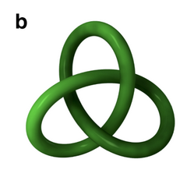
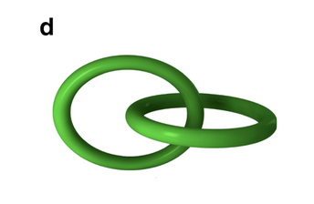
Original Space
(3D)
t-SNE
Low-dim Space
(2D)
1 Class
2 Classes

