Slide 1



Secure your IT like the DoD
PA Hackers
February 12th 2020
By Floyd Rodery
Systems Engineer

Slide 2

WHO AM I?
Floyd Rodery
* Current role: Systems Engineer
* 15+ years as an “IT Specialist” for “Alphabet Agencies”
* Security+, CEH, CHFI, blah blah blah..

Slide 3

DISCLAIMER
This presentation was prepared or accomplished by Floyd Rodery in his personal capacity. The opinions and information expressed in this presentation are the author's own and are not to be construed as official or reflecting the views of the Department of Defense, the Defense Information Systems Agency, or the United States government.

Slide 4
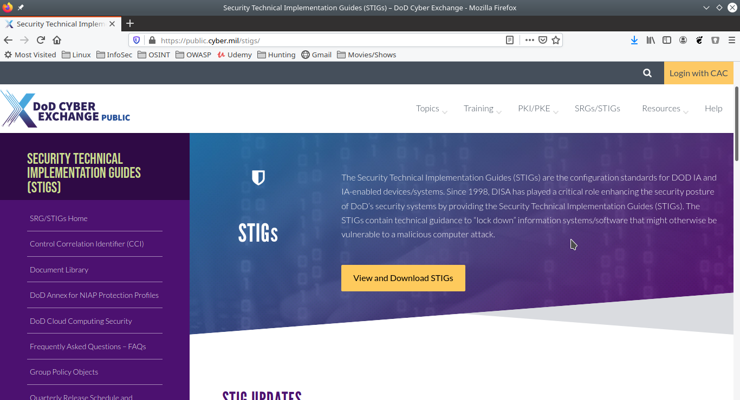
AGENDA
What is a STIG?
Why should I use it?
How do I use it?
All in 15 minutes…..maybe

Slide 5
WHAT IS A STIG?
STIG = Secure Technical Information Guide
A Security Technical Implementation Guide (STIG) is a Cybersecurity methodology for standardizing security protocols within networks, servers, computers, and logical designs to enhance overall security. These guides, when implemented, enhance security for software, hardware, physical and logical architectures to further reduce vulnerabilities.
Technical guidance to “lock down” information systems/software that might otherwise be vulnerable to a malicious attacks.
Notes:
STIG’s are produced by DISA, a DoD agency
STIG is basically a guideline or framework to secure your “out of the box” operating system or application. It covers changing default configs, among other changes, to “harden” your system or application.

Slide 6
WHY SHOULD I USE IT?
Do you even Security bro?
Lock your sh*t down! (aka Uses Cases)
Do you have a secure system and can you prove it?
Give yourself a secure baseline image to build defense in depth!
Windows, Linux, iOS, Android, IIS, Apache, SQL, Active Directory
Docker, Cisco, etc. – 469 available STIG’s!
Notes:
- Personal Use
Win10 laptops/workstations, ,VM’s, home network equipment (routers, NAS, etc.)
- Professional Use
Company workstations, web servers, VM’s, file servers, databases, Active Directory, etc
Can you prove to an auditor or stakeholder you have taken care of configuration vulnerabilities and are deploying secure IT infrastructure.

Slide 7
HOW DO I USE IT?
What do I need to get STIG'gy with it?
1. STIG Viewer (JAR file, cross OS compatible)
https://public.cyber.mil/stigs/srg-stig-tools/
2. Download a STIG (469+ to chose from!)
https://public.cyber.mil/stigs/downloads/
Notes:
Download the STIG Viewer, jar file, make it executable in Linux.
Download your STIGs, unzip them, import them into the STIG Viewer, create a checklist and secure away.

Slide 8

QUICK, SHOW ME BEFORE TIME RUNS OUT!
WATCH MY LIVE DEMO NOT FAIL!

Slide 9
IF YOU SEE SOMETHING, SAY SOMETHING
Got Questions?

