Slide 1

Keeping It In The Family
Team I - Schwabingo
Bingqing (Claire) Li
Anne-marie Cocauthrey Charlie Wu
Xinyu Xieyang
January 26, 2019

Slide 2
Outline
Background
Problem Statement
Risk Factors
Methodology & Models
Predictions
Application & Demo
Q & A

Slide 3

Background
More than 2100 Schwab team members dedicated to custody, trading and operations
Over 7500 advisors
Representing $3.56 trillion in assets under management (AUM)

Slide 4
Problem Statement
Identify an at-risk relationship between the clients and advisors early to begin rebuilding that trust and loyalty before it’s too late
Notes:
Identify and segment risky customer based on the cause of the risk
Flag risk earlier in customer to manage

Slide 5
At-risk relationship
Inactive customer
Unresponsive
Never consulted with an advisor
Fluctuations in customer behavior
Previously consulted
Client’s actions vs account’s objectives
Overt action
Currently consult
Overall dissatisfaction with services and products

Slide 6
Risk Factors
Economy
Growth
Inflation
Investor sentiment and expectation
Portfolio performance
Low performance vs market index
Advisor performance
Account logistics
Frequency of contributions and withdrawals
Wealth transfer
Death of account holder

Slide 7
Methodology
Literature review. Gerrans, P., & Hershey, D. A. (2016). Financial Adviser Anxiety, Financial Literacy, and Financial Advice Seeking. Journal of Consumer Affairs, 51(1), 54-90. doi:10.1111/joca.12120
Regression Trees : 40% accuracy
Data simulation, visualization
Candidate Machine Learning models : Logistic regression, KNN, etc
Gerrans, P., & Hershey, D. A. (2016). Financial Adviser Anxiety, Financial Literacy, and Financial Advice Seeking. Journal of Consumer Affairs, 51(1), 54-90. doi:10.1111/joca.12120

Slide 8
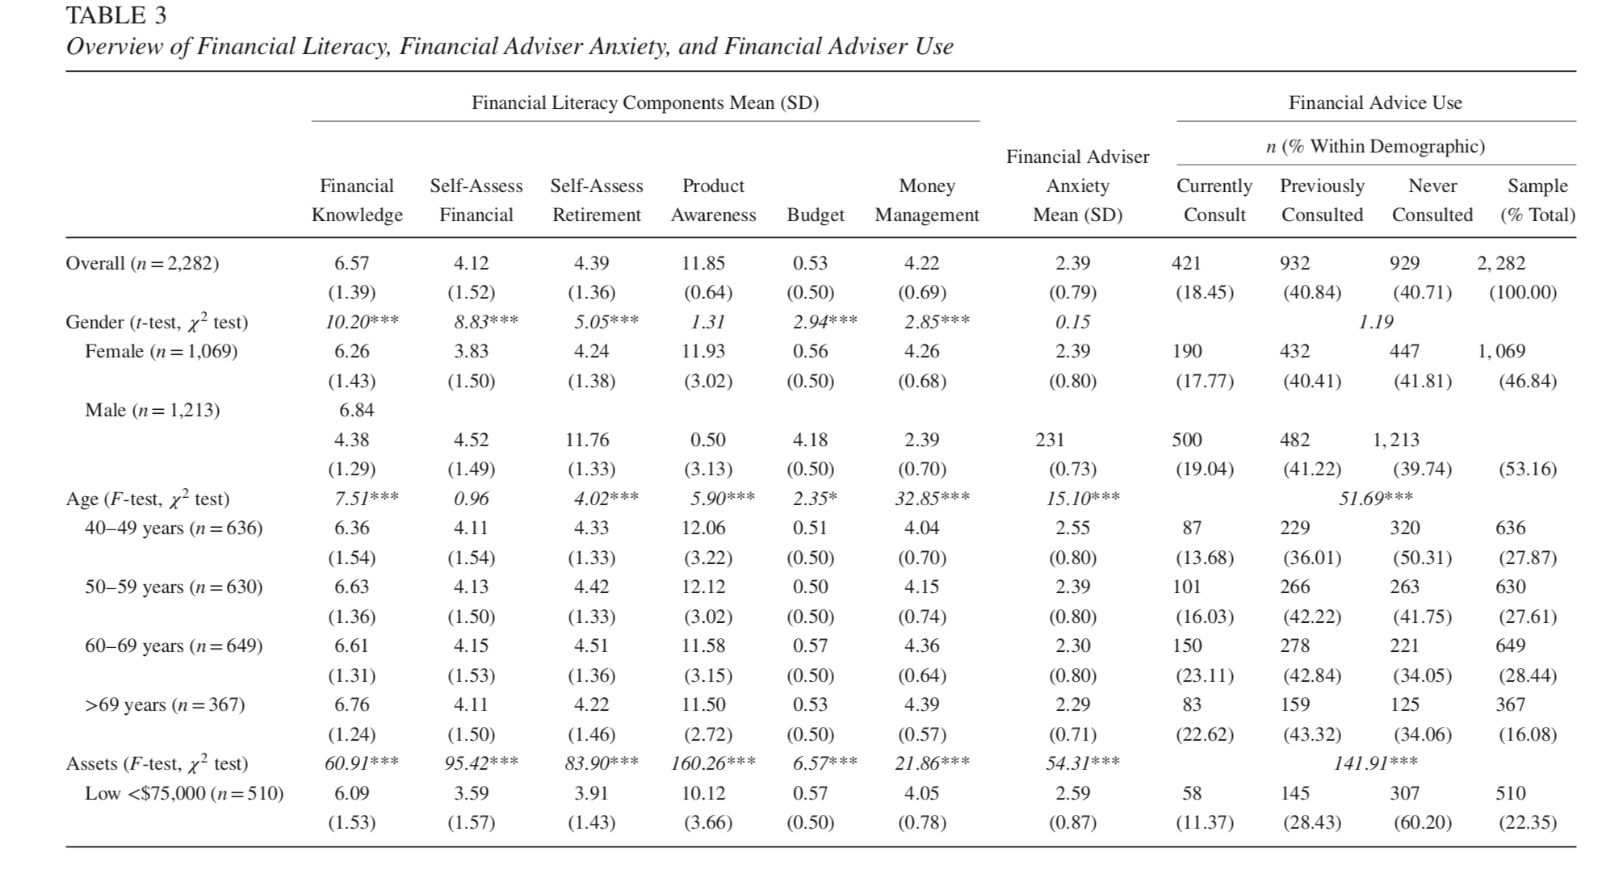
Observations
Gerrans, P., & Hershey, D. A (2016). Financial Adviser Anxiety, Financial Literacy, and Financial Advice Seeking. Journal of Consumer Affairs, 51(1), 54-90. doi:10.1111/joca.12120
‹#›

Slide 9
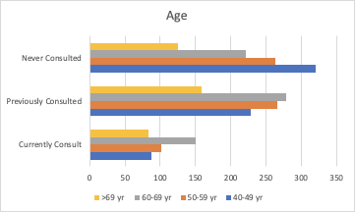
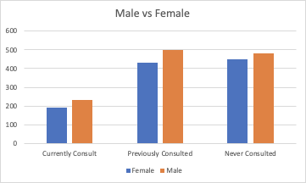
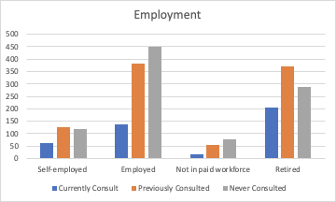
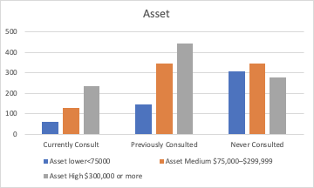
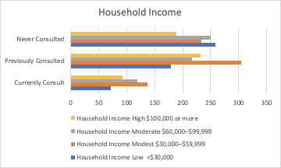
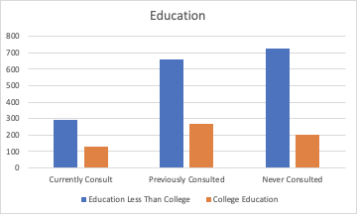
Observations
‹#›

Slide 10
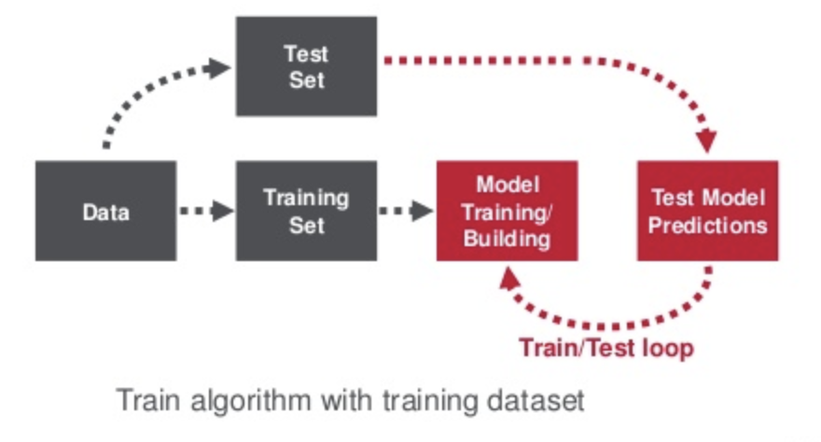
Machine Learning Pipeline

Slide 11

Models
We have ran 4 different models (accuracy score after tuned):
Logistic regression (0.703)
Random forest (0.659)
Xgboost (0.563)
KNN (0.677)

Slide 12
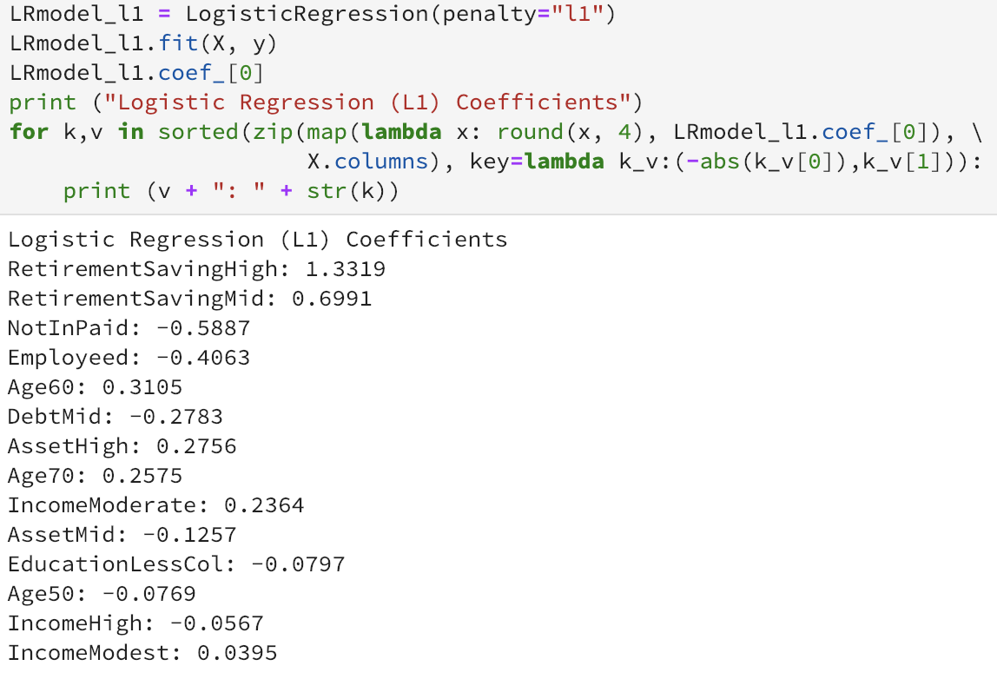
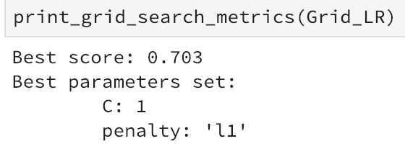
Prediction

Slide 13
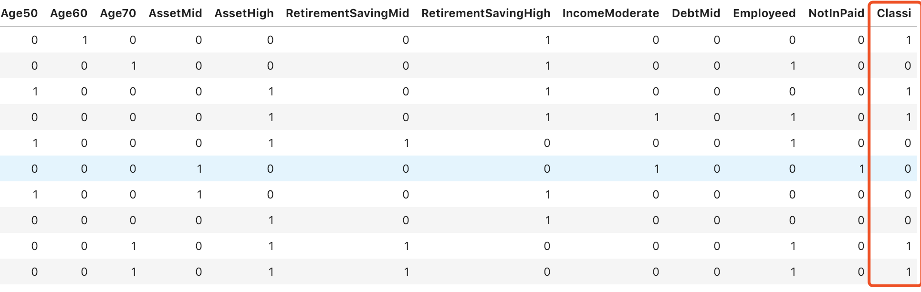
Prediction

Slide 14
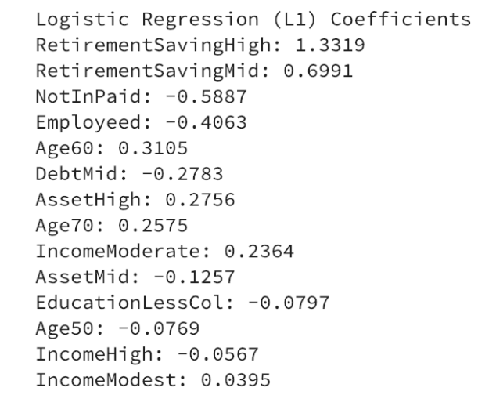
Insights
Retirement Savings Higher than $25,000 indicates a positive response on consulting needs. Hence, they tend to be safe and stable clients
Unemployments tend to put risk on clients’ interests in investment because of restricted income
Stable revenue and busy lifestyle seem adversely affects clients’ needs for investment.
Seniority (>60) gives rise to clients’ needs for insurance.
Conclusion: Insurance seems to be a major concerns regarding to investment decisions.

Slide 15
Future work
Insights analysis
Model tuning
Caution discussion

Slide 16
Demo

Slide 17
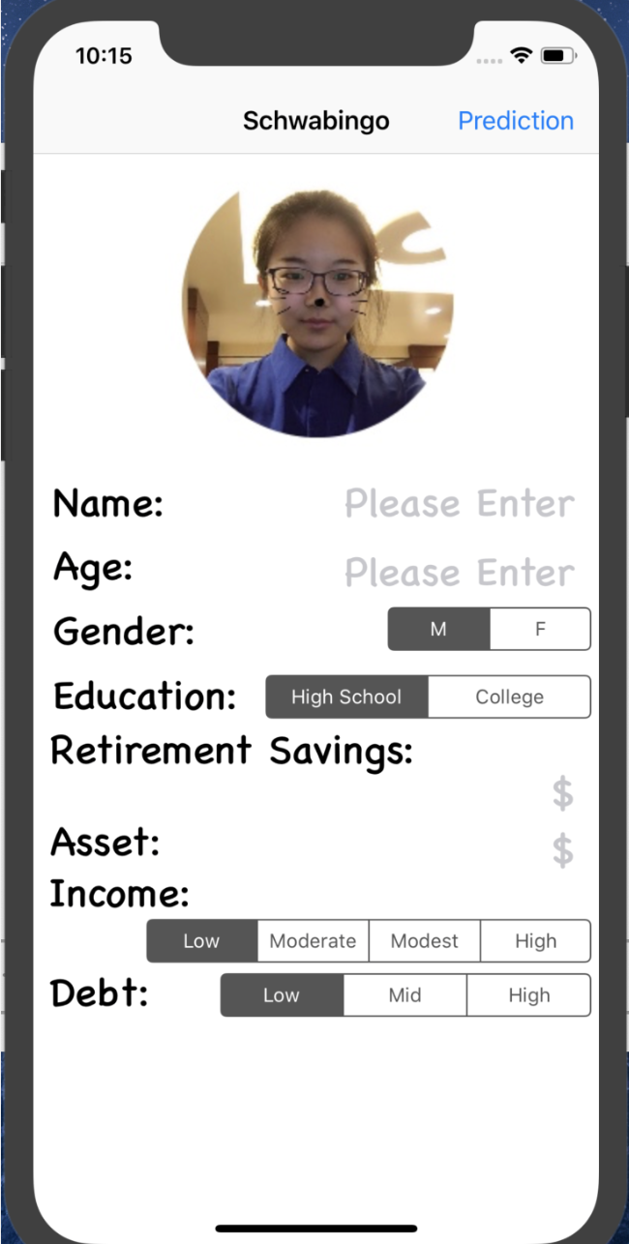
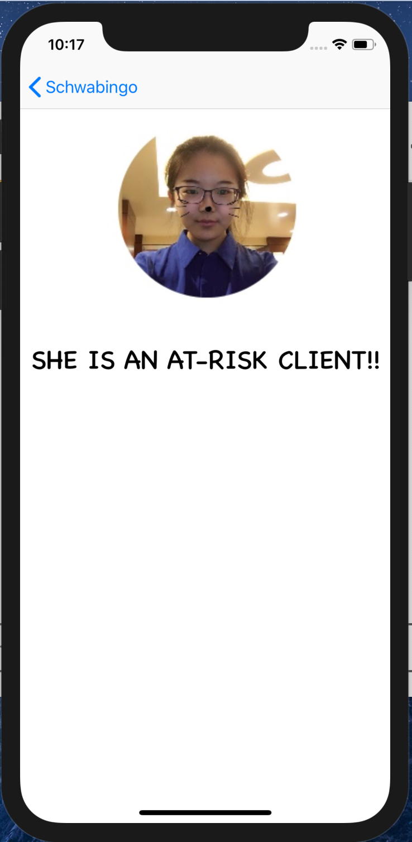
Application

Slide 18
Q&A

