Slide 1
Peachtree Street Traffic Simulation
Rahul Nihalani, Yaohong Xi, Zangwan Cao
College of Computing, Georgia Institute of Technology

Slide 2
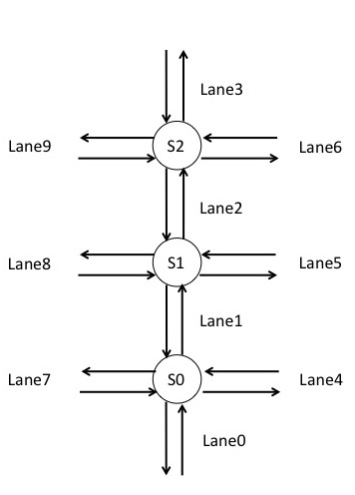
Abstract
Goal: compare the average travel time for vehicles to traverse a section of Peachtree Street using synchronized and to unsynchronized traffic signals.
The result of our simulation shows there is no significant difference between sync and unsync.

Slide 3
INTRODUCTION
Traffic signal synchronization is a method of timing groups of traffic signals.
By calculating the arrival time for a group of vehicles at specific speed, we can simulate the traffic flow for different synchronization schemes.
A more realistic application for this project is we can optimize the travel process and come out with the most effective traffic light pattern to reduce the traffic congestion.

Slide 4
ASSUMPTION & SIMPLIFICARION
Assumptions:
The distribution of vehicle on the minor roads is derived from the data of major road (the Peachtree Street).
We treat them as unaggressive drivers, and then we induce no one will pass the cars before.
Entering time for each car, entering intersection for each car and exiting intersection for each car all obeys uniform distribution.
Simplification:
Each lane has unlimited capacity to hold vehicles.
There are two lanes on each side.
The car can start and stop immediately
For all cars, the time for crossing each intersection is fixed (3 sec).

Slide 5
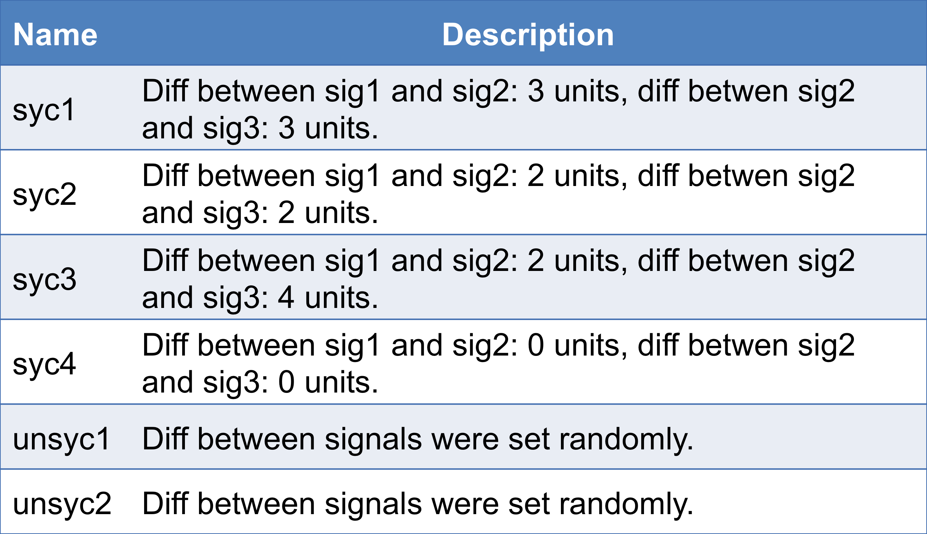
Synchronization schemes

Slide 6
SIMULATION MODEL
Our model consists of four events, which are briefly described as follows:
1) EnterLane: EnterLane is called whenever a car tries to enter a lane.
2) SignalCheck: It is fired by the first car in any lane, and then remains active for that lane till it becomes empty again. It's job is to see if the front car can pass to it's next lane.
3) ExitLane: Very similar to entry lane, it is called when a car wants to leave a lane
4) SignalChange: It is scheduled when a signal light needs to change.

Slide 7
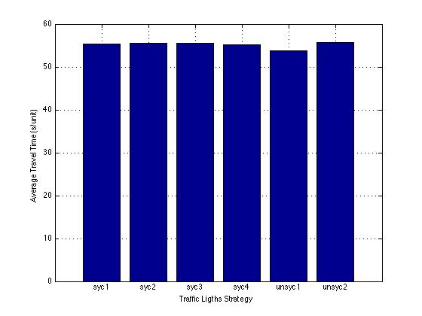
Average times for different runs
No. of car
--- 350
Intersect delay
--- 3 secs
Green time
5 secs
Left green time
3 secs

Slide 8
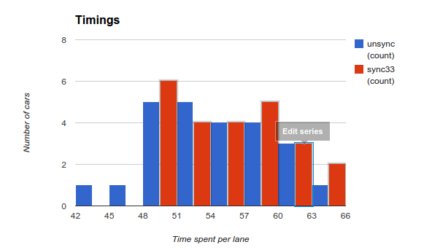
Comparison of sync vs unsync

Slide 9
RESULT & DISCUSSION
Our simulation results shows there is no significant difference between synchronized and unsynchronized scenarios.
Though the unsynchronized scheme is a little better
This result may be caused by the small size of our system. We only have three intersection here and number of vehicle coming into the system during the simulation time is also not huge.

