Slide 1
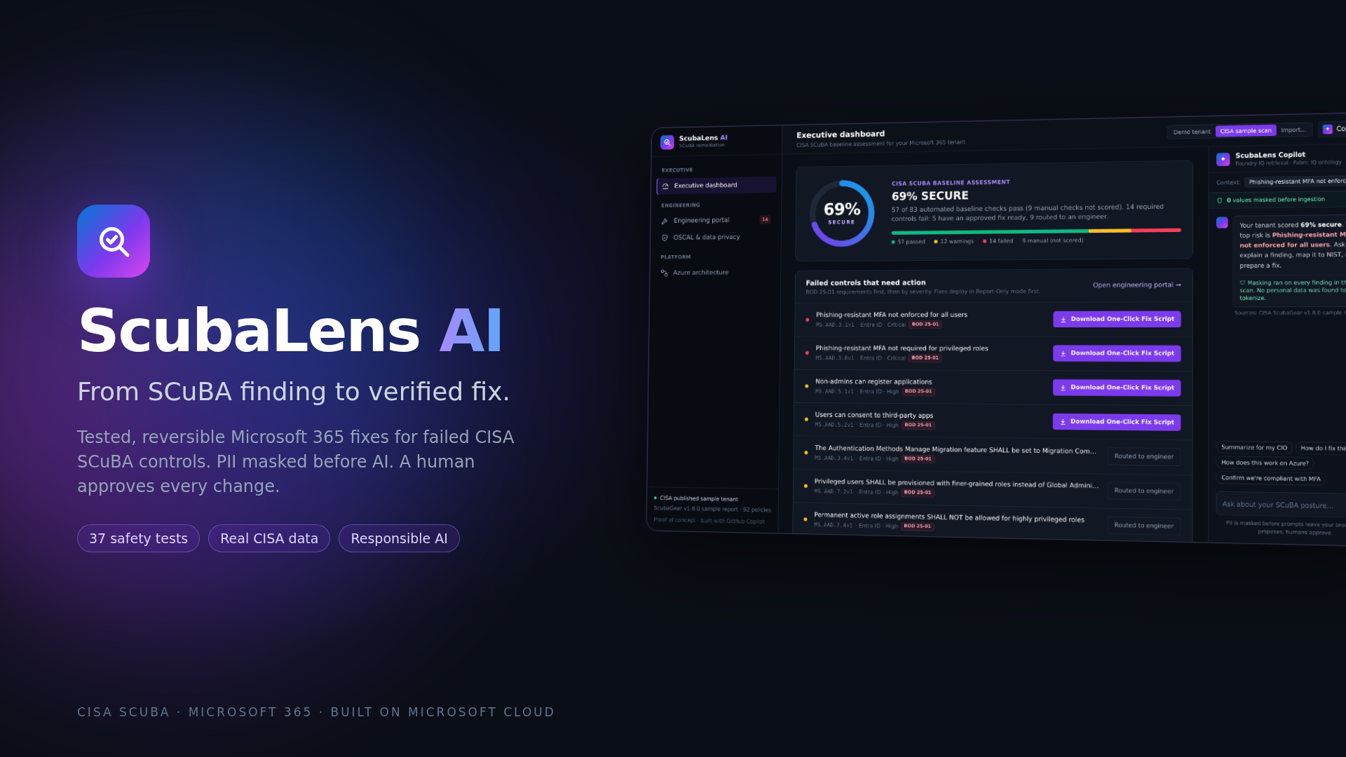
Claire Perrault · George Mason University · Microsoft & CCI Innovation Challenge for Virginia 2026 · SCuBA Security Application
Notes:
ScubaLens AI. Every federal agency now has to scan Microsoft 365 against CISA SCuBA baselines. Other tools document what is wrong. ScubaLens closes it: a tested, reversible fix for each failed control, with a human approving every change.

Slide 2
THE PROBLEM
Scanning is automated. Fixing isn't.
CISA BOD 25-01 made SCuBA mandatory for every federal civilian agency, and it expects deviations to keep being fixed as the baselines evolve.
14
Dec 2024
21 Feb 2025
25 Apr 2025
20 Jun 2025
BOD 25-01 issued
Tenants identified
ScubaGear deployed
Mandatory policies in place
required controls failing in CISA's own published ScubaGear sample tenant
Every failed control is still closed by hand:
All 14 are BOD 25-01 requirements. Each one is a manual fix today.
Research
Write PowerShell
Test
Deploy
Re-scan
Source: CISA ScubaGear v1.8.0 sample report
One analyst, one control, repeated for every tenant and every scan.
Notes:
BOD 25-01 made ScubaGear mandatory. The deadlines have passed, and agencies are expected to keep remediating as baselines change. Scanning is automated. Fixing is still manual: research, write PowerShell, test, deploy, re-scan, for every control and every tenant. On CISA's own sample tenant that is 14 failing required controls.

Slide 3
THE GAP AFTER THE REPORT
Other tools document the risk. ScubaLens closes it.
Report & chat tools
ScubaLens AI
Convert scans to OSCAL documents
Map findings to NIST SP 800-53
Answer questions in plain English
Stop at a remediation plan (POA&M)
An engineer still writes and tests every fix
Exports validated OSCAL results too
A tested fix script for each failed control
Report-Only rollout or rollback file first
A human approves every change
ScubaGear re-scan proves the fix worked
A remediation plan is still paperwork. ScubaLens ships the fix.
Notes:
Existing SCuBA tools, including strong OSCAL compilers, turn scan results into documents and answers. That work is valuable, and we complement it: ScubaLens also exports validated OSCAL. But they stop at a plan. ScubaLens is the step after the plan: a tested fix, human approval, safe rollout, and a re-scan that proves it.

Slide 4






HOW SCUBALENS WORKS
From finding to verified fix, safely
01
02
03
04
05
06
Scan
Mask
Match
Approve
Roll out
Verify
ScubaGear checks the tenant against SCuBA baselines
Emails, tenant IDs and IPs become tokens before AI sees anything
Each failure is matched to a pre-approved, tested fix template
An engineer reviews and approves the change
Report-Only mode first, or a rollback file is saved
ScubaGear re-scan proves it, results export as OSCAL
AI proposes. Identity authorizes. Humans approve. Enterprise controls execute.
Notes:
Six steps. Scan with ScubaGear. Mask personal data before anything reaches AI. Match each failure to a pre-approved, tested template: the AI never writes free-form code. An engineer approves. The fix deploys in Report-Only mode or saves a rollback file first. A re-scan verifies it, and the results export as OSCAL evidence.

Slide 5
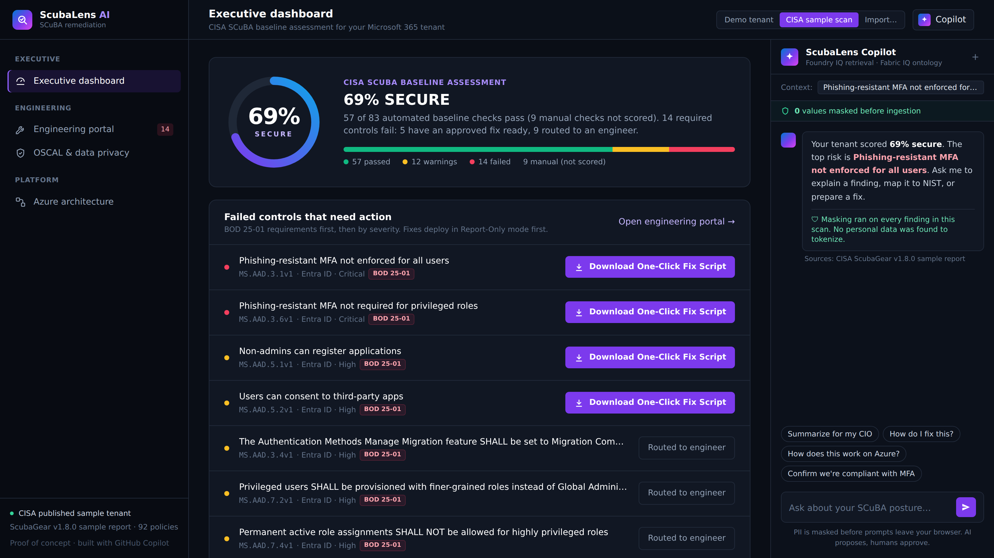
REAL DATA, NOT A MOCKUP
Proven on CISA's own sample scan
92
policies read from CISA's ScubaGear v1.8.0 sample
14
failing required controls, all BOD 25-01
5
approved one-click fixes ready
9
routed to an engineer, never AI-written
Agencies can also import their own ScubaGear results. Files are read in the browser and masked on load.
Notes:
This is CISA's own published sample report, not our demo data. 92 policies, 14 failing required controls. ScubaLens has approved, tested templates for 5 of them. The other 9 are routed to an engineer, because we will not let AI write untested changes to a federal tenant. Agencies can import their own results the same way.

Slide 6
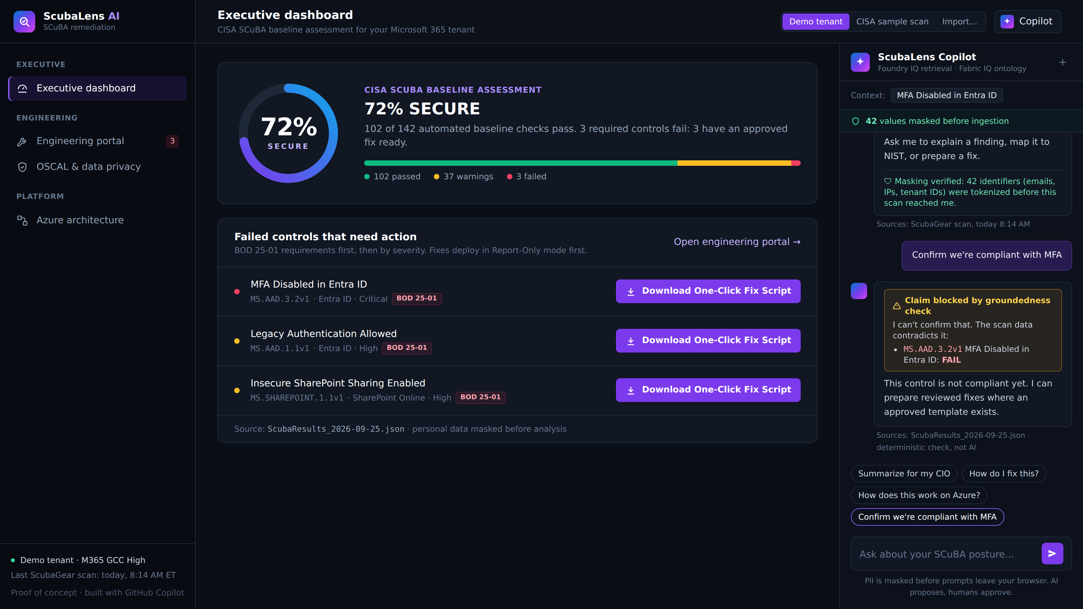



DATA SAFEGUARDS
Responsible AI you can see and test
PII masked before ingestion
Keyed HMAC tokens replace emails, tenant IDs, IPs, phones and SSNs. Key in Azure Key Vault.
Groundedness guardrail
"Confirm we're compliant with MFA" is blocked and the failing control is shown.
42 automated safety tests
Every fix must stay Report-Only, exclude break-glass accounts and save a rollback file.
Tamper test
Change a fix to "enforced" and the safety gate fails with exit code 1.
Tests run on GitHub on every push. The OSCAL export passes validation with the open-source compliance-trestle toolkit.
Notes:
Responsible AI here is not a promise, it is tested. Personal data is masked before the AI sees it. The groundedness guardrail blocks false compliance claims. 42 automated tests check every fix stays safe, and in the live demo I change a fix to enforce immediately and the safety gate blocks it.

Slide 7
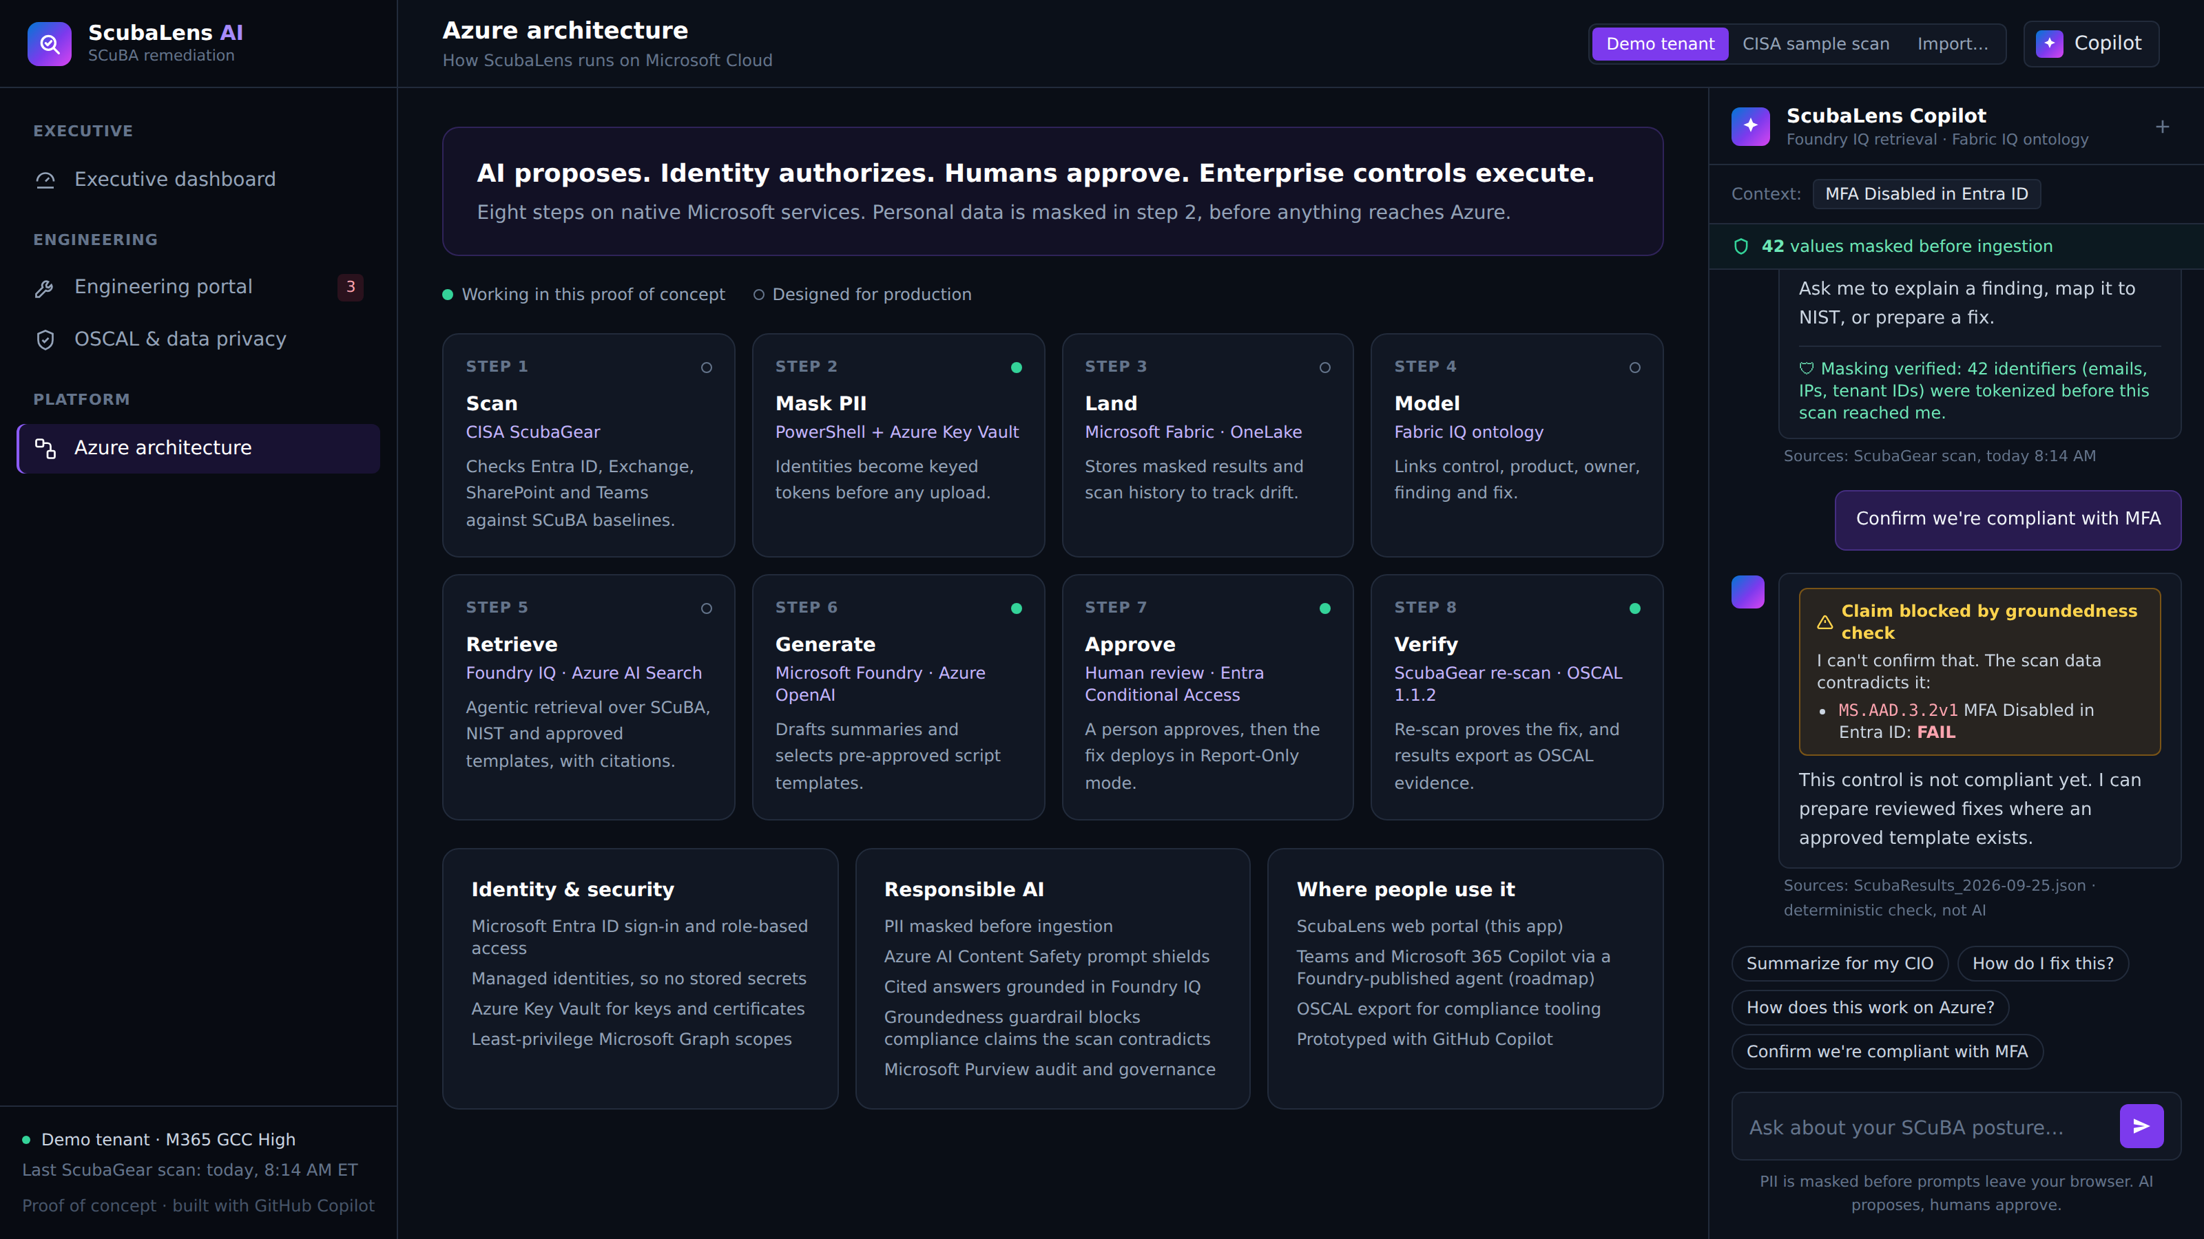
AZURE ARCHITECTURE
Built on Microsoft Cloud
Fabric IQ
Ontology linking control, product, owner, finding and fix, over scan history in OneLake
Foundry IQ
Agentic retrieval across SCuBA baselines, NIST 800-53 and approved templates, with citations
Microsoft Foundry (live)
gpt-4.1-mini deployed (West US 3) explains masked findings; every line is checked against the scan
Entra ID · Key Vault · Purview
Sign-in, managed identities, masking keys, audited re-identification
Teams & M365 Copilot
Agent published where analysts already work (roadmap)
Live today: masking, fix templates, safety tests, OSCAL export and the Microsoft Foundry call. Designed: Fabric IQ, Foundry IQ, hosted back end.
Notes:
Masked scan data lands in Microsoft Fabric. A Fabric IQ ontology links controls to products, owners and fixes. Foundry IQ runs agentic retrieval over that ontology plus the baselines and approved templates, so every answer is cited. Entra ID, Key Vault and Purview handle identity and governance. The app labels each step honestly: working in the prototype, or designed.

Slide 8




APPROACH & KEY LEARNINGS
How we approached it, and what we learned
We started with a chatbot, then changed course
Templates beat free-form AI code
Every other SCuBA team was building OSCAL conversion or Q&A. The gap nobody closed was the fix itself, so ScubaLens became a remediation tool.
A federal tenant cannot run code no one tested. The AI explains and selects; pre-approved, tested templates do the changing.
Real data changed our numbers
Tests are the Responsible AI story
Our demo showed 3 failures. CISA's own sample showed 14, and only 5 had safe templates. Showing the other 9 as "routed to an engineer" made the tool more honest, not weaker.
Promises are easy to write. A tamper test that fails the build when a fix turns unsafe is what makes the safety claim believable.
Notes:
Our approach changed during the week. We first planned a compliance chatbot, but every other team was converting reports or answering questions. The real bottleneck was the fix. We learned that templates beat AI-written code for federal systems, that real CISA data changed our numbers and made us more honest, and that tests, not promises, are what make Responsible AI believable.

Slide 9
IMPACT
Economic value & societal impact
Illustrative ROI
Honest scope
560 hrs
$532K
Working front-end prototype with real fix scripts, real CISA data, tests and OSCAL export. The Microsoft Foundry call is live; Fabric IQ, Foundry IQ and the hosted back end are designed, not yet deployed. Fix scripts are not yet run on a live tenant.
saved per tenant per year (~$53,200)
per year for a 10-tenant agency (~5,600 hrs)
Assumptions: 40 non-passing controls per quarterly scan; 4 analyst hours per manual fix vs 0.5 hours to review a ScubaLens script; $95/hour loaded cost. Replace with agency data.
Next
Deploy Fabric IQ + Foundry IQ back end
Entra-authenticated approval workflow
More templates: Exchange, Defender, Teams
Publish the agent to Teams and M365 Copilot
Societal impact: these tenants hold citizens' tax, benefits and health records. Closing phishing-resistant MFA and legacy-auth gaps directly shuts down credential-theft attacks.
Try it: claireluisa.github.io/ScubaLens-AI Code: github.com/Claireluisa/ScubaLens-AI
Notes:
The ROI is a model with stated assumptions, not a measurement. The real benefit is faster closure of the controls attackers use most. To be clear on scope: this is a working prototype with real scripts and real CISA data; the Azure back end is designed and is next. Closing line: ScubaLens turns SCuBA from a compliance report into continuous, verified hardening. Try it live at the link.

