Slide 1

PDS CA2- Unethical Lyfe Advisor
By Liew Xi Wei (Claire), DIT/FT/2B/32
Lecturer: Ms Dora Chua

Slide 2
What is Unethical Lyfe Advisor?
Unethical Lyfe Advisor is a website for Singaporeans to identify:
The range of their salary;
Approximately how much can they earn per month at certain age range;
Starting Pay based on their university course cluster
Which expenditure quartile are they in (how much they spend per month)
If they’re thinking of buying a car, how much would it cost them.

Slide 3
Datasets used
Average Monthly Household Expenditure by Type of Goods and Services Broad and Expenditure Quintile (CSV)
https://data.gov.sg/dataset/average-monthly-household-expenditure-by-type-of-goods-and-services-broad-and-expenditure-quintile
Car Cost Update (xls)
https://www.onemotoring.com.sg/content/onemotoring/en/lta_information_guidelines/buy_a_new_vehicle/car_cost.html
Gross Starting Salary of Graduates (xlsx)
http://stats.mom.gov.sg/Pages/Employment-and-Monthly-Gross-Starting-Salary-of-Graduates.aspx
Median Monthly Basic And Gross Wages Of Common Occupations By Age And Establishment Size In All Industries, June 2017 & Median, 25th And 75th Percentiles Of Monthly Basic And Gross Wages Of Common Occupations By Industry, June 2017 (xlsx)
http://stats.mom.gov.sg/Pages/Singapore-Yearbook-Of-Manpower-Statistics-2017-Income-Earnings-and-Wages.aspx

Slide 4










Libraries Used
Frontend:
Vue.js
Backend:
Data:
Python
Pygal
Chart Libraries:
Google Charts

Slide 5
Graphs

Slide 6
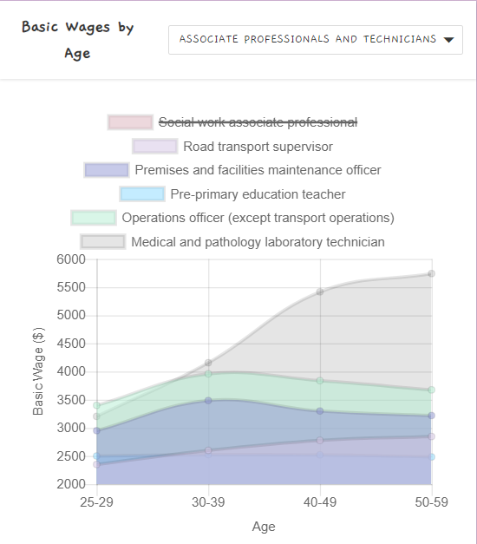
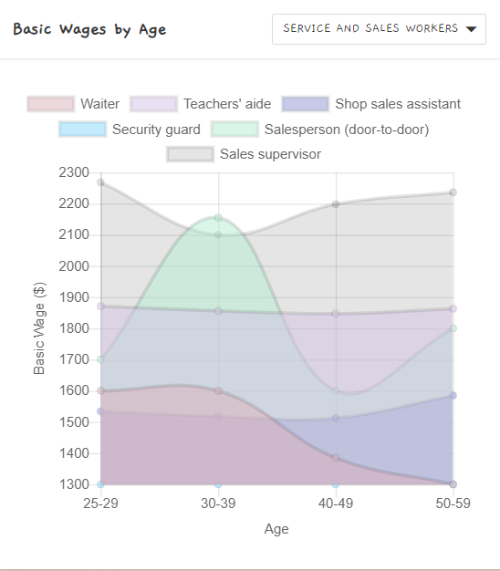
Notes:
We all know that some jobs earn a lot and some jobs might be lesser, but no one really knows which job’s salary will grow as you gain more experience. Such jobs are more sustainable and makes you become richer and richer. For example, the graph at the right side shows that Operations officer and Medical & pathology laboratory technician gets about the same amount of wages at range 25-39. However, the salary of operations officers drops a bit when they reach 40 years old, but the laboratory technician’s salary rises a lot. By analysing the rise in wages, we can conclude that a laboratory technician might be a more sustainable job than a operations officer.
By graph 2, we can see that the salary of a waiter and a door to door salesperson drops drastically at age 40-49. This might be due to both of these careers are heavy reliant on physical labour, and the labour force of an 40+ might not be as good as the younger ones.

Slide 7
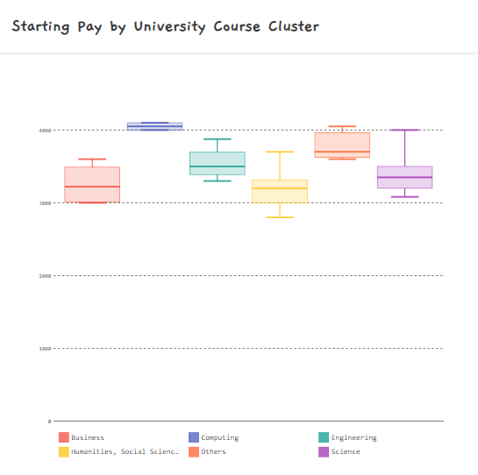
Pygal
Notes:
This data is about the basic starting pay of each course cluster. Generally, the Computing course cluster starts with higher pay (about 4000 per month).
This graph is plotted with pygal, then embedded to Vue js with a very long html string. It is very painful as there is no documentation on how to embed pygal graph to vue js. Also, I personally think that pygal is not a very good library. The axes must start at 0, which makes the graph very squashed. Although it allows customization, I find it not as straightforward as chartjs and google charts

Slide 8
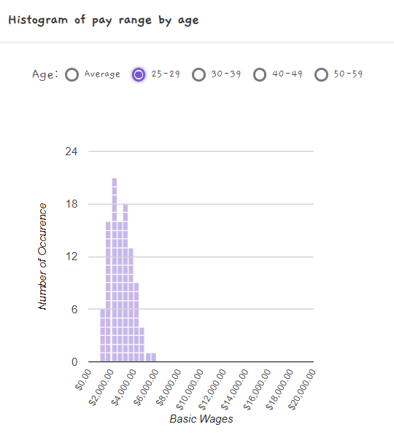
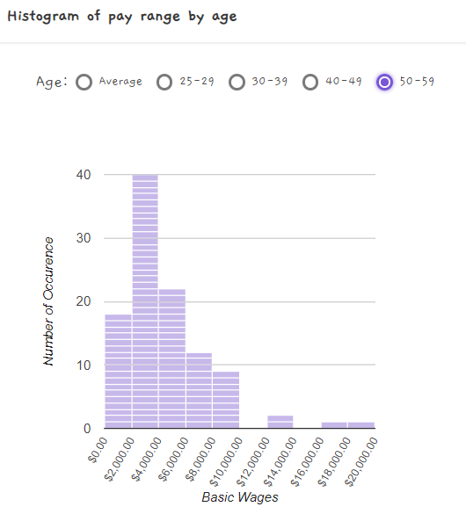
Google Charts
Notes:
This histogram illustrates the pay range by age. From these graphs, we can see that an average Singaporean’s pay is around 2k to 6k. Also, the graph became more left skewed as the age increases. This shows that singaporeans generally gets richer and richer.
This is plotted with google charts, main reason being chart js does not have a default histogram.

Slide 9
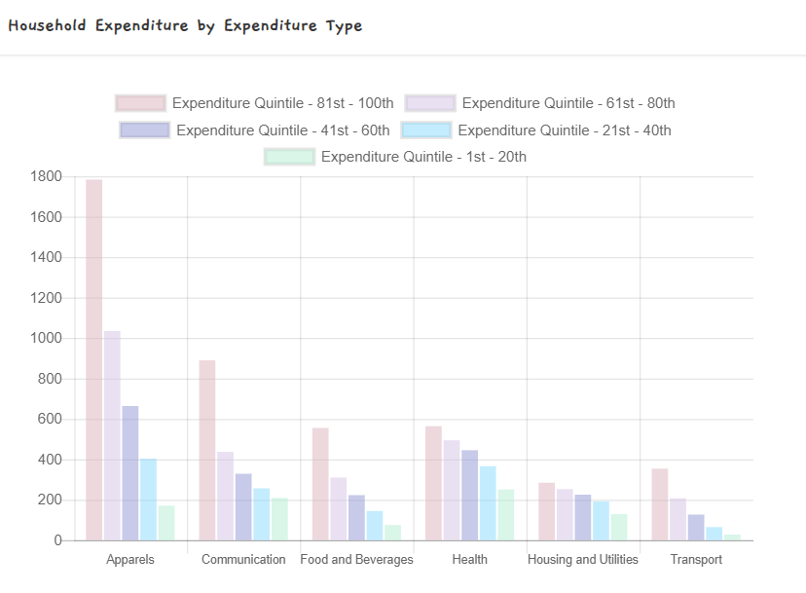
Notes:
This graphs shows the household expenditure by expenditure type. Surprisingly, although the higher ses people spend a lot more on apparels and communications (which imo, is not necessity), the other expenses are only slightly higher than other groups. I focus on these few groups as I feel like these are more relatable.

Slide 10
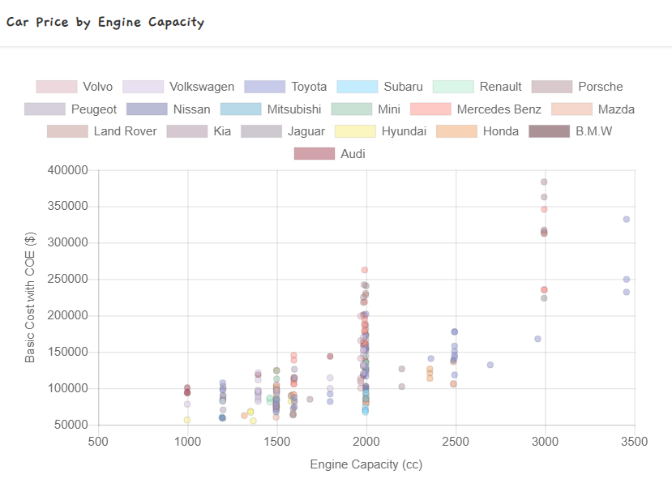
Notes:
I included this as a personal interest. I always wondered how much I need to earn to be able to afford a car in Singapore. Also, I think this is one of the biggest amount singaporeans can spend, as most of them already had their HDB so they don’t need to buy one. From this graph, we can see that cars with 2000cc has the widest range of price. One of the reason being most cars are at 2000 cc because it is more stable and still not too costly when it comes to petrol. I find most people drives 2000cc as well. Therefore, some high end brand 2000 cc car (eg: Mercedes Benz, Porsche) can be a lot more expensive then a 2500cc car because of brand and quality.

Slide 11
Conclusion

