Slide 1
MIS 5050/6050
Advanced Web-Based MIS Development
ASP.NET the .NET Framework
Notes:
1
ISM 3005 Course Introduction

Slide 2
ASP.NET 4.5
Latest Generation of Microsoft’s Active Server Pages server-side scripting Technology
  Not backward-compatible with ‘classic’ ASP!
Program that runs inside Microsoft’s Internet Information Services (IIS) Internet Server
ASP.NET files may contain HTML, XML, and Scripts, and (usually) end in a .aspx file extension
See http://www.asp.net/vnext/overview/aspnet/whats-new for an overview of new features

Slide 3

Traditional Web Applications
HTTP Request for Web Page
HTTP Response with static HTML Page
What are the limitations of this architecture?

Slide 4

Server-side Scripting (ASP.NET)
HTTP Request for Web Page
ASP Processing Request
Response with
dynamic HTML Page
ASP.NET Engine
HTTP Response with
dynamic HTML Page
How does architecture overcome the disadvantages of the earlier architecture?

Slide 5
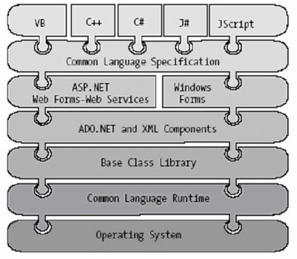
ASP and the .NET Framework
Framework
Class
Library (FCL)

Slide 6
ASP and the .NET Framework
High-Level Code
Language-Specific Compilers
Microsoft Intermediate Language (MSIL)
JIT Compiler
Cached after 1st Request
Native Machine Code

Slide 7
ASP.NET Programming Models
Our focus
  Three ASP.NET programming models:
Web Pages | Web Forms | MVC
Simple model built around individual pages Inline scripting model with Razor syntax Simplified model with top-to-bottom execution | Control- and event-based programming model Controls encapsulate HTML, JS, and CSS Rich UI controls included (including AJAX) Different Browser differences handled for you Sharepoint builds on Webforms | Lower-level programming model Total control of HTML markup Supports unit testing Encourages more prescriptive applications Extremely flexible and extensible
See: http://www.asp.net/web-forms/videos/how-do-i/choosing-the-right-programming-model for more information

Slide 8


ASP.NET vs. PHP
vs.
ASP.NET
PHP
  Bottom Line
Both have advantages and disadvantages
Both are excellent technologies for developing server-side Web applications

Slide 9
Deep Thought
When the age of the Vikings came to a close, they must have sensed it. Probably, they gathered together one evening, slapped each other on the back and said, "Hey, good job."
-Jack Handey

