Slide 1
Basics on Deep Learning as a General Approximator
Sukho Lee(이석호)
Dongseo Univ.
@울산대학교 2017.7.17~18

Slide 2
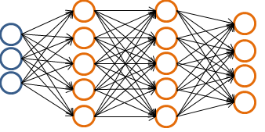
Deep Learning
Deep learning is a learning technique which
Learns through a deep neural network
# of layers <=3 → shallow network
# of layers >3 → deep network
Layer 1
Layer 4
Layer 2
Layer 3

Slide 3









Layer 1
Layer 2
Layer 1
Layer 2

Slide 4


Layer 1
Layer 2

Slide 5
Layer 1
Layer 2
Layer 3

Slide 6
Layer 1
Layer 2
Layer 3
If there is no non-linearity between the layers than the 3-layer network can be expressed by a
Single matrix. → The same as having only 2-layers with the weights in .

Slide 7
Layer 1
Layer 2
Layer 3
Neural Network can be seen as a mapping function between two vectors(tensors) .
The above network maps to .

Slide 8
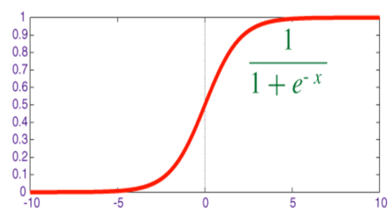
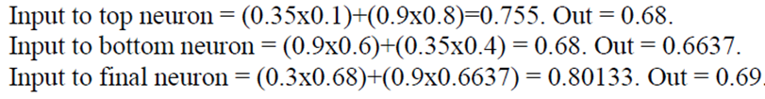
Neural Network with non-linear function
=0.1
C
A=3.5
Sigmoid 함수
=0.3
=0.4
E
output
=0.8
D
=0.6
=0.9
B=0.9
Weight parameter
(Target of learning)

Slide 9
Problem of Recognition ≈ Problem of Classification,
Problem of Regression
Voice Recognition : Problem of how to classify different voices
Image Recognition : Problem of how to classify objects in image
Given a vector what is the proper function which can approximate ?
Input
True Output
Estimated Output
voice1
tom
voice2
Becky

Slide 10
Deep Learning as a Universal Approximator
Data
Output
vector(or Tensor)
vector(or Tensor)
Deep Neural Network can be seen as a
Tensor-to-Tensor mapping function
Why is it called an Approximator? It tries to find a function which approximates the true value
It is called a Universal Approximator because it can approximate even in the case that the relation between and is highly non-linear.

Slide 11
Deep Learning as an automatic programming
Classic programming
Data
Computer
(Execution)
Output
Program
Machine Learning
Data
Computer
(Synthesis)
Program
Output
Why Machine Learning becomes important : difficult to write Program for difficult data

Slide 12


Deep Learning as a Universal Approximator
1
Data
0
…
0
0
Data
0
…
1

Slide 13
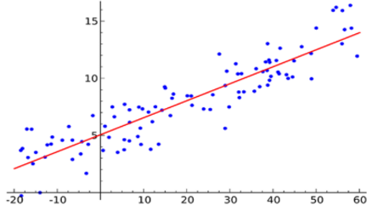
Simple Linear Regressor
Parameters are and
If the relation between and is simple, this relation can be modeled by a simple model,
and it is easy to obtain the parameters.

Slide 14

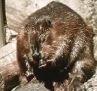
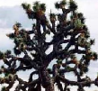




Deep Learning as a Universal Regressor
Highly non-linear
anchor
beaver
Joshua
tree
In the pixel space, the distance between the Beaver images can be more far than the distance between the Beaver and the Anchor images

Slide 15









Highly non-linear = neural network
anchor
beaver
Joshua
tree
The model can only represent a linear relationship.
In comparison, “neural network” can represent a highly non-linear relationship.
So it can be said that “neural network” has a greater representation power than

Slide 16
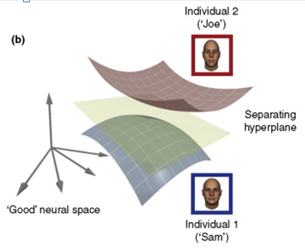
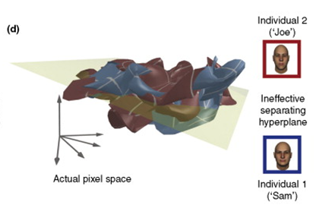
In the pixel space, the distance between the Beaver images can be larger than the distance between the Beaver and the Anchor images
fa
Feature mapping
Separating function

Slide 17
Not so non-linear
anchor
beaver
Joshua
tree
Feature space
Feature
Engineering:
ex) sift, hog,
Try to find a function which maps to a feature space , where the vectors belonging to the same class become closer

Slide 18








Deep Neural Network as a Mapping Function
Not so non-linear
output
anchor
Top layers of
The Neural
Network
beaver
feature
Joshua
tree
Lower layers
of the Neural
Network
Feature space
Feature
Engineering:
ex) sift, hog,
input

Slide 19

OR
Neural network as a
Universal Approximator
anchor
output
beaver
Joshua
tree
input
Learning : Find the parameters of

Slide 20
Learning (Training) : Supervised Learning
Tell the model that the output should be for as the input
Model(?)
…..
…..
input
output
Given a set of inputs and outputs data
train the model.
After training
train(learning)
Model(!)
Test data
The ouput may be
구하고자 하는 파라미터는 와 임.

Slide 21
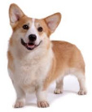







Learning (Training) : Supervised Learning
Tell the model that the output should be dog for as the input
Model(?)
…..
...
input
output
After training
Given a set of inputs and outputs data
train the model.
train(learning)
Model(!)
The output maybe: = cat
Test data
구하고자 하는 파라미터는 와 임.

Slide 22
Design the Model
Design the model:
Define the form of the relation between input and output.
The form determines the exactness of the approximation to the true output
Model(?)
Model A
Model Z
……
are the parameters
are the parameters
Need at least 2 sets of data.
Need at least 3 sets of data
구하고자 하는 파라미터는 와 임.

Slide 23

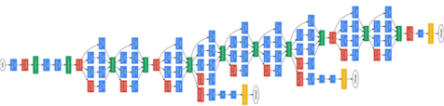
Design the Model
Design the model:
Define the form of the relation between input and output.
The form determines the exactness of the approximation to the true output
Deep Neural Network
Google Inception Model
VGG Model
……
Find the parameters (weight, bias)
for the Inception model
Error : 3.6%
Find the parameters (weight, bias)
for the VGG model
Error : 6.8%
구하고자 하는 파라미터는 와 임.

Slide 24
Define the loss functon : Define what you want to decrease
Model
…..
True output
Current output
Different
Because the parameters are not right
Different

Slide 25
Define the loss functon : Define what you want to decrease
How to measure the difference
Different
Loss function has large value if the
Difference is large:
A measure on the Loss
True output
Current output
different
Want to change the parameters such that the difference decreases (such that decreases)
How?
Gradient Descent

Slide 26
Finding the parameters : gradient descent
When to use gradient descent:
If depends on find which decreases
A value
Can be a Scalar
a vector, or a Tensor

Slide 27
Gradient descent: is 1-D
The slope at :
If positive has to move left (-direction) for to decrease
If negative : has to move right (+direction) for to decrease
Small positive number : Learning rate

Slide 28
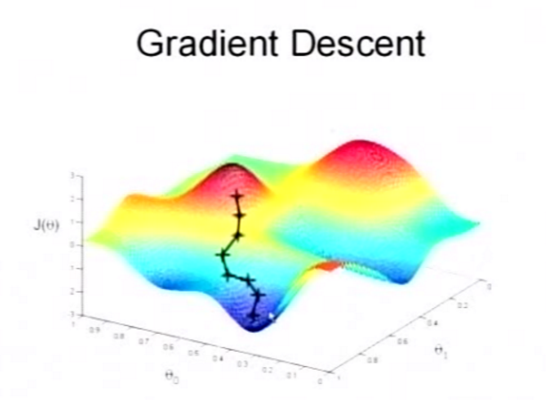
Gradient descent: is 2-D
: A value (height)
: A vector
: 2-D vector : (x,y) coordinates

Slide 29
Compute:
: n-dimension
: n-dimension
EX)

Slide 30
Define the loss functon : Define what you want to decrease
Model:

Slide 31
24
8
11보다는 7에 더 가까와짐.

Slide 32
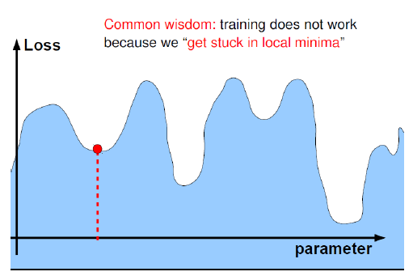
Common Wisdom
Slide : Ranzato

Slide 33
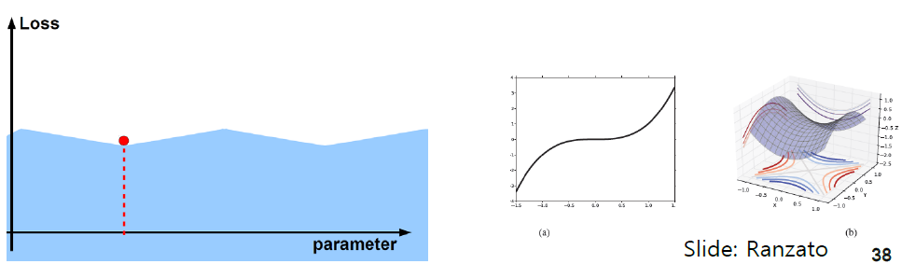
In fact
Local minimum
Local minimum
There is hardly a “true” local minimum. There are many local minima. Many local minima are
as OK as the true global minimum.

Slide 34
However
Local minimum
Local minimum
However, it is good to start with a good initial point (good initial parameters). This reduces the
training time. How to get these points? → use unsupervised learning with a large data

Slide 35
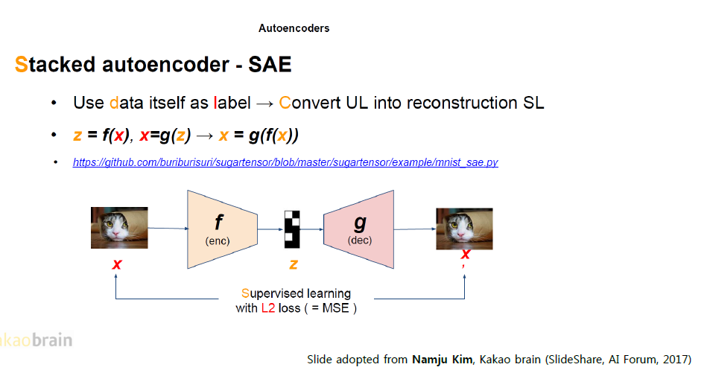
Unsupervised Learning

Slide 36
Role of Regularization
예:
1
Want to get 1 here
With
With

Slide 37
Development of Deep Learning:
DNN(Deep Neural Network) Model was not good.
→ Better models: Use of ReLU, etc.
Algorithm to find parameters in DNN Model was not good
→ Use of Drop-Out, unsupervised learning, stochastic gradient descent…
Data was not enough
→ Big Data (Data on Internet)
Computation power was low
→ GPU, GPGPU(General Purpose GPU)

Slide 38
Convolutional Neural Network
a
b
c
d
a
b
c
image
d
Convolutional
Neural Network
a
b
c
d
b
a
c
d
=
image
*
a
b
=
c
d

Slide 39

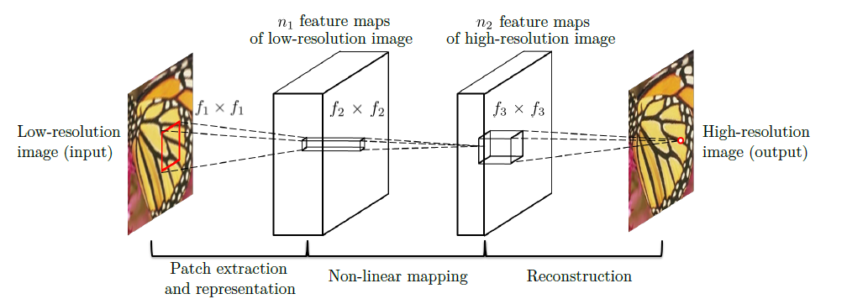
Example : Superresolution
Target
(original
Image)
Train the network
so that the difference
becomes small
Neural Network

Slide 40
a
1
b
c
0
6
d
0
1
0
1
3
1
0
1
0
0
0
1
0
1
e
1
2
f
0
g
h
Consecutive Matrices can be
Expressed by a single matrix
Layers without non-linear functons
are equal to a 1-layer neural network
a
b
6
0
c
3
d+a
b
0
c
d
0
2

Slide 41
Role of the Non-linear Operator
a
1
b
c
0
6
d
0
1
0
1
3
1
0
1
0
0
0
1
0
1
e
1
2
f
0
g
h
Some kind of non-linear function has to come between the layers
Tanh(), Sigmoid, ReLU, Max pooling etc. …..

Slide 42
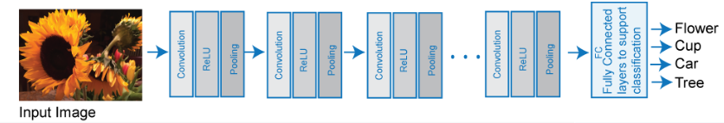
Example : Convolutional Neural Networks
Non-linear function

Slide 43
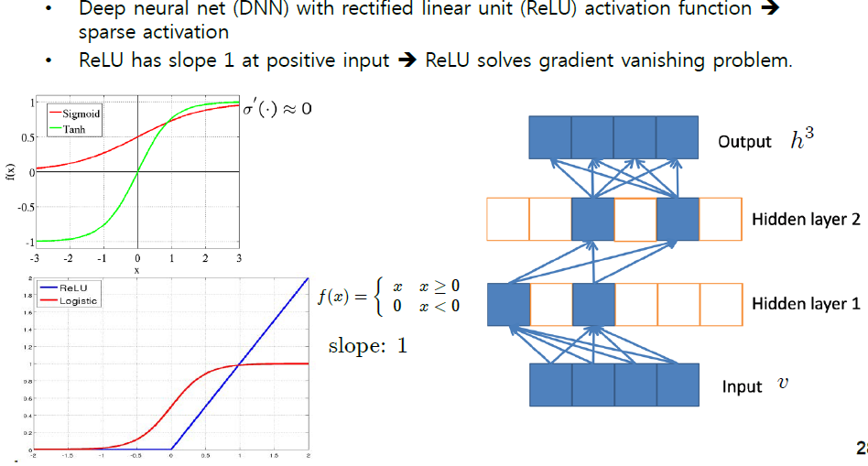
Role of the Non-linear Operator (ReLU)

Slide 44
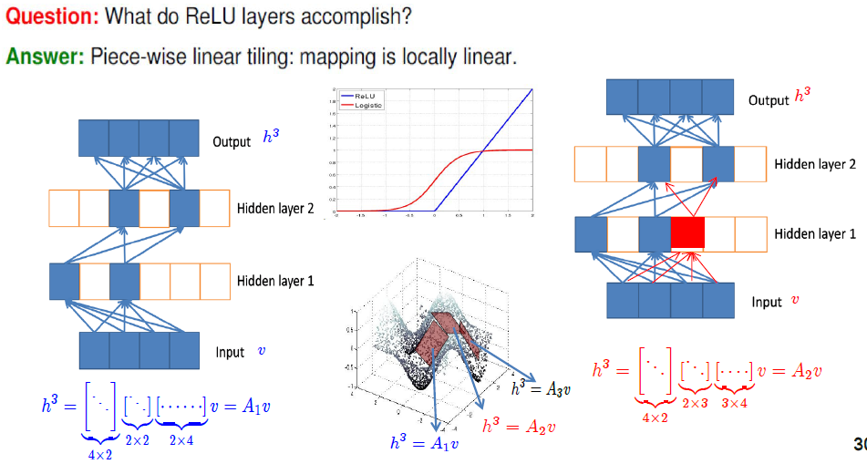
Role of the Non-linear Operator (ReLU)

