Slide 1
Mg Alloys
Clancy and Weihs Group

Slide 2
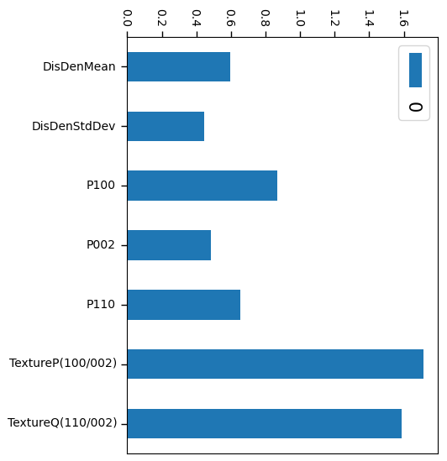
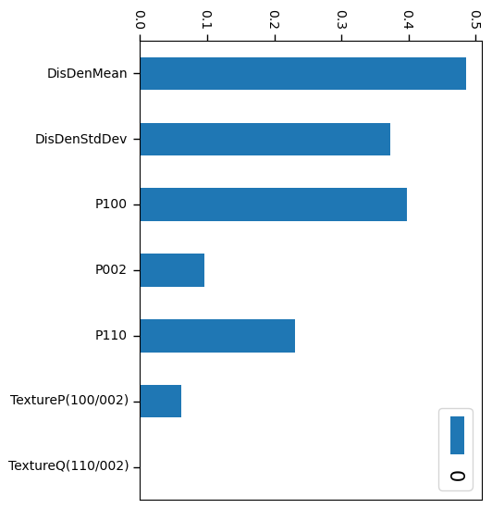
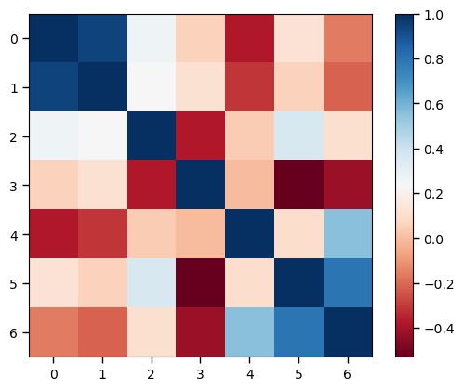
Target: Corrosion Rate
Notes:
Meet with Sreenivas and talk about what other properties might be important.

Slide 3
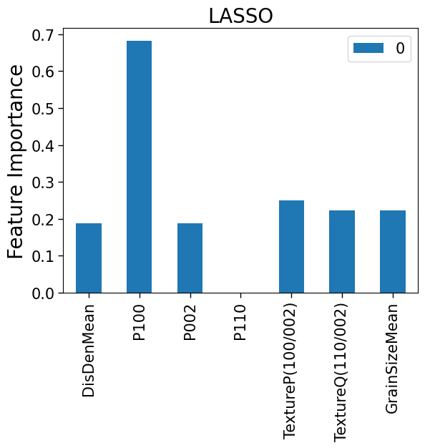
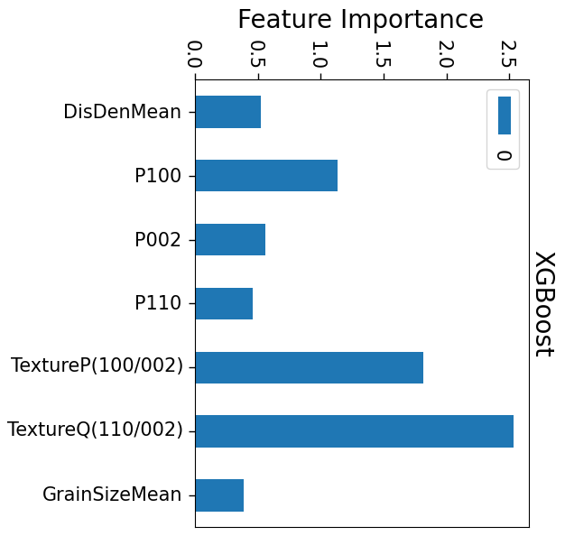
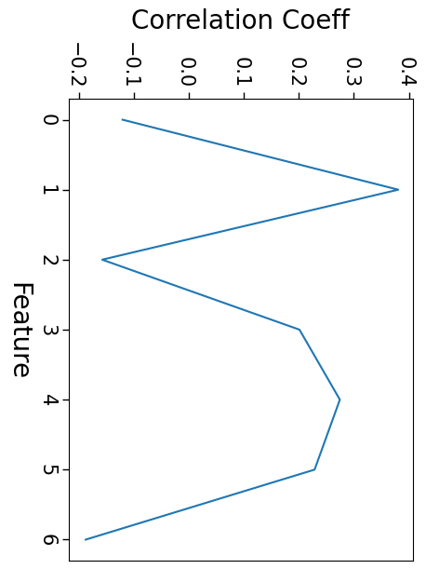
Target: Corrosion Rate
LASSO
XGBoost
Notes:
Meet with Sreenivas and talk about what other properties might be important.

Slide 4
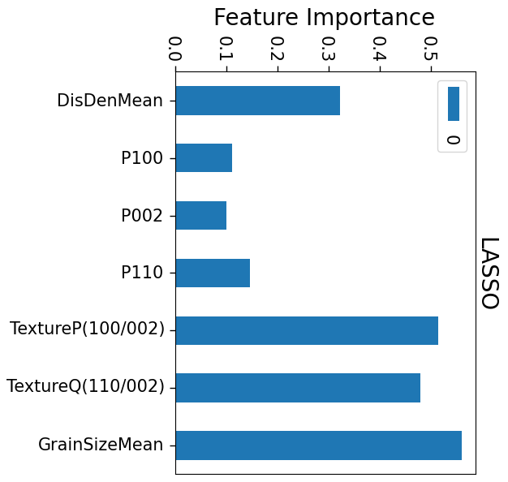
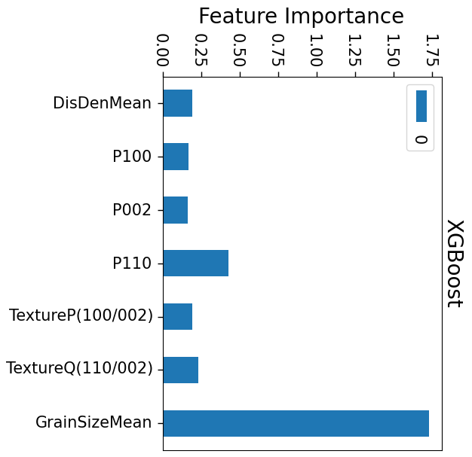
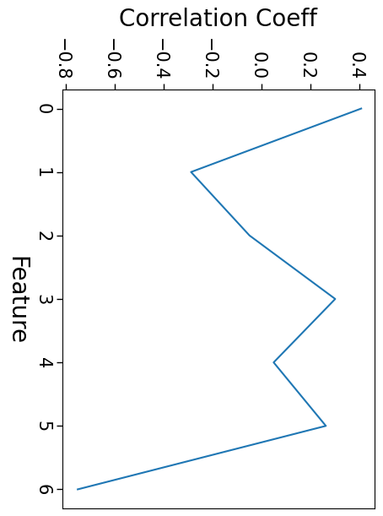
Target: Hardness
LASSO
XGBoost
Notes:
Meet with Sreenivas and talk about what other properties might be important.

Slide 5
ST Study
26th September, 2023

Slide 6
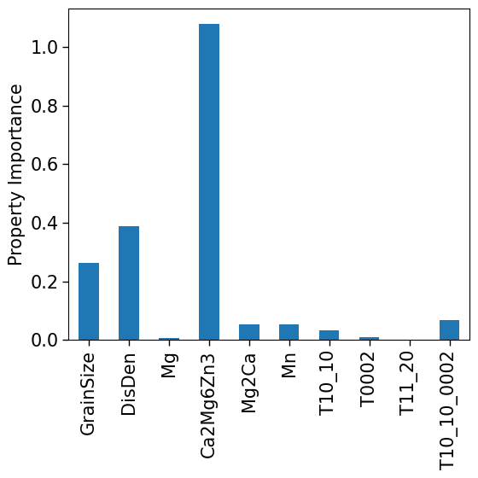
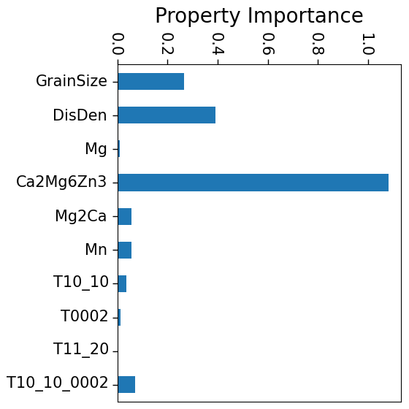
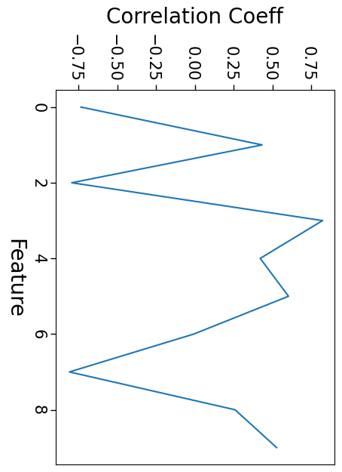
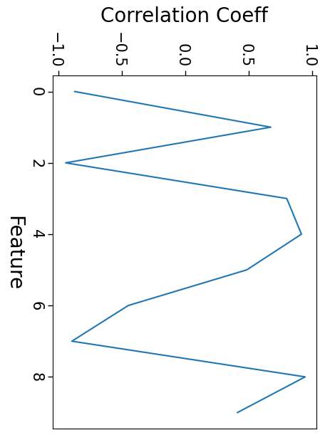
Microstructure vs Corrosion and HV XGBoost and PCC
XGBoost
Notes:
Meet with Sreenivas and talk about what other properties might be important.

Slide 7
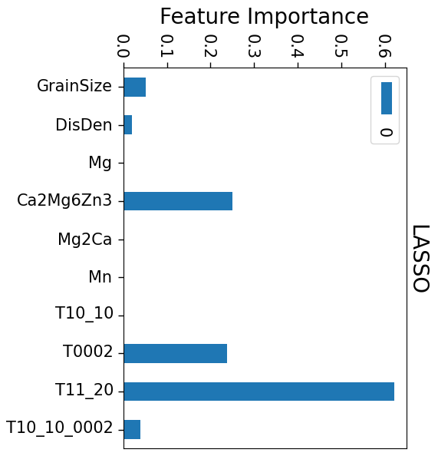
Microstructure vs Hardness
XGBoost
LASSO
Notes:
Meet with Sreenivas and talk about what other properties might be important.

Slide 10
Next Steps
ST– Study Data Analysis
Discover ideal processing conditions
Notes:
Meet with Sreenivas and talk about what other properties might be important.

Slide 11
Microstructure vs Corrosion and HV XGBoost and PCC
Corrosion
Hardness Value
XGBoost
Notes:
Meet with Sreenivas and talk about what other properties might be important.

Slide 12
Next Steps
ST– Study Outline
Assisting Sreenivas in putting together the outline for the paper
Journal options?
Journal of Materials Chemistry B
Notes:
Meet with Sreenivas and talk about what other properties might be important.

Slide 13
ST Paper
16th October, 2023

Slide 14
Things to do this week
Refit the grain growth kinetics curve
Fit data to
Guo-Sha Model (Relating Precipitate to Hardness)
Hall – Petch Relationship (Relating Grain Size to Hardness)
Bailey-Hirsh Model (Relating Dislocation Density to Hardness)
Goal of doing this: What microstructure properties are dominating the targets at different solution treatment times.
Wonder if we should do some kind of symbolic regression on the data?
Notes:
Is there a way to model the small time scale grain growth?
Richard Catlow – NY, Alfred University
Glass transition example
Gibbs nucleation model - too simple.
Look at phase transition barriers – Divya's idea!
Competition between: Volume vs. Surface energy
Look for possible potentials?
Phase field model – for qualitative hypothesis, transition between 2 types of growths.
Lenard Jones
MEAM potentials - https://www.sciencedirect.com/science/article/pii/S0364591614000789?via%3Dihub
Ask Sreenivas - Consistency in the samples and who made them. (Prof. Clancy)

Slide 15
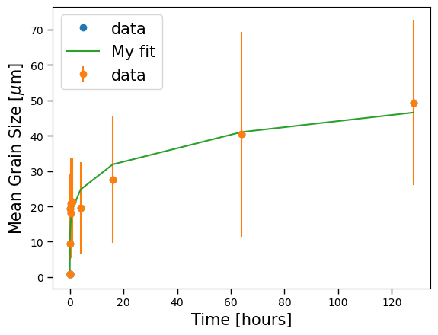
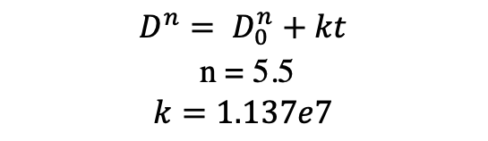
Grain Growth
$$D^{n}= D_{0}^{n}+kt$$
$$\text{n}\text{ = 5.5}$$
$$k=1.137e7$$
Notes:
Is there a way to model the small time scale grain growth?
Richard Catlow – NY, Alfred University
Glass transition example
Gibbs nucleation model - too simple.
Look at phase transition barriers – Divya's idea!
Competition between: Volume vs. Surface energy
Look for possible potentials?
Phase field model – for qualitative hypothesis, transition between 2 types of growths.
Lenard Jones
MEAM potentials - https://www.sciencedirect.com/science/article/pii/S0364591614000789?via%3Dihub
Ask Sreenivas - Consistency in the samples and who made them. (Prof. Clancy)

Slide 16
Updated Texture and Precipitates Data

Slide 17
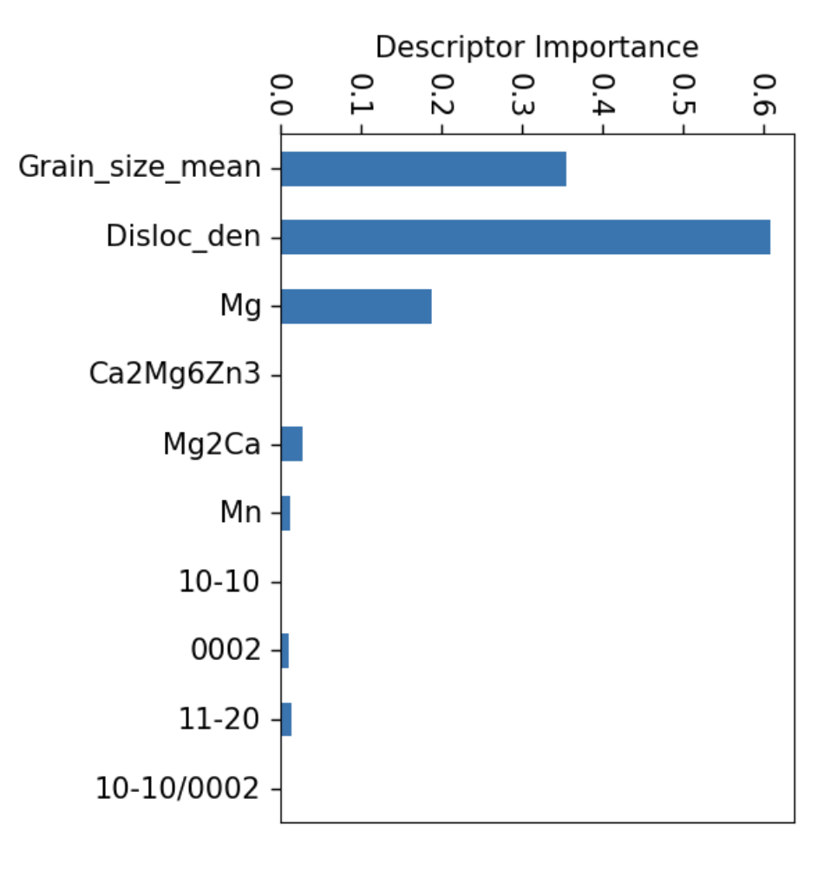
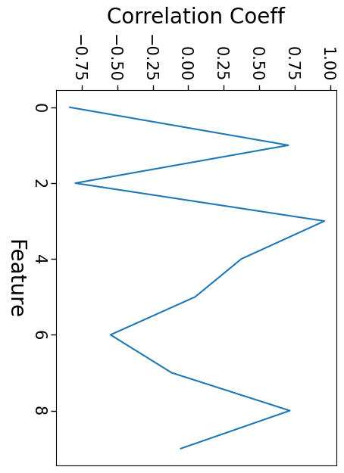
Corrosion Rate
XGBoost

Slide 18
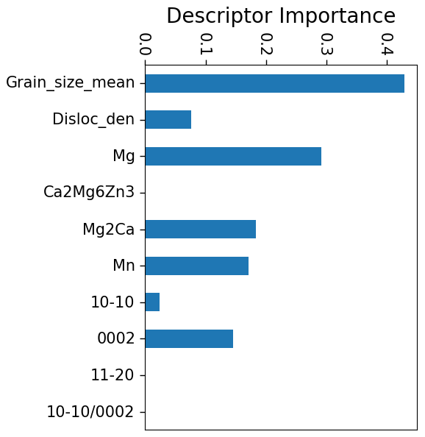
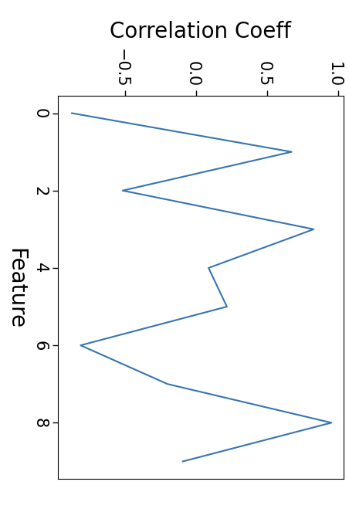
Hardness Value
XGBoost

Slide 19
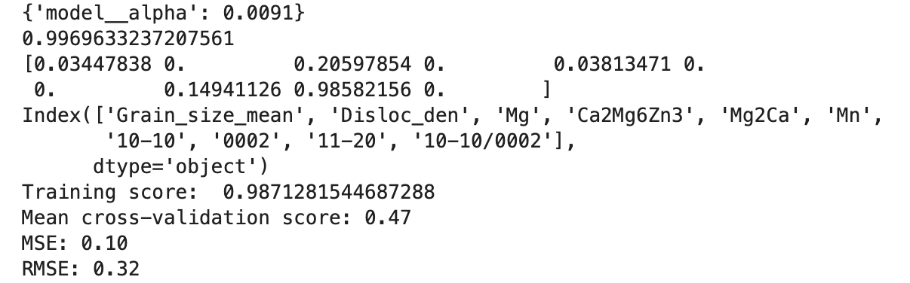
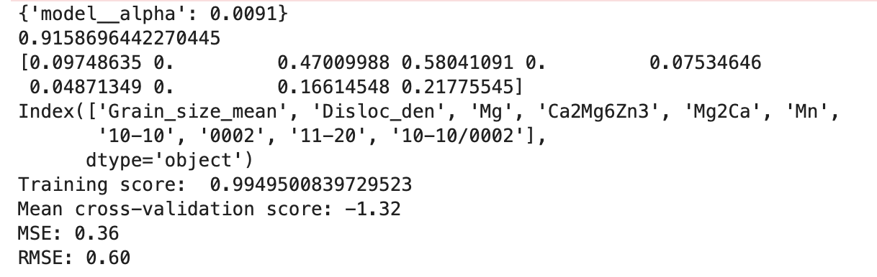
Training Scores: Hardness
Training Scores: Corrosion

Slide 20
Updated Data from November 2023

Slide 21
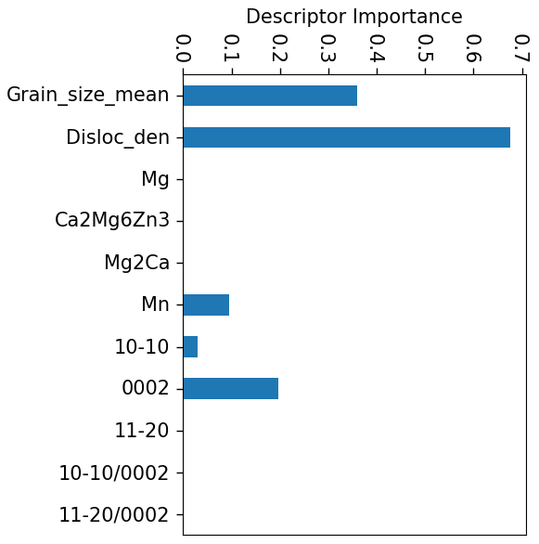
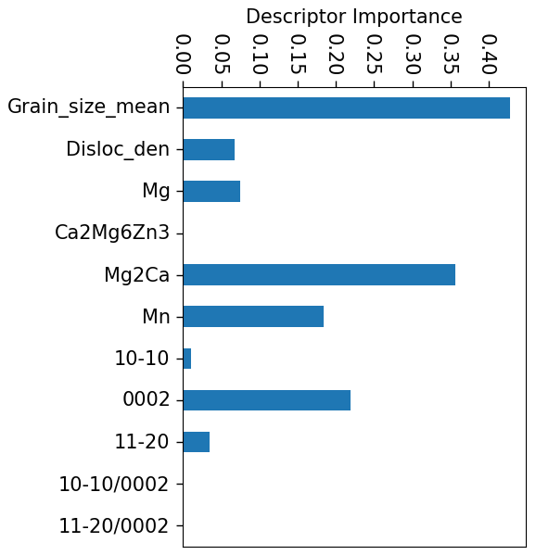
Corrosion Rate
Hardness

Slide 22
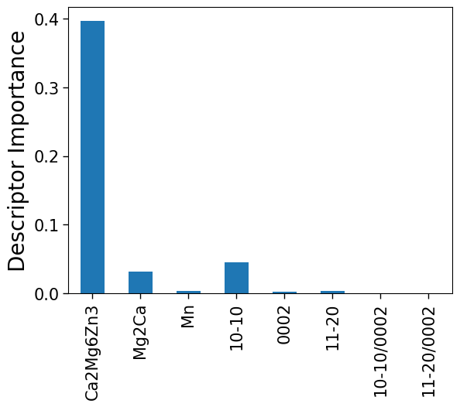
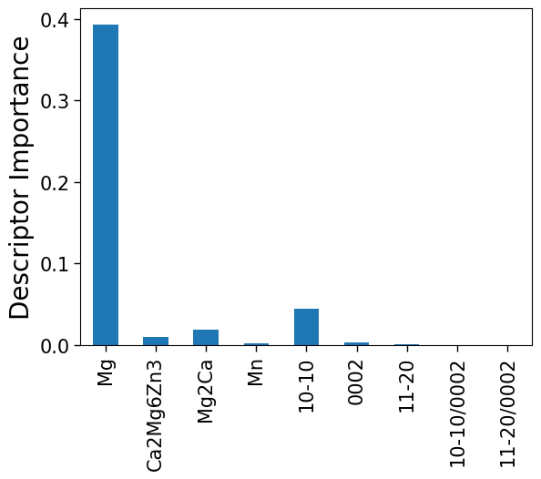
Hypothesis Testing for Hardness
Training Score: 0.997
Training Score: 0.996

Slide 23
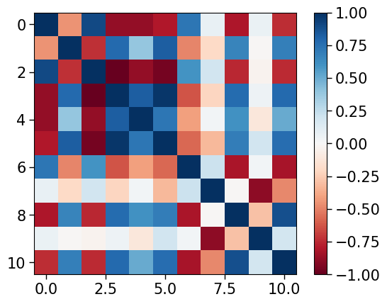
Hypothesis Testing for Hardness
0. 'Grain_size_mean’, 1. 'Disloc_den’,
2. 'Mg’, 3. 'Ca2Mg6Zn3’, 4. 'Mg2Ca’, 5. 'Mn’,
6. '10-10’, 7. '0002’, 8. '11-20’, 9. '10-10/0002’,
10. '11-20/0002'
Training Score: 0.988

Slide 24
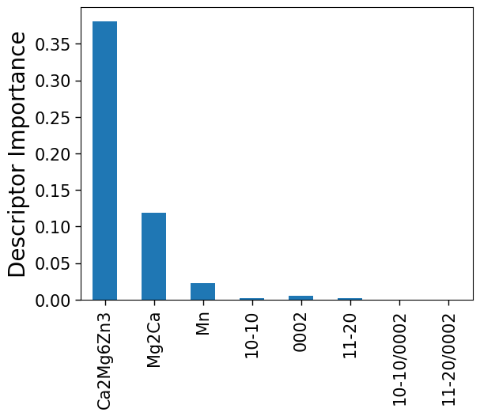
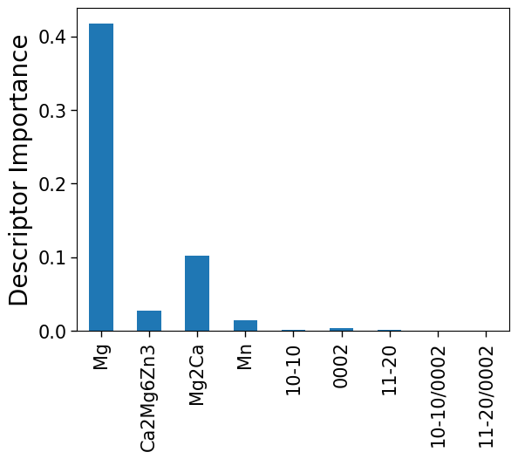
Hypothesis Testing for Corrosion
Training Score: 0.996
Training Score: 0.996

Slide 25
Updated Data from November 2023

Slide 26
Hardness Value
XGBoost

Slide 27
Hypothesis Testing for Hardness
Training Score: 0.997
Training Score: 0.996

Slide 28
Hypothesis Testing for Hardness
0. 'Grain_size_mean’, 1. 'Disloc_den’,
2. 'Mg’, 3. 'Ca2Mg6Zn3’, 4. 'Mg2Ca’, 5. 'Mn’,
6. '10-10’, 7. '0002’, 8. '11-20’, 9. '10-10/0002’, 10. '11-20/0002'
Training Score: 0.988
Notes:
Ternary Phase and Mg difference in electrochemical potential –
Binary Phase and Mg electrochemical potential –
Mn and Mg electrochemical potential –
Ternary - 396.05
Binary - 126.42
Mn - 205.66

Slide 29
Corrosion Rate
XGBoost

Slide 30
Hypothesis Testing for Corrosion
Training Score: 0.996
Training Score: 0.996

Slide 31
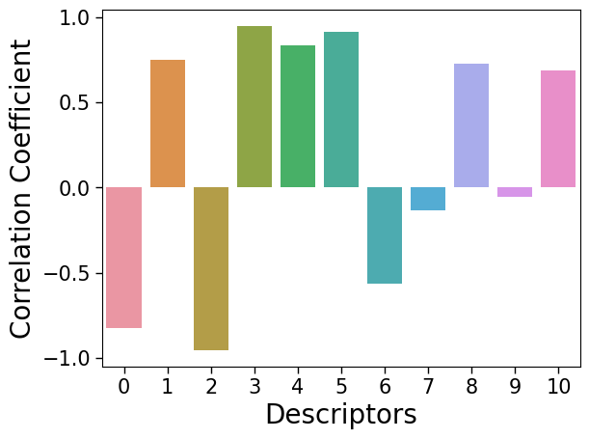
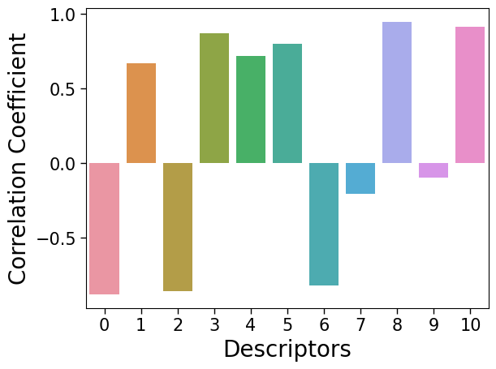
What to put in the paper
Correlation analysis between the target variables and the input features

Slide 32
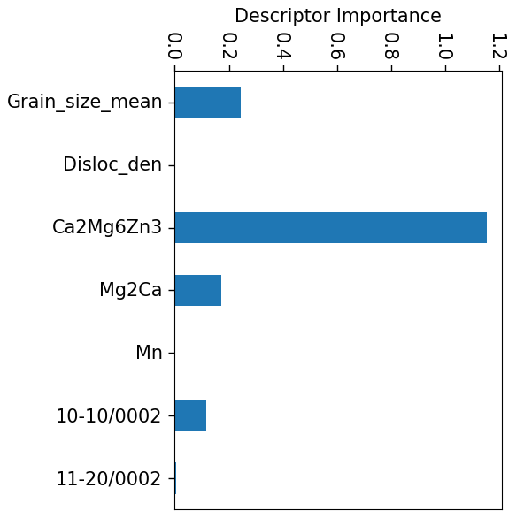
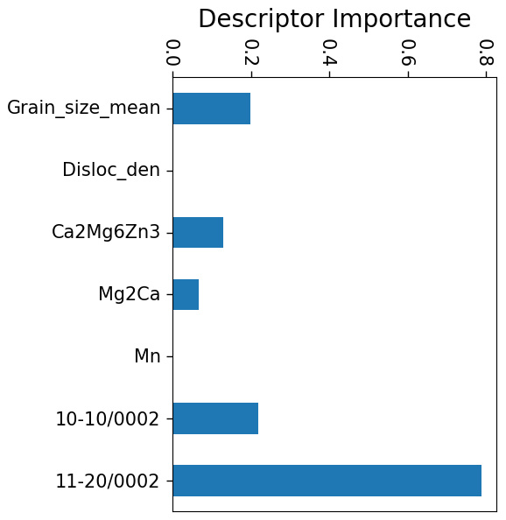
LASSO
Corrosion Rate
Hardness
Notes:
Variables are highly correlated
Limit of these methods – Talk about which of the two methods works better. LASSO picks out texture which does not make physical sense.

Slide 33
Literature Review
Data augmentation – 2022
NN – 2022
Random Forest – 2022, 2023
Clustering (t-SNE) – 2023
Sequential Feature Selection – 2023

Slide 34
Sreenivas Slides

Slide 35
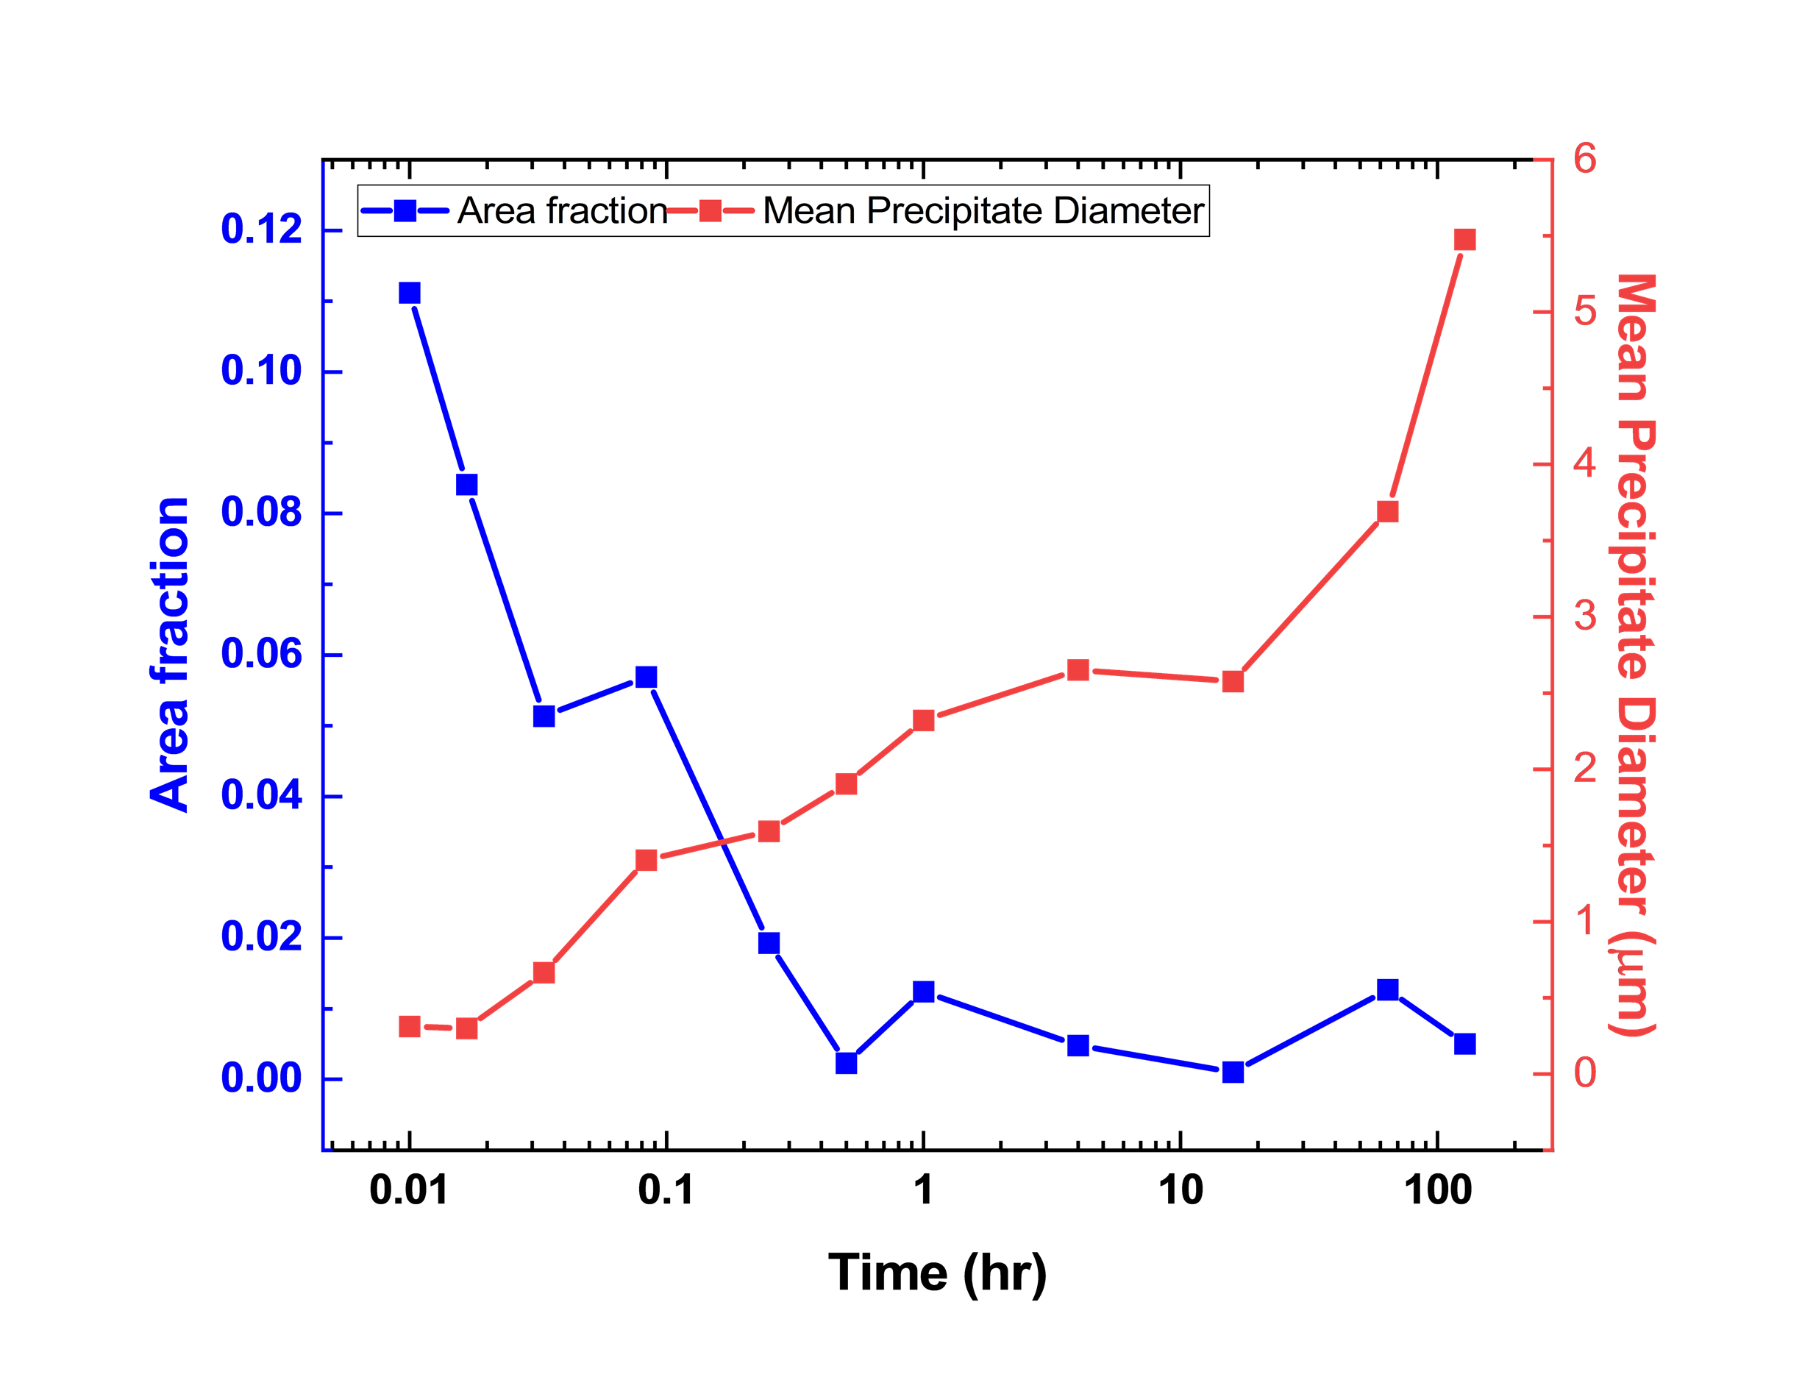
Current Version
From SEM Image Analysis
From XRD Integrated Area Analysis
Notes:
What’s the uncertainty here?

Slide 36
Current Version

Slide 37
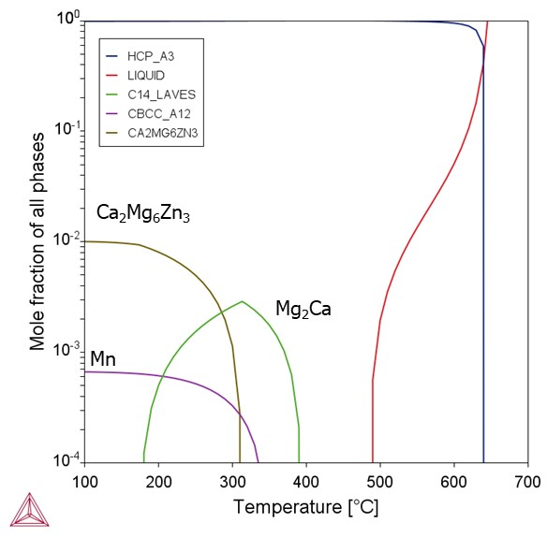
Phase Diagram

Slide 38
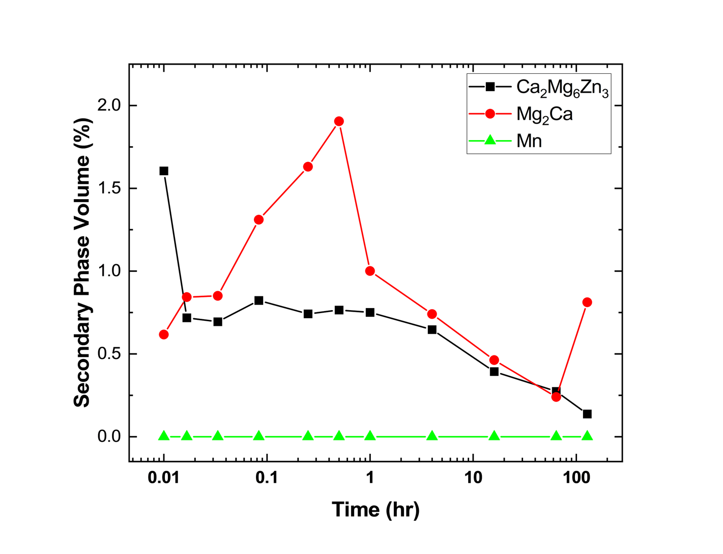
Previous Version

Slide 39
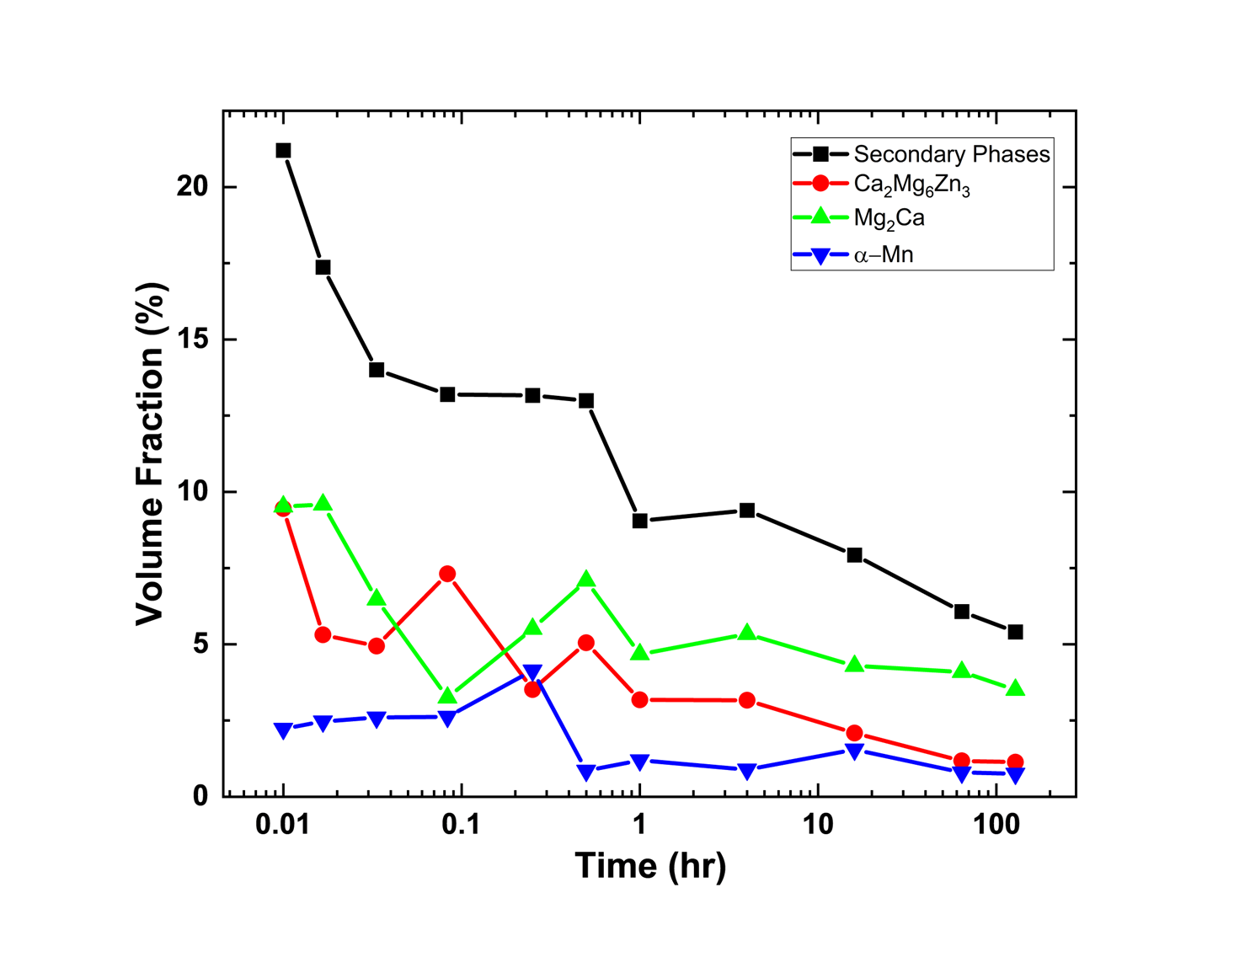
First Version

Slide 40
Updates Feb

Slide 41
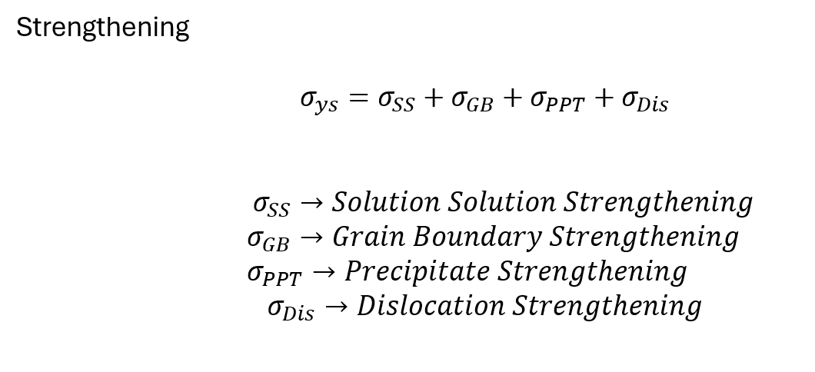
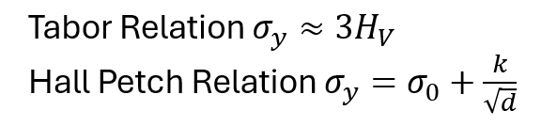
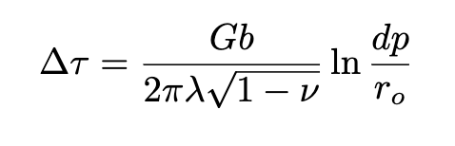

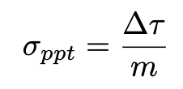
Feature Selection using physics-based features
Grain Boundary Strengthening
Precipitate Strengthening
Dislocation Strengthening
Notes:
critical resolved shear stress

Slide 42
Feature Selection using physics-based features
Updated input features:
Grain boundary as d^{-1/2}
Precipitates as Vol Frac * volta-potential difference between the intermetallic and Mg matrix
Dislocation density as rho^{1/2}
Grain Boundary Strengthening
Precipitate Strengthening
Dislocation Strengthening
Notes:
critical resolved shear stress

Slide 43
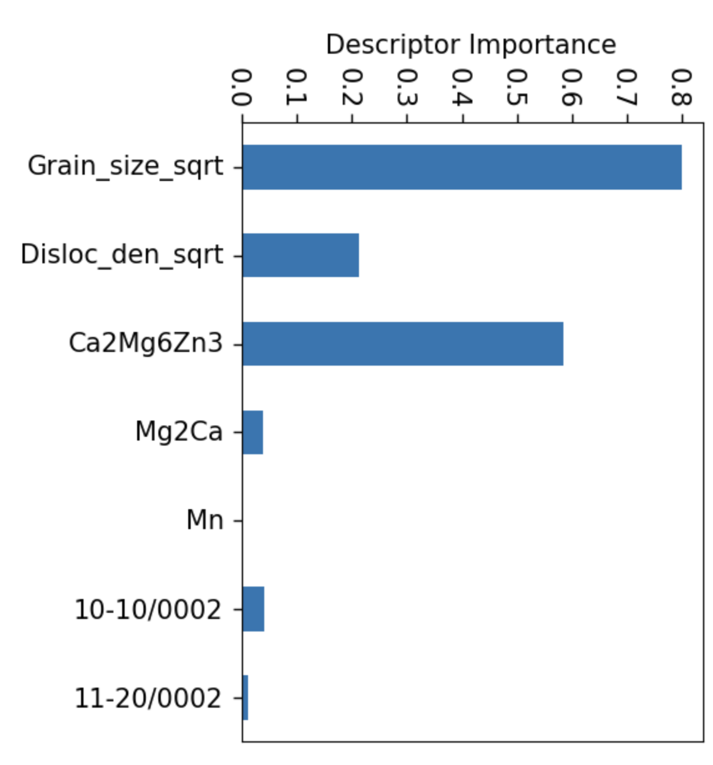
Feature Selection using physics-based features
LASSO
Notes:
critical resolved shear stress

Slide 44
Feature Selection for Corrosion using physics-based features
LASSO
Notes:
critical resolved shear stress

Slide 45
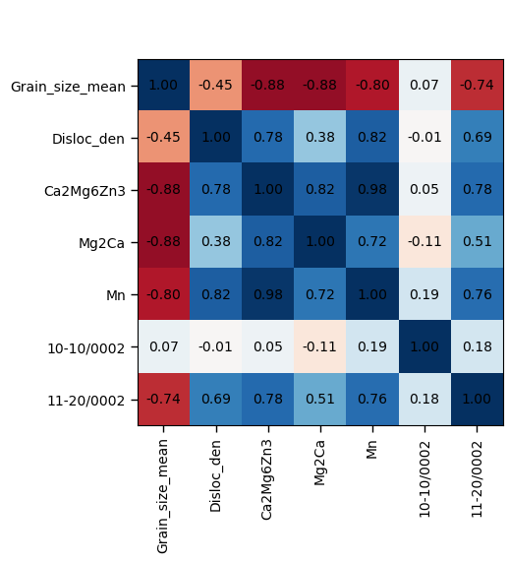
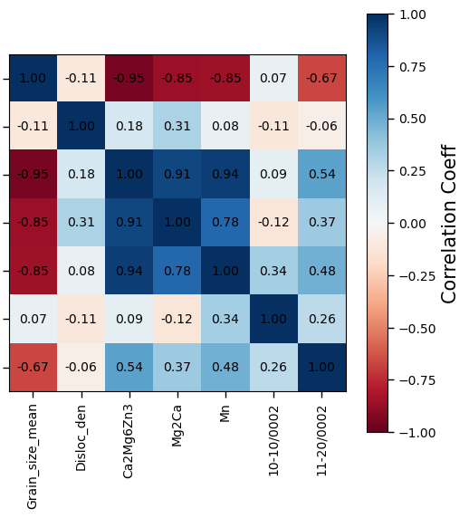
Analysis Discussion
Notes:
critical resolved shear stress

Slide 46
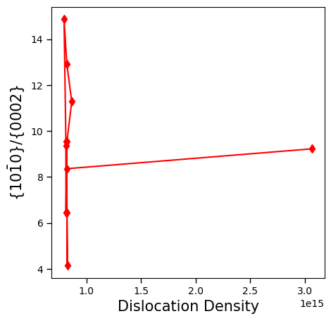
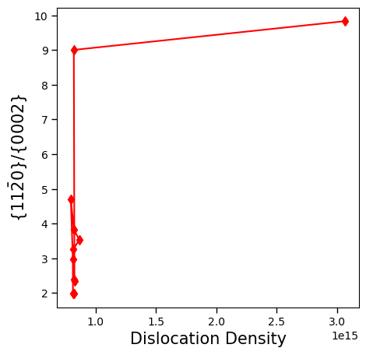
Analysis Discussion
Notes:
critical resolved shear stress

Slide 47
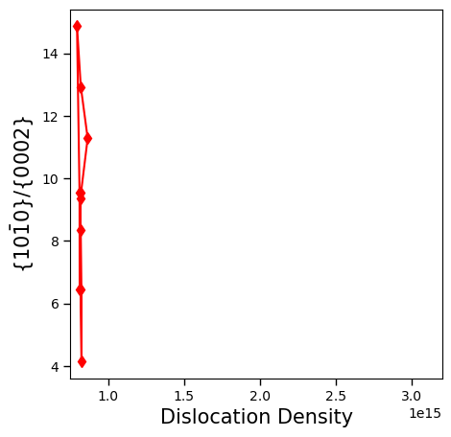
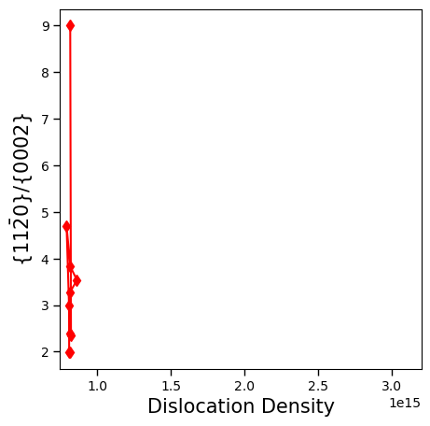
Analysis Discussion
Notes:
critical resolved shear stress

Slide 48
Results for paper

Slide 49
Feature Selection using physics-based features
Grain Boundary Strengthening
Precipitate Strengthening
Dislocation Strengthening
Notes:
critical resolved shear stress

Slide 50
Feature Selection using physics-based features
Updated input features:
Grain boundary as d^{-1/2}
Precipitates as Vol Frac * volta-potential difference between the intermetallic and Mg matrix
Dislocation density as rho^{1/2}
Grain Boundary Strengthening
Precipitate Strengthening
Dislocation Strengthening
Notes:
critical resolved shear stress

Slide 51
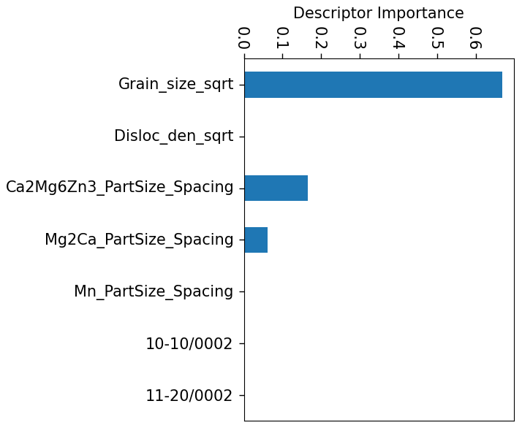
Feature Selection for Hardness using physics-based features
Previous

Slide 53
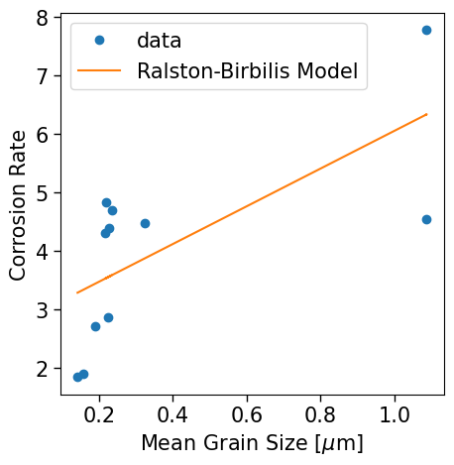

Fit for Ralston-Birbilis Model
A = 2.8217812
B = 3.22930937
R2 = 0.466

Slide 54


Fit for Bahmani Model with only precipitates
A = 0.71593123
B = 0.1195259
R2 = 0.872

Slide 55

Fit for complete Bahmani Model

