Slide 1
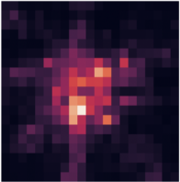
(32,32)FeatureFuse(32)
f0
FeatureExtract
(1)FeatureExtract(32)
f1
FeatureExtract
FeatureFuse
(32)Predict(1)
f2
FeatureExtract
FeatureFuse
... ...
DATASET | RMSE old | RMSE new
MobileBJ | 36.29 | 33.5
BikeNYC | 5.96 | 5.9
fT
FeatureExtract
FeatureFuse
Predict

Slide 2
f0
FeatureExtract
FeatureExtract
f1
FeatureExtract
FeatureFuse
33.5 ==> 34
f2
FeatureExtract
FeatureFuse
FeatureFuse
... ...
33.5 ==> 40
fT
FeatureExtract
FeatureFuse
Predict
没有像LSTM那样的门控制
纯Convolution
没有tanh ==> 输出无上限

Slide 3
result
t4
t3
t5
t2
t6
t1
result

Slide 4
dataset | MobileBJ | BikeNYC
DeepSTN+ | 36.29 | 5.96
sequential | 34 | 5.9
Rotation0 | 34==>48
Rotation1 | 34==>33.25 | 5.9==>5.9

Slide 5
1、在新数据上测试
2、将OD融入网络

