Slide 1
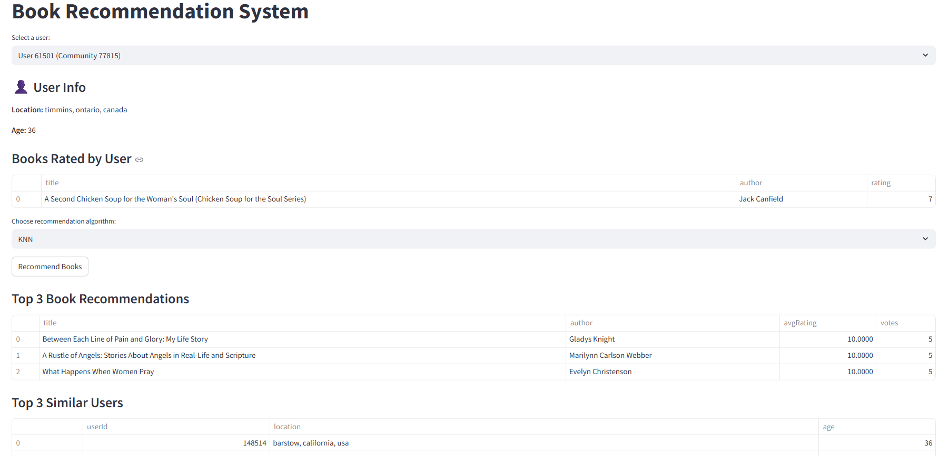
Graph Database Application for Book Recommendations
Clara Krieger & Thuy Linh Pham

Slide 2
CONTENT
Scenario Definition
Implementation
Technologies and Tools
Demo
Discussion

Slide 3
Scenario: Book recommendations
Relationship-based:
Users rated books
→ Similar users
Suggesting new books to users
Goal: A simple application that:
Lists users and their rated books
Allows to choose between different algorithms
Recommends new books to users
Shows similar users
Visualizes the connections
Measures the performance of the applied algorithm

Slide 4
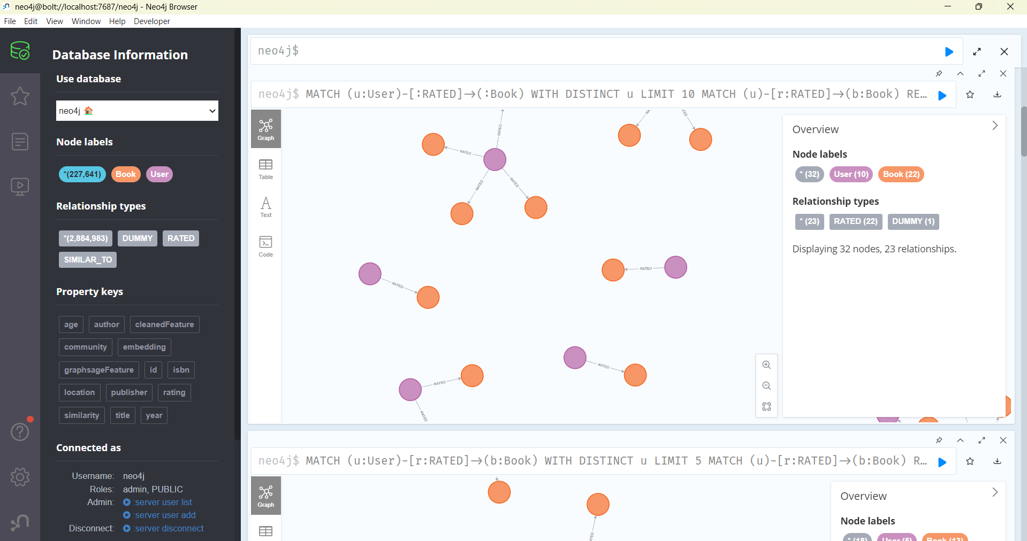
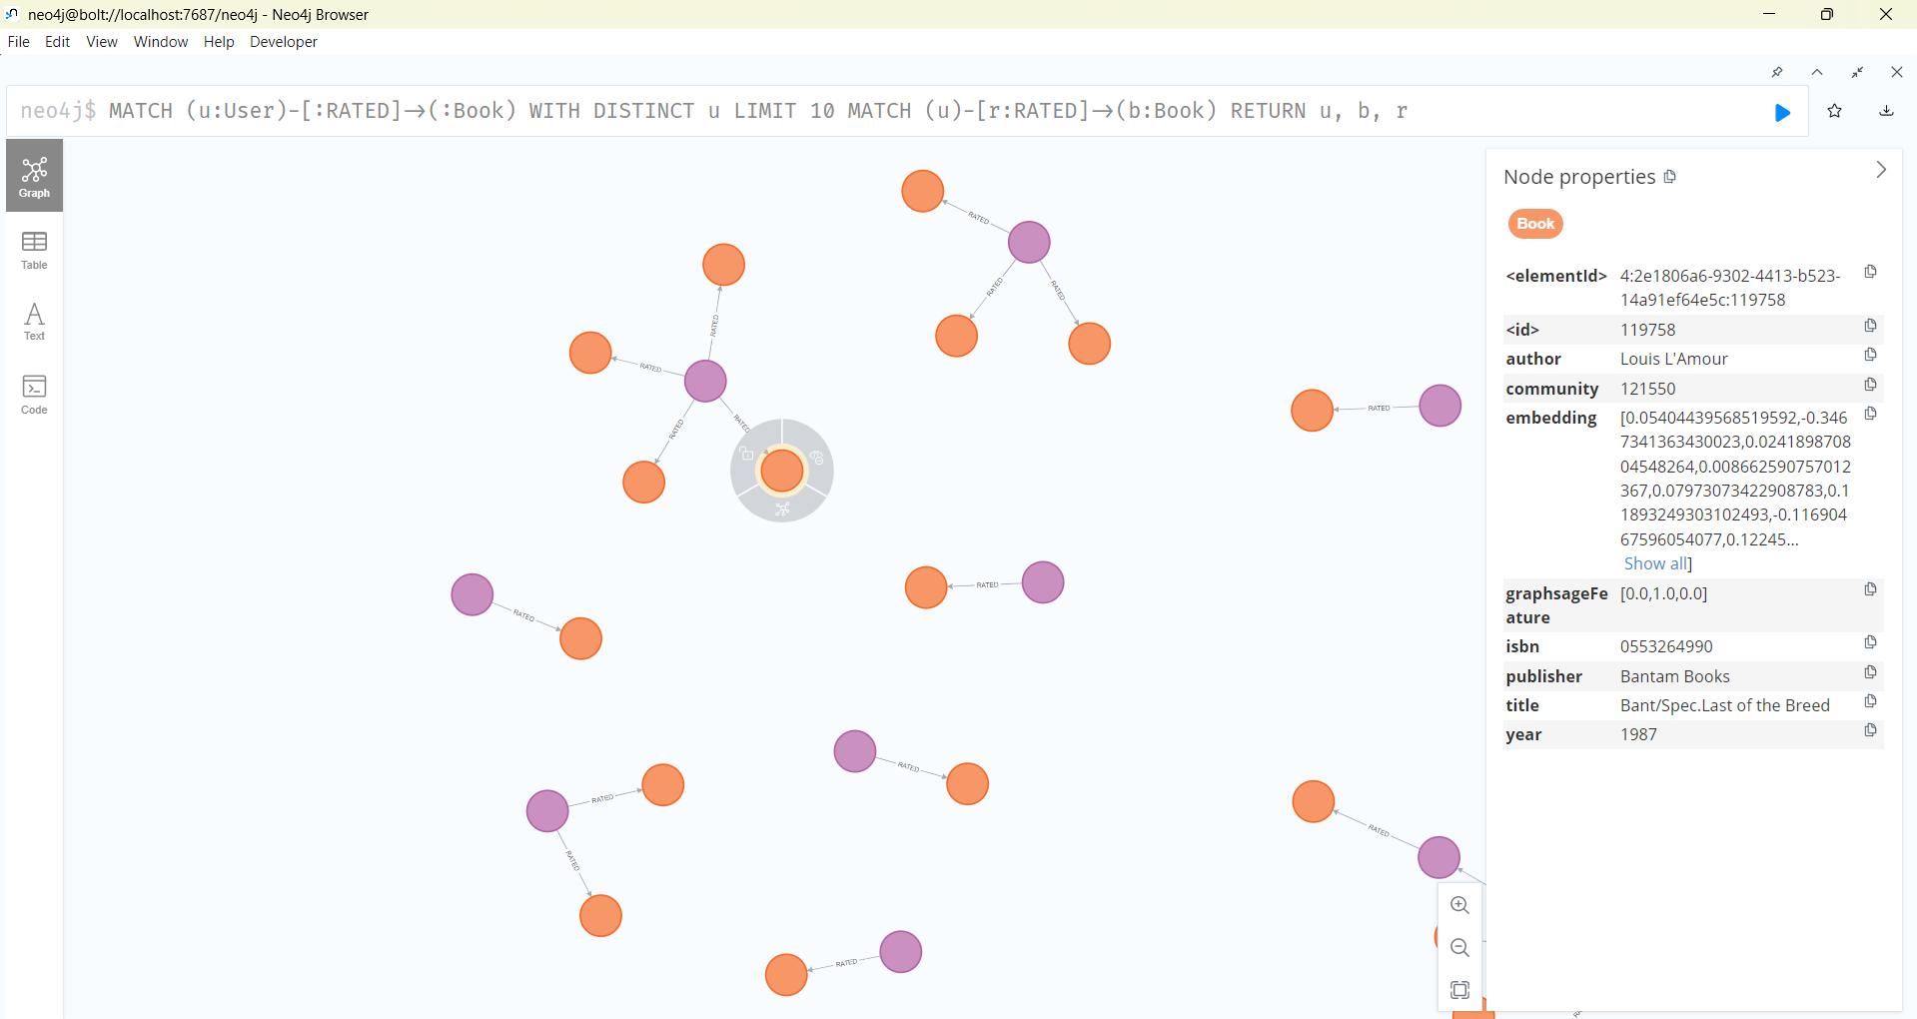
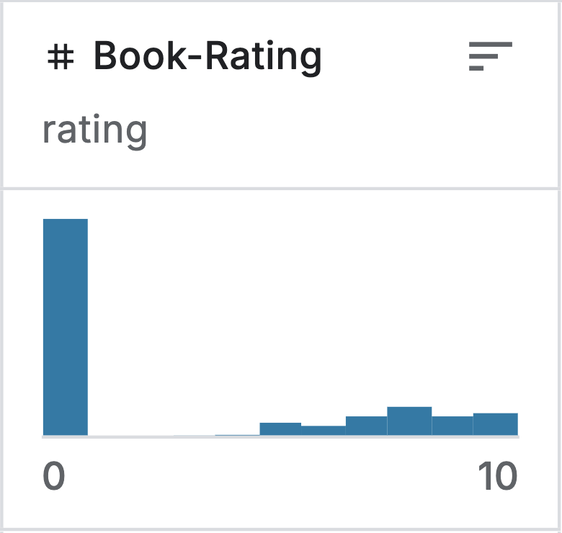
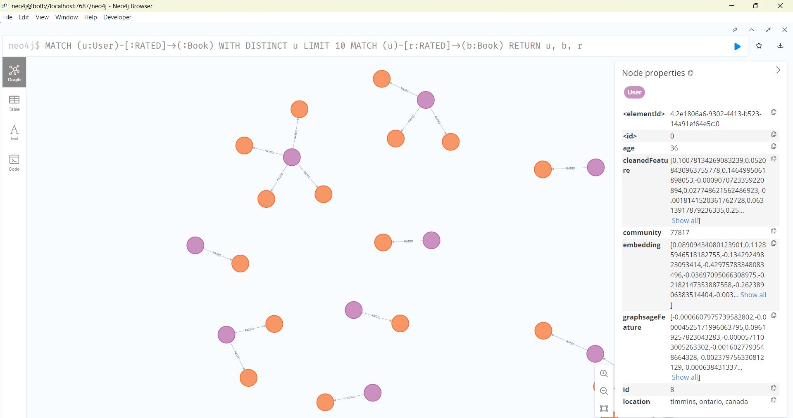
Implementation data
Read, clean and import data from Kaggle
3 datasets:
Books: 149.836 nodes
Users: 77.805 nodes
Ratings 1-10: 383.842 relationships

Slide 5
Implementation Algorithms
 | Community Detection | K-nearest Neighbors (KNN)
Goal | Group users based on shared book preferences | Find the most similar users to a given user
Algorithm | Weighted Louvain algorithm (via Neo4j GDS) | Graph embeddings (GraphSAGE)
Output added to each User node | Community property (e.g. 77817) | Embedding property (e.g. [0.2, 0.8, -0.1, ...])
Recommendation Logic | Recommend books highly rated by others in the same community | Recommend books liked by top K similar users
Pros | Simple and efficient | Highly personalized
Cons | Less personalized | Requires embedding calculation

Slide 6
Implementation why a graph database?
Focus on relationships
Efficient queries over connections
Graph algorithms
Flexible data structure
Intuitive visualization
Explainability

Slide 7
Technologies and tools
Graph database: Neo4j
Graph Visualization: Pyvis.network
UI: Streamlit

Slide 8

Demo
Goal: A simple application that:
Lists users and their rated books
Allows to choose between different algorithms
Recommends new books to users
Shows similar users
Visualizes the connections
Measures the performance of the applied algorithm

Slide 9
Further development
Rating = 0: books seen but not rated
More realistic, complex datasets like Goodreads instead of Kaggle
Inclusion of isolated Users and Books
Algorithms:
Deep KNN
Neural Recommenders
Temporal Analysis
Comparison

Slide 10
Q&A

