Slide 1


Internship project Status W12: CAD Import & meshing in Wakis
Student: Clara R.Wimmelmann. Supervisors: Elena De La Fuente Garcia, Carlo Zannini & Jakob Schiøtz
Date: 22/4-2026
Notes:
I will present a project focused on improving the robustness of geometry handling in Wakis. While Wakis performs well for simple geometries, importing complex CAD models introduces challenges. This project aims to address these issues by improving geometry cleaning, meshing, and sub-cell material modeling.

Slide 2
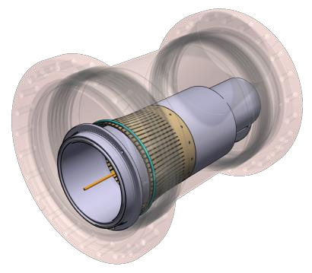
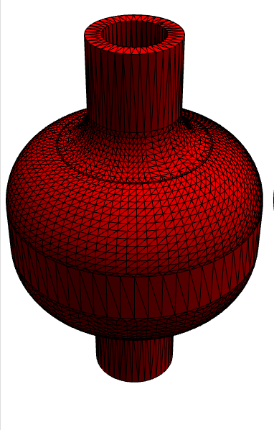


Outline
Benchmarks of the methods on the shell & 6L2 device objects mask
Mask volume (quantitative)
High grid resolution results
Mask slices (qualitative: visual inspection)
Wakis wakefield simulation of the simple shell cavity device for all methods
Voxelize_rectilinear results & Impedance mode shifts
Decimate benchmarks
Decimate, decimate_pro and the optimal decimation factor
Decimate_pro(0.80) benchmark per method for 6L2 objects
The meshing algorithm times

Slide 3
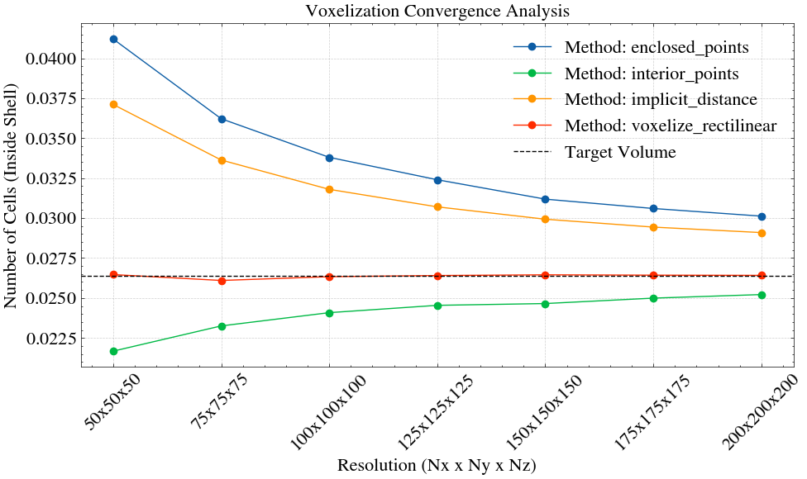
Benchmark shell: mask volume

Slide 4
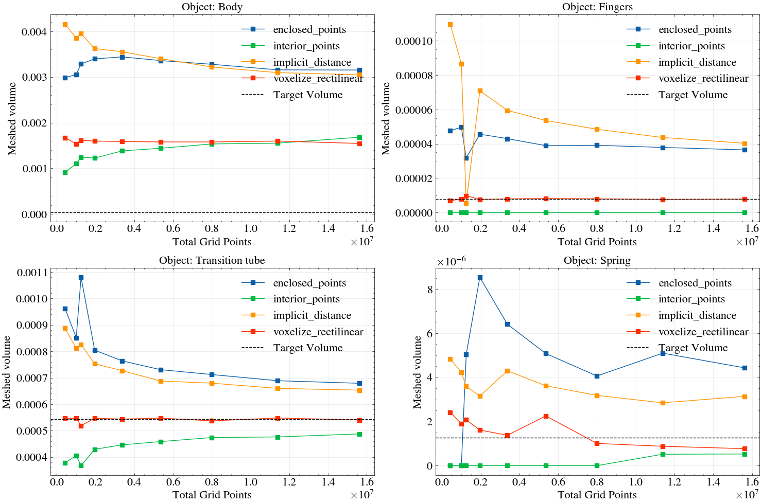
Benchmark: 6L2 sub-objects (added N=225,250 grid resolutions)
Unphysically thin object:
Volume_body=4.3e-5 m^3

Slide 5
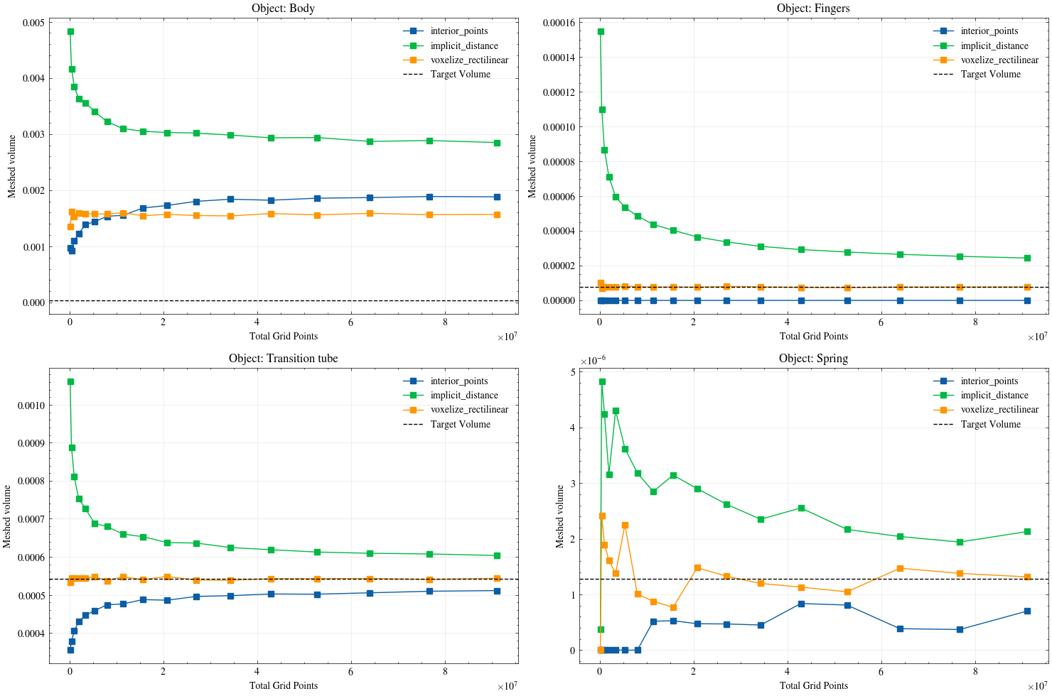
Benchmark: 6L2 sub-objects (high grid resolutions added; till N=450 ~ 91e6 grid points )

Slide 6
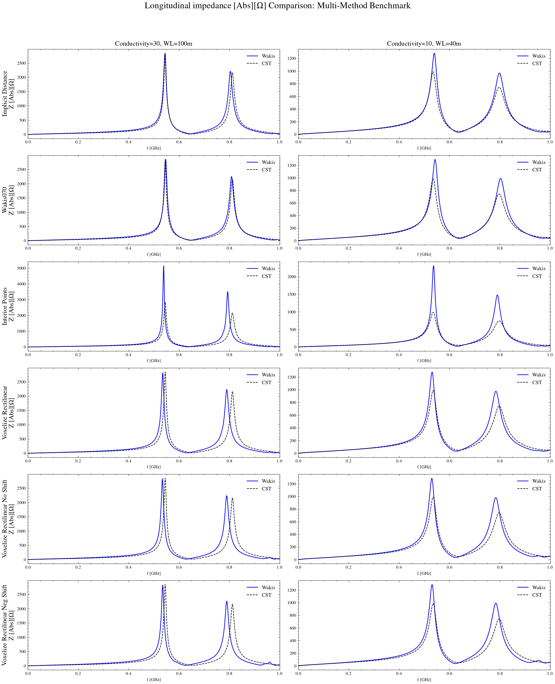
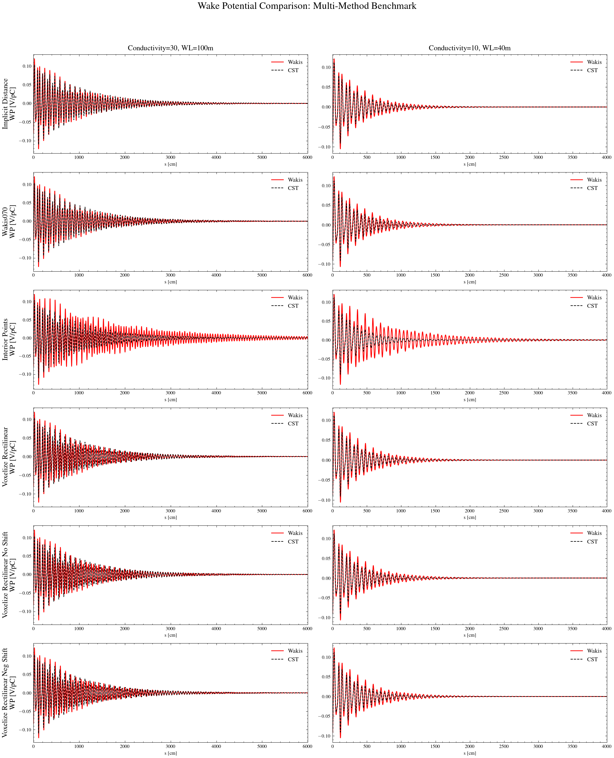





Simulation benchmarks to CST & the current Wakis version 0.7.0 : The simple shell cavity
Longitudinal Impedance
Wake potential
We see mode shifts for all the new methods -> new mask = new object geometry, inner radius
Interior_points method under-masks -> shell mask too thin -> conductivity

Slide 7
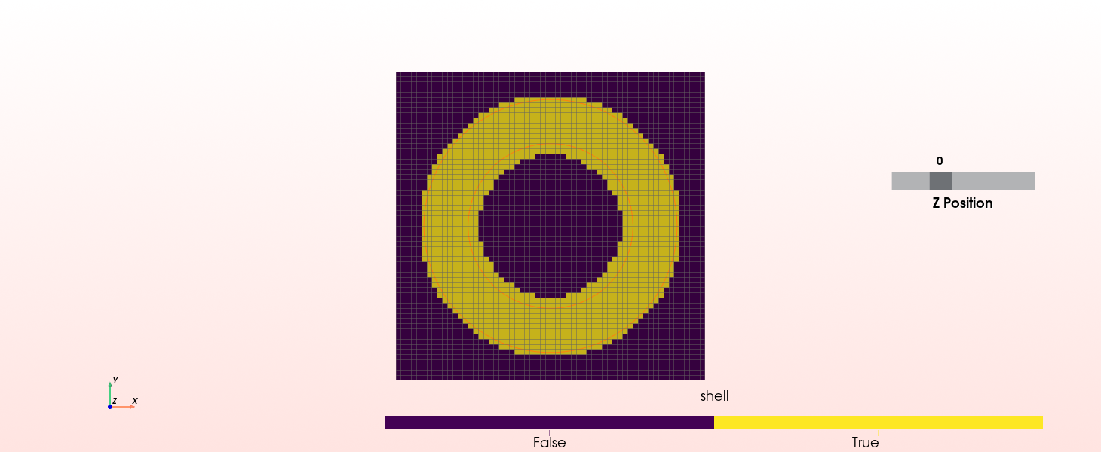
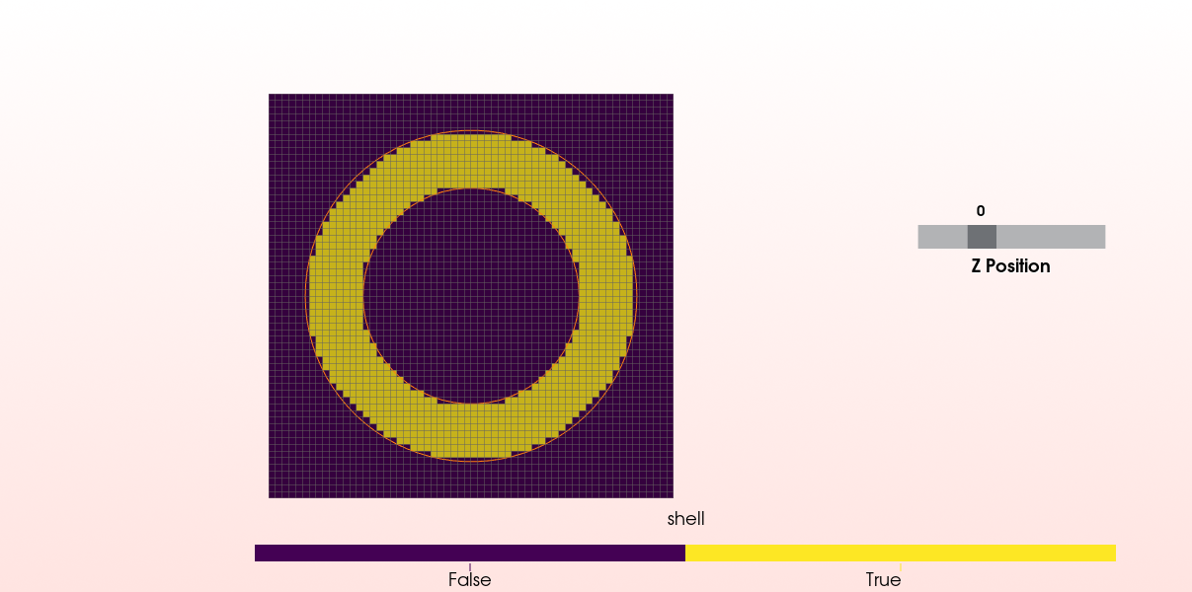

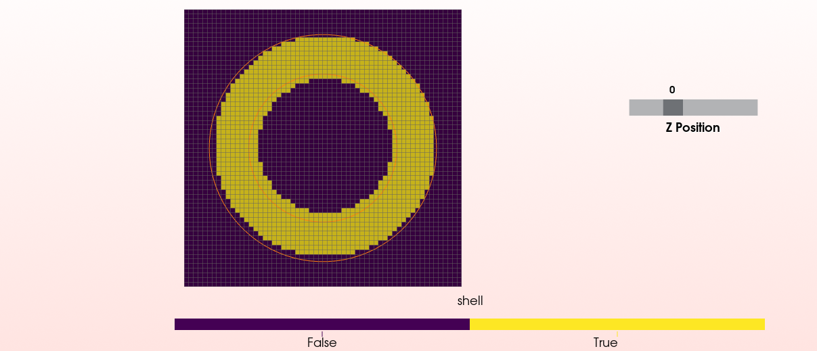
Comparing the mask slices from these simulations
Select_enclosed_points() w. threshold=stl_tolerance
Select_interior_points() w. threshold=0.5
Implicit_distances()
Voxelize_rectilinear()

Slide 9
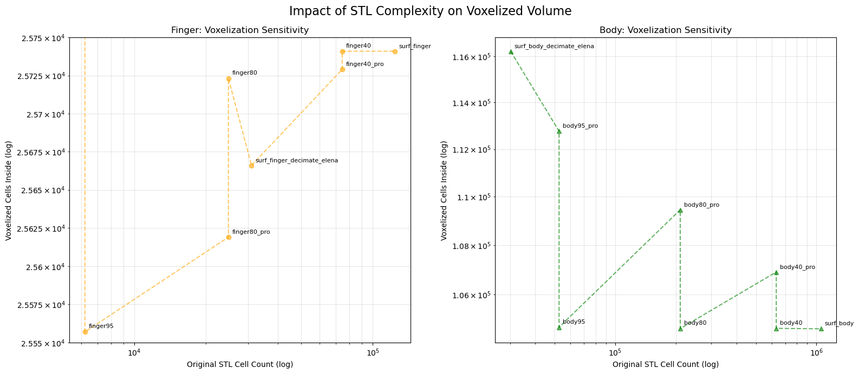


STL Decimation benchmark: how reducing the STL structure, and hereby computation time, influence the mask quality

Slide 10
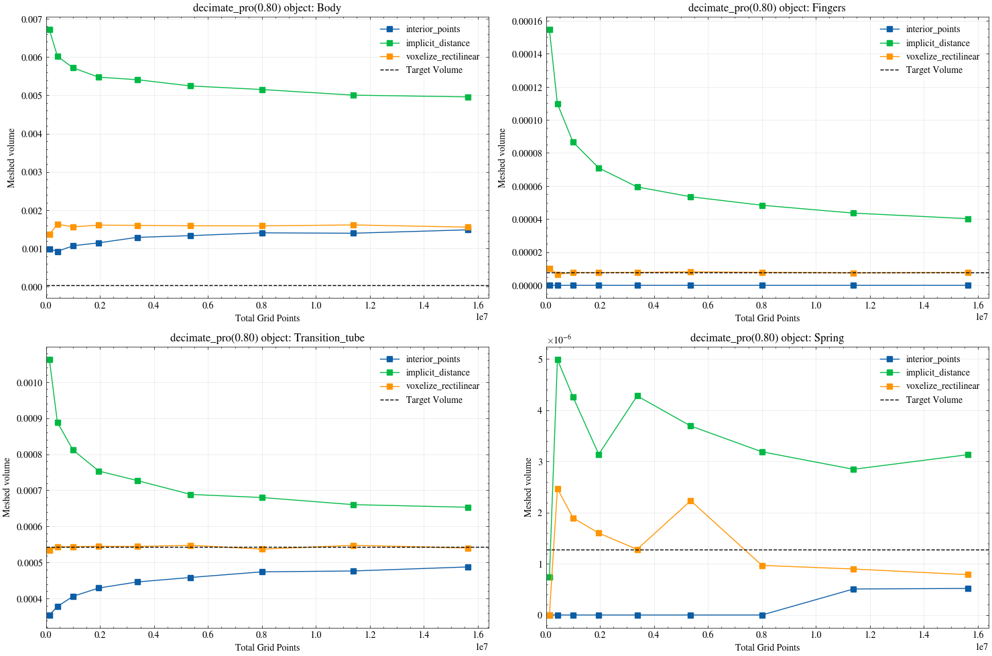
Decimate_pro(0.80): reducing 80% of STL cells

Slide 11
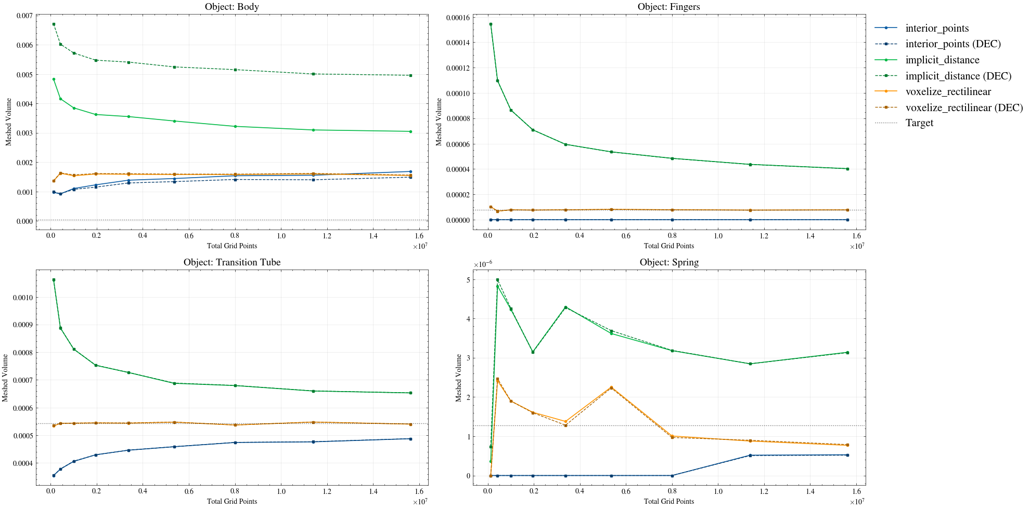
Benchmarked to the 6L2 mask volume results (slide 5): findings= decimate 80 does not seem to reduce quality of the voxelize_rectilinear meshing method

Slide 12
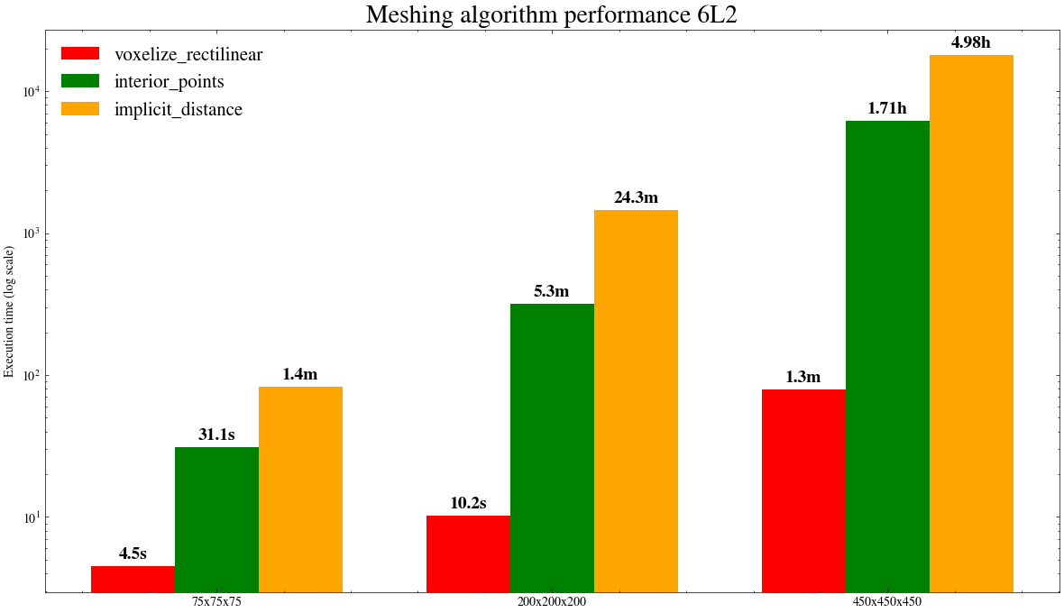
Scaling times of the meshing algorithms with grid resolution (& STL size)

Slide 13
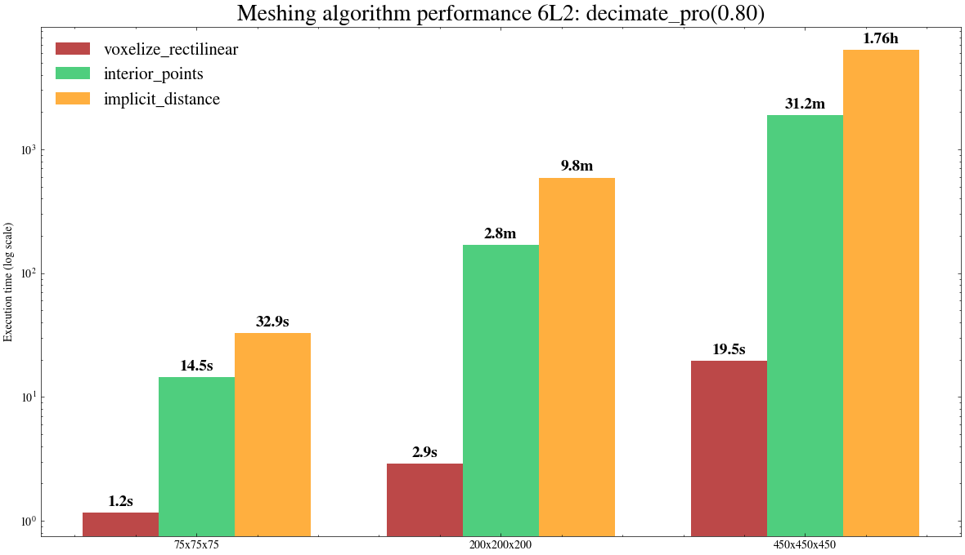
Scaling times with 80% less STL triangles (in each of the 6L2 objects)
Taking this into account (as well as the methods’ masking qualities), do we want to proceed with studying the implicit_distance method ?
Team agreed.

Slide 14
To do
Start with the subpixel smoothing ! :D Last part of project (3/5 month almost passed.)
Add qualitative benchmark of decimation to CodiMD (mask slices) ?
Further try out Trimesh Boolean operations?
Warp the Body of the 6L2 and try out voxelization benchmark again
Make high grid resolution sweep with the different methods on the shell, inspect these masks to study if the voxelize_rectilinear is superior here (like slide 7) AND perform Wakefield Wakis simulation on these high resolution grids (like side 6)
Perform high grid resolution Wakis Wakefield simulation on the full 6L2 device (like on the shell, slide 6)
Continue to understand the physical effects of mask variations
Too thin mask (select_interior_points with point-to-cell mask threshold 0.5)
Skin depth conductivity & wakefield length
Voxelize_rectilinear mask of the simple shell cavity has an inner radius different to current Wakis results
Shift in Impedance modes

Slide 15
The Pyvista methods (repetition)
M: no. of points P_M in grid (M probe points)
N: no. of triangles in the surface STL file
Select_enclosed_points()
What Wakis currently uses, outdated because of numerical instability
Select_interior_points(method)
static search (tree is build once & cannot be changed = optimized for memory)
Set-up cost: Axis-Aligned Bounding Box (AABB) tree implementation: O(N logN)
Query cost: M points in plane searching for closest point ‘hit’ on surface is O(M logN)
Compute_implicit_distance()
searches = vtkAbstractCellLocator which defaults to AABB tree
Set-up costs: AABB tree : O(N logN)
Query cost: O(M logN)
Signed distance dot product calculations: O()
Voxelize_rectilinear()
Doesn’t search mesh geometry per point P on the grid, but ‘paints’ mesh onto a grid;
Looks at each row (slices of the 3D (Image)grid) & decides where mesh enters & exits that row with ray casting
Set-up cost: Linear with no. of triangles N O(N)-O(N logN) for the scan-conversion process ()
Query cost: O (logN + rows_grid x scanlines_per_row x hits_per_scanline) + O(Voxels in grid)
+logN because only small amount of search queries: algorithm exploits spatial coherence of the tree and grid.
O((M+N) logN)
O((M+N) logN)??? Probably more: ask PyVista community on Slack
O ( NlogN +rows x scanlines x hits +logN) + no. of voxels in grid)
Ask PyVista community on Slack

Slide 16
Overview slides

Slide 17


Project goals (for overview)
Test new methods to improve CAD import robustness: Handle meshing of non-manifold and imperfect geometries
Improve performance by: Cleaning STL triangle meshes & Reducing unnecessary triangles
Retrieve sub-cell volume and area information & Improve material modeling using subpixel smoothing
Potentially revisit smart meshing algorithm ?
Ultimately simulate the 6L2 geometry in Wakis
To do
Currently looking at: Initiated the masking & simulated the simple shell cavity
Soon & TODO
Notes:
The main goal is to make Wakis more robust and efficient when handling real-world CAD geometries.

Slide 18
Tuning & benchmarking open source tools 4 Wakis ☺
 | Simple cavity & shell structure (as sanity check) | The ‘fingers' | 6L2 device
PyVista 0.47.0 select_interior_points()
PyVista Implicit_distance()
PyVista voxelize_rectilinear()
… on uniform & smart meshing
PyVista decimate() for mesh cleaning
Trimesh boolean operations

Slide 19

Methods to be investigated
1. New PyVista-based methods
Select_interior_points()
implicit_distance
voxelize_rectilinear
Testing on uniform and smart meshes
Implementation in Wakis & Wakefield simulations with Wakis
2. Mesh cleaning & simplification: STL triangle reduction to remove unwanted internal faces
PyVista decimation
Trimesh boolean operations
3. Sub-cell volume reconstruction
Compute solid’s volume fraction per computational cell
Gradient-based surface distance
Apply subpixel smoothing principles
ABP-BE-CEI, student trainee Clara R.W.
Project status presentation

