Slide 1
Using online tools to study response inhibition
Kolloquium Allgemeine Psychologie
Clara Kuper

Slide 2
The world can surprise us …
… how do we adapt to these surprises?

Slide 3
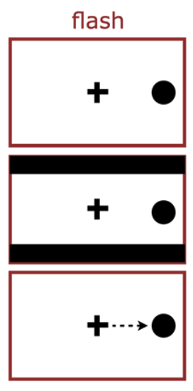
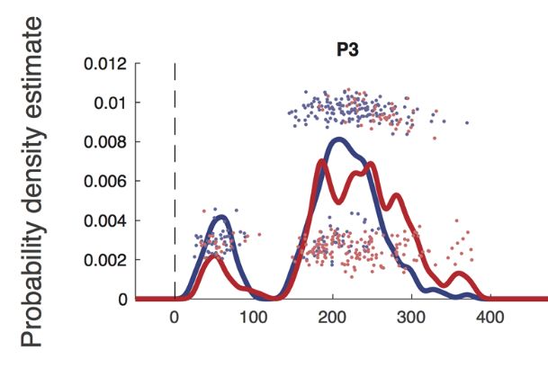
The world can surprise us …
Adapation through inhibition?
… how do we adapt to these surprises?
Buonocore et al 2017

Slide 4


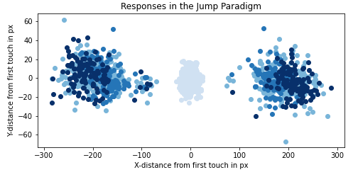




A universal mechanism? Only for saccades?
Fixation
Go Signal
Flash
Flash+Shift
Response

Slide 5




Bringing the task online. The toolbox
Coding
Server
Recruitment
JATOS
Javascript based library
Combined with custom html & javascript
Tool for hosting the study on a server
Installed on Humboldt Psychology servers
European platform for online experiments & surveys

Slide 6



Outlook
Parameters:
behavioral relevance
salience
timing of change onsets
Can inhibition of motor responses facilitate reprogramming?
THANK YOU!

