Slide 1
How is new visual evidence used for the preparation of manual movements?
Question

Slide 2
Behaviour
Linear regression models describe response behaviour.
Response choices
Response times
more
slow
predicted
# "go" responses
predicted
response times
less
fast
1
0
1
1
0
1
evidence for a "hit"
evidence for a "hit"
sample 3
sample 1
sample 2
sample 4
sample 5
sample 6
0
.
0
0
.
2
0
.
4
0
.
6
0
.
8
1
.
0s

Slide 3
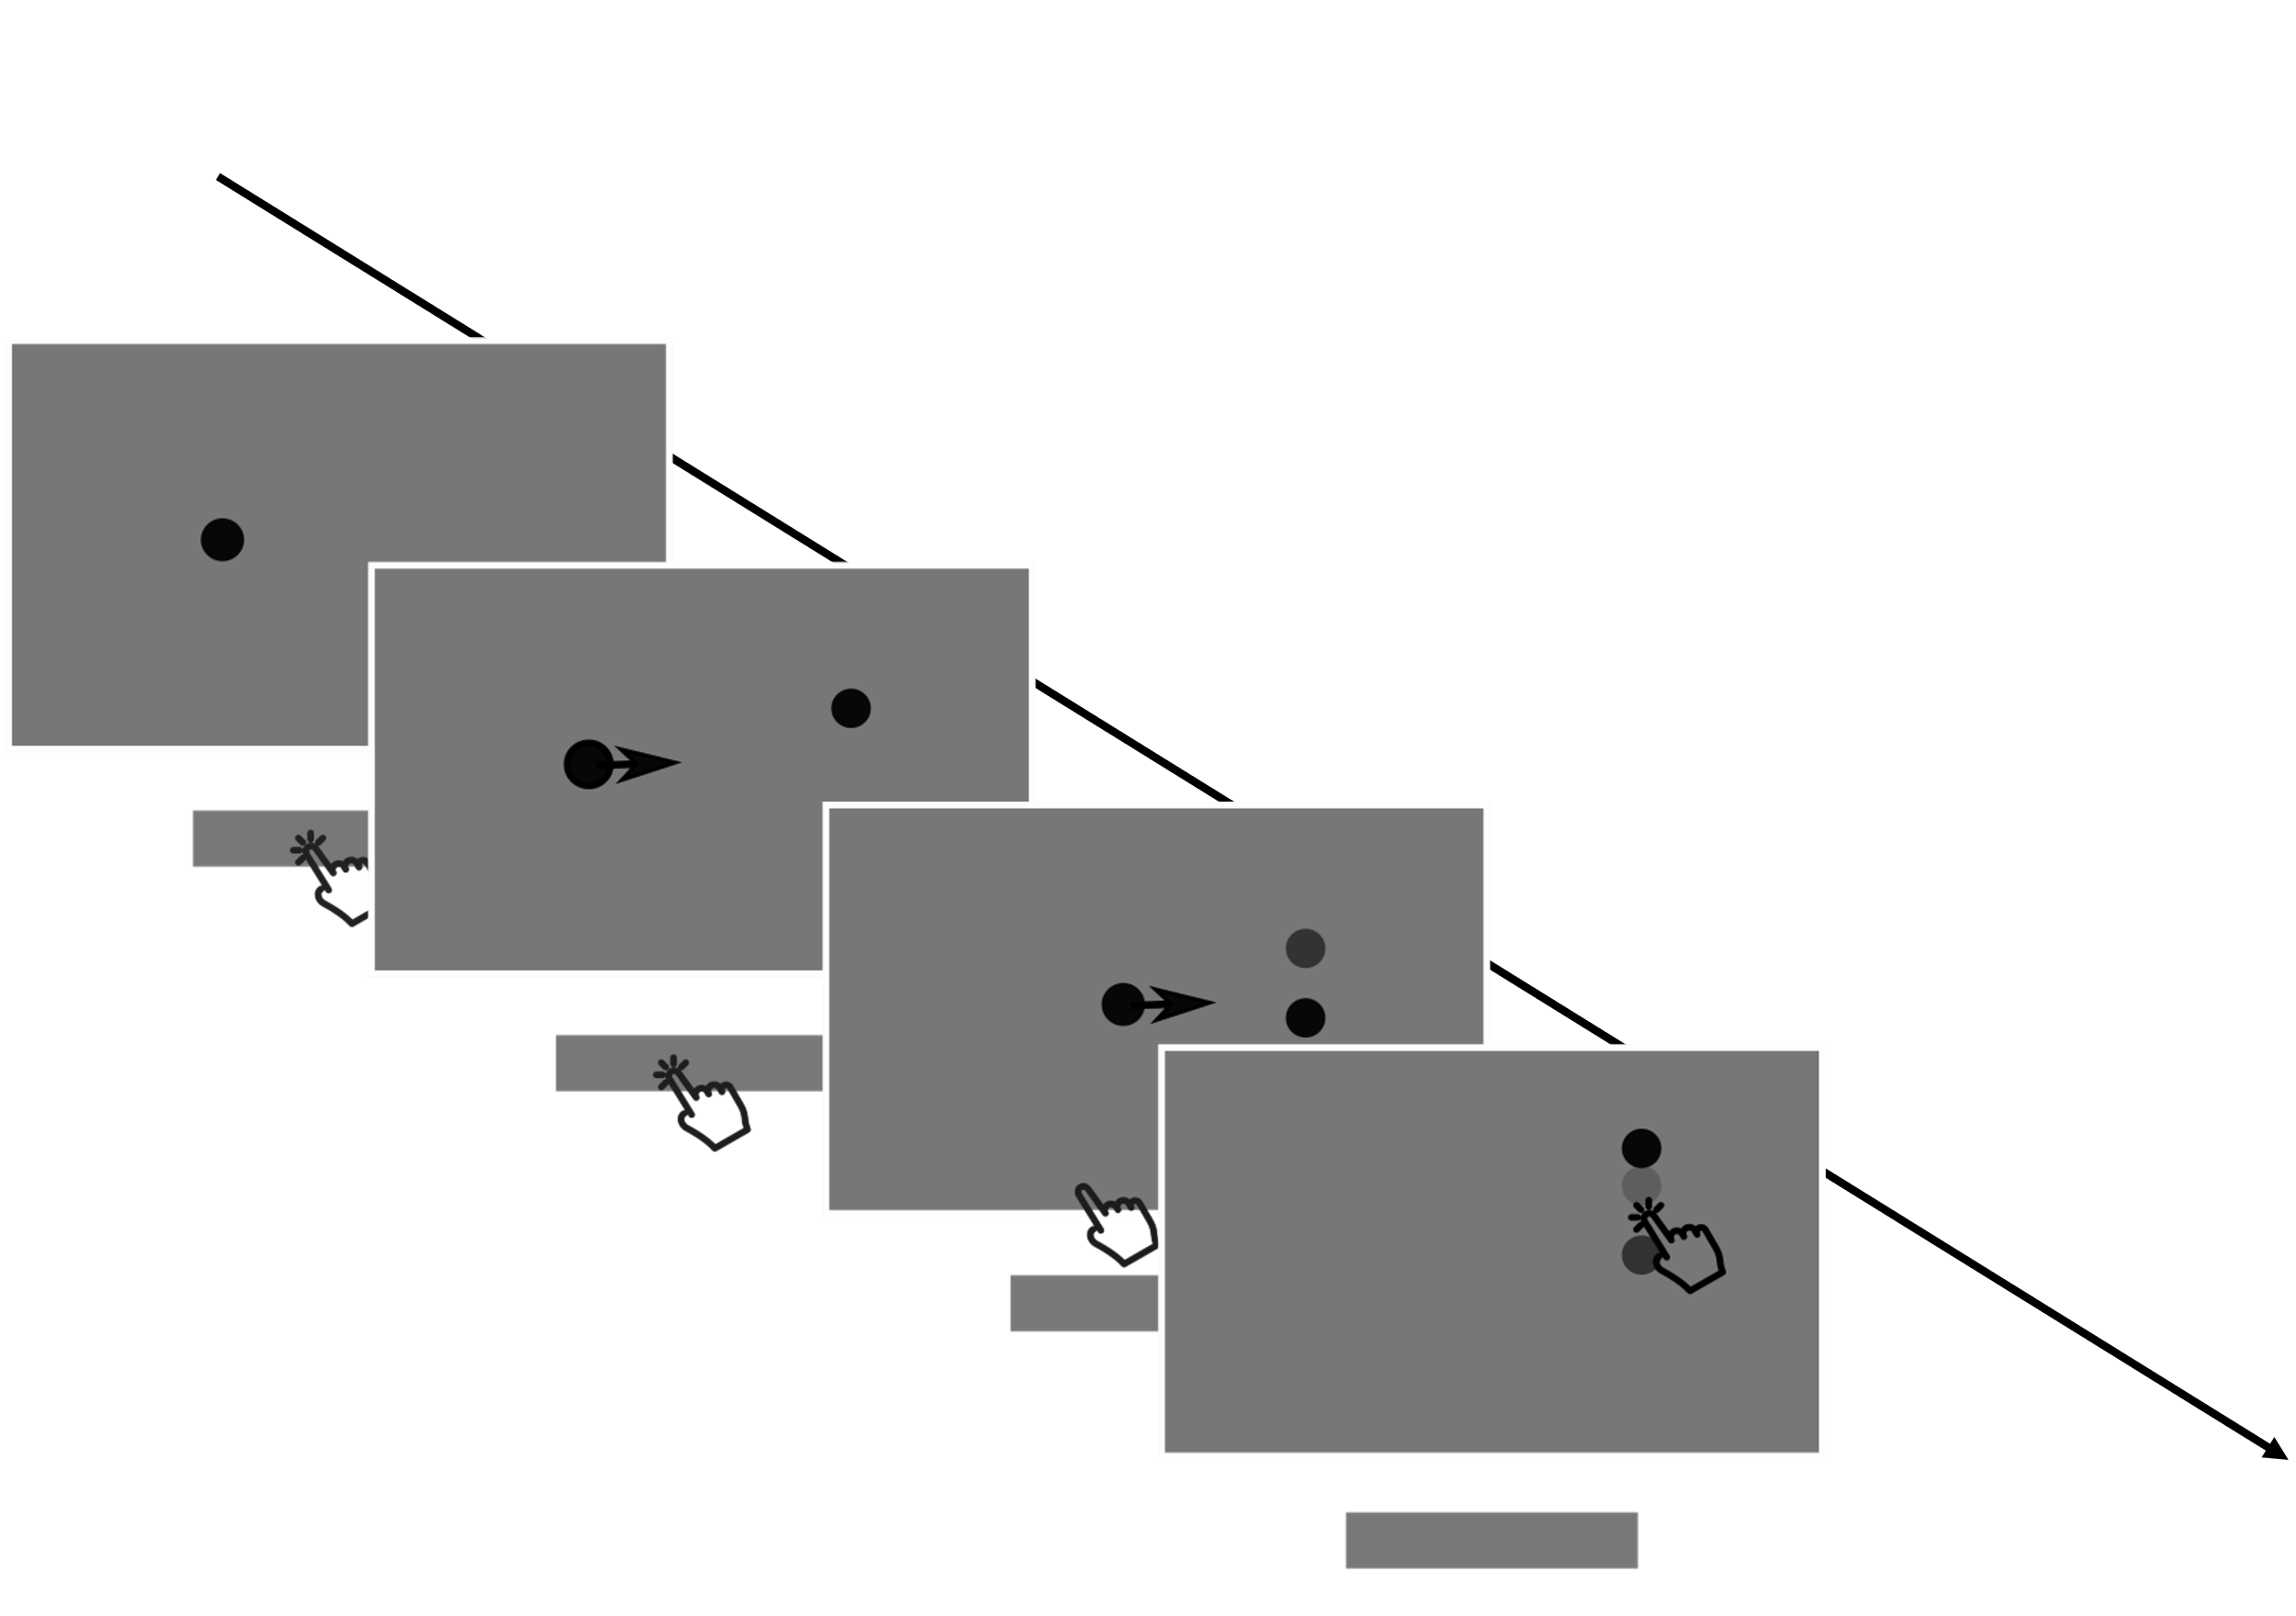
This attacker will try to hit your goal. But where is your goal?
These dots are samples of your goal’s location.
Trial starts
Go signal
Attacker hits: go
Attacker passes: no-go
Response
Interception
Trial ends after 1 s
Paradigm

Slide 4
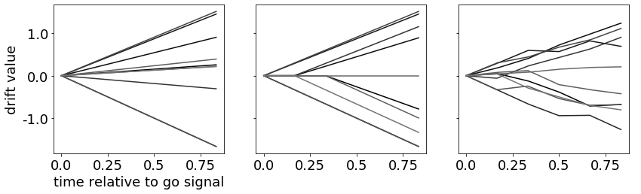
Mechanism
Drift diffusion models describe how motor plans evolve in time.
Go with First
Wait & Go
Go & Adapt
Go
No-go

Slide 5
Control of manual movements…
… is well described as a decision making process.
Gallivan et al 2019, Nat Neurosci Reviews
… gradually changes with the decision variable.
Selen et al 2012, J Neurosci
… rapidly adjusts to new informa-tion even after movements are launched.
Nashed et al 2014, J Neurosci
But what if new evidence requires a different response?
Does this also happen during response preparation?

Slide 6
Observers: 4
Sessions: 3
Trials/session: 800
Final Datapoints: 9589
We collected data in a pilot study.

Slide 7
The hit probability p[H] for each sample is given by the cumulative density function of a uniform distribution, with parameters that could be known by the observer:
cdf(x)
x: absolute distance between attacker and sample
a: width of the goal
b: sample position, normalized to zero.

Slide 8
Human observers adjust to early new evidence, but not to late evidence.
Full models included:
p[H] of each sample (sample 1-6)
Trial condition (hit or pass trial)
Fully specified random effects per subject

Slide 9
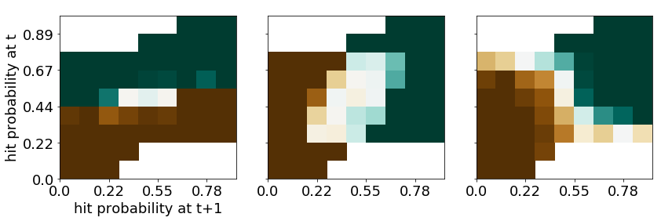
Not all drift diffusion models adjust well to new evidence.
Go with First
Wait & Go
Go & Adapt

