Slide 1
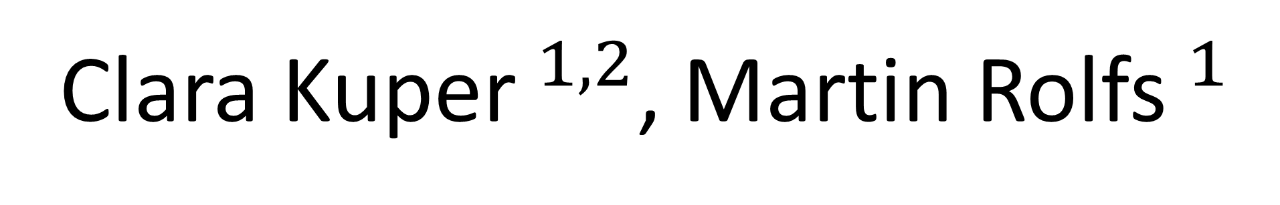
Go- no-go decisions based on gradually
Clara Kuper$^{1,2}$, Martin Rolfs$^{1}$
$^{1}$Humboldt-Universität zu Berlin, $^{2}$Berlin School of Mind and Brain

Slide 2
revealed visual information

Slide 3
The best fitting linear models were:
pass trials
hit trials
2
 | Estimate | Z-stat | P-val
Intercept | -0.589 | -1.952 | 0.05
sample 1 | 1.234 | 28.261 | < 0.01
sample 2 | 1.067 | 24.900 | < 0.01
sample 3 | 0.461 | 11.154 | < 0.01
trialCondition | 1.006 | 11.408 | < 0.01
response choice ~ sample 1+ sample 2 + sample 3 + trial condition + (1|subject)
"
o
g
"
s
0
d
d
o
n
l
2
1
0
1
1
0
1
n
o
r
m
a
l
i
z
e
d
p
[
H
]
0
.
6
0
0
]
 | Estimate | DF | T-stat | P-val
Intercept | 0.56 | 3.00 | 17.23 | < 0.01
sample 1 | -0.034 | 4743.14 | -23.53 | < 0.01
sample 3 | 0.007 | 4743.05 | 5.57 | < 0.01
sample 6 | 0.003 | 4743.01 | 2.69 | < 0.01
response time ~ sample 1 + sample 3 + sample 6 + (1|subject)
s
[
0
.
5
7
e
5
s
a
m
p
l
m
e
1
i
t
s
a
m
p
l
e
2
0
.
5
5
e
0
s
a
m
p
l
s
e
3
n
s
a
m
p
l
o
e
4
p
0
.
5
2
5
s
a
m
p
l
s
e
5
e
s
a
m
p
l
r
e
6
0
.
5
0
0
1
0
1
n
o
r
m
a
l
i
z
e
d
p
[
H
]

Slide 4
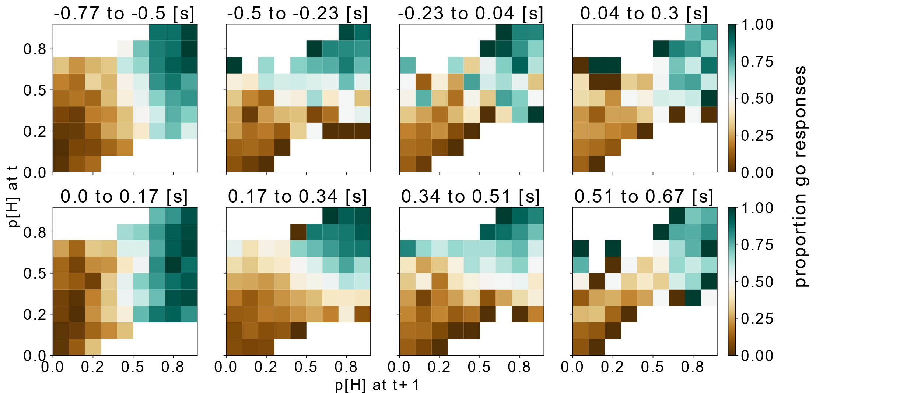
Response update patterns of human observers relative to the response onset …
These patterns most closely match the predictions from Go & Adapt model.
See the code
https://github.com/ClaraKuper/VVSS2021
… and relative to the go signal suggest that earlier samples can update the response choice, while later samples can’t.

