Slide 1
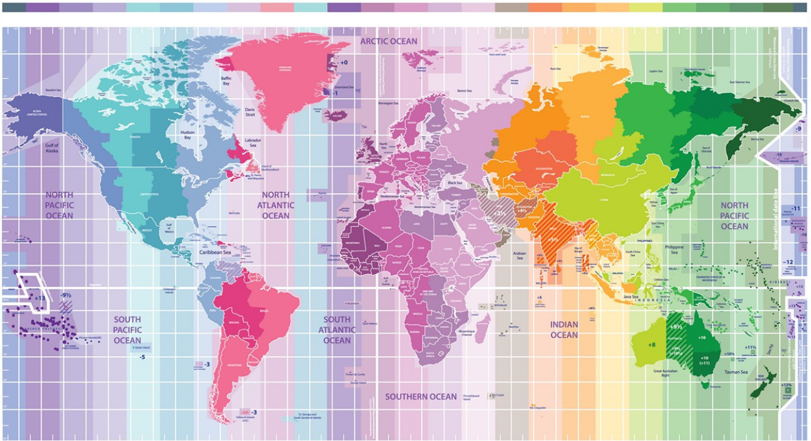
3:00
4:00
5:00
6:00
7:00
8:00
9:00
10:00
11:00
12:00
13:00
14:00
15:00
16:00
17:00
18:00
19:00
20:00
21:00
22:00
23:00
24:00
00:00
Poster Session A: Saturday, May 22nd 8am EDT/ 2pm CEST
“Perception and Action: Decision making, models, neural mechanisms” Room: Egret
map adapted from: https://24timezones.com/

