Slide 1
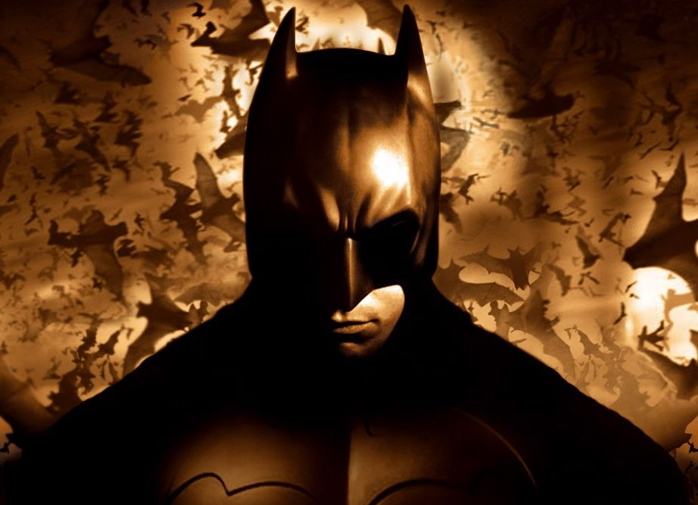
How the people in Gotham created Batman
A Power BI Word Cloud Presentation
By Clara Domingues

Slide 2
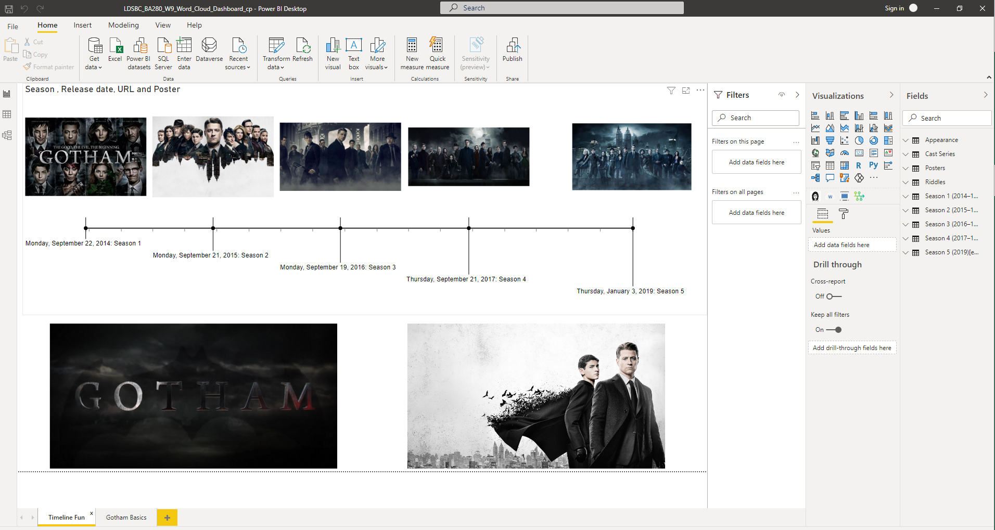

Slide 3
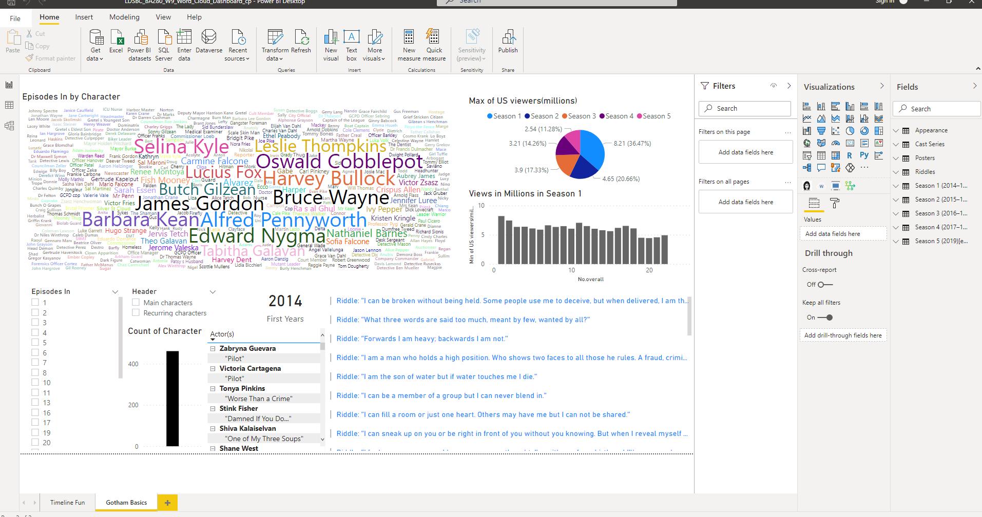

Slide 4
