Slide 1
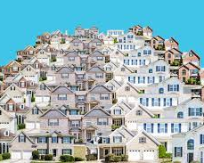
Kaggle: Predict House Prices
Clara Piraja Domingues

Slide 2
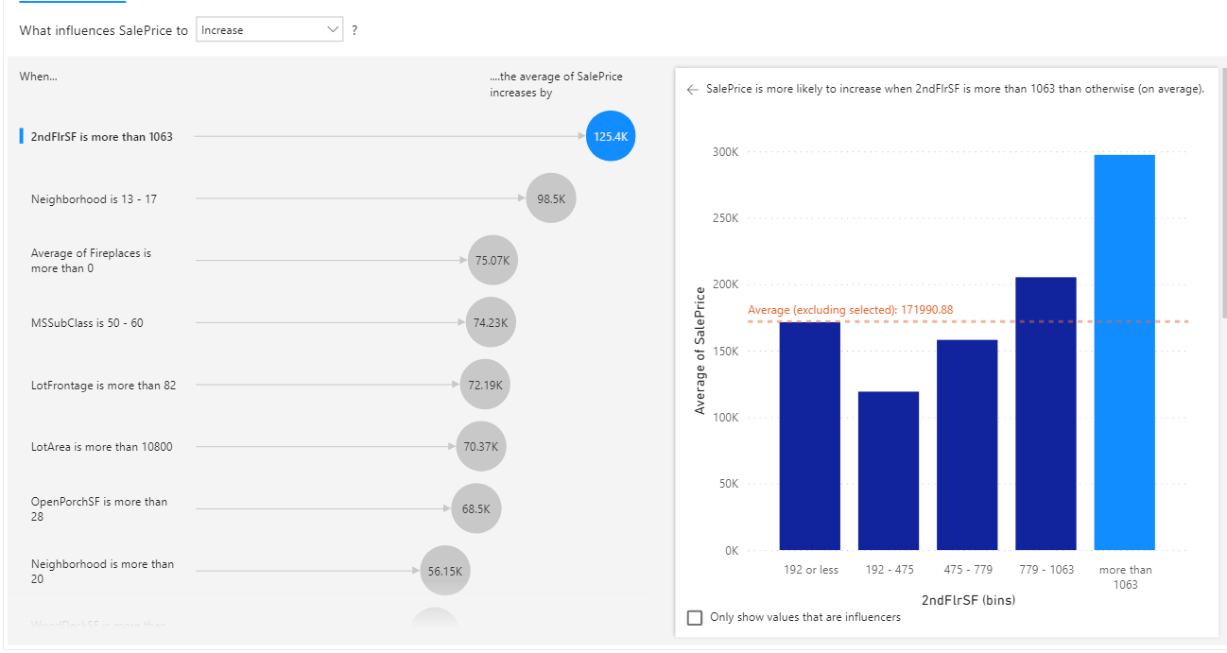

Slide 3
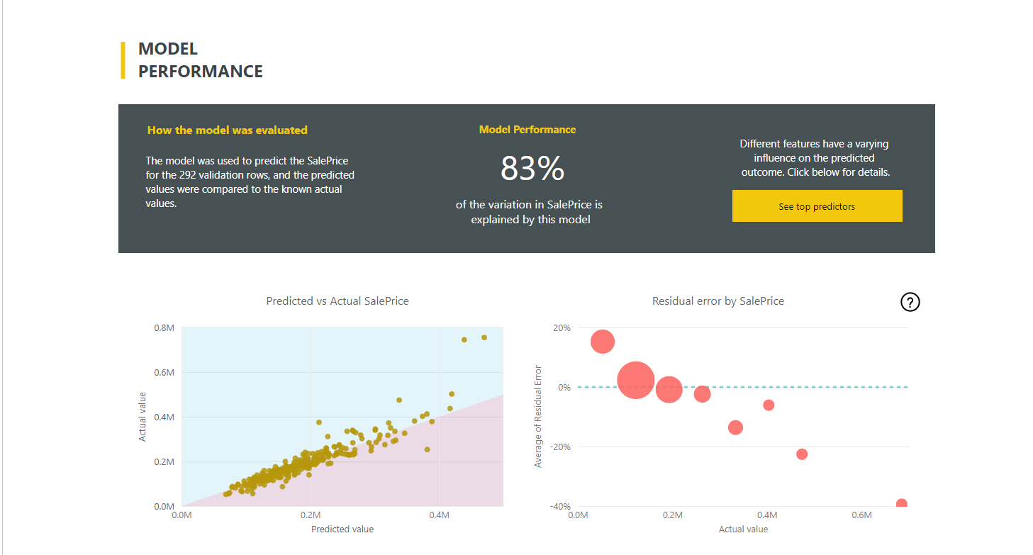

Slide 4
