Slide 1
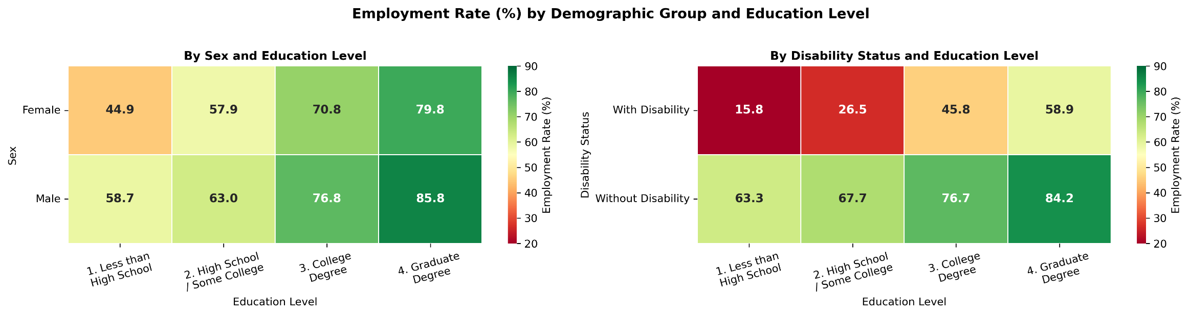
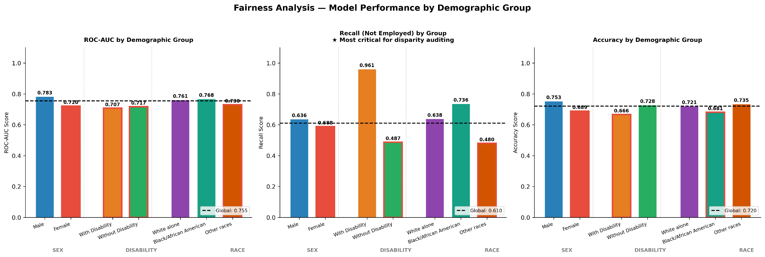
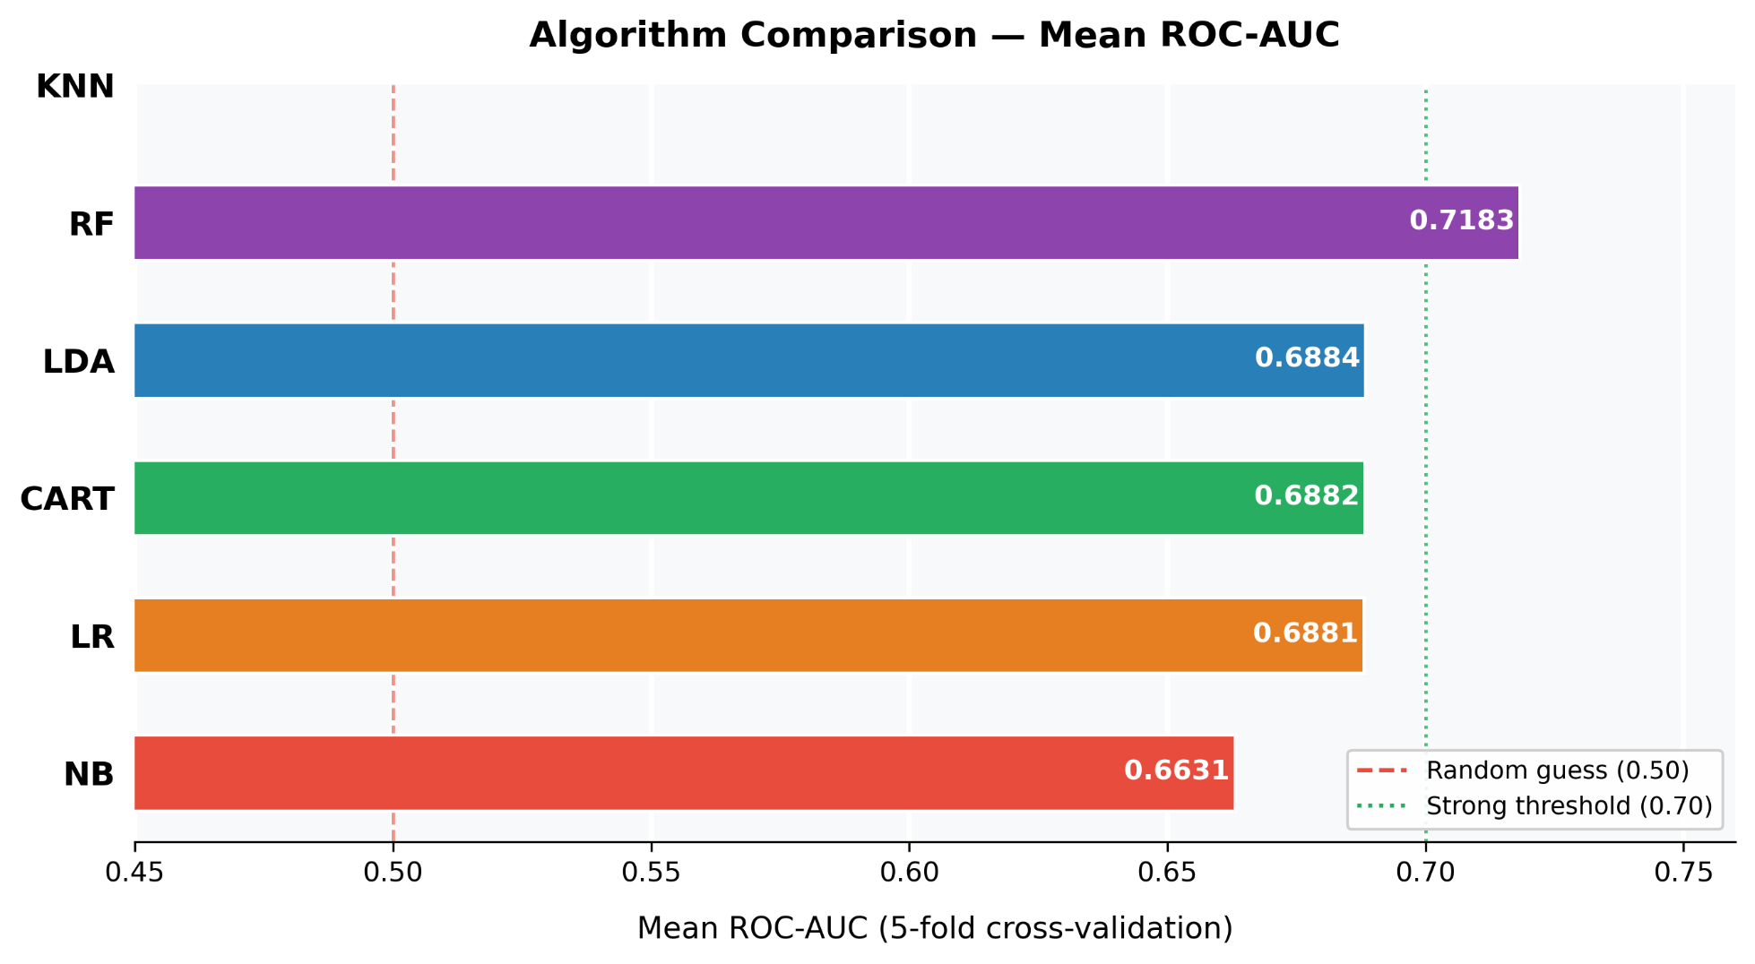
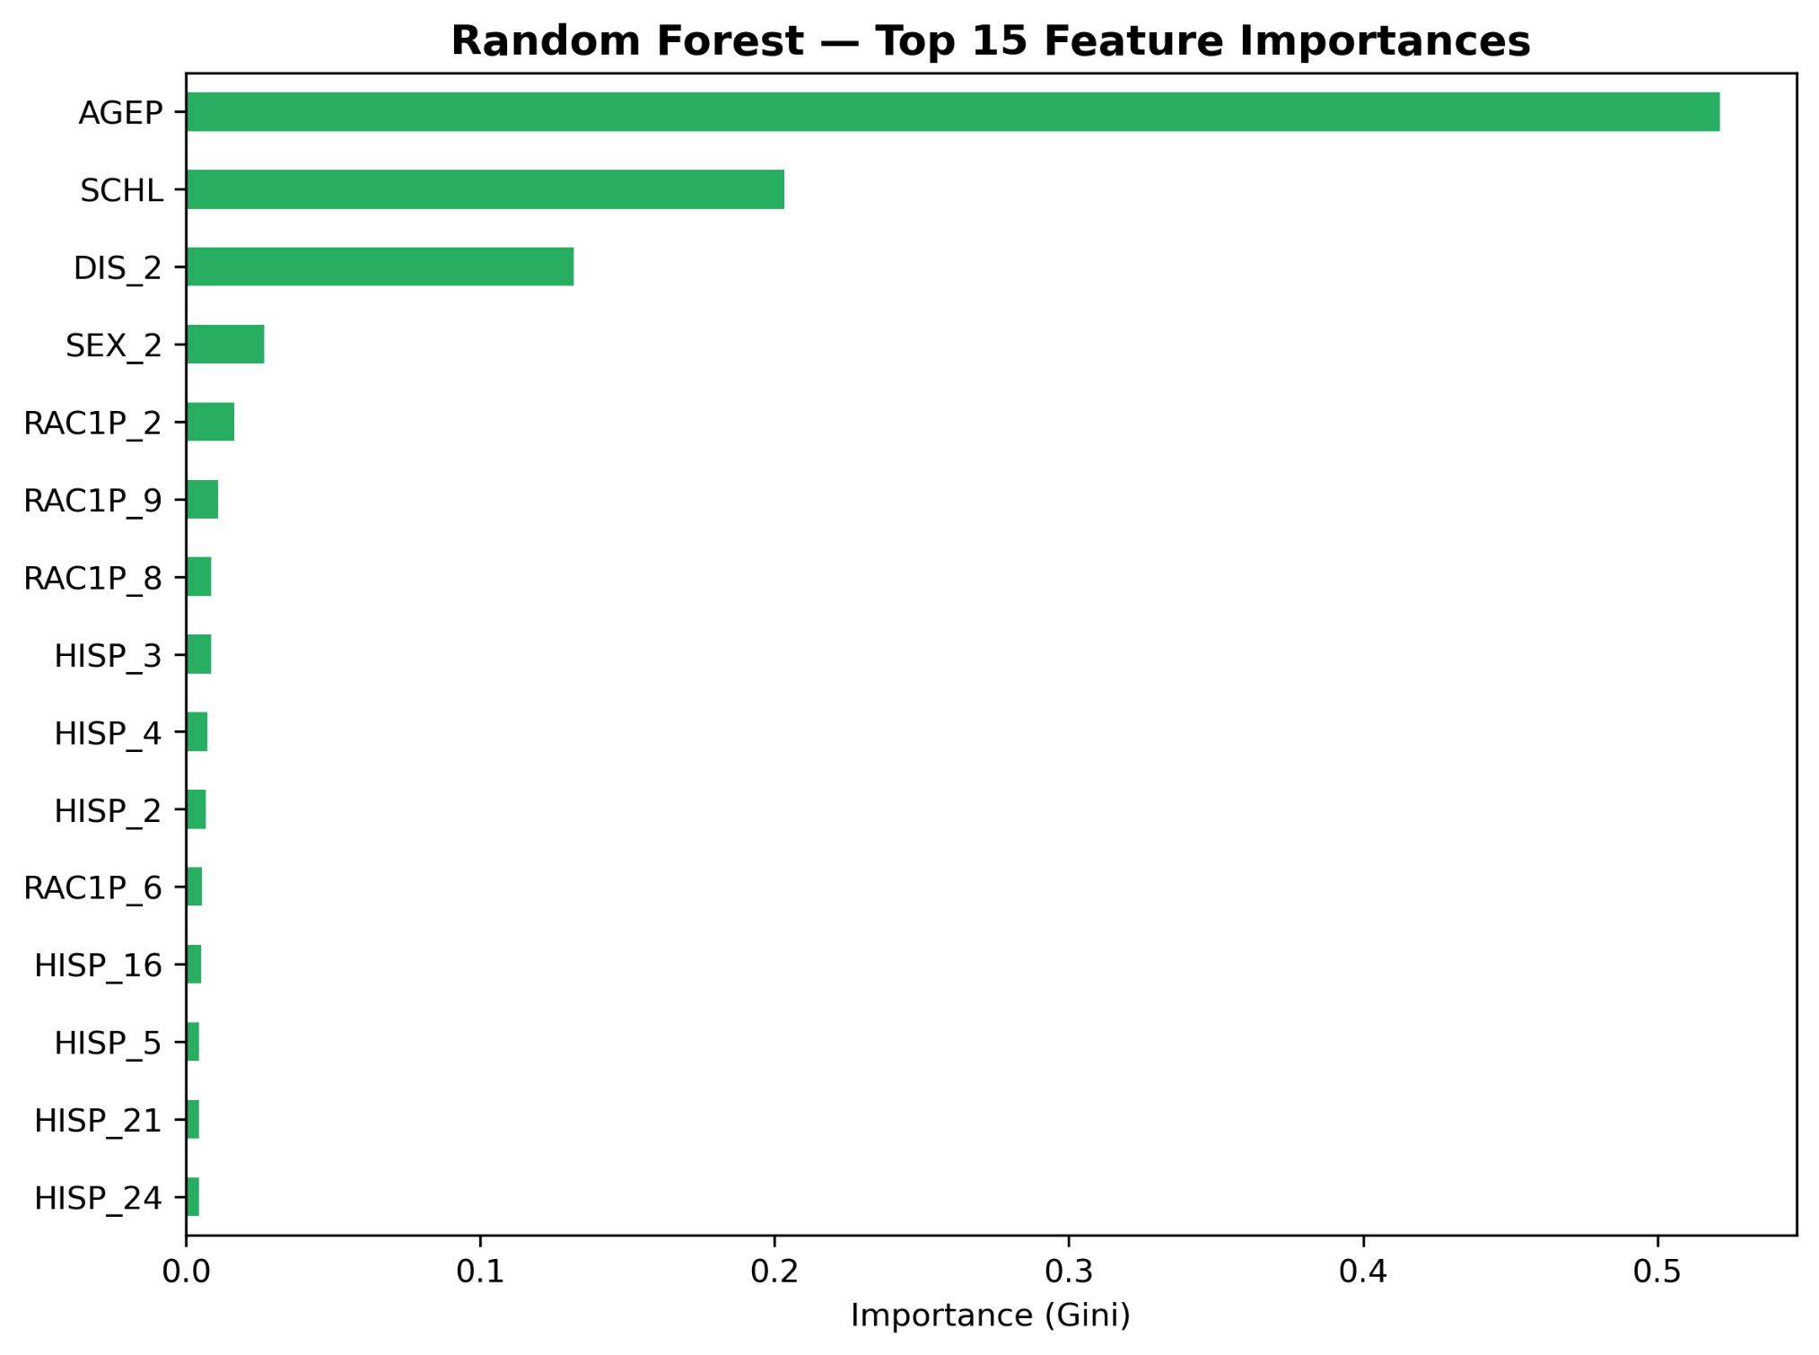
AI Bias Auditing Framework for Labour Market Disparity Analysis
Ana Clara R Quilapan - Student no 2022475 - CCT College Dublin
ABSTRACT
Employment Rate by Demographic Group
PHASE 4: MODELLING & MODEL SELECTION
PHASE 5: FAIRNESS ANALYSIS
This project develops an AI Bias Auditing Framework using ACS Florida labour market data. Logistic Regression and Random Forest models were evaluated, followed by fairness analysis across sex, disability status and race. The tuned Random Forest achieved ROC-AUC 0.7545. Significant disparities were detected, including a disability Recall gap of 0.474 and a sex AUC gap of 0.063 and a racial Recall gap of 0.256. A MySQL auditability layer supports EU AI Act and NYC Local Law 144 compliance.
5-fold stratified cross-validation (ROC-AUC) across 6 candidate algorithms. Logistic Regression selected as interpretable baseline;
Random Forest as primary model.
AUC gap > 0.05 or Recall gap > 0.05 = significant (Bellamy et al., 2019)
Key EDA Findings
Disability gap: Employment rate 36.4% vs 74.6%. Gap persists at every education level — disability operates as an independent employment barrier regardless of educational attainment.
Sex gap: Male employment 72.2% vs Female 67.7%. Gap largest at high-school education level; persists even at graduate degree level.
Race: White alone dominates the sample. Significant imbalance across groups; Other races most underserved in unemployment detection.
Age: Broadly spread across working-age range with stronger representation in older age bands (35–55).
BY SEX AUC Gap: 0.063 SIGNIFICANT ⚠ Male AUC 0.7829 vs Female AUC 0.7204. Employment: Male 72.2% vs Female 67.7%. Reflects structural labour force participation differences including caregiving responsibilities and occupational segregation.
PHASE 1: BUSINESS UNDERSTANDING
Note: KNN returned NaN (O(n²) memory constraints at 100k+ samples) and was excluded from final comparison.
BY DISABILITY Recall Gap: 0.4739 CRITICAL Employment rate 36.4% (disability) vs 74.6% (no disability). Model defaulted to 'structural pessimism' — predicting unemployment by default (Recall=0.9607). An HR system trained on this data would institutionalise existing labour market exclusion of disabled individuals
Problem: Organisations deploying AI in recruitment lack structured mechanisms to audit algorithmic outcomes across demographic
groups.
Aim: Develop a prototype framework to detect, measure, and log employment outcome disparities in an auditable manner.
Tools: Python 3 · scikit-learn · pandas · matplotlib · seaborn · MySQL (all open-source)
Feature Importance — Tuned Random Forest (Gini)
BY RACE Recall Gap: 0.256 SIGNIFICANT ⚠ Other races most underserved: Recall=0.48 for Not Employed class. AUC gap 0.038 within acceptable limits. Black/African American Recall=0.74 is acceptable — the disparity is concentrated in the Other races category, not across all non-White groups.
Correlation Matrix Signal: Strong WAGP–PINCP correlation; WKHP correlated with income variables. These early patterns triggered the leakage investigation in Phase 3. An initial model with all variables produced AUC=0.9528 — a red flag that confirmed data leakage. Removing 5 variables corrected this to AUC=0.6929.
CRITICAL: DISPARITY ≠ BIAS. The Qualified Pool Problem (Dwork et al., 2012) means outcome-based audits cannot distinguish a biased process from genuine applicant-pool differences. This framework detects and flags — fairness alerts trigger human investigation, not automatic discrimination findings. Example: if 90% of applicants in a sector are male, higher male employment reflects pool composition, not bias. Context and process-level data are required to determine causality.
Key Risks & Mitigation
Risk | Mitigation
Data Leakage | Sequential feature removal
Class Imbalance | class_weight='balanced'
Fairness misuse | Disparity ≠ Bias discussion
Deployment failure | MySQL testing before integration
PHASE 3: DATA PREPARATION
PHASE 6: DEPLOYMENT — MySQL AUDIT LAYER
Leakage Prevention — 6 Variables Removed:
✗ ESR — direct source of target variable
✗ WAGP — wages = 0 for unemployed
✗ WKHP — hours worked = 0 if unemployed
✗ PINCP — income reflects employment status
✗ COW — class of worker = N/A if unemployed
✗ PWGTP — survey weight — not a predictor
Top features: AGEP 51.9% · SCHL 20.3% · DIS 13.2% · SEX 2.9% · RAC1P 1.5%
audit_predictions
25,286 rows — individual predictions, demographic features, probability scores, timestamps. Supports EU AI Act Art.10(5). audit_fairness_log
7 subgroup metric records per run — enables longitudinal tracking of fairness gaps over time.
audit_report_summary
Executive summary per run — supports governance board reporting and regulatory submissions. Run ID: RUN_20260530_234959 · EU AI Act Annex III · NYC Local Law 144
Hyperparameter Tuning — GridSearchCV (36 combinations, 3-fold CV)
All 4 Success Criteria Met:
✔ Two ML models developed and compared
✔ Fairness analysis across 3 demographic dimensions
✔ Functional MySQL auditability layer
✔ Comprehensive CRISP-DM report
Parameter | Value | Justification
n_estimators | 200 | More trees → greater stability without overfitting
max_depth | 20 | Captures complex demographic interactions
min_samples_split | 5 | Reduces overfitting on minority class
class_weight | balanced | Compensates for 70/30 class imbalance
Final 6 Features (demographic only, no leakage):
AGEP (age) · SEX · SCHL (education) · RAC1P (race) · HISP (Hispanic origin) · DIS (disability status)
CONCLUSIONS
PHASE 2: DATA UNDERSTANDING
✔ Demographic data alone (6 features) achieves AUC 0.75 — confirming systematic signal in labour market outcomes.
✔ Three significant gaps detected: Sex AUC gap 0.063 · Disability Recall gap 0.474 · Race Recall gap 0.256
✔ Disability finding most critical: structural pessimism institutionalises labour market exclusion.
✔ MySQL audit layer provides reproducible, compliance-ready governance infrastructure.
✔ End-to-end methodology applicable to any organisation deploying AI in employment decisions.
ACS PUMS — Florida (State Code 12), U.S. Census Bureau (2022) 126,430 working-age individuals (18–66) · 16 variables · Demographics, socioeconomics & employment status
Target: EMPLOYED (derived from ESR)
88,393 Employed (69.9%) · 38,037 Not Employed (30.1%)
80/20 stratified split → 101,144 train | 25,286 test | 35 features after One-Hot Encoding
Final Model Performance — Held-Out Test Set (n = 25,286)
126,430
Total Records
69.9% Employed
30.1% Not Employed
36.4%
With Disability Employed
Model | Accuracy | ROC-AUC | F1-Emp. | F1-Not Emp.
Logistic Regression | 0.68 | 0.6929 | 0.77 | 0.49
RF Baseline | 0.70 | 0.7208 | 0.77 | 0.55
RF Tuned ★ | 0.72 | 0.7545 | 0.79 | 0.57
An AUC of 0.75 using ONLY 6 demographic variables confirms that demographic characteristics carry statistically meaningful predictive signal for labour market outcomes
References:
Ahmad et al. (2025) Frontiers in Data Science. doi:10.3389/fdata.2025.1487713
Bellamy et al. (2019) AI Fairness 360. IBM J. R&D 63(4/5).
Dwork et al. (2012) Fairness through awareness. ITCS.
European Parliament (2024) EU AI Act — Regulation 2024/1689.
Mehrabi et al. (2021) Survey on bias in ML. ACM Computing Surveys 54(6).
NYC Council (2021) Local Law 144 — Automated Employment Decision Tools.
Pedregosa et al. (2011) Scikit-learn. JMLR 12.
U.S. Census Bureau (2022) ACS 1-Year PUMS Florid

