Slide 1
PsychoPy basics
Dr Clare Sutherland
ARC Centre of Excellence in Cognition and its Disorders
School of Psychological Science, University of Western Australia
Notes:
Notes: citing PsychoPy:
Peirce, JW (2007) PsychoPy - Psychophysics software in Python. J Neurosci Methods, 162(1-2):8-13
Peirce JW (2009) Generating stimuli for neuroscience using PsychoPy. Front. Neuroinform. 2:10. doi:10.3389/neuro.11.010.2008
Download: http://psychopy.org/installation.html
To help you, there is an additional Word instructions file with screenshots (Additional_Instructions.doc) and an example experiment in the folder ExampleExperiment1.
A tutorial follows this one, (https://github.com/ClareSutherland/AdvancedPsychoPy)

Slide 2
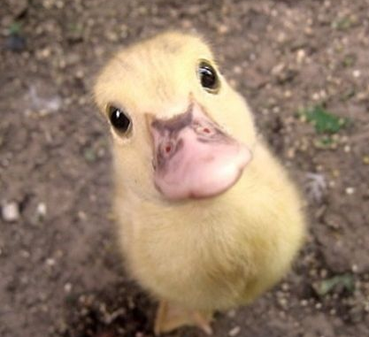
What will we cover?
What is Psychopy?
Routines, Components, Flow and Loops
Build an experiment
What does data output look like?
Pros and cons
Useful tips

Slide 3

What is PsychoPy?
Data collection software based on Python
Created by Dr Jon Pierce, University of Nottingham
Builder view
Coder view
Notes:
Uses Python programming language but you don’t need to know any Python
So it’s built for academics BY academics
Builder view = main PsychoPy interface (covered in this tutorial)
Coder view = for advanced experiments, and for people who prefer programming (next tutorial)

Slide 4
Routines
Settings
Run experiment
Components
Flow
PsychoPy Builder interface
Notes:
Builder View
Components – events in experiment
e.g. text, keyboard, image, sound, grating
Routines: a sequence of events, usually a trial sequence
e.g. where you see a fixation cross, an image and then answer a question
Flow: linear sequence of everything that happens in the experiment (welcome through to end)
Experiment settings – control what questions are asked at the start (participant number, age etc), control which data files are produced
Run experiment – big green button with a running man, VERY EASY ☺

Slide 5
Loops
Loop around routines to allow multiple trials
Loop types: random, sequential, staircase
Trial lists are stored in an excel or a csv file: TOO EASY!
$ symbol – used in PsychoPy to indicate a variable that’s different across trials (i.e. not literal image or text)
Notes:
Unlike Qualtrics/Superlab, you don’t have to manually upload images one by one! – you can just call them from an excel sheet. the excel sheet then contains the names of images within the same folder (so excel sheet, psychopy file, and images all need to be in the same folder)
No more hardcoding individual images, unlike qualtrics or superlab. TOO EASY!!
e.g. $image would refer to a column called ‘image’ in an excel sheet which you’ve used to store your trial list, and you’d call the image file ‘$image’ instead of hard coding a single image name
NOTES
In the loops options dialogue, make sure that the number of repetitions (‘nReps’) is set to ‘1’ unless you want multiple trials of the same type
You can also loop ‘blocks’ around ‘trials’ i.e. have nested loops. If you do this, untick the ‘Is trials’ box in the loop options. Note that blocks need to be very similar - just change the images and/or the instructions - or it gets tricky.

Slide 6
Let’s build an experiment!
Notes:
And now we will build the simple categorisation experiment shown in the images in the powerpoint slides.
TO FOLLOW ALONG, SEE THE WORD FILE WITH IMAGES (Additional_Instructions1)

Slide 7
Data output
xlsx file (Excel file, main output)
csv file (useful for seeing the exact structure of experiment, kind of like Superlab files)
log file (good for spotting errors)
psydat file (for advanced users)
Correct answers – set in PsychoPy to save hassle
Notes:
To change which files you get as output – go into Experiment Settings (little logo of screen with a double arrow on it) and you can can control which data files are produced.
PsychoPy DOESN’T save an excel file as a default (which is annoying).
Psychopy will save these output files every time the experiment is run, in a new subfolder it makes called “Data”. Try it!
If you have correct answers, can pre-code these and save yourself hassle later.

Slide 8

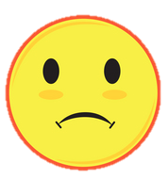
Pros and Cons
Pros
Cons
Very simple for easy experiments
Harder to build complicated experiments
Cross platform
Decisions in your hands – defaults not always helpful
Offline
Simple to run experiments
No dedicated support staff like commercial programs
Data output in excel
fMRI compatible
Offline (until end 2018)
Think like a coder
Hard to deliver to collaborators as a fixed ‘app’ – need to download
Open access – FREE!
Notes:
Pros
- Easy experiments like a rating task on one dimension
- Cross platform unlike eprime (windows) or superlab (mac)
- Offline (unlike Qualtrics) so not dependent on an internet connection
- Simple to run experiments so easy to give to students, RAs etc (even if complicated experiment)
- Returns data in a fairly simple format (no licence required)
Good online forums, help pages (see links in notes)
Interface with Python means you can move to programming much more easily, scaffolds learning
- Open access - time spent learning Psychopy is transferable if you move labs, can give students files, doesn’t require expensive licenses
in fact it’s FREE!
Cons
- Harder to include things like rest breaks, error feedback, conditional branching, more advanced randomisation (but see next workshop)
- Very advanced experiments need Python programming (BUT it makes it very flexible)
- Decisions are in your hands e.g. what are the units? which timing should you use, frames or seconds? (BUT this is probably a good thing in the long run)
- No dedicated support staff because free (unlike Eprime or Superlab)
- can’t be easily run online, unlike Qualtrics – although this is changing in late 2018

Slide 9
Tips
Common errors
Everything (images etc) in the same folder as the experiment file
Set ‘$image’ rather than ‘image’ and ‘set every repeat’ or it will just show the same photo on every trial!
PsychoPy version changes can mess things up: always test across computers!
Sometimes when transferring across computers Psychopy forgets the trial lists; just re-attach the excel file to the loop
Use frames rather than second/milliseconds for accurate timing
Help
PsychoPy documentation: www.psychopy.org/about/overview.html (see notes)
15min Youtube Tutorial: https://www.youtube.com/watch?v=VV6qhuQgsiI
“Psychopy Users” google group – Q and A format, friendly folks
Error codes appear in the log – google them before asking help! ☺
Notes:
EVERYTHING NEEDS TO BE IN THE SAME FOLDER ☺ Psychopy experiment, image files, instructions etc (unless you reference the right folder from within your experiment using code)
$ symbol is unique to PsychoPy, it’s not used the same way in Python (relevant if you use the coder).
I use version 1.82
Screen position is measured so that the origin i.e. [0,0] is the centre of the screen. Position is coded using the coordinate system as [x,y].
Use images rather than text to display instructions where possible (easier to edit)
Some other tips if you’re building your own experiment - it’s best not to use white spaces in names (I’ll explain why next week) and remember, in your excel list, you need to put the full filename i.e. ‘practice1.jpg’ not just ‘practice1’.
Other help links:
http://www.psychopy.org/documentation.html
http://www.psychopy.org/troubleshooting.html
https://groups.google.com/forum/#!forum/psychopy-users
http://discourse.psychopy.org/

Slide 10
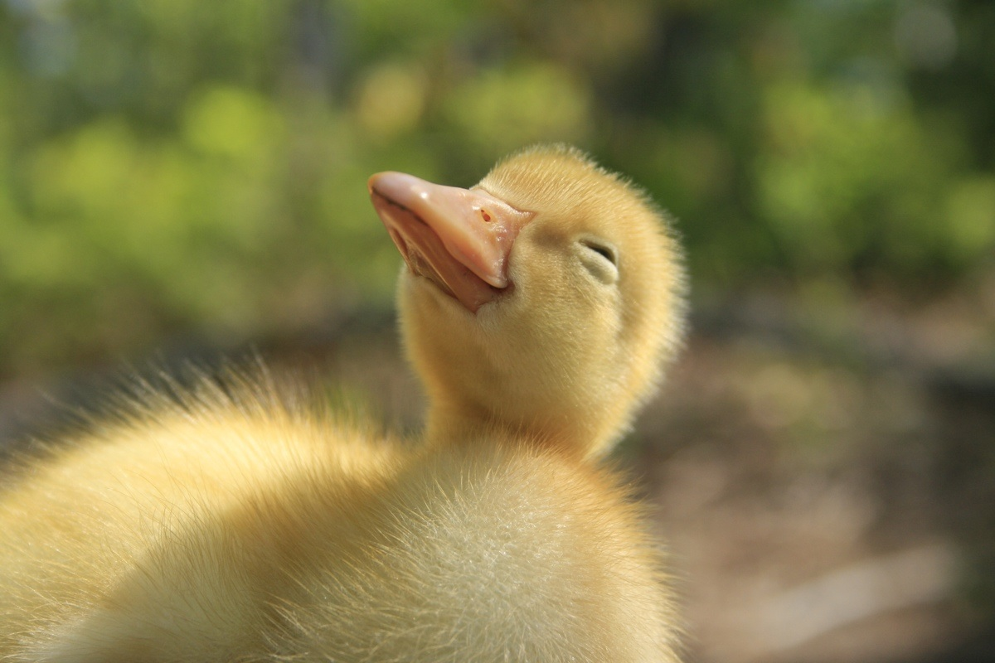
Round up
We covered:
- Psychopy Builder interface
- PsychoPy building blocks (Routines, Components, Flow & Loops)
- How to build a simple experiment
- Data output types
- Pros and cons
- Troubleshooting and tips
Next week:
- Advanced PsychoPy & basic Python

Slide 11
Test yourself!
TEST YOURSELF:
Create an experiment that shows 10 faces in random order and asks people to categorise them as attractive/unattractive. Give people practice trials.
BONUS: How rude! In my example experiment, I never thanked the participants.
Add in a routine to thank the participants at the end.

