Slide 1
R: The basics
Clare Sutherland & Yong Zhi Foo
ARC Centre of Excellence in Cognition and its Disorders
School of Psychology, University of Western Australia

Slide 2
First, download the materials here:
https://github.com/ClareSutherland/BasicR

Slide 3
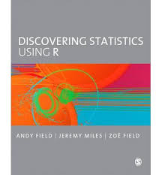
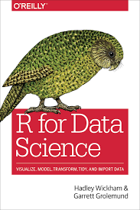
What will we cover today?
What is R?
VERY basic R
- the R studio environment
- basic R commands
- power analysis
- loading data
- manipulating data (NOT in a bad way!)
Next week: analysis and graphing

Slide 4
What is R?
Widely used statistical package language
Written in ‘R’ programming language
- main difference from SPSS: not point/click…
Actually…. many ‘packages’!
- other difference from SPSS, anyone can develop tools
R is also used in government and industry
- (because it is better and cheaper than SPSS ;)
Notes:
basically a very advanced calculator where lots of different people have written packages for you to use. R comes with basic packages, but the chance you need to load new ones e.g. we’ll use a custom power analysis package today (pwr), and next week we’ll use a graphing package.
don’t need to be a programming genius to use R! just need to know some functions and then select the right options from those functions

Slide 5
Let’s open up RStudio!

Slide 6
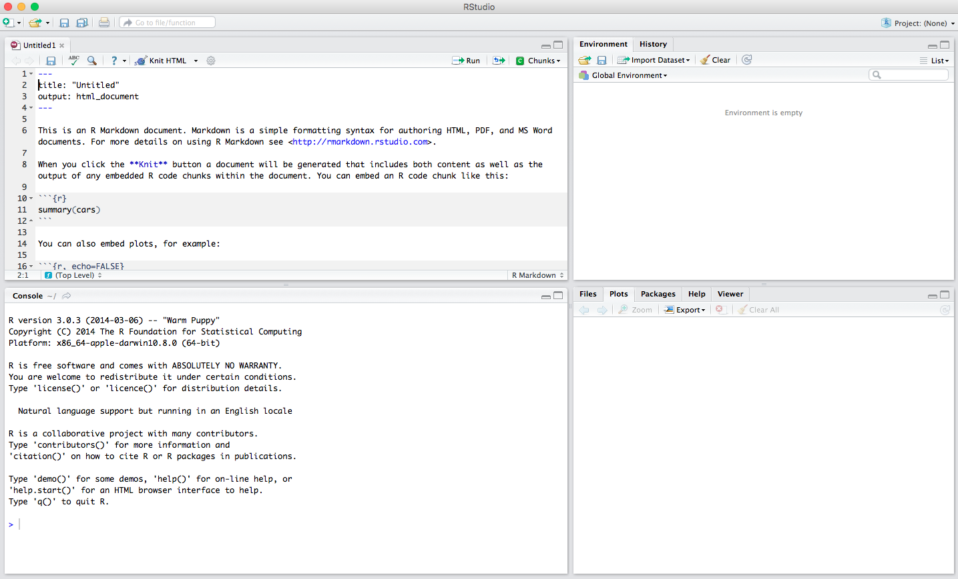
<- Press this button to open the script editor
R Studio interface
Notes:
FOUR PANELS: Console, Script editor, Environment, Help
don’t worry if Rstudio only has three panels when you open it - click this button to open the script editor
you can rearrange these panels in any way you want, just go to Preferences> Pane Layout

Slide 7
Console
Scratchpad – (raw R)
R Studio interface
Notes:
CONSOLE – This is the place where you can try out codes and see if things work. Kind of like a scratchpad. We’ll start off from working from this
Runs line by line code
So that’s what R in basic form looks like, but it’s a bit messy. R studio is useful because it also contains the three other panels which help keep stuff separate SCRIPTs, ENVIROMENT and GRAPHICS AND HELP

Slide 8
Script editor. Create, open and save scripts here
Save scripts here
Run scripts here
Scripts go here
These CAN be saved
R Studio interface
Notes:
SCRIPT EDITOR – scripts go here
scripts are basically the same things you’d run in the console, except you can save them in a tidy format for later. Quite often people will send you scripts and you can then open and reuse them

Slide 9
Environment
Broom – ‘cleans’ environment
(run at end to clear the workspace – useful to run and then check code still works)
Tip: After loading data or creating a variable, check that it shows up in the environment pane
R Studio interface
Notes:
TOP RIGHT
ENVIROMENT shows your variables, datasets, functions – anything you’ve loaded.
BROOM icon clears it from the memory in case you made a mistake and want to start again

Slide 10
Files
Lets you navigate and open files
R Studio interface
Notes:
BOTTOM RIGHT
FILES lets you navigate and open files from your computer

Slide 11
Plots
Any graphs you’ve created
appear here, otherwise empty
R Studio interface
Notes:
BOTTOM RIGHT
PLOTs show any graphs you’ve created

Slide 12
HELP!
R Studio interface
Notes:
BOTTOM RIGHT
HELP – kind of self explanatory, but that’s a good one to know!

Slide 13
Packages
Installed packages appear here
R Studio interface
Notes:
BOTTOM RIGHT
PACKAGES shows any custom modules you’ve installed, we should find the power analysis package PWR there.
PLOTs show any graphs you’ve created
HELP – kind of self explanatory, but that’s a good one to know!

Slide 14
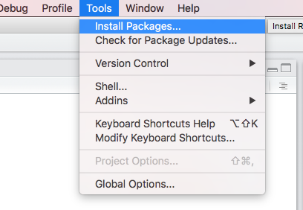
Installing packages
Packages are like books in a library
R is efficient: you only download packages you need (like buying a new book, but free!)
> install.packages("pwr")
You only need to call packages at the start of a script if you use them in that script (like getting a book from your bookshelf)
Notes:
You can install a package in two ways; first by downloading using this code, or going into Tools> install.packages
Calling packages means that you only ever load code that you need to, so it’s faster

Slide 15

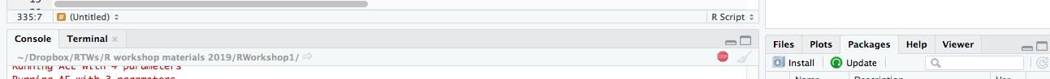


Common mistakes
Spelling mistakes – R is very picky!!!
Code is still running when you don’t want it to – press “esc” or the red button in the console (below) to stop
Plus sign appears and the code doesn’t run – there is a typo (e.g. you didn’t close brackets). Press “esc” to stop and start again.
Double check the script editor for errors:
Notes:
You can install a package in two ways; first by downloading using this code, or going into Tools> install.packages
Calling packages means that you only ever load code that you need to, so it’s faster
check data appears in the Environment tab of RStudio
View(data) will open it up so you can look at it

Slide 16
VERY basic R commands
> #this is a comment
> print ("Hello world!")
R INPUT
“
[1] Hello world!
R OUTPUT
Let’s run these in the console! (press return to make it run)
Notes:
anytime we want to show you some code, we’ll format it like this in a light blue box DON”T COPY DIRECTLY just type it in (powerpoint adds a space at the end and this breaks the code)
so this is a function to PRINT the text ‘hello world’, it doesn’t have to be hello world, it can be anything you like!
Note that hashtag precedes a comment (so it doesn't run as code)
if you have R open and want to try it out, THIS IS IN THE CONSOLE

Slide 17
VERY basic R commands
> data <- c(1,2,3,4)
R INPUT
> data
“
[1] (1,2,3,4)
R OUTPUT
Saving variables: use an arrow <-
‘c’ means ‘here is a list of things’ (c for concatenate)
Notes:
to save data, we save it using an ARROW like this and write c(1,2,3,4)
that creates the smallest data frame with ONE row and FOUR columns
Press RETURN to run in the console (press the ‘run’ button to run as a script)
to confirm that it created properly, write data and press return and R will show you this!
If you check the 'environment' tab, you should see an object called 'data' has appeared.

Slide 18
VERY basic R commands
> data <- c(1,2,3,4)
R INPUT
> Data
“
Error: object 'Data' not found
R OUTPUT
Saving variables: use an arrow <-
‘c’ means ‘here is a list of things’ (c for concatenate)
R is case sensitive (just like any other programming language)

Slide 19
VERY basic R commands
> ?cor
R INPUT
> ??pwr
? Help function (WOO HOO!)
Produces a useful information (top right hand box, help tab)
?? Double question mark for downloaded packages
Notes:
Single and double question marks index help functions.
This function will bring up help information on it in the help tab (bottom right panel in RStudio)
TRY:
?average(is arithmetic mean)
?std
?index
?sum
?min
Table 3.5 in Andy Field’s book has some other main commands

Slide 20
Running a power analysis
Between-subjects t-test
> library(pwr)
> pwr.t.test(sig.level = 0.05, power = 0.80, d = 0.2, type = 'two.sample’)
Correlation
> library(pwr)
> pwr.r.test(sig.level = 0.05, power = 0.80, r = 0.5)
Let’s combine these into a script to save it for later!
Notes:
type in library(pwr) to load PWR into your packages
we can check for loaded packages by checking the bottom right hand panel (‘packages’ tab)
NOTE - any of these values can be changed e.g. a small effect size of 0.1, power of 0.95 etc
Run post hoc test by putting in the number of participants to calculate observed power, or whatever (??pwr shows which options are available)
See also:
pwr.t.test(sig.level = 0.05, power = 0.80, d = 0.2, type = 'paired') for a paired t-test
pwr.t.test(sig.level = 0.05, power = 0.80, d = 0.2, type = 'one.sample') for one sample
pwr.t.test(sig.level = 0.05, power = 0.80, n = 300, type = 'one.sample') for post hoc power

Slide 21

Loading and manipulating data

Slide 22
Loading data
First, we tell R where the file is stored. Write this code in the script to open the current folder and then check:
> dir.name <- dirname(rstudioapi::getActiveDocumentContext()$path)
> setwd(dir.name)
> getwd()
Easiest and safest to load a .csv file (‘save as > csv’ in Excel). Write this code in the script to load and view the csv file:
> DuckData <- read.csv('DuckGroups.csv', header = TRUE)
> View(DuckData)
Avoid using spaces in your filenames!! (R gets confused)
Notes:
Easiest = R has built-in functions to open csv files; safest = Microsoft office formatting can muck things up
get working directory checks where we are in the file system
then you can set the directory to be where your R folder is with the files that we sent you – THIS CODE ASSUMES THAT THE CSV FILE IS STORED IN THE SAME FOLDER AS THE SCRIPT! ☺
If you need to open a different folder, you need to set this manually. Try running file.choose() to locate the file (it opens up a dialogue to choose a file).
load csv data into a R
the file is called DuckGroups.csv. The header = true means that the first line contains our variable names
see Andy Field’s chapter on importing data (3.7.1) for more info

Slide 23
Subsetting data (columns)
Imagine we just want the Duck categorisation task data
R uses the format [row, column]
Leaving either rows or columns blank will select all
- [, column1] specifies take column1, all rows
- [row1, ] specifies take row1, all columns
> DuckCategorisationData <- DuckData[,c("Group","DuckCategPerform")]
> View(DuckCategorisationData)
Notes:
Remember that rows are set to blank so all rows are selected
remember that ‘c’ here means ‘this is a list of things!

Slide 24
Subsetting data (rows)
Imagine we just want the people who have a duck phobia
Remember (row, column)
To refer to a particular column in a particular dataset: dataset$column (dataset part v important!)
== represents “is equal to” (just to be confusing!!)
> DuckPhobicPeople <- DuckData[DuckData$Group == ("DuckPhobic"),]
> View(DuckPhobicPeople)
Notes:
Remember that columns are set to blank so all columns are selected

Slide 25
Subsetting data (both!)
Row and column subset functions can be combined:
> RunningOutOfNamesNow <- DuckData[DuckData$Group == ("DuckPhobic"), c("Phobiascore","DuckCategPerform")]
> View(RunningOutOfNamesNow)
Test it yourself with different columns/rows!
Save it as a script so you can access it later

Slide 26


Pros and Cons of R
Pros
Very easy to re-run scripts once they’ve been created (e.g. entire analysis for a paper)
Intuitive because whatever you enter is just what you need for the analysis
It is 100% cheaper than SPSS etc (IT IS FREE!!!)
Good online help – google, google google! Someone will have hit your problem before!
Used by academia, industry and government – helps you interpret papers + transferrable
Cons
Open source – when a new version comes out, not always backwards compatible
Very flexible, forces you to think about your data & models …. but also statistical details e.g. Type 1 versus Type 3 sums of squares
Increased chance of making a mistake? (solution: verify with SPSS while you learn)
Function names/style not always obvious (and double check with 'clean’ script at end – broom icon)
Notes:
NASA, EDF, ebay, Nestle.... all use RStudio

Slide 27
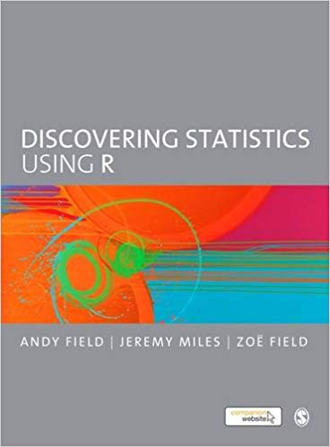
Tips
Common errors
R is case sensitive: ‘Image’ is not the same thing as ‘image’.
Code is generally pickier than point and click – need to be very precise
R gets confused by spaces in filenames when loading (like many programming languages)
Andy Field’s book has some errors, check erratum and google if you get stuck
Help
Good textbooks on R:
Help function in R itself or CRAN info online for packages you loaded
UWA R group that meet in the library/cafes (“WA data carpentry” Facebook group)
Stack Overflow or Rblogger – Q and A format, friendly folks who code
Google problem before asking help, take note of operating system and R version! ☺
Notes:
Google errors before asking questions online – also, if you ask a question, include your error code, what troubleshooting steps you have taken, and details about your computer operating system, which version of R you are running.
Also look at:
https://www.uvm.edu/rsenr/vtcfwru/R/fledglings/02_RStudioTour.html
https://www.rstudio.com/products/RStudio/

Slide 28

Round up
Learnt the main differences between R and SPSS
Took a tour of the R Studio interface
Covered basic R commands and help functions
Wrote a script to run power analysis
Wrote a script to load and manipulate data

Slide 29
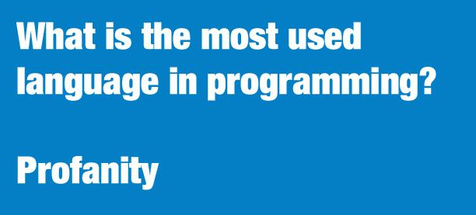
Test yourself!
TASK
Take a (real!) experiment you’re about to set up
run a power analysis to calculate how many people you should test (then cry ☹)
BONUS: take an experiment you’ve already run, and run a power analysis in R to calculate what your observed power was
DOUBLE BONUS: take some of your own (real) data. See if you can select a column and/or a group.
Thank you!

