Slide 1


Structural equation modelling in R
Clare Sutherland, Laura M. Engfors & Jeremy Wilmer
@C_AMsutherland

Slide 2


New to R?
This workshop assumes basic knowledge of R and RStudio
If you’re new to R, try working through some basics:
https://github.com/ClareSutherland/BasicR
Good textbooks on R:

Slide 3
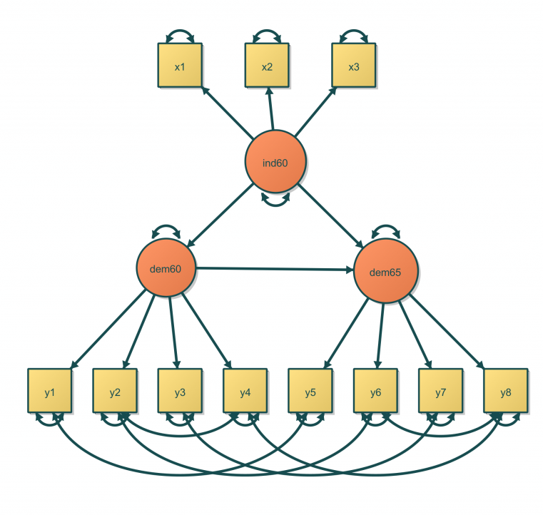
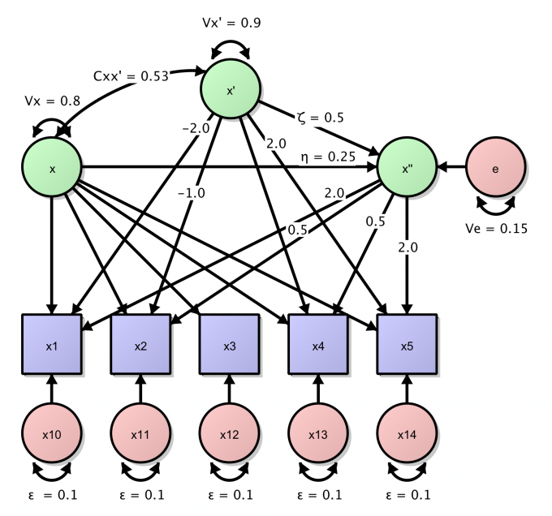
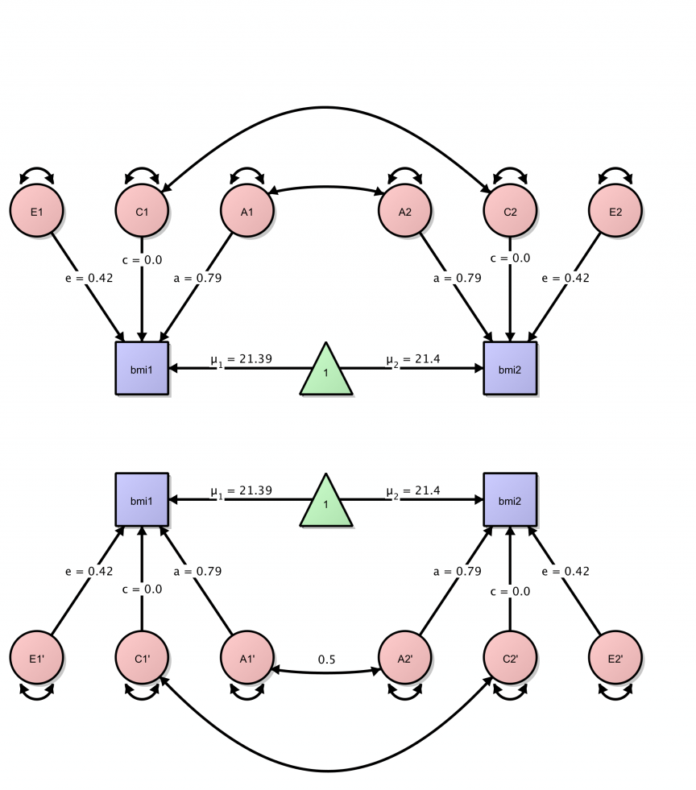
What is SEM?
Structural equation modeling includes a diverse set of mathematical models, computer algorithms, and statistical methods that fit networks of constructs to data Wikipedia
Path analysis, confirmatory factor analysis, latent growth analysis, hybrid models, twin models
Notes:
Example models under the SEM umbrella
Models images taken from: http://onyx.brandmaier.de/

Slide 4
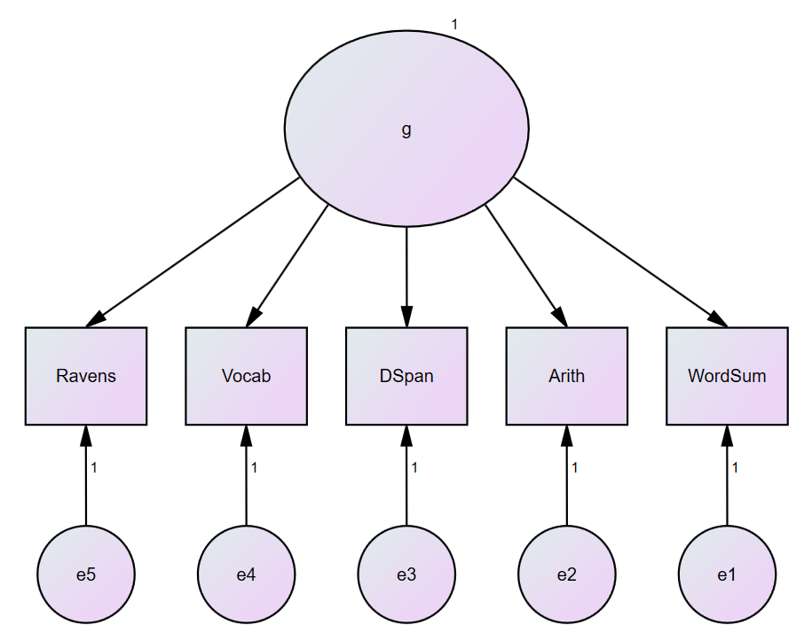
Simple structural equation model in AMOS
Notes:
Technically a Confirmatory Factor Analysis - a first step to building a structural model (the structure part of SEM is the relationships between the latent variables which is not depicted here)
We will build a simple model in R taking an example model in AMOS
Ravens’ matrices
Vocab = vocabulary
DSpan = digit span
Arith = arithmetic
WordSum = verbal reasoning
g = general intelligence (theorised concept)

Slide 5
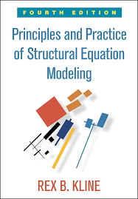
Model identification
To test the model, it needs to be identified i.e. theoretically possible for the computer to fit an unique estimate of every model parameter
For a CFA model, every factor needs to have a scale, PLUS observations > parameters. Then, model is over-identified and can be tested
If observations = parameters then the model is just-identified
If observations < parameters then the model is under-identified
Even if these conditions are met, model can still be empirically unidentified given problems in the data e.g. multicollinarity
If a standard unidimensional CFA model with 1 factor has 3 or more indictors, it is identified Kline p205
Notes:
Model identification: for more details, see Kline’s book. Essentially, you need more observations (data you have collected in terms of measured variables in your model, NB not sample size) than free parameters (aspects of the model that you are testing) in order that you have df to test your model (so model is over identified). If the number of observations equal the number of free parameters, it’s fully identified, so the model will fit the data exactly - which sounds good but isn’t because you then can’t test if it’s a good model (because it will fit the data perfectly). If it’s under identified (too many free parameters) then you don’t have enough observations. You should think about this carefully BEFORE you collect the data!
Observations for cfa = variances + covariances of measured variables i.e. (measured variables in model(measured variables in model + 1)/2
Parameters = statistical effects being measured i.e. for CFA total no of variances + covariances of the factors and of the measurement errors plus factor loadings
Four indictors means over identified for one factor model

Slide 6
Manifest variables
Observed, measured OR manifest variables
Variables that you measure and have data on
Appear in square box
Notes:
variables you actually have measured

Slide 7
Latent variables
Hypothesised variables that are not themselves measurable (sometimes also called factors).
Measured by the manifest (observed) variables.
Appear in circles/ellipses
Notes:
Hypothesized constructs e.g. motivation, IQ etc

Slide 8
Paths – latent to manifest
Casual, unidirectional paths are shown from latent to manifest (observed) variables
Can be free or fixed (here, free)
Can be unidirectional (causal, shown here) as in a latent variable model
If bidirectional (double-headed arrow, correlational, not shown here)
Notes:
You could also fix the latent variable to one of your observed variables e.g. factor loading from g → WordSum to 1. In that case, fix the latent variable to the observed variable which best approximates the latent variable (either theoretically speaking, or based on the correlations in your data)

Slide 9
Error terms
Residuals
Attached to each manifest variable
Appear in circle
If you’re predicting variance in a variable, you need to have an associated residual
Why? models unexplained variance like error or any other unobserved effect
Notes:
Note - errors not just on manifest/observed variables - in a full structural equation model you are usually predicting latent variables too, so they would also need a residual term.
Also - the error term captures 2 things: 1) imprecision in the measurement of
the measured variable, because all our measurement tools
are subject to some degree of error; and 2) all the other factors
affecting the measured variable that we didn’t measure

Slide 10
Paths – error to manifest
Casual, unidirectional paths are shown from error to manifest (observed) variables
Typically fixed to 1 (i.e. not free)
Fixing is done to allow for identification and so that each error term is scaled to its associated observed variable.
Notes:
Similarly, paths from the error terms are also fixed to 1 for identification of the model and to make the scale of the error term equal to the scale of its associated observed variable.

Slide 11
Variance of latent variable
Variance of latent variable is fixed to 1
This step is done to identify the model and to give the latent variable a scale (otherwise it wouldn’t have a scale!)
Can also scale the latent variable to one of the observed variables
Notes:
If you scale it to one of the latent variables, then pick a theoretically important one, or the variable which best corresponds to that factor in the data

Slide 12

Putting it together
2
5
3
1
4
Notes:
the model might look complicated but its actually pretty simple, you just need to work through it step by step 1-5
And, in R, we need to build up each aspect of the model

Slide 13
Structural equation modelling in R
Using package ‘OpenMx’
first install the package (only need to do once; if it asks you to download from source, try ‘y’, if that doesn’t work, try ‘n’):
> install.packages("OpenMx”)
then load the package (do this every time you run the analysis):
> require(OpenMx)
Notes:
Note you might have also come across library(OpenMx) – this will also load the OpenMx program
BUT library is less helpful in the error messages it gives if the package is used within a function so it’s better in this instance to use require
require won’t work unless OpenMx is installed
If you’re asked to download from source (y/n), try selecting ‘y’, if it gives you an error, rerun ‘install packages’ and this time select ‘n’

Slide 14
Loading data into R
We are using some example data, from a file called demoOneFactor.csv
Change the working directory so that the path points to where your data are stored (so R knows which file to load)
> setwd("YOUR/PATHNAME/HERE")
Load and view your dataset:
> OneFactorData <- read.csv('demoOneFactor.csv', header = TRUE)
> View(OneFactorData)
Notes:
Dataset is example data from OpenMx (it’s made up data)
Header = TRUE represents the first line being column name i.e. variable names in the csv file
If you have a Windows computer, the filepath is composed of backwards slashes not forwards slashes

Slide 15
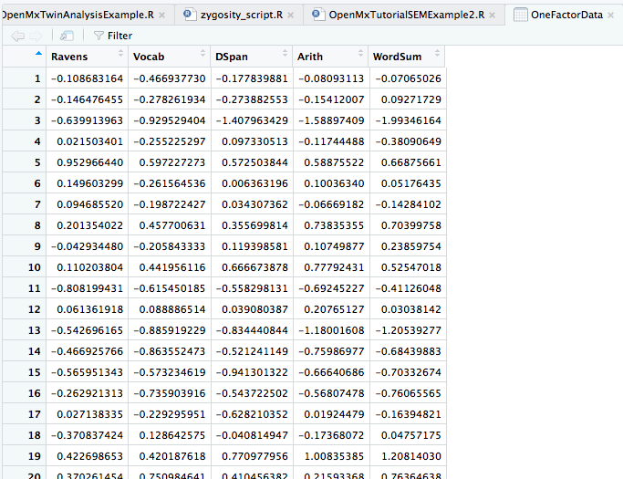
Dataset
Notes:
Dataset is example data from OpenMx (it’s made up data)

Slide 16
1 & 2 Create variables
Create variables containing lists of manifest and latent variables (you’ll use these later)
There are five manifest variables, representing different intelligence tests - Ravens, Vocab, DSpan, Arith and WordSum
There is one latent variable, g i.e. general intelligence
> manifests <- c("Ravens","Vocab","DSpan", "Arith", "WordSum")
> latents <- c("g")
Notes:
Ravens’ matrices
Vocab = vocabulary
DSpan = digit span
Arith = arithmetic
WordSum = verbal reasoning

Slide 17
3. Set paths
Create paths from latent to manifest variables
These paths should be unidirectional (arrows = 1)
The paths between g to Ravens, Vocab, Dspan, Arith are not fixed
If you want to scale a variable, add “free = FALSE”
> g_FreePaths <- mxPath(from="g", to=c("Ravens","Vocab","DSpan", "Arith", "WordSum"), arrows=1)
Notes:
Set ‘from’ to be the latent variable, and ‘to’ to be the manifest variables
Note, free is the default but you can also specify it with free = TRUE or fix the path instead
So as an example, to set the word sum path to 1, the code would look like this:
> g_FixedPaths <- mxPath(from="g", to="WordSum", arrows=1, free=FALSE, values=1.0)
Arrows = 1 means unidirectional
Arrows = 2 means bidirectional

Slide 18

4. Set residuals
Create residuals to all manifest variable
These paths should be bidirectional (arrows = 2) and don’t specify ‘to’ option
The regression weights should be set to 1 automatically (i.e. don’t need to fix path)
Labels are optional, but help remind you that they stand for errors ☺
> residuals <- mxPath(from=manifests, arrows = 2, labels = c("e1", "e2", "e3", "e4", "e5"))
Notes:
Note, only set ‘from’ manifests, no ‘to’ option
What this actually does, is create a little loop around the manifest variables (see figure on right)
The regression weights are automatically fixed to 1
I like to label them because then it reminds me later what they are.
Note that if you label them, you need to give them unique label names OR OpenMx will force them to be the same path i.e. equal
Remember,
Arrows = 1 means unidirectional
Arrows = 2 means bidirectional

Slide 19
5. Set variance
1
Include latent variance
Path is variance so should be bidirectional (arrows = 2) and don’t specify ‘to’ option
Should be fixed to 1 (free = FALSE)
> g_variance <- mxPath(from="g", arrows = 2, free = FALSE, values = 1.0)
Notes:
Note, only set ‘from’ manifests, no ‘to’ option
What this actually does, is create a little loop around the manifest variables (see figure on right)
Usually fixed to 1 to standardise latent variable
Remember,
Arrows = 1 means unidirectional
Arrows = 2 means bidirectional

Slide 20
Build model
> factorOneFactorModel <- mxModel(name = "Intelligence model", type = "RAM",
manifestVars = manifests, latentVars = latents,
g_FreePaths, g_variance, residuals,
mxData(observed=cov(OneFactorData), type="cov", numObs=500))
mxModel builds a model
name = sets the name of your model
type = RAM is the type of matrix algebra it uses as a default
manifestVars sets the manifests to the variable you created earlier
latentVars sets the latent to the variable you created earlier
add your path, variance and residual variables which you created earlier
mxData sets the data, here you have specified a covariance matrix (and N = 500)
Notes:
You can also specify type = LISREL matrix algebra if you like, but then you need to set means explicitly
Check spelling – MUST be ‘manifestVars’ and ‘latentVars’
N = sample size = happens to be 500, to run your own models you need to change to your own sample size

Slide 21
Run model
> factorOneFactorModel <- mxRun(factorOneFactorModel)
> summary(factorOneFactorModel)
You’re now ready to run your model!
summary(model) then gives you the output of your model, including the fit statistics:
Chi-square (χ²) p-value should be > 0.05
Normed Chi-Square χ² /df: values close to 1 indicate good fit but values less than 1 may indicate overfit
RMSEA should be 0.05 or less and p value should be > 0.05 (check CI)
TLI should be > 0.95 (but not over 1, >1 may indicate overfit)
CFI (takes on values between 0 and 1, you want it to be >0.95)
AIC: When comparing models the model with the smallest AIC value is the most parsimonious.
Based on recommendations from: Schumacker & Lomax (2010), Hu & Bentler (1995, 1999), Byrne (1998, 2001, 2006 & 2011), Marsh, Hau & Wen (2004) and Arbuckle (1983-2011)
Notes:
mxRun(model) runs the model
Once a model has been specified, checked for identification and the parameters have been estimated, the next step is to check whether or not the model “fits” the data. Model fit assesses whether the specified model is a reasonable representation of the data it purports to portray (that is, we are hoping that the matrix of implied variance/covariances is very similar to the sample variance/covariances).
Chi-square (χ2) p-value should be > 0.05:
Normed Chi-Square χ2 /df: values close to 1 indicate good fit but values less than 1 may indicate overfit
RMSEA should be 0.05 or less and PCLOSE (only produced by AMOS?) should be > 0.05 – check CI in R
TLI should be > 0.95 (but not over 1)
CFI (takes on values between 0 and 1, you want it to be >0.95)
AIC: When comparing models the model with the smallest AIC value is the most parsimonious.
Troubleshooting: if you get an error where you just get :” Length Class Mode 1 MxRAMModel S4 “ instead of the summary of results, try closing R, then starting by running require(OpenMx) – R hiccups and forgets OpenMx is loaded

Slide 22
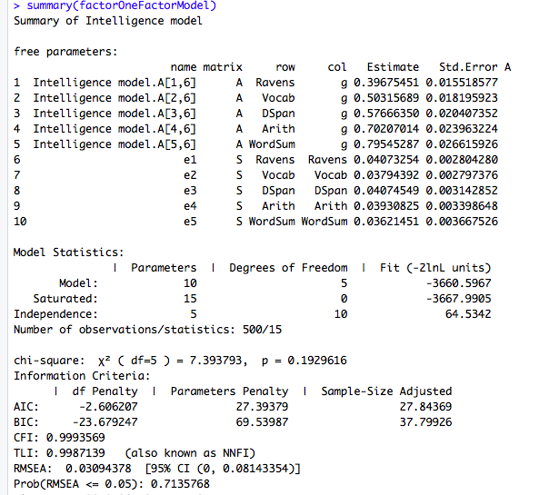
Output
unstandardised estimates
no. parameters and df
chi2 and associated df and p value
AIC
CFI
RMSEA

Slide 23
Final Script
#-------------initialise and load data--------------
#initialise openmx
require(OpenMx)
#example data set taken from the Open Mx User guide with renamed variables
setwd(”REPLACE WITH YOUR FILEPATH")
OneFactorData <- read.csv('demoOneFactor.csv', header = TRUE)
View(OneFactorData)
#--------------create variables, paths and residuals--------------
#set up variables that contain lists of the manifest and latent variable names
manifests <- c("Ravens","Vocab","DSpan", "Arith", "WordSum")
latents <- c("g")
#paths between latents to manifests
g_FreePaths <- mxPath(from="g", to=c("Ravens","Vocab","DSpan", "Arith", "WordSum"), arrows=1)
#Note you could also fix a path to be one to scale the latent to that manifest variable
#but then take WordSum out of the previous paths and add this fixed path to the model
#g_FixedPaths <- mxPath(from="g", to="WordSum", arrows=1,free=FALSE, values=1.0)
#add a residual to each manifest variable i.e. error
residuals <- mxPath(from=manifests, arrows = 2,labels = c("e1", "e2", "e3", "e4", "e5"))
#constraint latent variance to be 1
g_variance <- mxPath(from="g", arrows = 2, free = FALSE, values = 1.0)
#--------------build model--------------
#build model
#mXData tells it where to get the data and whether it's raw or cov data (recommended), or cor matrix (not recommended)
factorOneFactorModel <- mxModel(name="Intelligence model",type="RAM",
manifestVars=manifests, latentVars=latents,
g_FreePaths, g_variance, residuals,
mxData(observed=cov(OneFactorData), type="cov", numObs=500))
#run model and summarise model output
factorOneFactorModel <- mxRun(factorOneFactorModel)
summary(factorOneFactorModel)
#-----heading-----
lets you switch between parts of code more easily

Slide 24
Plotting the path model diagram
Using package ‘Onyx’
Download self-standing app here: http://onyx.brandmaier.de/download
Then install the package in R (only need to do once):
> source('https://raw.githubusercontent.com/brandmaier/onyxR/master/tools/install.R’)
you might need to also install java development kit, here: www.oracle.com/technetwork/java/javase/downloads/jdk10-downloads
then load the package (do this every time you run the analysis):
> require(Onyx)
Notes:
If that doesn’t worK:

Slide 25
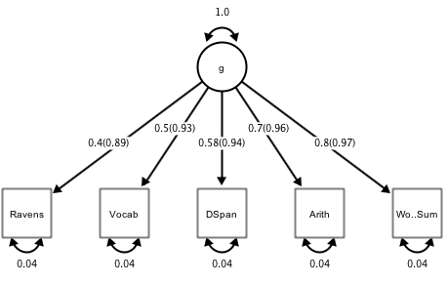
Path model diagram
> onyx(factorOneFactorModel)
Right click on model background, select
- Customise model > change path style to ‘values only’ and untick the ‘hide unit values’
- Apply diagram style > modern
- Change grid properties > display grid, lock to grid and manually align model
Right click on paths, select:
> customise paths > standardised estimates
Notes:
Onyx provides publication friendly, high res PDFS
don’t be fooled by the tree shape, this is the same model
note that the model here provides the same estimates as in AMOS! WOO HOO!
you need a bit of formatting to get it looking clean

Slide 26
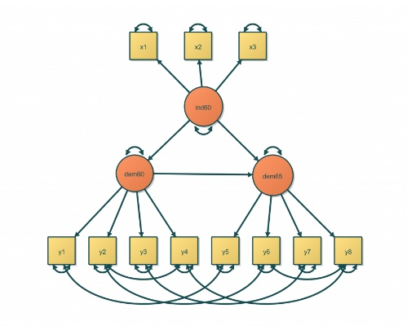
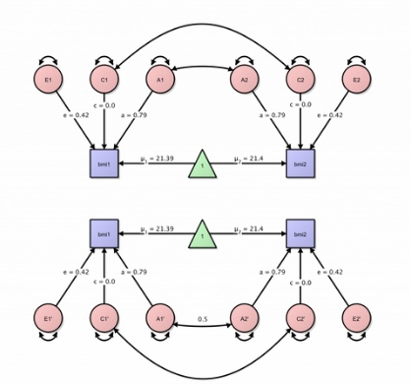
Path model diagram
> onyx(factorOneFactorModel)
For more examples and a user guide:
http://onyx.brandmaier.de/

Slide 27
Lavaan
We started with OpenMx because it tells you exactly what each step involves
But there is alternative program called Lavaan which is simpler to run than OpenMx: http://lavaan.ugent.be/
first install the packages (only need to do once):
> install.packages("lavaan")
> install.packages("semPlot")
then load the packages (do this every time you run the analysis):
> require(lavaan)
> require(semPlot)
Notes:
SemPlot is an alterative to Onyx

Slide 28
Lavaan
Set the working directory (if need be)
> setwd("REPLACE WITH YOUR FILEPATH")
specify the model (latent variable to left, measured variables to right, leftmost measured variable is set to 1)
> model <- 'g =~ Ravens + Vocab + DSpan + Arith + WordSum'
load the data (pasted with variable names from spreadsheet into a text file data.txt)
> a=read.table("data.txt", sep='\t', header=T)

Slide 29
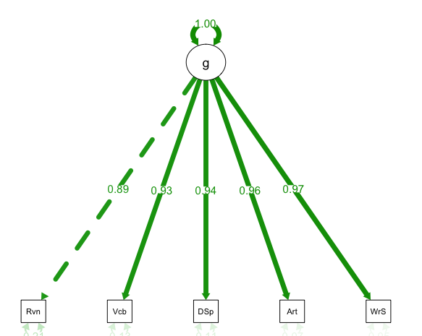
Lavaan
fit model named “model” to data in variable “a”
> fit = sem(model, data=a)
plot a path diagram
> semPaths(fit, "std", edge.label.cex=1, curvePivot=TRUE, layout="tree")
print summary statistics
> summary(fit, standardized=TRUE, rsq=T)
print measures of goodness of fit
> fitMeasures(fit)
display model in onyx (if onyx is installed)
> library(onyxR)
> onyx(fit)

Slide 30
Further Reading – SEM in R
Scripts will be also made available at https://github.com/ClareSutherland
We covered the path modelling approach to SEM, you can also use the matrix algebra approach (see the OpenMx User Guide):
https://vipbg.vcu.edu/vipbg/OpenMx2/docs//OpenMx/2.8.3/OpenMxUserGuide.pdf?q=docs/OpenMx/2.8.3/OpenMxUserGuide.pdf

Slide 31
Further Reading – SEM
Harrington, D. (2008). Confirmatory Factor Analysis. Oxford University Press
Brown, T. (2006). Confirmatory Factor Analysis for applied research. New York: Guilford
Streiner, D. (2006). Building a Better Model: An Introduction to Structural Equation Modelling. Research Methods in Psychiatry
Kline, R. (2011). Principles and Practice of Structural Equation Modeling. The Guilford Press
http://www2.gsu.edu/~mkteer/semnet.html SEMnet - email list for help with SEM

Slide 32
Citations
If you use these packages, PLEASE cite the developers. They have spent all this time setting it up for you, and it will really help them!
OpenMx: Michael C. Neale, Michael D. Hunter, Joshua N. Pritikin, Mahsa Zahery, Timothy R. Brick Robert M. Kirkpatrick, Ryne Estabrook, Timothy C. Bates, Hermine H. Maes, Steven M. Boker. (2016). OpenMx 2.0: Extended structural equation and statistical modeling. Psychometrika, 81(2), 535-549. doi:10.1007/s11336-014-9435-8
Onyx: von Oertzen, T., Brandmaier, A. M., & Tsang, S. (2015). Structural equation modeling with Ωnyx. Structural Equation Modeling, 22, 148-161. doi:10.1080/10705511.2014.935842
Lavaan: Rosseel, Y. (2012). lavaan: An R Package for Structural Equation Modeling. Journal of Statistical Software, 48(2), 1-36. http://www.jstatsoft.org/v48/i02/
SemPlot: Epskamp, S. (2015). semPlot: Unified visualizations of structural equation models. Structural Equation Modeling: a multidisciplinary journal, 22(3), 474-483. doi=10.1080/10705511.2014.937847

