Slide 1


Twin analyses in R
Clare Sutherland & Jeremy Wilmer
@C_AMsutherland

Slide 2
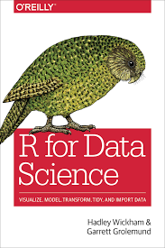
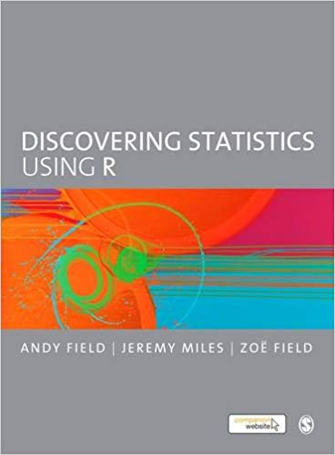
New to R?
This workshop assumes basic knowledge of R and RStudio
If you’re new to R, try working through some basics:
https://github.com/ClareSutherland/BasicR
Good textbooks on R:

Slide 3
Classic twin studies
Monozygotic twins (identical)
Dizygotic twins (non-identical)
r = .745
r = .340
Twin 2 BMI
Twin 2 BMI
Twin 1 BMI
Twin 1 BMI
100% genes
50% genes
Notes:
at heart the twin model is REALLY simple. you measure how similar pairs of twins are, e.g. on BMI (body mass index)
so for example, these identical, MZ twin pairs look like they have really similar BMI scores – when one twin has a high BMI, the other twin tends to as well.
OK so how does this tell us about genetics? well, MZ twins share 100% of the same genes. BUT there are also NON identical twins, who share 50% of the same genes.
you can then compare the difference between identical and non identical twins. why? In this example, you can see that non identical twins are much LESS related than the identical twins. That suggests that genetics might be involved because the main difference between identical and non identical twins are their percentage shared genes

Slide 4
Classic twin model (ACE)
We’re going to run a twin model on BMI (body mass index) data from an Australian Twin sample.
How heritable is BMI?
Notes:
We will build the classic twin model, shown here
I KNOW it looks complicated but its actually not that hard
we’ll go through it

Slide 5
ACE model
We are going to fit a classic ACE twin model. ACE stands for:
A = Additive genetic variation (i.e. genes, inherited variation, heritability)
C = Common environmental variation (aspects of the environment that are shared between twin pairs e.g. family, school).
Note: this environment is assumed to be equal across monozygotic and dizygotic twins “equal environments assumption”.
E = unshared Environmental variation (aspects of the environment that are different across twin pairs, e.g. friends, unique social experiences).
Note: unshared environmental variation is calculated as whatever variation is left when you have calculated A and C, so therefore it also includes error e.g. unreliability on a test.

Slide 6
Falconer’s formula
Falconer’s formula gives an easy way to calculate the proportion of variance explained by A, genetic variance (here called heritability, H_{b}²)
Not as precise as ACE modelling, but results should be very similar
H_{b}² = 2(r_{mz} - r_{dz})
Logic: what is the correlation between identical (monozygotic) twins minus the correlation between non-identical (dizygotic) twins?
Remember, comparing 100% genetically correlated twins - 50% genetically correlated twins = 50% genetic effect
So, multiply by two to estimate the overall genetic effect, A
Notes:
Falconer’s idea is that any difference between identical twins must be environmental (i.e. not genetic), while the difference between dizgotic twins is half genetic and half environmental, so the difference between the two is half genetic

Slide 7
Falconer’s formula
H_{b}² = 2(r_{mz} - r_{dz})
To estimate C, subtract A from the MZ twin correlation.
Logic: the MZ correlation reflects the upper bound for identical twins to be similar (they can’t be more similar than they actually are in the data!) i.e. thus leaving the common environment
To estimate E, take 1 – (C + A)
Logic: everything left over is unshared environment (meaning E is inflated by unreliability and/or any error)

Slide 8
Falconer’s formula
H_{b}² = 2(ICC_{mz} - ICC_{dz})
Small caveat:
We actually calculate intraclass correlations (ICCs), not Pearson’s r correlations, because twins 1 and 2 are interchangeable.
Pearson’s r assumes that assignment to 1 or 2 is systematic (makes sense if you consider the correlation between height and weight – these variables aren’t interchangeable!)
ICCs don’t have this assumption, so allow twin 1 and twin 2 to be interchangeable.
NB: We’ve never really seen it make a difference but good practice.
Notes:
intraclass correlation coefficient is used, not Pearson’s r, because the twin 1 and twin 2 pairs are interchangeable i.e. Nichola could be twin 1 or twin 2 (vice versa for her sister), and that’s true as you move down a column of twin data for all twins
ICC can be found in SPSS under Scale>Reliability>Options select Intraclass Correlation Coefficient, select one-way random and keep the 95% and 0 default values, and look at the single measures

Slide 9
Falconer’s formula – BMI example
H_{b}² = 2(ICC_{mz} - ICC_{dz})
Falconer’s formula falls down sometimes: e.g. for the twin BMI data:
A = .745 (BMI ICC_{mz} for twins 1 and 2) - .340 (BMI ICC_{dz} for twins 1 and 2) x 2 = .81 A = 81%? normally, yes, BUT:
C = .745 -.810 = -0.065. Wait, this doesn’t make sense, you can’t have negative variance explained! So, if negative, set to C = 0%
That means A is actually - 0.065 + .810 = 0.745 so A = 74%
E = 1 – (0.745 + .0) = 0.255, so E = 26%
Umx estimates:
A = 74%
C = 0%
E = 26%
Notes:
Note, only same sex twins are valid to use in this formula because MZ same sex twins are always more related than DZ twins of opposite sex, so looks artificially like genetic variation
I have left an excel calculator that calculates these aspects for you

Slide 10
Classic twin model in R
Using package ‘OpenMx’
first install the package (only need to do once; if it asks you to download from source, try ‘y’, if that doesn’t work, try ‘n’):
> install.packages(“OpenMx”)
then load the package (do this every time you run the analysis):
> require(OpenMx)
Notes:
Note you might have also come across library(OpenMx) – this will also load the OpenMx program
BUT library won’t give informative errors inside functions so it’s better in this instance to use require
NB require won’t work unless OpenMx is installed
When installing OpenMx, if you’re asked to download from source (y/n), try selecting ‘y’, if it gives you an error, rerun ‘install packages’ and this time select ‘n’

Slide 11
Identical twins model
We’re actually going to build two models, one for monozygotic (identical) twins
And one for dizygotic (non-identical twins)
We’ll cover the identical twin model first
Monozygotic twins = share 100% genetic variance
Notes:
So this model is essentially a mirror image, where half of the model relates to Twin 1 and the other half relates to Twin 2

Slide 12
Twin 1 and twin 2
Twin 1
Twin 2
The whole model is mirrored
One side reflects Twin 1 (e.g. Nichola)
The other side reflects Twin 2 (e.g. her sister)
Essentially, it’s arbitrary whether Nichola or her twin are designated Twin 1 or 2
Note that there is only one triangle (more on this later!)
Monozygotic twins = share 100% genetic variance
Notes:
So this model is essentially a mirror image, where half of the model relates to Twin 1 and the other half relates to Twin 2

Slide 13
Manifest variables
bmi1 and bmi2 squares represent the dependent variable for each twin
E.g. BMI, height, scores on a test… etc.
Square variables in path diagrams represent manifest (observed or measured) variables
The DV is a manifest variable because we have measured actual data (here, BMI)
Monozygotic twins = share 100% genetic variance
Notes:
So this model is essentially a mirror image, where half of the model relates to Twin 1 and the other half relates to Twin 2

Slide 14
Latent variables (ACE)
Each twin also has an circle for each ACE component:
A = additive genetic
C = common environment
E = unshared environment
Circles in path diagrams represent latent (hypothesised or construct) variables
These ACE components are all latent variables, because we don’t directly measure them (they’re hypothesised constructs)
Monozygotic twins = share 100% genetic variance
Notes:
see the structural equation modelling workshop for more info on path notation

Slide 15
Paths – ACE (latent) to DV (manifest)
Each ACE latent variable is assumed to have a casual relationship to the manifest variables (i.e. genes and environment predict the observed variable – here, BMI)
This idea is shown by unidirectional paths from each ACE latent variable to the manifest variable
The paths are left free to vary, although plausible starting values are used
Monozygotic twins = share 100% genetic variance
Notes:
see the structural equation modelling workshop for more info on path notation

Slide 16
Paths – ACE starting values
A good plausible starting value is the variation in the manifest (DV) variable so to scale the latent to the variable
You need to divide the variance by 3 (because 3 paths per Twin i.e. each ACE path), and we want to be unbiased
Then take the square root of that value (so in SD units i.e. standardised). For BMI, it’s 0.56
Note variance assumed to be the same across twin 1 and 2, dz and mz twins (check!)
Monozygotic twins = share 100% genetic variance
Notes:
see the structural equation modelling workshop for more info on path notation
you can think of the sqrt as changing the variance (like R2) into correlation (i.e. r)

Slide 17
A = additive genetic variation
A1 represents Twin 1’s genetics
A2 represents Twin 2’s genetics
In path diagrams, fixing a path to 1 means the two variables are equal
The path between A1 and A2 is fixed at 1 for identical (monozygotic) twins because they share 100% (the same) genes
It’s bidirectional, because Twin 1 and Twin 2 covary
1.0
Monozygotic twins = share 100% genetic variance
Notes:
see the structural equation modelling workshop for more info on path notation

Slide 18
A = additive genetic variation
A1 represents Twin 1’s genetics
A2 represents Twin 2’s genetics
In path diagrams, fixing a path to 0.5 means the two variables are 50% equal
The path between A1 and A2 is fixed at 0.5 for non- identical (dizygotic) twins because they share 50% (the same) genes
It’s bidirectional, because Twin 1 and Twin 2 covary
0.5
Dizygotic twins = share 100% genetic variance
Notes:
see the structural equation modelling workshop for more info on path notation

Slide 19
C = common environment
1.0
C1 represents Twin 1’s genetics
C2 represents Twin 2’s genetics
Remember, fixing a path to 1 means the two variables are constrained to be equal
The path between C1 and C2 is fixed at 1 (due to the equal environments assumption)
It’s bidirectional because Twin 1 and 2 covary
Notes:
that is, not that twin 1 predicts twin 2 or vice versa; assignment to twin 1 or 2 is essentially random across twins I THINK

Slide 20
E = unshared Environment
E1 represents Twin 1’s genetics
E2 represents Twin 2’s genetics
E1 and E2 aren’t connected by a path at all because these latent variable inherently reflects unshared (uncorrelated) environments i.e. they don’t have a relationship
Notes:
see the structural equation modelling workshop for more info on path notation
note that no path here = constrained to 0 – you can check if you like but specifying this relationship and fixing it to 0 gives you the same model

Slide 21
Why no error variables?
Actually, E1 and E2 are the error or residual variables
They represent everything that varies between twin pairs
So, variance not accounted for by common environments and genetics (which would make twins similar)
Thus, E1 and E2 represent unshared environments AND error (a potential confound)
Notes:
hence why we need to make sure we use the best possible tests of dependent measures

Slide 22
Observed (manifest) mean
Triangle depicts means in the model. E.g. the mean of the observed scores across twins. This mean is left free to vary, although a plausible starting value is used
A good plausible starting value is the mean of the manifest (observed) data (here, 21.6).
Mean is usually assumed to be the same for mz and dz twins 1 and 2, so you need to check the means are similar across these four groups, or remove this assumption
Notes:
Note, people also often check that the means hold across birth order too
for those of you at the structural equation modelling class, we didn’t include a mean then because we used covariation, where the means are constrained to be 0, but sometimes this assumption is too restrictive (e.g. like here, where we have raw data, that DO have an observed mean)
basically long story short, the likelihood modelling needs the mean to know if the paths are realistic or not. See:
Boker, S., Neale, M., Maes, H., Wilde, M., Spiegel, M., Brick, T., ... & Mehta, P. (2011). OpenMx: an open source extended structural equation modeling framework. Psychometrika, 76(2), 306-317.

Slide 23
Latent means and variance
Each of the latent variables has variance constrained to 1
Also a mean of 0 (you can’t see it on the path because it’s zero i.e. constrained not to be there)
These constraints reflect the latent variables being standardised variables
Notes:
see the structural equation modelling workshop for more info on path notation

Slide 24
Putting it all together
Monozygotic twins (identical)
Dizygotic twins (non-identical)
1.0
0.5
In ACE modelling, there is literally only one difference across monozygotic and dizygotic twin models:
the co-variation between Twin 1 and Twin 2 additive genetics
= 1 for monozygotic twins
= 0.5 for dizygotic twins

Slide 25
Comparing MZ and DZ twin models
Monozygotic twins (identical)
Dizygotic twins (non-identical)
1.0
0.5
So, you build both models, then compare them.
Each model has a -2*loglikelihood value which demonstrates overall fit.
You take the difference between these two -2*loglikelihood values, which difference so happens to fit the chi2 distribution, meaning it has an associated significance value (NICE!)
If this test is significant, it tells you that genetics do contribute
If this test is not significant, it tells you that genetics don’t contribute that much

Slide 26

Questions?

Slide 27
Loading data into R
We are going to use some example (real) twin data that come with OpenMx
Data represent body mass index (BMI).
How heritable is BMI in women?
Load and view your dataset:
> data(twinData)
> View(twinData)
Notes:
Dataset donated by Jeremy Wilmer, thank you!

Slide 28
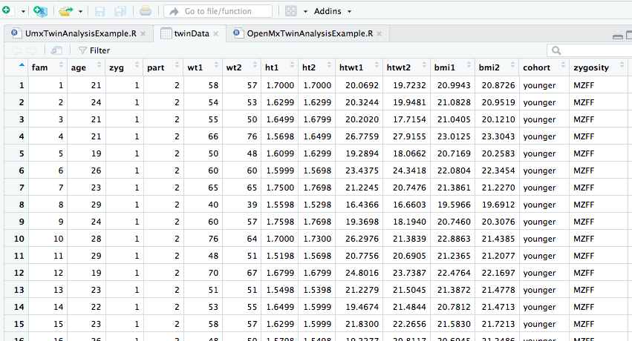
View data
zygosity i.e. identical or not
BMI values for twin 1 and twin 2

Slide 29
Create manifest and latent variables
Create variables that contain lists of your manifest and latent variables (you will use later)
Remember, there is one manifest variable (BMI) per twin: bmi1, bmi2
There are three latent variables per twin: A1, A2, C1, C2, E1, E2
> selVars <- c('bmi1','bmi2')
> aceVars <- c("A1","C1","E1","A2","C2","E2")

Slide 30
Set MZ and DZ twin data
1.0
0.5
Remember we are just looking at women, so we need to subset just the female data
And, we need to tell R which are the identical (MZ) twins and non-identical (DZ) twins
And, only select the manifest variable we care about (saved under selVars)
> mzData <- subset(twinData, zygosity=="MZFF", selVars)
> dzData <- subset(twinData, zygosity=="DZFF", selVars)
Notes:
remember we created selVars in the last step
also remember that we don’t need to select out the ACE variables because these are latent i.e. not actually observed in our data
We use zygosity variable here to subset which has both MZ and DZ info, plus gender (FF means both twin 1 and 2 are female). The example data frame is pretty big so note that there are other ways to subset the data.

Slide 31
Set starting values
We need plausible starting values for the observed (manifest) mean and ACE paths
For the mean, we take the grand mean observed for the manifest variable across all four twin groups
> MeanStartValue <- mean(colMeans(rbind(mzData,dzData), na.rm = T), na.rm = T)
For the ACE paths, we take the mean variance across all four twin groups, divided by 3 (because 3 ACE components) and sqrt that value
> varMz <- cov(mzData,use="complete")
> varDz <- cov(dzData,use="complete")
> VarStartValue <- sqrt((mean(c(varMz[1],varMz[4],varDz[1],varDz[4]), na.rm = T))/3)
Notes:
Although the means and the variances are freely estimated, we need some plausible start values

Slide 32
Constrain latent variance
Include latent variance (for all latent variables, i.e. ACEVars)
Path is variance so should be bidirectional (arrows = 2)
Should be fixed to 1 (free = FALSE)
> latVariances <- mxPath(from=aceVars, arrows=2, free=FALSE, values=1)
Notes:
Note, only set ‘from’ latents, no ‘to’ option
Remember,
Arrows = 1 means unidirectional,
Arrows = 2 means bidirectional

Slide 33
Means of observed variables
Include mean of observed variable (from = “one” to manifest)
Path is unidirectional (arrows = 1)
Should be free (free = TRUE), but plausible start value (you created this earlier i.e. 21.6)
Labelled ‘means’ so constrained to be equal across groups (since same label)
> obsMeans <- mxPath(from="one", to=selVars, arrows=1, free=TRUE, values = MeanStartValue, labels="mean")
Notes:
means in the path notation is represented by a path “from = “one”
to here, the manifest variable which you saved earlier under selVars
Giving paths the same label in a path model means that they’re constrained to be the same path
NOTE if the means AREN’T he same, you can remove this constraint

Slide 34
Means of latent variables
Include mean of latent variables (from = “one” to latents)
Path is unidirectional (arrows = 1)
Fixed to 0 because mean of latents is assumed to be 0 (free = FALSE)
NB you can’t see these paths in the diagram because constrained to zero
> latMeans <- mxPath(from="one", to=aceVars, arrows=1, free=FALSE, values=0)
Notes:
means in the path notation is represented by a path “from = “one”
to here, the latents which you saved earlier under aceVars
for some reason you have to tell it to constrain the mean to 0 here, but when you’re modelling covariation e.g. between E1 and E2 (also 0) by not drawing it, you specify it’s zero

Slide 35
Paths – ACE (latent) to DV (manifest)
set path coefficients from latents to manifest for twin 1 and twin 2
unidirectional (arrows = 1)
free, but given plausible start value (created earlier i.e. 0.56)
same label so constrained to be the same across twins
> pathAceT1 <- mxPath(from=c("A1","C1","E1"), to=selVars[1], arrows=1, free=TRUE, values = VarStartValue, label=c("a","c","e"))
> pathAceT2 <- mxPath(from=c("A2","C2","E2"), to=selVars[2], arrows=1, free=TRUE, values = VarStartValue, label=c("a","c","e"))
Notes:
Note that the code assumes that the data for twin 1 are held before the data for twin 2 in the selVars variable

Slide 36
Paths – Additive genetic
1.0
0.5
Set path for Additive genetic variance between twin 1 and twin 2
A = 1.0 for identical twins (MZ) and A = 0.5 for non-identical twins
So, free = FALSE, value = 1.0 for identical and 0.5 for non-identical twins
Arrow is bidirectional since covariance (arrows = 2)
> covA1A2_MZ <- mxPath(from="A1", to="A2", arrows=2, free=FALSE, values=1)
> covA1A2_DZ <- mxPath(from="A1", to="A2", arrows=2, free=FALSE, values=.5)

Slide 37
Paths – Common environment
Set path for Common environmental variance between twin 1 and twin 2
Constrain path to be 1 (free = FALSE, value = 1.0) to represent equal environments assumption
Arrow is bidirectional since covariance (arrows = 2)
> covC1C2 <- mxPath(from="C1", to="C2", arrows=2, free=FALSE, values=1)
Notes:
Note that no path is set for unshared environmental variation, left free to vary (represents everything left over, environment and error, and you measure how much this predicts)

Slide 38
Create MZ model
First list all of the paths that are the same across MZ and DZ models (we’ll use in both models)
> paths <- list(latVariances, latMeans, obsMeans, pathAceT1, pathAceT2, covC1C2)
mxModel builds a model
name = names your model
type = RAM is the default type of matrix algebra
manifestVars sets the manifests to the BMI variable you created earlier
latentVars sets the latent to the ACE variables you created earlier
paths holds the list of paths which are the same across mz and dz twins, created earlier
covA1A2_MZ specifies the Additive genetic variation i.e. set to 1, created earlier
mxData sets the data - here you have specified raw Mz data
> modelMZ <- mxModel(model="MZ", type="RAM", manifestVars=selVars, latentVars=aceVars, paths, covA1A2_MZ, mxData(observed=mzData, type="raw"))
Notes:
Note that you can use LISREL too if you like instead of RAM

Slide 39
Create DZ model
Basically almost exactly the same as the MZ model, but:
1) Give it a different name
2) Set Additive genetic variation to 0.5 (specified by the variable you set earlier, called covA1A2_DZ)
3) Set data to DZ data
> modelDZ <- mxModel(model="DZ", type="RAM", manifestVars=selVars, latentVars=aceVars, paths, covA1A2_DZ, mxData(observed=dzData, type="raw"))

Slide 40
Combine Mz and Dz models
Need to combine the mz and dz models to test the difference between them (i.e. how much does the difference in genetics contribute)
mxAlgebra and mxFitFunctionAlgebra set up the matrix algebra you use, you don’t need to worry about it!! (for details: see OpenMx user guide)
mxModel sets up the overall model
> minus2ll <- mxAlgebra(expression=MZ.fitfunction + DZ.fitfunction,
name="minus2loglikelihood")
> obj <- mxFitFunctionAlgebra("minus2loglikelihood")
> modelACE <- mxModel(model="ACE", modelMZ, modelDZ, minus2ll, obj)

Slide 41
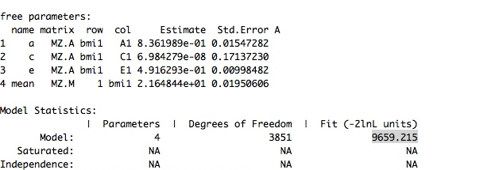
Run model
> fitACE <- mxRun(modelACE)
> sumACE <- summary(fitACE)
> sumACE
mxRun(model) runs your model, WOOO HOOO!!!
summary(model) gives you model output, including:
parameter estimates (note unstandardised so don’t add up to 1)
-2 log likelihood
number of parameters
Notes:
you can use this output to report the -2 loglikihood (fit) of the model, plus the no. of parameters
this is useful up to a point, but note that the free parameter estimates are unstandardised so don’t add up to 1 i.e. and we usually want to report the prop of variance explained

Slide 42
Proportion of variance explained
First generate some labels (so when we put in a table later, it’ll make sense):
> Alabel <- "A"
> Clabel <- "C"
> Elabel <- "E"
Get the parameters from the overall model summary using MxEval, square these
A <- mxEval(a*a, fitACE)
C <- mxEval(c*c, fitACE)
E <- mxEval(e*e, fitACE)
Work out the total variation to be explained (i.e. A + C + E)
> V <- (A+C+E)
Notes:
it’s a bit tedious in OpenMx to get the proportion of variance explained

Slide 43
Proportion of variance explained (cont)
Work out the proportion of total variance explained to 2 dp:
> a2 <- round(A/V,2)
> c2 <- round(C/V,2)
> e2<- round(E/V,2)
Put it all in a table; the bottom row shows the proportion of variance explained
> estACE <- rbind(cbind("ACE model",Alabel, Clabel, Elabel),cbind("standardised",A,C,E),cbind("prop variance explain",a2,c2,e2))
> estACE
While we’re at it, grab the -2 logliklihood value from the overall model (using mxEval)
> LL_ACE <- mxEval(fitfunction, fitACE)
> LL_ACE
Notes:
double check scientific notation i.e. not formatted that nicely

Slide 44
AE model
Monozygotic twins (identical)
Dizygotic twins (non-identical)
1.0
0.5
If the common environment path is close to 0 i.e. doesn’t explain much of variance in the manifest (observed DV) variable
Then, you can build simpler models without this variable (these models will be more parsimonious in path modelling terms, which is good)
You can then check that the model fit is still good
Also check that the A and E estimates don’t change from the ACE model

Slide 45
AE model
If the ACE model shows that C doesn’t contribute much, we can drop C (fixing to 0)
omxSetParameters updates parameters (i.e. make c = 0)
> modelAE <- mxModel(modelACE, name = "AE")
> modelAE <- omxSetParameters(modelAE,labels = "c", free = FALSE,values = 0)
run AE model using mxRun and view output using summary:
> fitAE <- mxRun(modelAE)
> sumAE <- summary(fitAE)
> sumAE
Calculate 2-log likelihood for AE model (using mxEval)
> LL_AE <- mxEval(fitfunction, fitAE)
> LL_AE
Notes:
happily this is really simple, we just duplicate the model but update one parameter using omxSetParameters
remember ‘c’ was the label given to our common environmental variance path

Slide 46
Compare AE and ACE models
How do we compare the models?
Happily, the difference between two -2 log likelihood models equals a chi2 distribution with df = 1
So we literally take the difference between the AE -2 log likelihood and the ACE -2 log likelihood, then check this against a chi 2 significance value table (df = 1)
If NOT significant, then AE model is better because more simple (parsimonious)
If significant, then the ACE model is better
> LRT_ACE_AE <- LL_AE - LL_ACE
> LRT_ACE_AE
Notes:
happily this is really simple, we just duplicate the model but update one parameter using omxSetParameters
remember ‘c’ was the label given to our common environmental variance path

Slide 47
AE model estimates
You should also check that the AE model estimates (e.g. proportion of variance explained by A and E) is the same as in the ACE model
Also check that C does actually equal 0 (it should do)
> Alabel <- "A"
> Clabel <- "C"
> Elabel <- "E"
> A_AEmodel <- mxEval(a*a, fitAE)
> C_AEmodel <- mxEval(c*c, fitAE)
> E_AEmodel <- mxEval(e*e, fitAE)
> V_AEmodel <- (A_Aemodel + C_Aemodel + E_AEmodel)
> a2_AE <- round(A_AEmodel/V_Aemodel,2)
> c2_AE <- round(C_AEmodel/V_Aemodel,2)
> e2_AE <- round(E_AEmodel/V_Aemodel,2)
> estAE <- rbind(cbind("AE model",Alabel, Clabel, Elabel),cbind("standardised",A_AEmodel, C_AEmodel, E_AEmodel),cbind("prop variance",a2_AE, c2_AE, e2_AE))
> estAE
Notes:
this code is all the same as the model estimates for the ACE model
remember, double check scientific notation i.e. not formatted that nicely

Slide 48
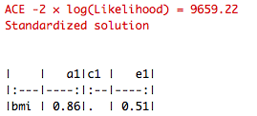
Umx - ACE model
Umx is a new package built on OpenMx which tries to make the ACE modelling more simple to implement
We went through OpenMx so you understand the ACE model but Umx is much easier
Umx and OpenMx results should be identical
> require(OpenMx)
> require(umx)
> data("twinData")
> selDVs = c("bmi")
> dz = twinData[twinData$zygosity == "DZFF", ]
> mz = twinData[twinData$zygosity == "MZFF", ]
> ACE = umxACE(selDVs = selDVs, dzData = dz, mzData = mz, sep = "")
Output:
-2 log likelihood value
Estimates are the square root of the proportion of variance explained

Slide 49
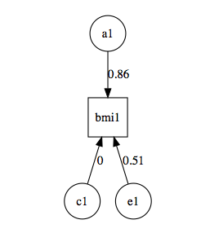

Umx – ACE model
> umxSummary(ACE)
UmxSummary(model) gives you a plot of the model
Estimates in the plot are the square root of the proportion of variance explained
So square these to get prop. variance explained:
A = 0.86² = 74%
C = 0² = 0%
E = 0.51² = 26%
> parameters(ACE)
parameters(model) gives you the free estimates (found in original table in OpenMx)

Slide 50
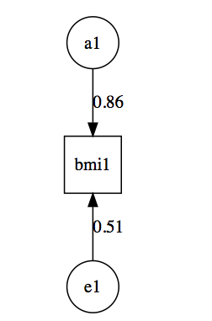
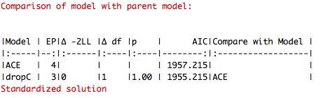
Umx - AE model
Remember you can drop C if it’s not explaining much variation (close to 0)
Do this by amending the ACE model and plot the estimates
> AE = umxModify(ACE, update = "c_r1c1", name = "dropC”)
> umxSummary(AE, comparison = ACE)
Output:
Estimates in plot are the square root of the proportion of variance explained
Not sig, so model AE is the better model
Notes:
Because there is essentially no difference in the models, the AE model is better fit

Slide 51
Path model diagram
Using package ‘Onyx’
first install the package (only need to do once:
> install.packages(“Onyx”)
you might need to also install java, follow instructions it gives you
then load the package (do this everytime you run the analysis):
> require(Onyx)
Notes:
downloading Onyx might not work, in which case you’ll need access to the internet when you run the models

Slide 52
Path model diagram
> onyx(modelACE)
Gives you the original model with starting values
Formatting: Right click on model background, select
Customise model > change path style to ‘values only’ and untick the ‘hide unit values’
Apply diagram style > modern
Change grid properties > display grid, lock to grid and use to align model
Notes:
Onyx provides publication friendly, high res PDFS
It’s nice to see the model laid out as a double check that you’ve done the right thing (should show start values)
You can also use Onyx to run the path model and estimate the data – go to the Onyx tab on the left hand panel, “load data” load the data, then drag the BMI values over to the model. You also need to set the groups to the right zygosities, also dragging over the zygosity info but now to the little diamond icons on the edge of the observed variables.

Slide 53
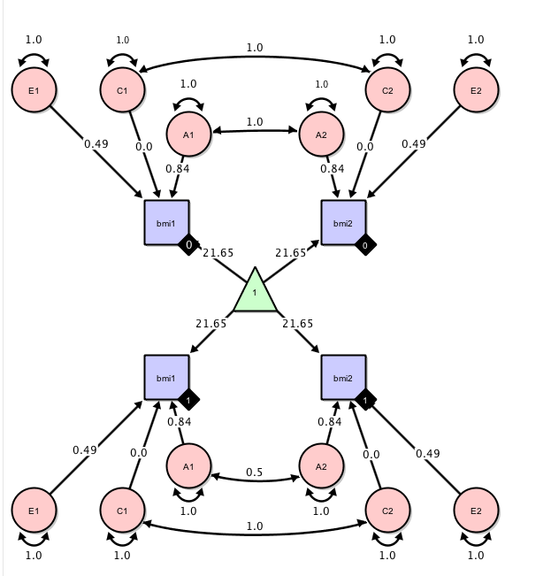
Path model diagram
> onyx(fitACE)
Shows the free parameters from the OpenMx code i.e. estimated model
For more examples and a user guide:
http://onyx.brandmaier.de/
You can also build and run models directly in Onyx (like in Amos, but free)
Notes:
Or, you can build and run the fitted model directly in Onyx.

Slide 54
Further Reading
Scripts will be also made available at https://github.com/ClareSutherland
This example follows the ACE tutorial from:
https://vipbg.vcu.edu/vipbg/OpenMx2/docs//OpenMx/2.8.3/OpenMxUserGuide.pdf?q=docs/OpenMx/2.8.3/OpenMxUserGuide.pdf
For more help on Umx, see Timothy Bates’ website:
https://tbates.github.io/
For more help on Onyx, see Andreas Brandmaier’s website:
http://onyx.brandmaier.de/
NB: Umx and Onyx can also be used for Structural Equation Modelling

Slide 55
Citations
If you use these packages, PLEASE cite the developers. They have spent all this time setting it up for you, and it will really help them!
OpenMx: Michael C. Neale, Michael D. Hunter, Joshua N. Pritikin, Mahsa Zahery, Timothy R. Brick Robert M. Kirkpatrick, Ryne Estabrook, Timothy C. Bates, Hermine H. Maes, Steven M. Boker. (2016). OpenMx 2.0: Extended structural equation and statistical modeling. Psychometrika, 81(2), 535-549. doi:10.1007/s11336-014-9435-8
Umx: Timothy C. Bates, Michael C. Neale, Hermine H. Maes, (under review). umx: Twin and path-based Structural Equation Modeling in OpenMx. Journal of Statistical Software,
Onyx: von Oertzen, T., Brandmaier, A. M., & Tsang, S. (2015). Structural equation modeling with Ωnyx. Structural Equation Modeling, 22, 148-161. doi:10.1080/10705511.2014.935842

