Slide 1
Wildlife
Protection
System

Slide 2

Contents
Problem Statement
Scope
Use Cases

Slide 3

PROBLEM STATEMENT
Our application goal is to conserve the world’s largest wild places of the three continents, viz. Asia, Africa and North America; home to more than 50% of the world’s biodiversity.
We would be developing a Java Swing application to collaborate various organizations involved in protecting wildlife species across these continents.
The application would act as a mediator in implementing conservation plans on species or populations engaging various organizations in providing solutions to curb activities that are harmful to the habitat. Protect endangered species by curbing poaching, deforestation and their illegal activities.

Slide 4
How do we plan to achieve this?
Maintaining the organizations involved in supporting species.
A Ticket Management System.
A live ticket generating system by sensors.
SMS and EMAIL notifications.
Drone Eye View - Live tracking of incidents on map and creation of tickets.

Slide 5
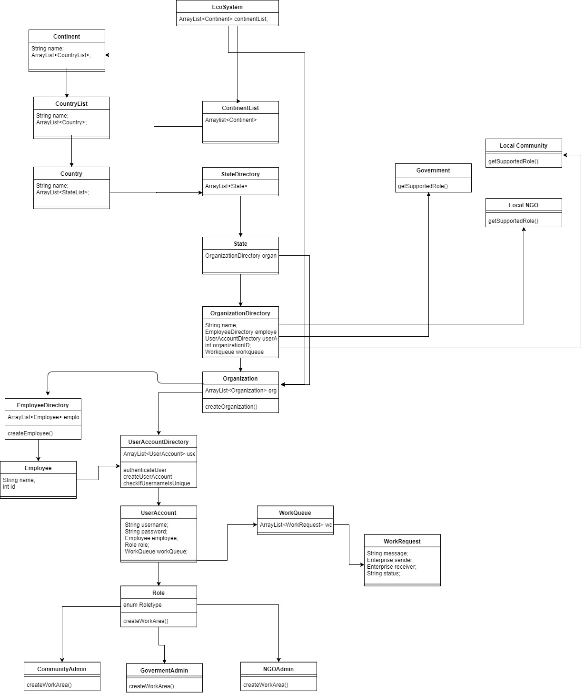

Slide 6
Object Model Explained
Our application follows the Continent – Country – State – Organization hierarchy.
We have primarily focused on North America, Africa and Asia as the main continents.
Every continent has countries under them. For e.g. North America has USA and Canada, Asia has India and so on.
Every country will have states.
Now every state will further have organizations like Governments, NGOs and Local Communities.

Slide 7
USER ROLES
OUR APPLICATION HAS THE FOLLOWING USER ROLES:
SYSTEM ADMIN : Has the authority to create continents, State Enterprises, Organizations and Enterprise Admin users. Also has some additional special privileges.
STATE ADMIN : Has the authority to create Organizations within his/her state enterprise. Can also create employees and employee accounts for the same.
ORGANIZATION ADMIN : Has the authority to create tickets and process tickets.

Slide 8
ANALYTICS
The analytics section of our application includes the following:
Issue representation graphically.
Issues per state representation.
Issues per organization.

Slide 9
ADDITIONAL FEATURES
Ticket tracker including sorting by state and history.
Organization wise ticket count and related reporting.
Kwik Sensor™ Tickets
Kwik Drone Eye™ View

Slide 10
FUTURE SCOPE
Ticket resolution timeline tracking.
Donations
Live Chat Option
SOS signal

Slide 11

DEMO RUN

Slide 12


