Slide 1
Hand pose estimation using point cloud
Clarissa Hamann
Project Plan Presentation
Supervisor: Shile Li

Slide 2
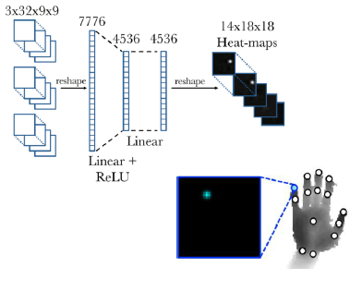
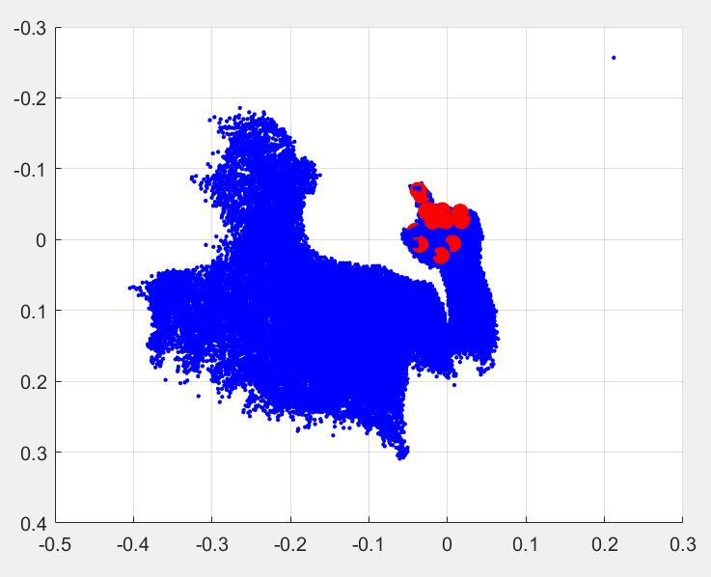
Hand pose estimation using point cloud - Motivation
Point cloud
Fully usage of 3D information
Unstructured input
Commonly used deep learning elements such as CNN cannot be used
Using the already existing PointNet (segmentation tasks) to estimate hand pose
Notes:
CNN: Convolutional Neural Network

Slide 3
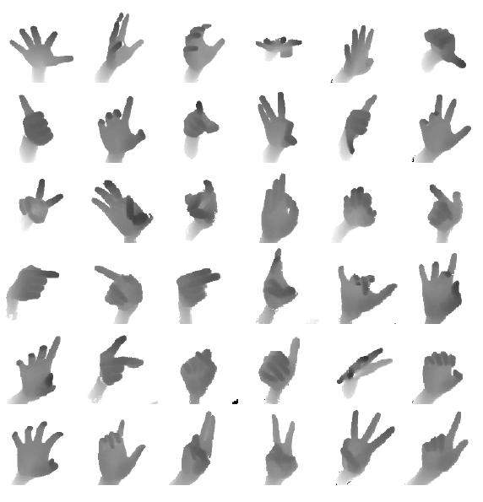
Preprocessing: ICVL dataset
Data import from ICVL dataset: .txt file with 16 joint positions and coresponding filname for depth image
Training data: 331006 sets
Testing data: 702/894 sets
Notes:
For capturing training and testing data
Captures depth images (lower noise level than structured-light sensors)
For each image 16x3 numbers in .txt file→ 16 joint locations (Palm, Thumb, Index etc.)

Slide 4

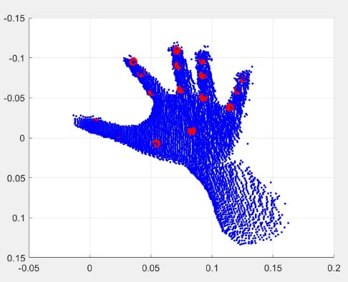
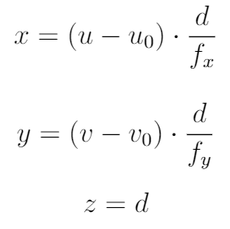
Preprocessing
Depth image to point cloud conversion
→ All relevant points converted to xyz coordinates
Notes:
Tensorflow framework for deep learning
→ Point cloud, unoform hand

Slide 5
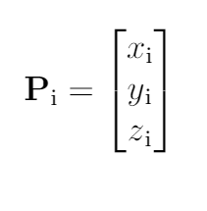
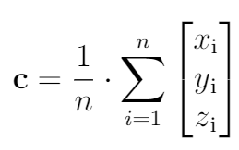


Preprocessing
Centroid point subtraction

Slide 6
Preprocessing
Write into h5 files
Downsample all point clouds to 4000 points
Every 30000 images save one h5 file
Conversion to tensorflow format

Slide 7
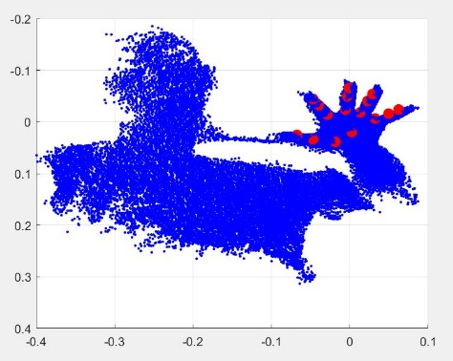
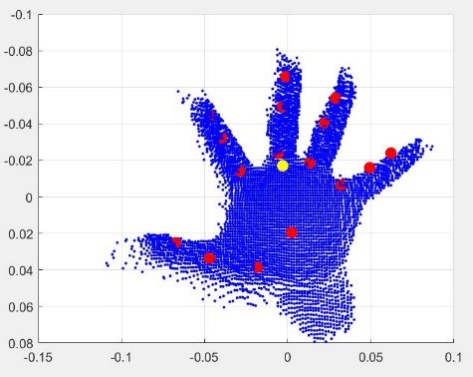

Preprocessing
Training data Problem: noise from environment
→ Creating a bounding box to delet useless data

Slide 8
PointNet
mlp: multi-layer perceptron
Batchnorm is used for all layers with ReLU
Dropout layers are used for the last mlp in classification net.
nx3
nx64
nx1024
1024
48
Max Pooling
mlp
(64,64)
mlp
(66,128,1024)
mlp (512,256,48)
Notes:
MLP: artifical neural network: use nonlinear actication function (RELU) and backpropagation for training
Max Pooling: unstructed point cloud, takes only the max value of the feature (one of n) → pose coordinates (red points)
Numbers in bracket are layer sizes
Dropout: regularization technique, randomly slected neurons get ignored during training

Slide 9
Project Plan
Implementation
PointNet based hand pose estimation framwork
Deep Learning
Training with ICVL dataset
Data loading
Data augmentation
Testing with ICVL dataset
Notes:
Augmentation, creat atrififcally more data, to increase size of the data

Slide 10

Time plan
08.11.18 Project Plan Presentation
→ finish Preprocessing
→ starting Implemention
06.12.18 Project Progress Presentation
→ finish Implementation
→ starting Training/Testing
Christmas ----------------------------------------
→ finish Training/Testing
→ writing report
14.01.19 Final Report Submission
17.01.19 Final Presentation

Slide 11

References
Charles R Qi, Hao Su, Kaichun Mo, and Leonidas J Guibas. Pointnet: Deep learning on point sets
for 3d classication and segmentation. Proc. Computer Vision and Pattern Recognition (CVPR) IEEE, 1(2):4, 2017
Danhang Tang, Hyung Jin Chang, Alykhan Tejani, and Tae-Kyun Kim
Latent regression forest: Structured estimation of 3d articulated hand posture. In Proceedings of the IEEE conference on
computer vision and pattern recognition
pages 3786{3793, 2014

